Slide 1
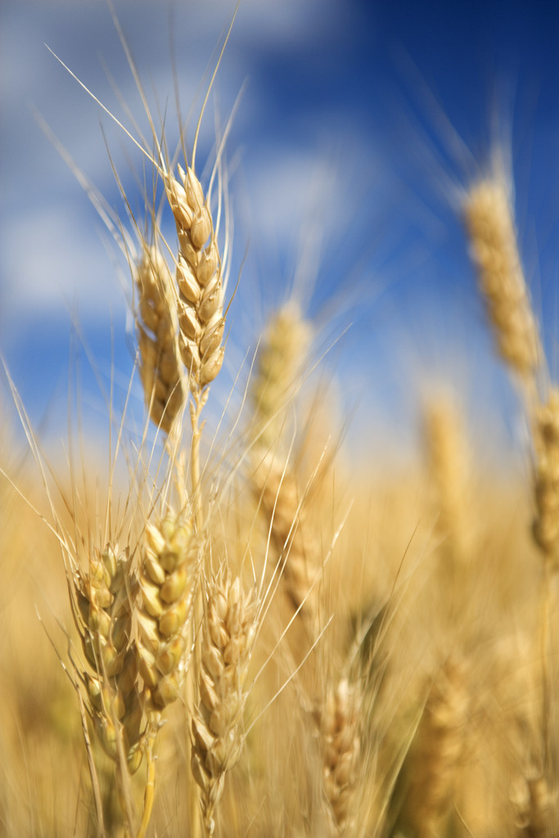
“Pray the Lord ….send forth Laborers”

Slide 2
“Pray the Lord ….send forth Laborers”
Matthew 9:37 - 38
37. “Then He said to His disciples, "The harvest truly [is] plentiful, but the laborers [are] few.
38. Therefore pray the Lord of the harvest to send out laborers into His harvest."

Slide 3
“Pray the Lord ….send forth Laborers”
Last Sunday (9/27/09) was “Missions Day” at the Centerville Church of Christ.
I personally “Thanked” the Elders, the Mission Committee and certainly all of the members at Centerville church of Christ for their generous hearts and for their support for the mission work in Anderson, South Carolina.
I thanked them for allowing me the opportunity to come and to speak to them about the work in Anderson and most of all, deliver a message from God’s Word.
The Elders wanted the “family” there to understand how important and needed is their support for Missions Work, especially Anderson, SC.

Slide 4
“Pray the Lord ….send forth Laborers”
I. There Is Work That Needs to Be Done!
1. As you all know - I am an old farm boy from southern Ohio, the oldest of 4 boys and the one that ran the “Family Farm” when my father finally had to go to work at the local steel mill when farming alone would no longer support the family.
I understand the concept of the message here in the passage with regard to the need to get the harvest in when it is ripe, when it is time.
There is a sense of Urgency in this Passage of scripture. “Therefore pray the Lord of the harvest to send out laborers into His harvest." Matt. 9:38

Slide 5
“Pray the Lord ….send forth Laborers”
In the Great Commission there is also this sense of Urgency- MATTHEW 28:18-20
“And Jesus came and spoke to them, saying, "All authority has been given to Me in heaven and on earth. 19. Go therefore and make disciples of all the nations, baptizing them in the name of the Father and of the Son and of the Holy Spirit,
20. teaching them to observe all things that I have commanded you; and lo, I am with you always, [even] to the end of the age." Amen.

Slide 6
“Pray the Lord ….send forth Laborers”
5. The Sense of Urgency is so GREAT that Jesus came to the Earth to Seek out the lost and to Save them.
“for the Son of Man has come to seek and to save that which was lost." Luke 19:10

Slide 7
“Pray the Lord ….send forth Laborers”
The harvest is READY
There is a NEED FOR LABORERS
GO !!!!!
Where DO We GO?

Slide 8
“Pray the Lord ….send forth Laborers”
MISSION WORK IS A PART OF OUR WORK
  Foreign Mission Work is VERY IMPORTANT
  1. Part of the Great Commission to “GO” includes “Foreign Mission Work”
  2. The three largest Foreign Mission Fields are China, Indonesia and India. (In that order)
  3. Guess what the 4th largest Mission field is in the World! - I’ll tell you in a minute or so.

Slide 9
“Pray the Lord ….send forth Laborers”
B. STATESIDE MISSION WORK IS ALSO IMPORTANT AND IS BECOMING ALMOST MORE IMPORTANT THAN FOREIGN MISSION WORK.
1. I read recently in the Christian Chronicle that the Missionaries in Korea say that they no longer need Missionaries to come to Korea, they are sending Missionaries to Asian Countries themselves.
  2. It has been predicted by some that if the Current Trend in Church “decline” here in the United States continues that by the year 2028 - India will be sending Missionaries to the United States to begin rebuilding the Church here.

Slide 10
“Pray the Lord ….send forth Laborers”
3. The Fourth Largest Mission field in the World is the -
United States
4. There is an URGENT NEED TO EVANGELIZE THE UNITED STATES – THERE ARE MORE STATE-SIDE MISSION FIELDS THAN ARE IMAGINEABLE.
5. It is estimated that there are anywhere from 300-360 million (depending on the source -The Christian Chronicle – 21st Century Christian) people in the United States -- 50% of them are considered “unclaimed” – don’t attend anywhere.

Slide 11
“Pray the Lord ….send forth Laborers”
The U.S. population is growing. And fast.
The nation's nearly 13,000 Churches of Christ — as a group — are not.
In a nutshell, that's the challenge facing a fellowship whose membership has increased only about 1.6 percent since the beginning of the Reagan era.
In the last quarter-century, the United States as a whole grew at a rate about 20 times faster than Church of Christ membership, an analysis by the Chronicle has found.

Slide 12
“Pray the Lord ….send forth Laborers”
WHY – What Are the Issues?
• Some blame complacency.
“There has been a disconnect between the doctrine of evangelism and the practice of evangelism,” said Rich Little, a minister in Naperville, Ill. “While we passionately believe we should reach the lost, we are not passionately seeking them.”

Slide 13
“Pray the Lord ….send forth Laborers”
* “When Churches of Christ were the fastest growing of all religious groups in America, the emphasis was on leading souls to Christ for salvation,” said Mack Lyon of In Search of the Lord’s Way, a media ministry based in Edmond, Okla. “Nowadays, it is on ‘church growth.’”

Slide 14
“Pray the Lord ….send forth Laborers”
6. There NEEDS to be a COMPASSION TO SEEK and Teach THE LOST.
“And Jesus, when He came out, saw a great multitude and was moved with compassion for them, because they were like sheep not having a shepherd. So He began to teach them many things.” MARK 6:34

Slide 15
“Pray the Lord ….send forth Laborers”
“for the Son of Man has come to seek and to save that which was lost.” LUKE 19:10
This was and still is the Mission of Christ through His Church Today!
Matthew 28:19 “Go therefore and make disciples of all the nations, baptizing them in the name of the Father and of the Son and of the Holy Spirit,”
That is what we are trying to do in Anderson, SC

Slide 16
“Pray the Lord ….send forth Laborers”
THE MISSION FIELD OF ANDERSON, SC
Anderson, SC is in what is called the “UPSTATE” region of South Carolina. The upper portion of the State.
We are about 20 miles East of the Georgia State Line and about 40-50 miles south from the North Carolina State Line, placing us in the Northwest corner of the State. About a 6-8 hour drive from Centerville, TN.
We are that close and we are a Mission Field.

Slide 17
“Pray the Lord ….send forth Laborers”
D. The Estimated Population of Anderson County is 183,000 – 200,000 people.
1. 718.02 Square miles and 230.8 people per Square Mile.
Research is indicating that between 48% to 52% of that Population do not attend “church” anywhere.
There are Three (3) congregations of the Lord’s Church in the entire County totaling about 150 members maximum, including Church of Christ - Anderson which is the Largest of the Three.

Slide 18
“Pray the Lord ….send forth Laborers”
1. The Anderson Congregation began in 1939 with 5-6 individuals
2. It grew a little and in 1946, brother H.M. Dodson raised enough support from some Nashville area Congregations to buy a lot to build a building
3. In 1970 a group came from the Frazer Street Church of Christ in Conroe, Texas, they were looking for a Mission Work and helped in hiring a preacher. The same group made two more trips to Anderson in the 70’s to do some “campaigning” and baptized 25-30 people, but only a few of those remained faithful.

Slide 19
“Pray the Lord ….send forth Laborers”
Karen, and I arrived in Anderson January 1, 2009 to begin our work here with the Congregation. - - We have now been here 9 months and to date there have been 12 baptisms and 6 restorations.
The average Attendance has increased from 52 to 72.
The actual role has increased from 68 to 110
Thanks the to Centerville Youth - we had the most Successful VBS Ever Experienced that anyone can ever remember at Anderson.

Slide 20
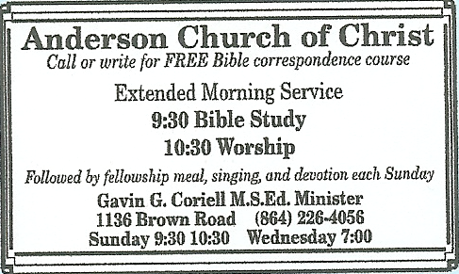
“Pray the Lord ….send forth Laborers”
We have our First Gospel Meeting Scheduled, that anyone can remember, for MAY 9-12, 2010 with Greg Dismuke from Rockford, ILL.
We are running a weekly ad in the local newspaper - (We are receiving BCC calls)

Slide 21
“Pray the Lord ….send forth Laborers”
Our Worship Services have been changed for several reasons.
  * 9:30 AM – Bible Study - 10:30 AM Worship
  Followed by a Fellowship Meal every Sunday
  Then a Devotional from 1:00 – 1:30 PM
  * 7:00 Mid-Week Bible Study - 1 & 3 Friday - Youth
  1. That is 4 Hours together on Sunday.
  a. Concentration of time together…
  b. Helps those who can’t afford to make 2 trips to the Building

Slide 22
“Pray the Lord ….send forth Laborers”
The Church is GROWING IN ANDERSON, SC
the Lord’s Work is being done,
Largely in part - due to the Compassion and Concern of the
Centerville Congregation

Slide 23
“Pray the Lord ….send forth Laborers”
By way of comparison-
Centerville church of Christ sets in Middle Tennessee – Hickman County to be exact.
2. From “People QuickFacts Hickman County Tennessee” has a Population, 2008 estimate 23,841 in the County and 6,214,888 in the State of TN.
3. There are 38 Congregations of the churches of Christ in the County of Hickman
4. Centerville = 3,800 population with about 1,000 being members of the Churches of Christ – 0f which about 600 attend Centerville church of Christ.

Slide 24
“Pray the Lord ….send forth Laborers”
Their Comments were-
“Not able to imagine the stats of the Church of Christ in our County”. That is not what they are “use to” living where they do and Anderson being so close to them.
Very interested in what we are doing here and how they can help.
Want to give more “hands on” assistance.
Wants to continue hear that the Gospel is being preached here and the “doctrine” of the Church is upheld.
Very satisfied and happy with the Message, Information and Progress reported.
Want to continue to Support us here in Anderson.

Slide 25
“Pray the Lord ….send forth Laborers”
Centerville is GOING, fulfilling the Great Commission by supporting the Work here in Anderson and other places as well.
Our Christian duty is to use that Support and GO into the County of Anderson and see that the Gospel is taught, making disciples of Christ.
Will meet the Challenge set before us?

Slide 26
Conclusion
MATTHEW 9:35 “Then Jesus went about all the cities and villages, teaching in their synagogues, preaching the gospel of the kingdom, and healing every sickness and every disease among the people.
36. But when He saw the multitudes, He was moved with compassion for them, because they were weary and scattered, like sheep having no shepherd.
37. Then He said to His disciples, "The harvest truly [is] plentiful, but the laborers [are] few.

Slide 27
38. Therefore pray the Lord of the harvest to send out laborers into His harvest."

Slide 28
Conclusion
1. We are set in the middle of 127 congregations of a particular denominational group among many others in Anderson –
but only one “Church of Christ” in the City
We have our work cut out for us (my goal is 100 souls in 2010)
2. It simply amazes me to see this situation in the United States. The people do not know who we are.
3. They are like sheep wandering around, not knowing where to go.
4. This morning - DO YOU KNOW WHERE YOU ARE GOING FOR ALL ETERNITY?

Slide 29
What MUST You Do to Be Saved?
Hear The Word Of God Romans 10:17
Believe His Word Mark 16:16, John 8:24
Repent of your sins Luke 13:3, Acts 2:38
Confess your belief Romans 10:10, Acts 8:37
Be Baptized Mark 16:16, Acts 2:38 For the Remission of Your Sins Acts 22:16 Galatians 3:26, 27
Live Faithfully Titus 2:11-14

