Slide 2
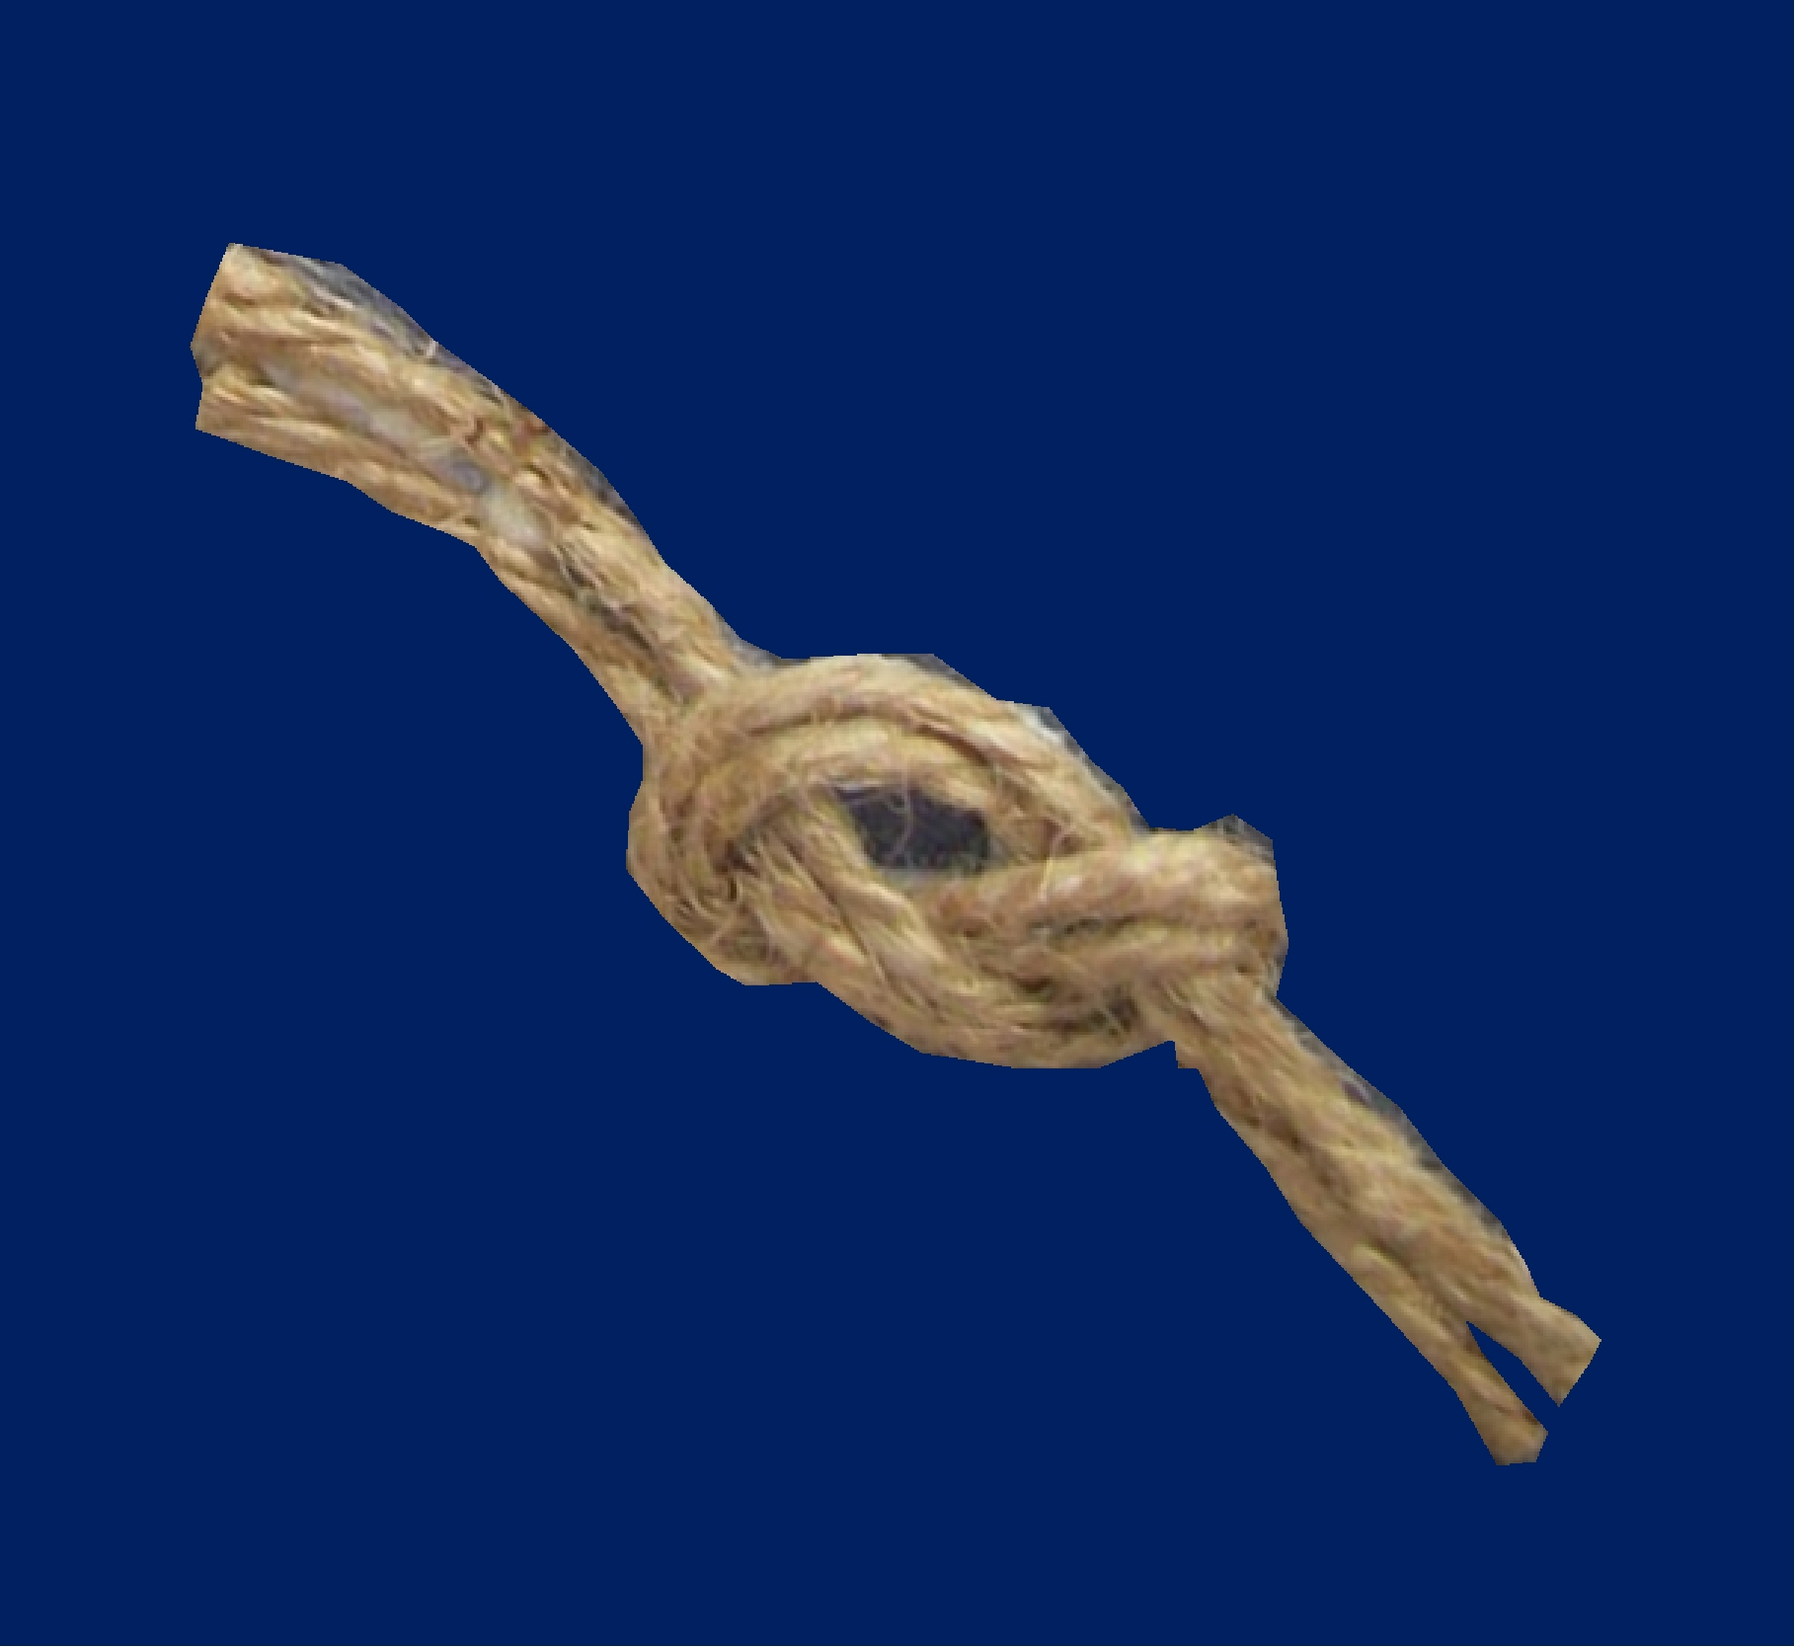
“NOTS”
That Cannot
Be
Untied

Slide 3
“Knot”
used to measure speed

Slide 4
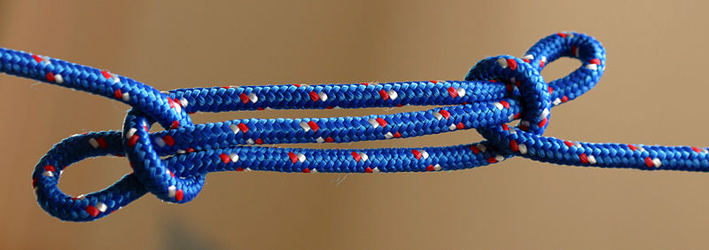
“Knot”
Tying with string

Slide 5
“Not”
Negative command
This means “NO!
To deny
To Refuse

Slide 6
“NOTS”
That Cannot
Be
Untied

Slide 7
God says
“DO NOT”
Deuteronomy 4:2
You shall not add to the word which I command you, nor take from it, that you may keep the commandments of the Lord your God which I command you.
Matt.24:35
Heaven and earth will pass away, but my words will not pass away.

Slide 8
A Man Is Justified By Works
NOT By Faith Only - James 2:24
Rom.5:1-2
¹ Therefore, since we have been justified by faith, we have peace with God through our Lord Jesus Christ. ² Through him we have also obtained access by faith into this grace in which we stand, and we rejoice in hope of the glory of God.
2 Cor.5:7
for we walk by faith, not by sight
Acts 16:31
Believe On the Lord Jesus Christ, and you will be saved, you and your household.

Slide 9
NOT everyone who calls on
The Lord will be saved – Matt.7:21
Acts 10:1-2
There was a certain man in Caesarea called Cornelius, a centurion of what was called the Italian Regiment, ² a devout man and one who feared God with all his household, who gave alms generously to the people, and prayed to God always.

Slide 10
NOT everyone who calls on
The Lord will be saved – Matt.7:21
Matt.23:5-7
⁵ But all their works they do to be seen by men. They make their phylacteries broad and enlarge the borders of their garments. ⁶ They love the best places at feasts, the best seats in the synagogues, ⁷ greetings in the marketplaces, and to be called by men, 'Rabbi, Rabbi.'

Slide 11
NOT everyone who calls on
The Lord will be saved – Matt.7:21
But woe to you, scribes and Pharisees, hypocrites!
For you shut up the kingdom of heaven against men
For you devour widows' houses.
for a pretense make long prayers.
For you a proselyte twice as much a son of hell.

Slide 12
NOT everyone who calls on
The Lord will be saved – Matt.7:21
But woe to you, scribes and Pharisees, hypocrites!
For you neglect the weightier matters of the law: justice and mercy and faith.
For you cleanse the outside of the cup and dish, but inside they are full of extortion and self-indulgence.

Slide 13
NOT everyone who calls on
The Lord will be saved – Matt.7:21
But woe to you, scribes and Pharisees, hypocrites!
For you are like whitewashed tombs which indeed appear beautiful outwardly, but inside are full of dead men's bones and all uncleanness.
Because you build the tombs of the prophets and adorn the monuments of the righteous,

Slide 14
NOT everyone who calls on
The Lord will be saved – Matt.7:21
WHAT DOES IT TAKE?
OBEDIENCE
Heb. 5:8-9
⁸ though He was a Son, yet He learned obedience by the things which He suffered. ⁹ And having been perfected, He became the author of eternal salvation to all who obey Him
In Luke 6:46
Jesus looked at His disciples and asked "But why do you call Me 'Lord, Lord,' and do not do the things which I say?

Slide 15
Buy the truth and sell it NOT
Prov.23:23
John 8:32
And you shall know the truth, and the truth shall make you free.

Slide 16
Be NOT conformed to this world
Rom.12:12
James 4:4
Adulterers and adulteresses! Do you not know that friendship with the world is enmity with God? Whoever therefore wants to be a friend of the world makes himself an enemy of God.
1Jn.2:15-16
¹⁵ Do not love the world or the things in the world. If anyone loves the world, the love of the Father is not in him. ¹⁶ For all that is in the world--the lust of the flesh, the lust of the eyes, and the pride of life--is not of the Father but is of the world … vs. 17 ¹⁷ And the world is passing away, and the lust of it;

Slide 17
NOT forsaking the assembling
Hebrews 10:25
not forsaking the assembling of ourselves together, as is the manner of some, but exhorting one another, and so much the more as you see the Day approaching.

Slide 18
I know you NOT
Matt.25:12
Unprepared
Waited too late
They were “NOT” received
It could “NOT” be undone

Slide 19
ARE YOU A CHRISTIAN?
Hear – Rom.10:17
Faith – Jn.8:24
Repent – Acts 17:30
Confess – Rom. 10:9
Be Baptized – 1 Pet.3:21
ARE YOU A FAITHFUL CHRISTIAN?
Confess sins – James 5:16
Live faithfully – Matt:10:22

