Slide 1
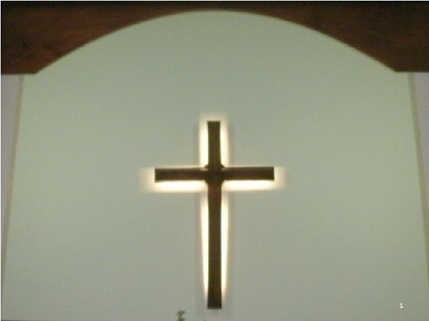

Slide 2
The Difficult Truth About Us
Ephesians 2
Notes:
Intro.
Did you ever accomplish something major in life, and as you looked at it,
Go back and think of when this journey first begin?
(Ex. Of building house in Alabama)
Look at your life as a Christian – Great feeling – saved – washed in blood of the lamb – redeemed.
Think back to earlier time in life – did not have this salvation – just like the gentiles here.
NEXT SLIDE

Slide 3
“Dead in trespasses and sins”

Slide 4
Ephesians 2:1-3
1 And you He made alive, who were dead in trespasses and sins, 2 in which you once walked according to the course of this world, according to the prince of the power of the air, the spirit who now works in the sons of disobedience, 3 among whom also we all once conducted ourselves in the lusts of our flesh, fulfilling the desires of the flesh and of the mind, and were by nature children of wrath, just as the others.
Notes:
In Eph. 2:1-3, Paul describes your journey:
READ Eph.2:1-3
NEXT SLIDE

Slide 5
Identifying the Cause of Our Death

Slide 6
Walked “according to the course of this world” (v. 2)
Walked “according to the prince of the power of the air” (v. 2)
The spirit of the sons of disobedience (v.2)
Conducted ourselves in “the lust of the flesh” (v. 3)
Notes:
1 - Walked “according to the course of this world” (v. 2)
You searched for worldly things – you laid up your treasures on worldly things
2. Walked “according to the prince of the power of the air” (v. 2)
Who is this? Satan, himself. – You walked after him (we would argue that point)
Remember the words of Jesus in Mt.12:30 – “he who is not with me is against me”.
3. The spirit of the sons of disobedience (v.2)
Not only did you follow after worldly things – you practiced disobedience to God.
You made it a point to go against Him.
4. Conducted ourselves in “the lust of the flesh”
There was nothing spiritual about you
Your only longing was for fleshly things.
NEXT SLIDE

Slide 7
Fulfilled the desires of the flesh and of the mind (v.3)
We were, by nature, children of wrath, as others (v.3)
Notes:
5. Not only that, you did what was necessary to fulfill your fleshly desires.
You put these things before your family, your job, other responsibilities
You just had to have these things
6. We were, by nature, children of wrath, as others (v.3)
You were just like everybody else
The English Standard Version says, “just like all of mankind.
NEXT SLIDE

Slide 8
James 1:13-15
HOW DID THIS HAPPEN?
Let no one say when he is tempted, "I am tempted by God"; for God cannot be tempted by evil, nor does He Himself tempt anyone.
14 But each one is tempted when he is drawn away by his own desires and enticed. 15 Then, when desire has conceived, it gives birth to sin; and sin, when it is full-grown, brings forth death.
Notes:
HOW DID THIS HAPPEN?
Turn to James 1:13-15
First of all, James says, let me tell you how it did not happen.
(READ vs. 13)
This is how it happened
(READ vs. 14-15

Slide 9
1 John 2:16-17
16 For all that is in the world -- the lust of the flesh, the lust of the eyes, and the pride of life -- is not of the Father but is of the world. 17 And the world is passing away, and the lust of it; but he who does the will of God abides forever.
Notes:
You see, you were living a life that was worldly. –
And you can’t be worldly and Godly at the same time.
(READ James 2:16-17)
Look at vs. 17 closely – worldly things are passing away.
In other words, it leads to death.
Only Godliness will abide forever

Slide 10
Ephesians 5:5-6
“Children of Wrath”
For this you know, that no fornicator, unclean person, nor covetous man, who is an idolater, has any inheritance in the kingdom of Christ and God. 6 Let no one deceive you with empty words, for because of these things the wrath of God comes upon the sons of disobedience.
John 3:36
36 “He who believes in the Son has everlasting life; and he who does not believe the Son shall not see life, but the wrath of God abides on him."
Notes:
Let’s discuss this phrase “children of wrath”
Paul describes this in Eph. 5:5-6
(READ EPH. 5:5-6)
John talks about a different kind of wrath – the wrath of God.
(READ JOHN 3:36)

Slide 11
Ephesians 2:4-5
4 But God, who is rich in mercy, because of His great love with which He loved us, 5 even when we were dead in trespasses, made us alive together with Christ
Notes:
Now, lets go back to Eph.2.
Vs.1-3 talks about what we was
Vs. 4-5 talks about what we are now as children of God.
Condemned before – redeemed now.
How – because of the love of God and the sacrifice of His dear Son.
Think about where you are spiritually.
Are you what these people were?
Or are you what you can be in Christ?
Outside of Christ? Obey Him now.
Erring child of God? Come back to Him now.
IF SUBJECT, COME

Slide 12
ARE YOU A CHRISTIAN?
Hear – Rom.10:17
Faith – Jn.8:24
Repent – Acts 17:30
Confess – Rom. 10:9
Be Baptized – 1 Pet.3:21
ARE YOU A FAITHFUL CHRISTIAN?
Confess sins – James 5:16
Live faithfully – Matt:10:22

