Slide 2
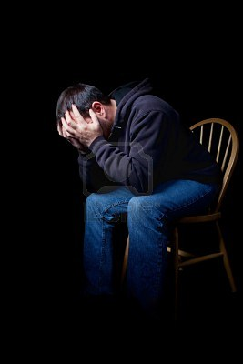
The
Tragedy
Of being
LOST

Slide 3
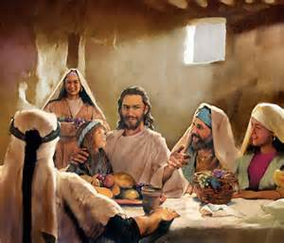
Lk.15:1-2
¹ Then all the tax collectors and the sinners drew near to Him to hear Him. ² And the Pharisees and scribes complained, saying, "This Man receives sinners and eats with them."

Slide 4
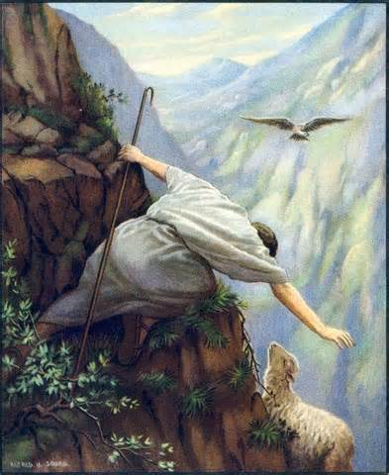
The
Tragedy of
Carelessness
Luke 15:4-7

Slide 5
Luke 8:14
Now the ones that fell among thorns are those who, when they have heard, go out and are choked with cares, riches, and pleasures of life, and bring no fruit to maturity.

Slide 6
Matt.6:19-21
¹⁹ "Do not lay up for yourselves treasures on earth, where moth and rust destroy and where thieves break in and steal; ²⁰ but lay up for yourselves treasures in heaven, where neither moth nor rust destroys and where thieves do not break in and steal. ²¹ For where your treasure is, there your heart will be also.

Slide 7
Luke 15:7
I say to you that likewise there will be more joy in heaven over one sinner who repents than over ninety-nine just persons who need no repentance.

Slide 8
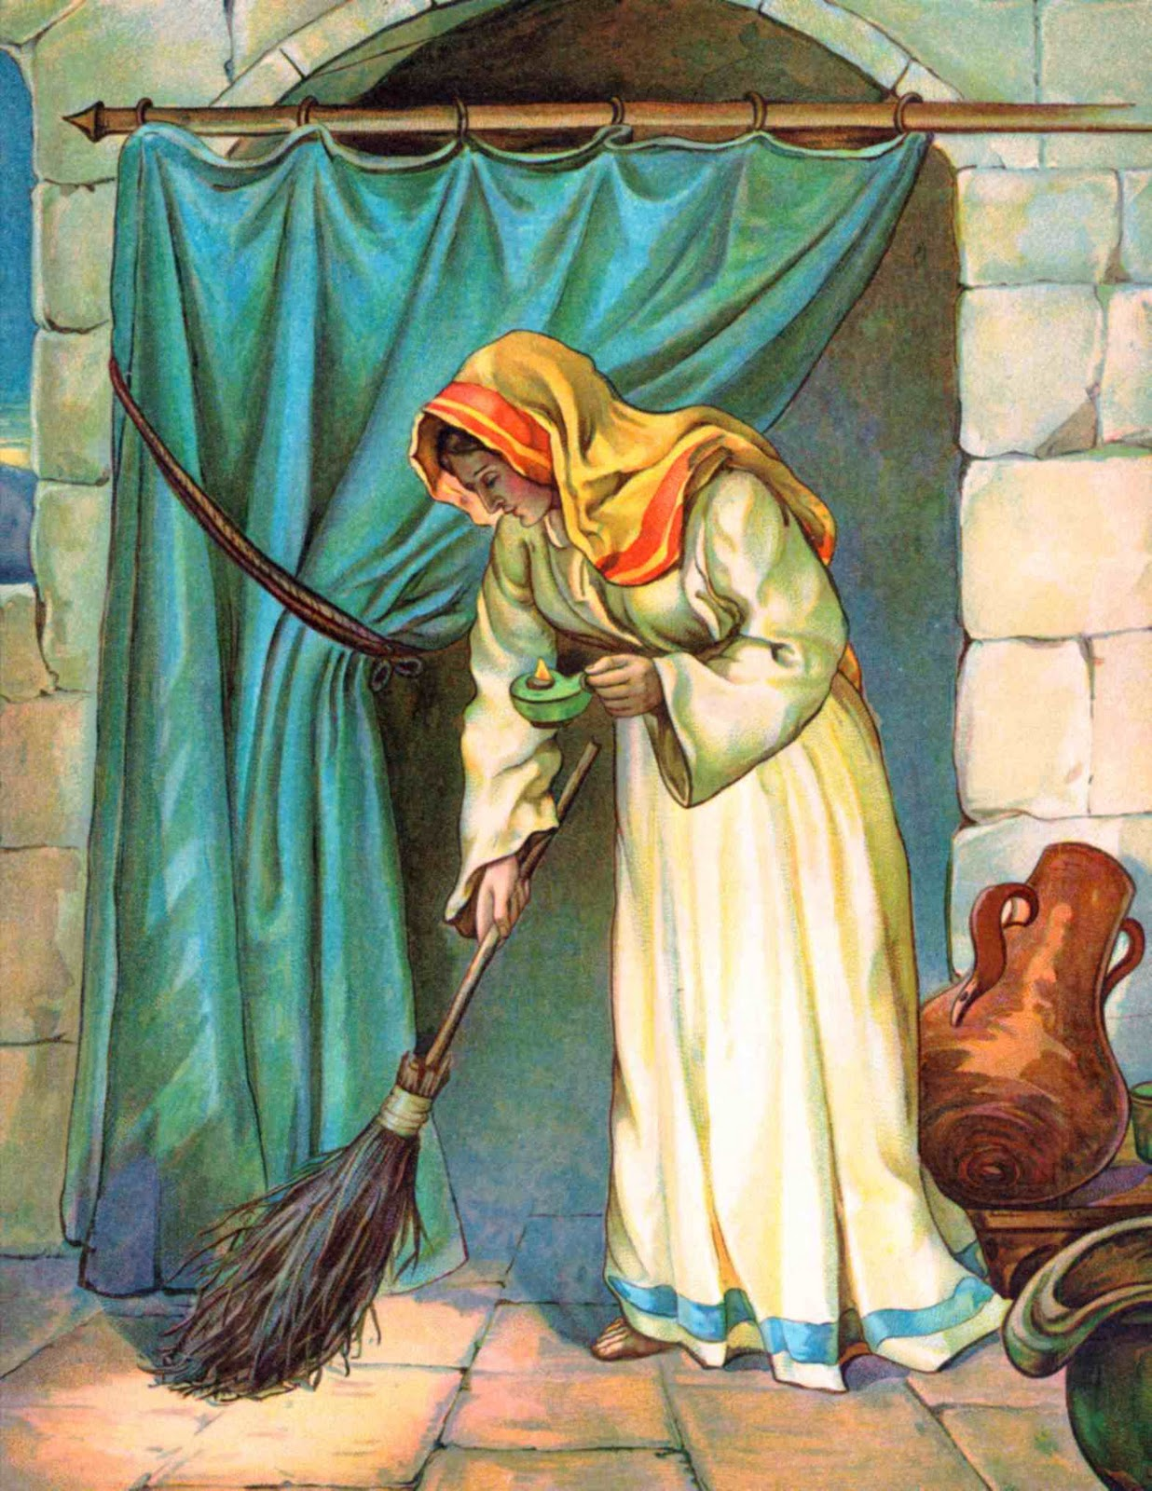
The
Tragedy of
Uselessness
Luke 15:8-10

Slide 9
Heb. 12:1-2
let us lay aside every weight, and the sin which so easily ensnares us, and let us run with endurance the race that is set before us, ² looking unto Jesus, the author and finisher of our faith

Slide 10
1 Tim. 6:12
Fight the good fight of faith, lay hold on eternal life, to which you were also called and have confessed the good confession in the presence of many witnesses.

Slide 11
Phil. 3:13-14
but one thing I do, forgetting those things which are behind and reaching forward to those things which are ahead, ¹⁴ I press toward the goal for the prize of the upward call of God in Christ Jesus.

Slide 12
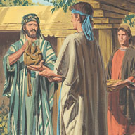
The Tragedy
Of
Being Lost
Willfully
Luke 15:11-24

Slide 13
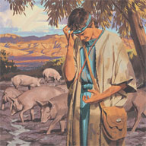
The Tragedy
Of
Being Lost
Willfully
Luke 15:11-24

Slide 14
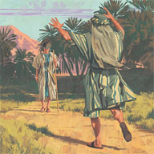
The Tragedy
Of
Being Lost
Willfully
Luke 15:11-24

Slide 15
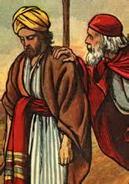
The Tragedy
Of
Bitterness
Luke 15:25-32

Slide 16
Principles to learn from this story
The Character Of God
Be Careful Lest We Be Lost
Our Concern For The Lost
Easy For Sinners To Surrender To God

Slide 17
ARE YOU A CHRISTIAN?
Hear – Rom.10:17
Faith – Jn.8:24
Repent – Acts 17:30
Confess – Rom. 10:9
Be Baptized – 1 Pet.3:21
ARE YOU A FAITHFUL CHRISTIAN?
Confess sins – James 5:16
Live faithfully – Matt:10:22

