Slide 2
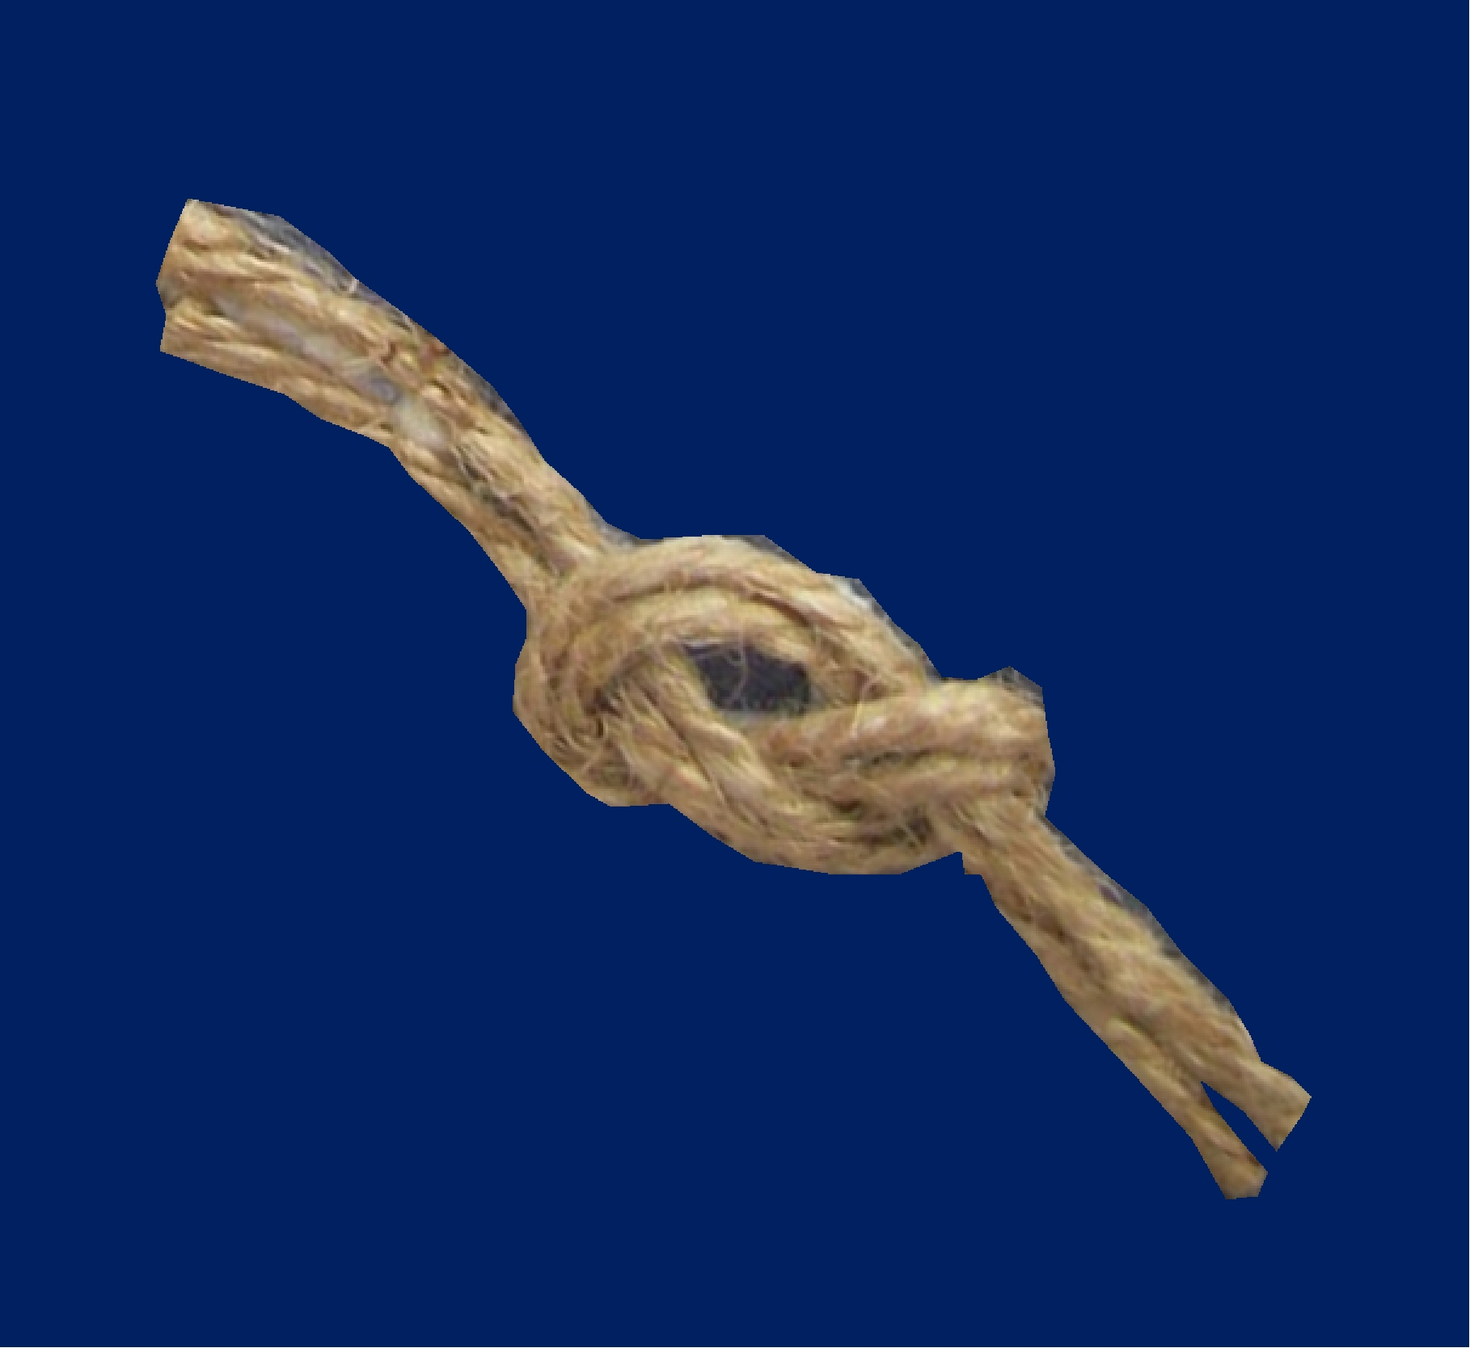
“NOTS”
That Cannot
Be
Untied
Notes:
Introduction:
A. For our lesson today, I'm going to talk about not's
1. In the English language the word "not" can have several meanings.

Slide 3
“Knot”
used to measure speed
Notes:
a. For example, the speed of a ship is measured in knots.
1) We have some navy people who could probably explain the knot.
2) the knot is just a little bit faster speed measurement that the mph.

Slide 4
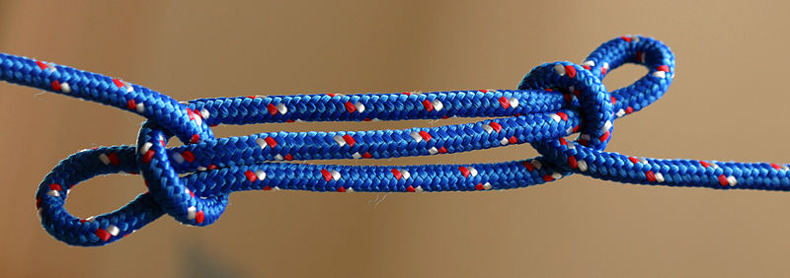
“Knot”
Tying with string
Notes:
b. Another definition for the knot is to tying string together.
1) Navy men know about this word as well.
2) This is the sheepshank knot -
Some may remember this name from the "Jaws" movie.
When Quint first met Mr. Hooper, he didn't want him on his boat.
So he threw him a rope and said, tie me a sheepshank, trying to make him look bad.
3) Sheepshank is a good knot to tie when you want to shorten a rope without cutting it.

Slide 5
“Not”
Negative command
This means NO!
To deny
To Refuse
Notes:
c. Then, there's another not, that is a negative command meaning no, denial or refusal.
1) You're not supposed to do something.

Slide 6
“NOTS”
That Cannot
Be
Untied
Notes:
B. For our lesson today, I want us to take this word and do a play on words
1. We're going to take "nots" and not be able to untie them.
2. Confusing? Stay with me, it will become clear.

Slide 7
God says
“DO NOT”
Deuteronomy 4:2
You shall not add to the word which I command you, nor take from it, that you may keep the commandments of the Lord your God which I command you.
Matt.24:35
Heaven and earth will pass away, but my words will not pass away.
Notes:
C. The Bible warns us "not" to change the word of God.
Deuteronomy 4:2 - You shall not add to the word which I command you, nor take from it, that you may keep the commandments of the Lord your God which I command you.
Matt.24:35 - Heaven and earth will pass away, but my words will not pass away.
1. Instead of trying to change the word of God to fit our lifestyle, we need to change our life to fit
the word.
2. Unfortunately, people try to do just the opposite.
a. They try to change the word of God to fit them.
D. The word “Not” is a small word.
1. But, but carries a great deal of power with it and a great deal of importance:
2. It is the difference between right and wrong.
E. There are a lot of "nots" in the Bible.
1. And like some K N O T's, they cannot be untied or changed. Let's look at a few of them.

Slide 8
A Man Is Justified By Works
NOT By Faith Only - James 2:24
Rom.5:1-2
¹ Therefore, since we have been justified by faith, we have peace with God through our Lord Jesus Christ. ² Through him we have also obtained access by faith into this grace in which we stand, and we rejoice in hope of the glory of God.
2 Cor.5:7
for we walk by faith, not by sight
Acts 16:31
Believe On the Lord Jesus Christ, and you will be saved, you and your household.
Notes:
This comes (James 2:24) where we read, You see then that a man is justified by works, and not by faith only.
1. Now, Paul tells us that man is justified by faith (Romans 5:1-2) ¹ Therefore, since we have
been justified by faith, we have peace with God through our Lord Jesus Christ. ²
Through him we have also obtained access by faith into this grace in which we stand,
and we rejoice in hope of the glory of God.
2. Paul also tells us that man lives by faith. (2 Corinthians 5:7) for we walk by faith, not by
sight.
3. He even told the Phillipian Jailer that man is saved by faith (Acts 16:31) "Believe on the Lord
Jesus Christ, and you will be saved, you and your household."
B. Now, James comes along and say, that a man is justified by works, and not by faith only.
1. Is either he or Paul wrong?
2. Does this mean that we have a choice?
3. No! It means we must do both.
E. Faith alone will not save - Works alone will not saved
1. It is a "not" that cannot be untied.

Slide 9
NOT everyone who calls on
The Lord will be saved – Matt.7:21
Acts 10:1-2
There was a certain man in Caesarea called Cornelius, a centurion of what was called the Italian Regiment, ² a devout man and one who feared God with all his household, who gave alms generously to the people, and prayed to God always.
Notes:
II "NOT" #2 - Not Everyone Who Calls the “Lord” Will Be Saved
A. This comes from a passage of scripture found in Matt.7:21. Jesus simply says, "Not everyone
who says to Me, 'Lord, Lord,' shall enter the kingdom of heaven, but he who does the will
of My Father in heaven.
1. Boy, this verse destroys a lot of man's thinking and a lot of denominational teaching.
B. This verse tells us several things:
1. One must be more than moral.
2. We actually have a Bible example of this found in Acts 10:1-2. There was a certain man in
Caesarea called Cornelius, a centurion of what was called the Italian Regiment, ² a
devout man and one who feared God with all his household, who gave alms
generously to the people, and prayed to God always.
a. Cornelius was a good moral man.
b. He was even a God fearing man.
c. But, he was a spiritually lost man.
d. His morality alone would not save him.
e. He had to conform to the same gospel commandments as everyone else.
C. Not only does this verse tell us one must be more than moral, it tells us that one must be more than
religious.

Slide 10
NOT everyone who calls on
The Lord will be saved – Matt.7:21
Matt.23:5-7
⁵ But all their works they do to be seen by men. They make their phylacteries broad and enlarge the borders of their garments. ⁶ They love the best places at feasts, the best seats in the synagogues, ⁷ greetings in the marketplaces, and to be called by men, 'Rabbi, Rabbi.'
Notes:
1. One of the most religious groups in the Bible were the Scribes and the Pharisees.
a. Let me read to you what Jesus said about the Scribes and the Pharisees.
Matt.23:5-7 - ⁵ But all their works they do to be seen by men. They make their phylacteries broad and enlarge the borders of their garments. ⁶ They love the best places at feasts, the best seats in the synagogues, ⁷ greetings in the marketplaces, and to be called by men, 'Rabbi, Rabbi.'

Slide 11
NOT everyone who calls on
The Lord will be saved – Matt.7:21
Vs. 13
But woe to you, scribes and Pharisees, hypocrites!
For you shut up the kingdom of heaven against men
For you devour widows' houses.
for a pretense make long prayers.
For you a proselyte twice as much a son of hell.
Notes:
b. Jump down to vs.13 and for the next 26 verses Jesus compiles what I call "the woes of the Scribes and Pharisees.
¹³ But woe to you, scribes and Pharisees, hypocrites! For you shut up the kingdom of heaven against men;
¹⁴ Woe to you, scribes and Pharisees, hypocrites! For you devour widows' houses, and for a pretense make long prayers.
¹⁵ Woe to you, scribes and Pharisees, hypocrites! For you travel land and sea to win one proselyte, and when he is won, you make him twice as much a son of hell as yourselves.

Slide 12
NOT everyone who calls on
The Lord will be saved – Matt.7:21
But woe to you, scribes and Pharisees, hypocrites!
For you neglect the weightier matters of the law: justice and mercy and faith.
For you cleanse the outside of the cup and dish, but inside they are full of extortion and self-indulgence.
Notes:
²³ Woe to you, scribes and Pharisees, hypocrites! For you pay tithe of mint and anise and cummin, and have neglected the weightier matters of the law: justice and mercy and faith.
²⁵ Woe to you, scribes and Pharisees, hypocrites! For you cleanse the outside of the cup and dish, but inside they are full of extortion and self-indulgence.

Slide 13
NOT everyone who calls on
The Lord will be saved – Matt.7:21
But woe to you, scribes and Pharisees, hypocrites!
For you are like whitewashed tombs which indeed appear beautiful outwardly, but inside are full of dead men's bones and all uncleanness.
Because you build the tombs of the prophets and adorn the monuments of the righteous,
Notes:
²⁷ Woe to you, scribes and Pharisees, hypocrites! For you are like whitewashed tombs which indeed appear beautiful outwardly, but inside are full of dead men's bones and all uncleanness.
²⁹ Woe to you, scribes and Pharisees, hypocrites! Because you build the tombs of the prophets and adorn the monuments of the righteous,

Slide 14
NOT everyone who calls on
The Lord will be saved – Matt.7:21
WHAT DOES IT TAKE?
OBEDIENCE
Heb. 5:8-9
⁸ though He was a Son, yet He learned obedience by the things which He suffered. ⁹ And having been perfected, He became the author of eternal salvation to all who obey Him
In Luke 6:46
Jesus looked at His disciples and asked "But why do you call Me 'Lord, Lord,' and do not do the things which I say?
Notes:
WELL, IF MORALITY WILL "NOT" SAVE AND BEING RELIGIOUS WILL "NOT" SAVE, WHAT WILL?
D. Obedience! One must be obedient
1. We have the example from Jesus Christ, Himself. Heb. 5:8-9 - ⁸ though He was a Son, yet
He learned obedience by the things which He suffered. ⁹ And having been perfected,
He became the author of eternal salvation to all who obey Him,
2. In Luke 6:46, Jesus looked at His disciples and asked "But why do you call Me 'Lord, Lord,'
and do not do the things which I say?
3. It takes obedience to please God.
4. Morality is "NOT" enough. Being religious is "NOT" enough.
5. This is a "NOT" that cannot be untied.

Slide 15
Buy the truth and sell it NOT
Prov.23:23
John 8:32
And you shall know the truth, and the truth shall make you free.
Notes:
III. Third "Not" - Buy The Truth And Sell It Not
A. Solomon coined this phrase in (Proverbs 23:23).
B. Believe it or not, some will sell the truth for their own personal gain.
1. Many sell the truth for popularity.
a. This is seen many times in our youth.
b. They will go along with the crowd
c. They will do something just because everyone else is doing it.
d. And when caught, that's always the excuse - "so-and-so did it"
2. Some sell the truth for job security.
a. Some will acquire questionable work habits, unethical work habits.
b. They will take the bribe
c. They will let something underhanded slide.
d. They will turn their head and look the other way.
3. Some will sell the truth for a little peace and comfort...
a. they will tell a lie to be left alone
b. They will cheat to have it a little better.
4. All of these untruthful things are condemning - they are enslaving.
C. Jesus said in John 8:32, And you shall know the truth, and the truth shall make you free."
1. Those who practice the truth, will remove these enslaving things from their lives.

Slide 16
Be NOT conformed to this world
Rom.12:12
James 4:4
Adulterers and adulteresses! Do you not know that friendship with the world is enmity with God? Whoever therefore wants to be a friend of the world makes himself an enemy of God.
1Jn.2:15-16
¹⁵ Do not love the world or the things in the world. If anyone loves the world, the love of the Father is not in him. ¹⁶ For all that is in the world--the lust of the flesh, the lust of the eyes, and the pride of life--is not of the Father but is of the world … vs. 17 ¹⁷ And the world is passing away, and the lust of it;
Notes:
IV. Next "NOT" - Be Not Conformed To This World
A. Paul tells us this one in Romans 12:2. And do not be conformed to this world, but be
transformed by the renewing of your mind, that you may prove what is that good and
acceptable and perfect will of God.
1. There must be something very wicked about the world for the New Testament writers to tell us
to stay away from it.
2. In fact, James tells us worldliness can make us enemies of God. James 4:4. Adulterers and
adulteresses! Do you not know that friendship with the world is enmity with God?
Whoever therefore wants to be a friend of the world makes himself an enemy of God.
3. John tells us that worldliness is not of the father. 1Jn.2:15-16 ¹⁵ Do not love the world or
the things in the world. If anyone loves the world, the love of the Father is not in him.
¹⁶ For all that is in the world--the lust of the flesh, the lust of the eyes, and the pride
of life--is not of the Father but is of the world.
4. He goes on to tell us in vs. 17, ¹⁷ And the world is passing away, and the lust of it;
5. We are not to give in to it - We are not to become a part of if.
6. It is a not that cannot be untied.

Slide 17
NOT forsaking the assembling
Hebrews 10:25
not forsaking the assembling of ourselves together, as is the manner of some, but exhorting one another, and so much the more as you see the Day approaching.
Notes:
V. Next "NOT - Not Forsaking The Assembling
A. I really don't need to read the command scripture - I mean, we've heard it so many times.
(Hebrews 10:25). not forsaking the assembling of ourselves together, as is the manner of some,
but exhorting one another, and so much the more as you see the Day approaching.
1. Corporate worship is emphasized because of its vital importance.
a. It helps us in our study, which is part of our worship commandment.
b. It helps us be around the right kind of people.
1) We have the example of the early Christians in acts cha.2.
c. Being together as a group helps us ward off Satan and his snares.
1) It has always been true that we are stronger in numbers.
2. Our assembly is a strong tied "NOT"

Slide 18
I do NOT know you
Matt.25:12
¹ "Then the kingdom of heaven will be like ten virgins who took their lamps and went to meet the bridegroom. ² Five of them were foolish, and five were wise. ³ For when the foolish took their lamps, they took no oil with them, ⁴ but the wise took flasks of oil with their lamps. ⁵ As the bridegroom was delayed, they all became drowsy and slept. ⁶ But at midnight there was a cry, 'Here is the bridegroom! Come out to meet him.‘ ⁷ Then all those virgins rose and trimmed their lamps.
Notes:
A. It was spoken in Matt.25
¹ "Then the kingdom of heaven will be like ten virgins who took their lamps and went to meet the bridegroom. ² Five of them were foolish, and five were wise. ³ For when the foolish took their lamps, they took no oil with them, ⁴ but the wise took flasks of oil with their lamps. ⁵ As the bridegroom was delayed, they all became drowsy and slept. ⁶ But at midnight there was a cry, 'Here is the bridegroom! Come out to meet him.‘ ⁷ Then all those virgins rose and trimmed their lamps.

Slide 19
I do NOT know you
Matt.25:12
⁸ And the foolish said to the wise, 'Give us some of your oil, for our lamps are going out.‘ ⁹ But the wise answered, saying, 'Since there will not be enough for us and for you, go rather to the dealers and buy for yourselves.‘ ¹⁰ And while they were going to buy, the bridegroom came, and those who were ready went in with him to the marriage feast, and the door was shut. ¹¹ Afterward the other virgins came also, saying, 'Lord, lord, open to us.‘ ¹² But he answered, 'Truly, I say to you,
I do NOT know you
Notes:
⁸ And the foolish said to the wise, 'Give us some of your oil, for our lamps are going out.' ⁹ But the wise answered, saying, 'Since there will not be enough for us and for you, go rather to the dealers and buy for yourselves.‘ ¹⁰ And while they were going to buy, the bridegroom came, and those who were ready went in with him to the marriage feast, and the door was shut. ¹¹ Afterward the other virgins came also, saying, 'Lord, lord, open to us.‘ ¹² But he answered, 'Truly, I say to you, I do not know you.

Slide 20
I do NOT know you
Matt.25:12
They were “NOT” Prepared
They were “NOT” received
It could “NOT” be undone
Notes:
1. It came to those who were "NOT" prepared.
2. They had waited too late to take care of their problem.
3. and They were "NOT" received.
4. And it was a "NOT" that could not be undone.

Slide 21
“NOTS”
That Cannot Be Untied
Notes:
Conclusion:
A. Today is the day that you need to make preparation.
2. Someday we will all stand before the judgment seat of God and give an answer for
all of these little nots.

Slide 22
ARE YOU A CHRISTIAN?
Hear – Rom.10:17
Faith – Jn.8:24
Repent – Acts 17:30
Confess – Rom. 10:9
Be Baptized – 1 Pet.3:21
ARE YOU A FAITHFUL CHRISTIAN?
Confess sins – James 5:16
Live faithfully – Matt:10:22
Notes:
3. So today, if you are "NOT" a Christian, give your life to the Lord through obedience to the
gospel.
4. And if you are "NOT" living as a faithful Christian should, repent and come back to the Lord.
SO THAT YOU WILL "NOT" BE LOST
IF, SUBJECT, COME

