Slide 1
Why I Am A Member of the Church of Christ
Reason #7:
Because it is Scriptural in Organization

Slide 2
Ecclesiasticisms
“The denominations are ruled by their ecclesiastical forms of government.”
The changes that have been made to the government of the church are not authorized by Scripture.
They reject Christ as the supreme authority.

Slide 3
A Monarchy
“Christ’s church is a monarchy.”
Colossians 1:18 (NKJV)
18 And He is the head of the body, the church, who is the beginning, the firstborn from the dead, that in all things He may have the preeminence.
Ephesians 1:22-23 (NKJV)
22 And He put all things under His feet, and gave Him to be head over all things to the church, 23 which is His body, the fullness of Him who fills all in all.

Slide 4
As head, Jesus has been given all authority.
Matthew 28:18 (NKJV)
18 And Jesus came and spoke to them, saying, “All authority has been given to Me in heaven and on earth.
The apostles were given authority to teach and preach what they had been taught.
John 14:26 (NKJV)
26 But the Helper, the Holy Spirit, whom the Father will send in My name, He will teach you all things, and bring to your remembrance all things that I said to you.
Matthew 28:19-20 (NKJV)
19 Go therefore and make disciples of all the nations, baptizing them in the name of the Father and of the Son and of the Holy Spirit, 20 teaching them to observe all things that I have commanded you...
Matthew 16:19 (NKJV)
19 ...and whatever you bind on earth will be bound in heaven, and whatever you loose on earth will be loosed in heaven.”

Slide 5
The Autonomy of the Church
The autonomy of the local church or congregation...
“Autonomy is defined as ‘right of self-government; a self-governing state; an independent body.’ ”
“All congregations had the same head, foundation, and mission; preached the same gospel; constituted one body. But each was independent to direct its own work.”

Slide 6
“The wisdom of God is seen in such an arrangement for His churches. If one became corrupted in doctrine or affected by evil practices, other churches would not be so affected. If dissensions arose in one, it would not spread to the others; if one perished, the others would not be dragged down. If a window is made of one large pane, a break injures the entire pane; but if it be made of several panes, it is not so bad to break one. The independence of the churches is a protection for each one.”
–H. Leo Boles
Gospel Advocate, February 15, 1940

Slide 8
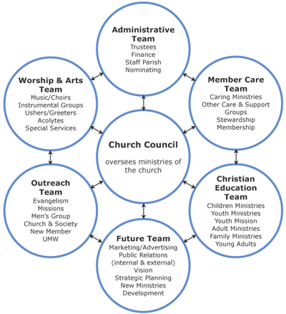
United Methodist Church

Slide 9
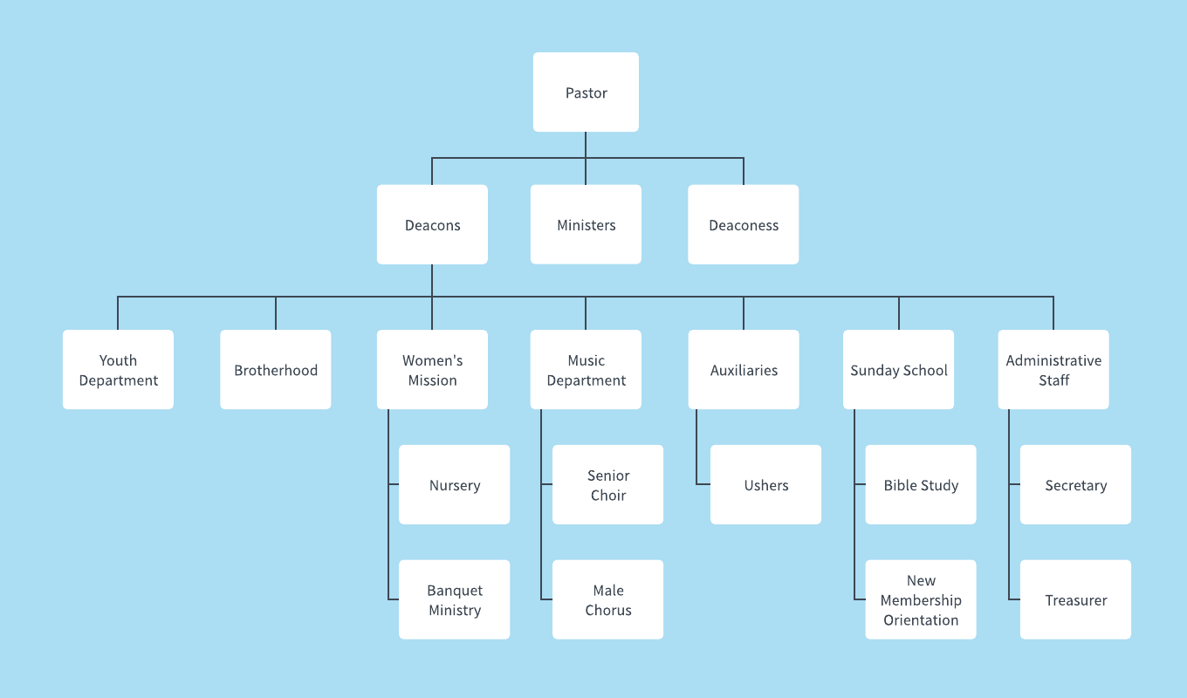

Slide 10
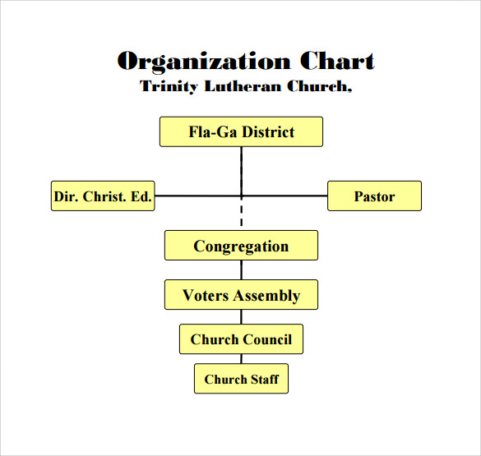

Slide 11
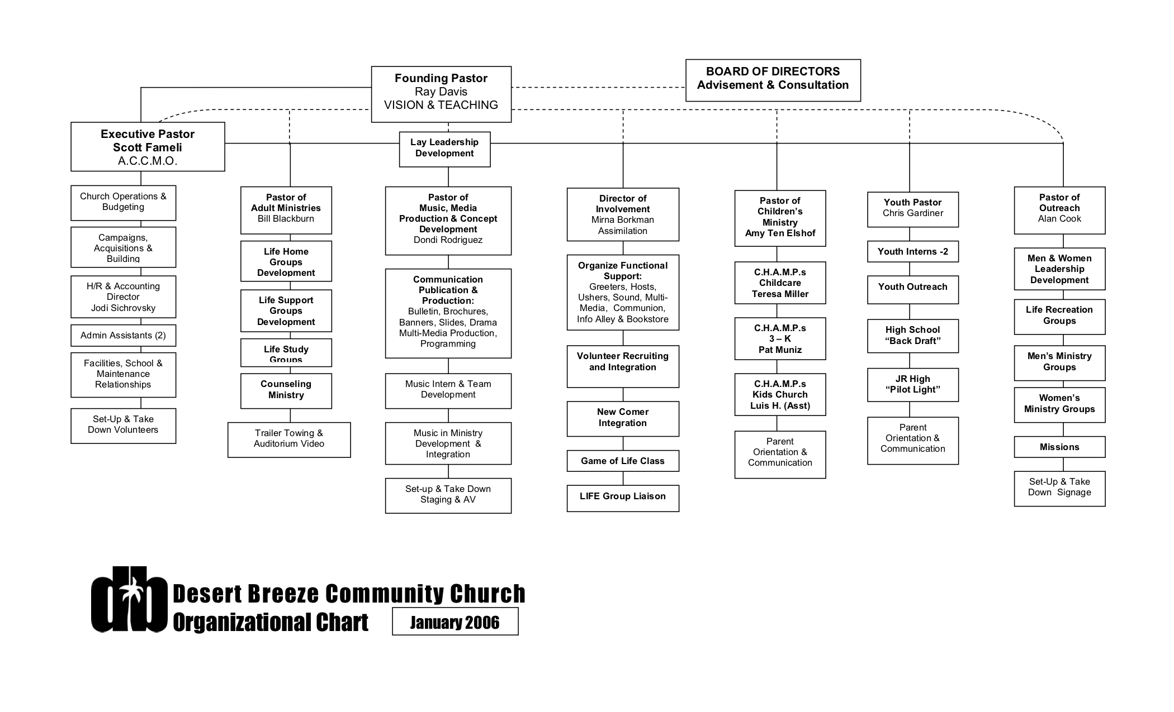

Slide 12
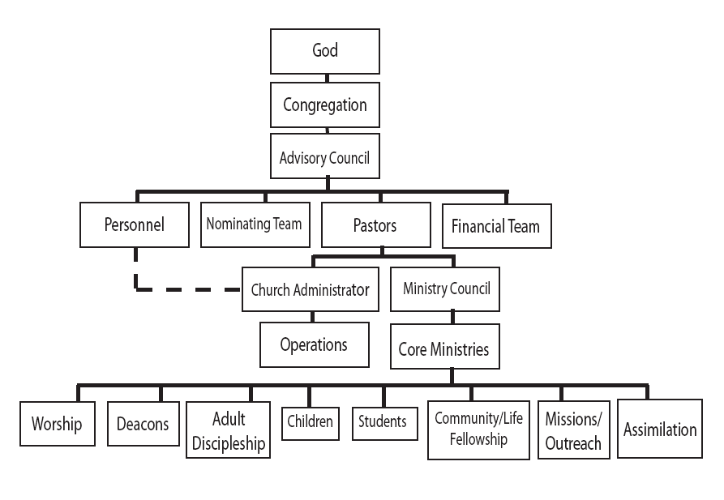
Baptist Church Organizational Chart

Slide 13
Elders in Every Church
Titus 1:5 (NKJV). For this reason I left you in Crete, that you should set in order the things that are lacking, and appoint elders in every city as I commanded you...
According to Acts 20:28, they are referred to as “bishops” (ASV) or “overseers” (KJV, NKJV).
Ephesians 4:11 makes reference to “pastors.”
Scripture always mentions multiple men overseeing the flock.

Slide 14
Responsibilities of Elders
Take heed...
Acts 20:28 (NKJV) Therefore take heed to yourselves and to all the flock, among which the Holy Spirit has made you overseers, to shepherd the church of God which He purchased with His own blood.

Slide 15
Responsibilities of Elders
Help the Weak...
Acts 20:35 (NKJV) I have shown you in every way, by laboring like this, that you must support the weak. And remember the words of the Lord Jesus, that He said, ‘It is more blessed to give than to receive.’ ”

Slide 16
Responsibilities of Elders
Exhort… Convict…
Titus 1:9 (NKJV) ...holding fast the faithful word as he has been taught, that he may be able, by sound doctrine, both to exhort and convict those who contradict.

Slide 17
Responsibilities of Elders
Admonish (Warn)… Encourage (Comfort)…
1 Thessalonians 5:14 (NKJV) Now we exhort you, brethren, warn those who are unruly, comfort the fainthearted, uphold the weak, be patient with all.

Slide 18
Responsibilities of Elders
Examples to the Flock…
1 Peter 5:2-3 (NKJV) Shepherd the flock of God which is among you, serving as overseers, not by compulsion but willingly, not for dishonest gain but eagerly; nor as being lords over those entrusted to you, but being examples to the flock;

Slide 19
Responsibilities of Elders
Visit the sick…
James 5:14-15 (NKJV) Is anyone among you sick? Let him call for the elders of the church, and let them pray over him, anointing him with oil in the name of the Lord. 15 And the prayer of faith will save the sick, and the Lord will raise him up. And if he has committed sins, he will be forgiven.

Slide 20
Responsibilities of Elders
Watch for the souls of the members…
Hebrews 13:17 (NKJV) Obey those who rule over you, and be submissive, for they watch out for your souls, as those who must give account. Let them do so with joy and not with grief, for that would be unprofitable for you.

Slide 21
Responsibilities of Elders
“[These] duties have been imposed upon them by the Lord. When this work is not performed, the congregation suffers.”
-Leroy Brownlow

Slide 22
Qualifications of Eldership
He must desire the position or office.
1 Timothy 3:1 (NKJV)
This is a faithful saying: If a man desires the position of a bishop, he desires a good work.

Slide 23
Qualifications of Eldership
He must be blameless (1 Timothy 3:2; Titus 1:6).
Without or above reproach

Slide 24
Qualifications of Eldership
He must be the husband of one wife (1 Timothy 3:2; Titus 1:6).

Slide 25
Qualifications of Eldership
He must be temperate (1 Timothy 3:2; Titus 1:8).
Vigilant (KJV)

Slide 26
Qualifications of Eldership
He must be sober-minded (1 Timothy 3:2; Titus 1:8).
Sober (KJV)
Prudent (NASB)

Slide 27
Qualifications of Eldership
He must be of good behavior (1 Timothy 3:2).
Orderly (ASV)
Respectable (NASB)

Slide 28
Qualifications of Eldership
He must be hospitable (1 Timothy 3:2; Titus 1:8).
Given to hospitality (KJV)

Slide 29
Qualifications of Eldership
He must be able to teach (1 Timothy 3:2).
Apt to teach (KJV)

Slide 30
Qualifications of Eldership
He is not given to wine (1 Timothy 3:3; Titus 1:7).
No brawler (ASV)
Not addicted to wine or pugnacious (NASB)

Slide 31
Qualifications of Eldership
He is not greedy for money (1 Timothy 3:3; Titus 1:7).
Not greedy for filthy lucre (KJV)
Free from the love of money (NASB)

Slide 32
Qualifications of Eldership
He is gentle (1 Timothy 3:3)
Patient (KJV)

Slide 33
Qualifications of Eldership
He is not quarrelsome (1 Timothy 3:3).
Not contentious (ASV)
Peaceable (NASB)

Slide 34
Qualifications of Eldership
He is not covetous (1 Timothy 3:3).

Slide 35
Qualifications of Eldership
He is one who rules his own house well (1 Timothy 3:4; Titus 1:6).
One who manages his own house well (NASB)
His children are submissive and reverent.

Slide 36
Qualifications of Eldership
He is not a novice (1 Timothy 3:8).
Not a new convert (NASB)
Lest he is puffed up with pride...

Slide 37
Qualifications of Eldership
He has a good testimony with those outside (1 Timothy 3:7).
Good report (KJV)
Good reputation (NASB)

Slide 38
Qualifications of Eldership
As listed in Titus 1...
Titus 1:6-9 (NKJV)
6 ...if a man is blameless, the husband of one wife, having faithful children not accused of dissipation or insubordination. 7 For a bishop must be blameless... not self-willed, not quick-tempered, not given to wine, not violent, not greedy for money, 8 but hospitable, a lover of what is good, sober-minded, just, holy, self-controlled, 9 holding fast the faithful word as he has been taught...

Slide 39
Duties of the Congregation
Recognize them... Esteem them highly...
1 Thessalonians 5:12-13 (NKJV)
And we urge you, brethren, to recognize those who labor among you, and are over you in the Lord and admonish you, and to esteem them very highly in love for their work’s sake. Be at peace among yourselves.

Slide 40
Duties of the Congregation
Honor them...
1 Timothy 5:17 (NKJV)
Let the elders who rule well be counted worthy of double honor, especially those who labor in the word and doctrine.

Slide 41
Duties of the Congregation
Obey them... Be Submissive to them...
Hebrews 13:17 (NKJV)
Obey those who rule over you, and be submissive, for they watch out for your souls, as those who must give account. Let them do so with joy and not with grief, for that would be unprofitable for you.

Slide 42
Duties of the Congregation
Do not receive accusations against them...
1 Timothy 5:19 (NKJV)
Do not receive an accusation against an elder except from two or three witnesses.

Slide 43
Qualifications of Deacons
1 Timothy 3:8-13 (NKJV)
Likewise deacons must be reverent, not double-tongued, not given to much wine, not greedy for money, holding the mystery of the faith with a pure conscience. But let these also first be tested; then let them serve as deacons, being found blameless. Likewise, their wives must be reverent, not slanderers, temperate, faithful in all things. Let deacons be the husbands of one wife, ruling their children and their own houses well. For those who have served well as deacons obtain for themselves a good standing and great boldness in the faith which is in Christ Jesus.

Slide 44
Responsibilities of Deacons
Acts 6:1-4 (NKJV)
Now in those days, when the number of the disciples was multiplying, there arose a complaint against the Hebrews by the Hellenists, because their widows were neglected in the daily distribution. Then the twelve summoned the multitude of the disciples and said, “It is not desirable that we should leave the word of God and serve tables. Therefore, brethren, seek out from among you seven men of good reputation, full of the Holy Spirit and wisdom, whom we may appoint over this business; but we will give ourselves continually to prayer and to the ministry of the word.”

Slide 45
Though these men were given the title or reference of deacons, their responsibilities were very similar...
Deacons assist the elders in meeting their responsibilities, so they will not be overburdened.
Meeting the physical needs of members, so they are not neglected.

