Slide 1
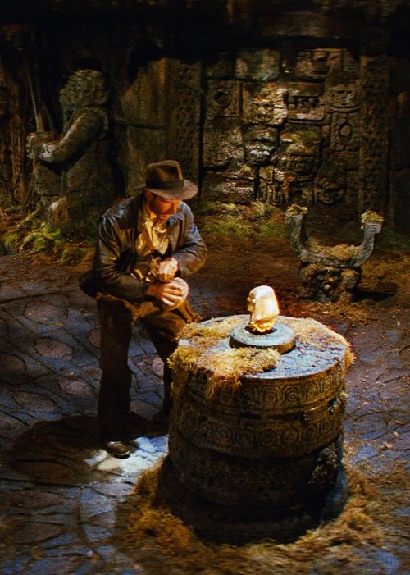
A QUEST OF UNSPEAKABLE VALUE…
QUEST: “An act of instance of seeking
SEARCH; an adventurous
pursuit; to go in search of”
“For indeed Jews ask for signs, and Greeks search for wisdom…” (1Cor. 1:22)
“By truth, and do not sell it, get wisdom and instruction and understanding.” (Prov. 23:23)

Slide 2
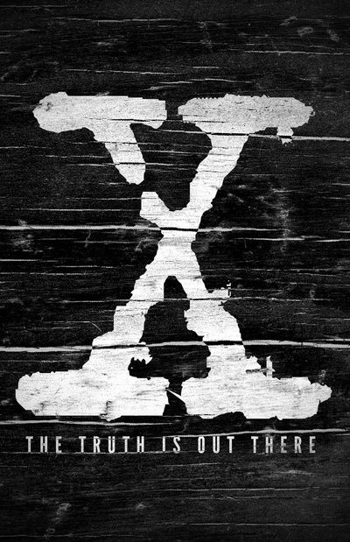
X: The Unknown Factor? (not so much)
TRUTH; Found 116 times in the NASB translation of the New Testament
TRUTH (Aletheia) Αλετηεια “objectively, signifying the reality lying at the basis of an appearance; the manifested, veritable essence of a matter…sincerity of integrity or character” (W.E. Vine)
“Conformity to fact or actuality; faithfulness to an original or standard” (Nelson’s Bible Dictionary)
“Reality; Actuality” (Webster’s II Dictionary)

Slide 3
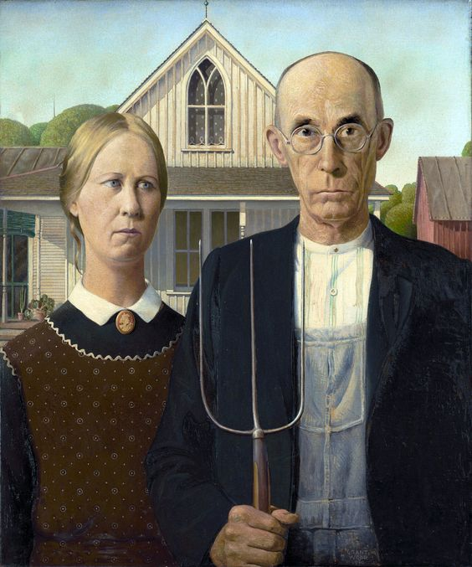
BACK TO BASICS
2Peter 1:12-21
“…have been established in the truth which is present with you.”
2Peter 1:12b
“…stir you up by way of reminder.”
2Peter 1:13b
The Purity & Beauty Of Truth:
A Recurring Theme of Peter
1Peter 2:1-2; 1Peter 4:11; 2Peter 3:17-18
Awaken To Truth Found In God’s Word & Embrace It

Slide 4
What An Amazing Introduction To God & All That Is Set Forth In The Scriptures…
Hebrews 11:3, 6
“By faith we understand that the
worlds were prepared by the words
Of God….And without faith it is impossible to please Him, for he who
comes to God must believe that He is
and that He is a rewarder of those
who seek Him.”
THE WHOLE BASIS OF TRUTH &
FAITH BEGINS IN GENESIS 1:1
“Now faith is the assurance of things hoped for the conviction of things not seen.”

Slide 5
GODHEAD UNITED IN TRUTH
A Unique ONENESS Exists With Respect To Deity Genesis 1:26 Deuteronomy 6:4
Three Separate & Unique Identities Comprise DEITY God Is Love
DEITY Joined Together In TRUTH Ephesians 1:3-13
IS NOT
FATHER
SON
IS
IS
GOD
IS NOT
IS NOT
IS
HOLY SPIRIT
“Then God said, ‘Let Us make man in Our image, according to Our likeness; and let them rule over the fish of the sea and over the birds of the sky, and over every living thing that moves on the earth.’” (Genesis 1:12)

Slide 6
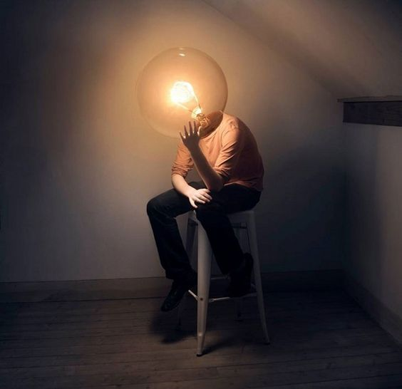
THE “DAWNING” OF UNDERSTANDING:
GOD IS THE
ESSENCE OF TRUTH
God Is Fully Worthy
Of Our Trust. He Remains True To His Nature (2Tim. 2:11-13)
Impossible For Deity To Lie; Inconsistent With Divine Nature
Titus 1:2, Heb. 6:18, Rom. 3:4
Godhead United In TRUTH
Psalms 115:1
John 1:14,17
John 14:16-17
“In Him, you also, after listening to the message of truth…”

Slide 7
“What Is Truth?”
“if indeed you have heard Him and have been taught in Him, just as truth is in Jesus.” (Ephesians 4:21)
Word Is TRUTH; Jesus Is The WORD; Grace & TRUTH Found In CHRIST
Word, Truth & Christ Inseparable:
All One In The Same
Speak The Truth
Uphold The Truth
Support The Truth
Ephesians 4:14-15
Reject anything that is not of the TRUTH
“and you shall know the truth, and the truth shall make you free”

