Slide 1

A Principle Set In Place…
“Only be strong and very courageous; be careful to do according to all the law which Moses My servant commended you; do not turn from it to the right or the left…”
(Joshua 1:7)
“Whatever was written in earlier times was written for our instruction…”
(Romans 15:4)
Galatians 1:8-9
Revelation 22:18-19
CONSTITUTION: “an established law; a system of beliefs and laws by which and organization is governed; a written instrument embodying the rules of an organization.”

Slide 2
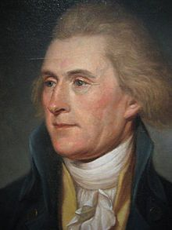
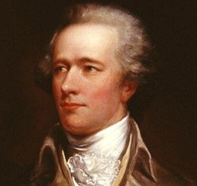
Constitution: Historical Backdrop
Thomas Jefferson (antifederalist) strict constructionist…Stood openly opposed to the foundation of a federal or national bank: “the Constitution is the supreme law of the land;…we cannot establish a nation bank, because there is no provision for it.”
Alexander Hamilton (federalist) loose constructionist…insisted a national of federal bank be established: “there is nothing in the Constitution prohibiting the establishment of a national bank. There is not a single line that says, thou shalt not have the government engaging in the banking business.”

Slide 3

“in order that the manifold wisdom of God might now be made known through the church to the rulers and authorities in the heavenly places.”
(Ephesians 3:10)
2Timothy 3:16-17
1Timothy 6:3 “Sound words”
2Timothy 1:13
SOUND: “wholesome, legally valid; logically valid and having true premises”
Ephesians 4:3-6
A ONENESS
Held Together By A Spiritual Constitution
MUST BE STRICT CONSTRUCTIONISTS IN A SPIRITUAL SENSE
“and whatever you do in word or deed, do all in the name of the Lord Jesus…”
Colossians 3:17

Slide 4

A CORE QUESTION:
Strict Constructionist or Loose Constructionist?
Autonomy of local congregation
Acts 20:28; Philippians 1:1
Does New Testament Authorize Anything Larger Than Local Congregation?
Avenues Of Approach In Worship
Hebrews 11:4/Genesis 4:3-7
Abel Proved To Be A Strict Constructionist
John 4:20, 21-24/1Kings 12:25-33
Jeroboam & The Ten Tribes Proved To Be Loose Constructionists

Slide 5

Seeking To Bind That Which Isn’t Bound In The Spiritual Constitution (New Covenant)
Acts 15:1,5,24; Colossians 2:11-15
“I Robbed Other Churches…”
2Corinthians 11:8; Phil. 4:14-16
Funds Were Never Sent Through
An Agency Or “Society”

Slide 6

“On the first day of every week, let each one of you put aside and save, as he may prosper…”
1Corinthians 16:2
Where Is There Authorization For The Church To Garner Funds By Business Ventures?
Strict constructionist
Loose constructionist
2Corinthians 8:1-6
2Corinthians 9:6-7
Where There Is No Specific Authority Prohibiting Something, Can We Assume A Liberty That Is Not Present?

Slide 7
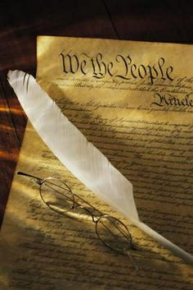
ONCE THE LINE IS CROSSED; WHERE DOES IT END
There Were 10 Amendments When Ratified; Now There Are 33
There Have Been 11,539 Proposals To The Constitution Since When It Was Ratified
Strict or Loose Constructionist?
Is God’s “Constitution” Being Respected?
2John 8-10
1Peter 4:11
SPIRITUAL APPLICATION:
God’s Word Is Perfect, How Can Anyone Improve On Perfection?
Psalms 19:7; James 1:25
2Peter 1:19-21

