Slide 1
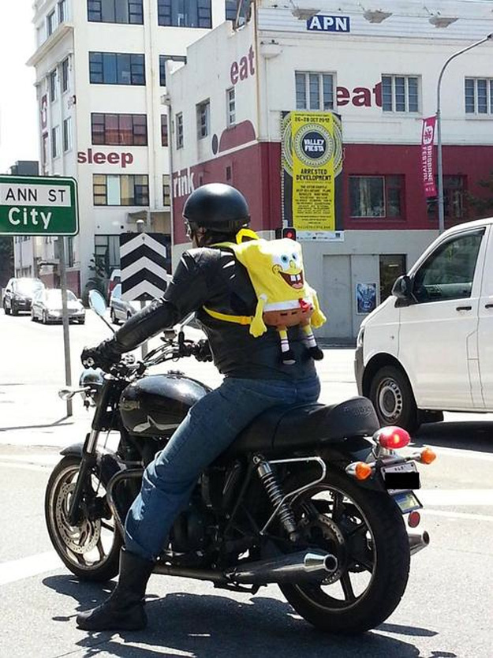
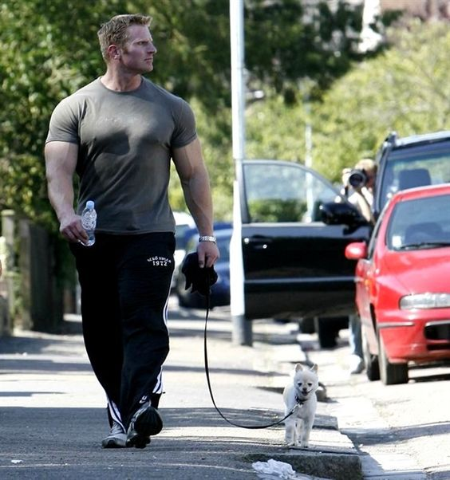
SOME TIMES THINGS DON’T QUITE FIT THE PICTURE….
THE QUESTION IS IF YOU FIT THE PICTURE OF A CHRISTIAN:
A LIGHT IN THE WORLD

Slide 2

Lights In The World:
Influence & Example
An appeal to be unique & distinctive:
in the hidden person of the heart
“Let your light shine before men in such a way that they may see your good works, and glorify your Father who is in heaven.” (Matt. 5:16)
Romans 12:1-2
Galatians 2:20
“Pre” & “Post” Cultures
Changing World Views…
In Light Of Which, What Should We Do?

Slide 3
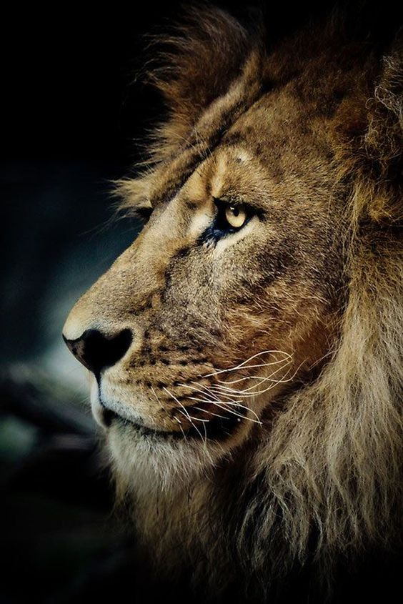
“…But the righteous are bold as a lion.” (Proverbs 28:1)
Courage doesn’t mean you don’t get afraid. Courage means you don’t let fear stop you.
Courage To Take A Stand
2Timothy 1:7-14
Not a spirit of timidity
Numbers 13:30-31, 14:1-8, 11-12
Joshua & Caleb
John 9
Man born blind
Courage of Daniel & His Three Friends
Revelation 21:8
WHAT IS YOUR COURAGE QUOTIENT?

Slide 4
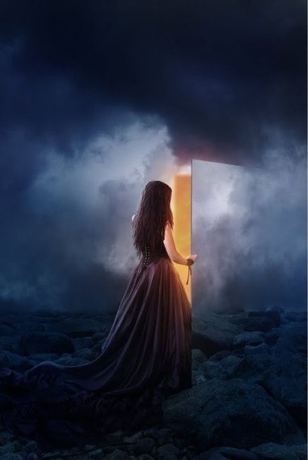
LIGHTS IN THE MIDST
Regardless of the wickedness and perversity that surrounds us, we must appear as a light shining in a dark place
Philippians 1:27
Conduct, worthy of Christ
Titus 2:7-8
Show yourself to be an example
Ephesians 4:20-23
Awaken To The Power Of Example & Influence
1Peter 2:11-12
“Keep your behavior excellent”

Slide 5

“ you are the light of the world…”
(Matthew 5:14)
Philippians 2:12-16
“Work out your salvation…”
Make It Personal
Get Yourself Together
“With fear and trembling”
Allow God To Work In You
“Without grumbling or disputing
“Prove yourselves blameless”
“Holding fast to the Word of life”
Hebrews 4:12-13
Ephesians 5:7-9
How honest are we with respect to where we are as reflecting the Light of the World?

Slide 6

PENSIVE THOUGHT:
What Is God’s Definition Of A Christian?
(is it the same as man’s understanding?)
“Christian” found only three times in the Bible
1Peter 4:16
Acts 11:22, 26:28
CHRISTIAN: χηριστιανοσ
(christianos)
“an adherent of Christ”
CHRISTIAN: A Noun
Never used as an adjective in the New Testament
Clearly Mankind Has A Different Understanding Than Does God
“It is clear that the final lexicon exists only in the mind of God.”
Webster’s II Dictionary, Preface; Howard Webber, Publisher

Slide 7
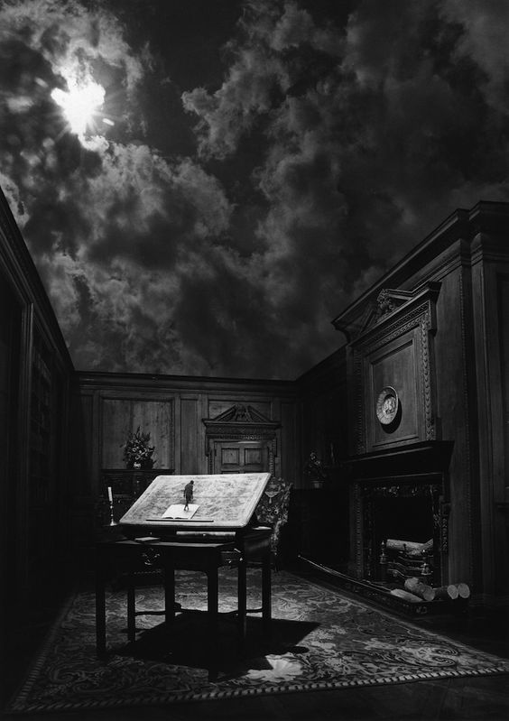
CHRISTIAN:
God’s Definition
(as seen in 1Peter)
1Peter 1:14
An obedient child
1Peter 1:18-22
One redeemed by the precious blood of Christ
1Peter 2:9-12
Obedient in all
Facets of life
One Living A Life That Clearly Reflects A Vibrant Relationship With God Through Christ…
Is That It?

Slide 8
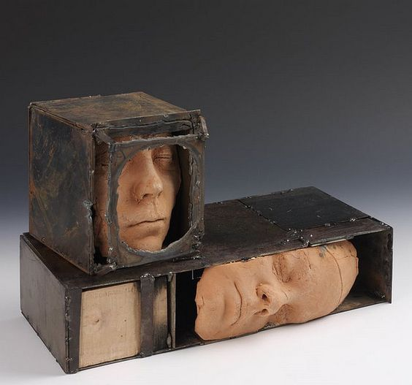
AN UNCOMMON PERSON IN A COMMON WORLD
Not Boxed Up In Conformity
Romans 12:1-2
1Corinthians 6:19-20
Living a life reflective of the purchase price paid by Christ
1Peter 2:9
Citizen of a holy nation
Colossians 1:13
One called out of darkness into light
1Peter 2:21
One who has clear focus on Christ
Philippians 2:5-8
Mind set like that of Christ

Slide 9
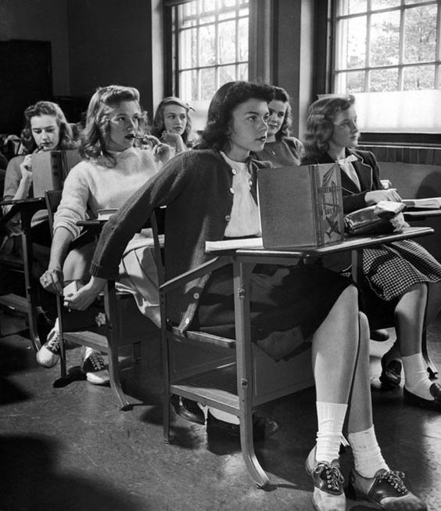
A CHRISTIAN IS A DISCIPLE:
A Student/Learner
Acts 11:26
(John 6:44-45, 63)
Longs For The Pure Milk
Of The Word
2Peter 3:18
Grows In Grace & Knowledge
2Peter 1:2-8
How Well Do You REALLY
Know Jesus, Who Is The
Christ?

Slide 10

A CHRISTIAN IS ONE THAT IS HOLY, DEDICATED & TRANSFORMED
To begin a transformation, you must peel back the layers and go to your core: the inner man
1Peter 1:15-16
Titus 2:11-14
1Thessalonians 4:1-12
A Transformation Of The
Mind; Impacting The Total Essence Of The Individual
In The World, But Not Of The World (James 1:27)

Slide 11
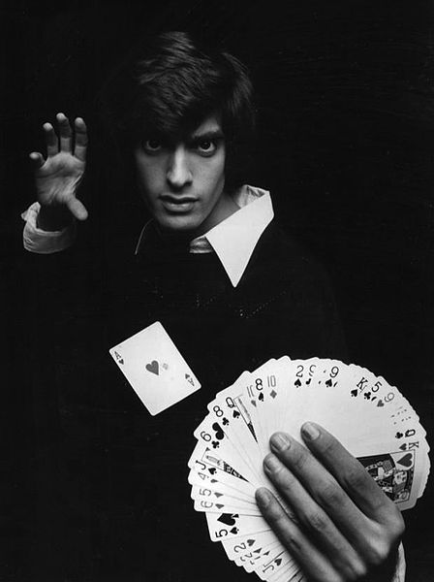
There is nothing magical about it…
A christian abstains & attains
1Peter 2:11-12
ABSTAIN
Galatians 5:19-21
James 3:14-16
ATTAIN
Galatians 5:22-25
Hebrews 6:1
James 3:17-18

Slide 12
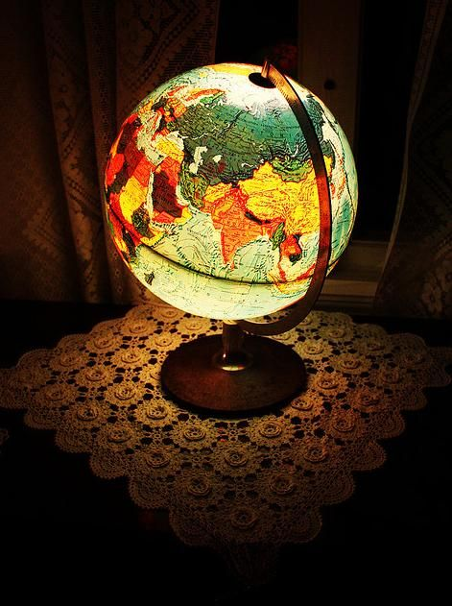
“MY KINGDOM IS NOT OF THIS WORLD…” (John 18:36)
Unique relationships based on our precious relationship with Christ
1Peter 2:4-10
Living Stone
Spiritual Household
Holy
Royal Priesthood
Citizen of a Holy Nation
A Christian Is Divinely Appointed To Fulfill A Given Role Within The Framework Of The Kingdom Of Christ. It Cannot Be Done Alone, Nor Taken Lightly

Slide 13
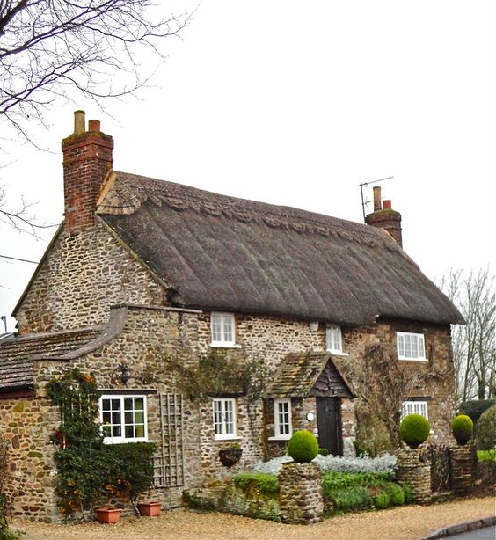
LIVING STONE,
IN A SPIRITUAL HOUSEHOLD
Rom. 12:10-16; Col. 2:2, 16
Devoted to one another in brotherly love
Knit together as a family
Ephesians 2:19-22
Expected to fulfill part as a family member

Slide 14
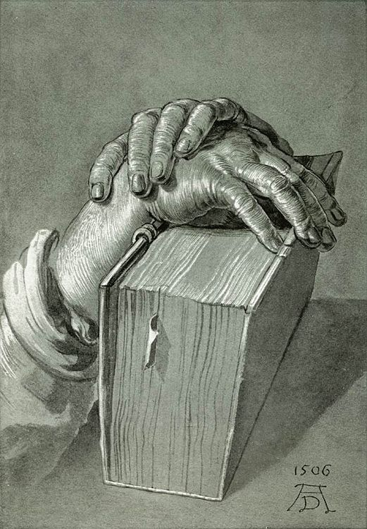
A Christian Is Part Of A Royal Priesthood
1Peter 2:5, 9
“I was glad when they said to me, let us go
to the house of
The Lord.”
Psalms 122:1
John 4:23-24
Col. 3:16-17
2Cor. 9:7

Slide 15
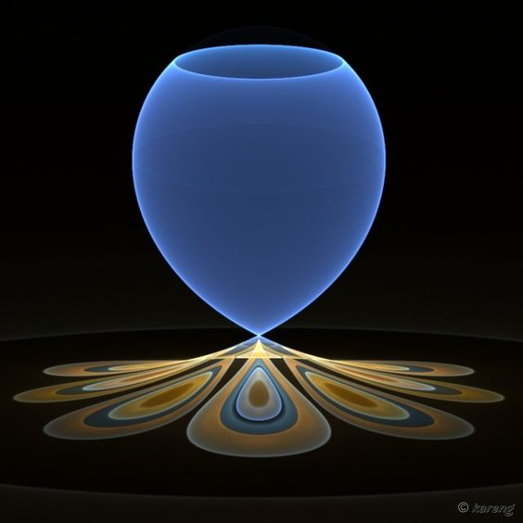
A CHRISTIAN IS A CITIZEN OF A HOLY NATION
Willingly
Humble Self
To The Monarch
“King of Kings, and Lord of Lords”
Col. 1:13
1Cor. 6:19-20
Matt. 17:1-5
Matt. 28:18-20
Mark 7:7-8
“Manifold wisdom of God…”
Eph. 3:10
As A Citizen We Enjoy Rights & Privileges;
But Also Have Responsibilities Enjoined

Slide 16

A Christian Is One Who Has Set Christ
First In The Heart
1Peter 3:15-22
Colossians 3:1-3
Matthew 22:37
Proverbs 4:23
Proverbs 23:7
Matthew 12:34-35
If Christ Is The Center Of Your Life,
Then What Sort Of Life Will You Be Living?

