Slide 1

Listen Closely In Order To Hear What The Blood Of Christ Has To Say To All Of Mankind (Hebrews 12:24)
The Blood Of Christ Is Dualistic In What It Has To Say: Infinite Beauty & Anguish
Hebrews 1:3; John 14:6
Opened Up The Way
Romans 1:16
Christ’s Blood Speaks Of
The Power Of The Gospel
Must Never Take For
Granted The Shed Blood
Of Christ
LISTEN AS IF YOUR LIFE DESPENDS ON IT
BECAUSE IT DOES!

Slide 2

LISTEN CLOSELY AND YOU WILL “HEAR” THE BLOOD OF CHRIST AS IT SPEAKS ABOUT…
1John 4:9-10
Romans 5:5-9
1John 2:4-6
John 15:13-14
The Wonderful, Matchless Love, Grace &
Mercy Of God
Eph. 2:4-5
Eph. 3:19

Slide 3
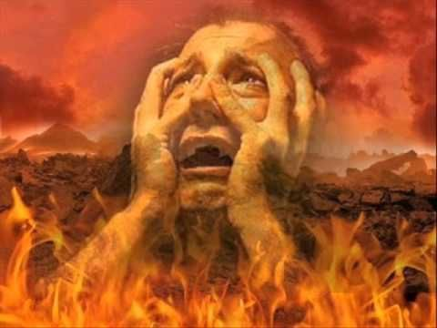
Jesus’ Blood Also “Speaks”
About The Absolute
Wretchedness
Of Sin
The Price To Be
Paid To Deal
With Sin
Isaiah 53:4-8
2Corinthians 5:21
1John 3:4
“lawlessness”
“FOR ALL HAVE SINNED AND FALL SHORT OF THE GLORY OF GOD.” (Romans 3:23)
“FOR THE WAGES OF SIN IS DEATH…”
(Romans 6:23)

Slide 4

The Blood Of Christ “Says” Mankind Incapable To
Author Salvation
1Peter 1:18-19
“Helpless”
Romans 5:6
Ephesians 2:8-9
Matthew 26:28
“I know O Lord, that a man’s way is not in himself.”
Jeremiah 10:23

Slide 5

The Blood Of Christ “Speaks” Of ATONEMENT…
Atonement is the centerpiece of christianity. Atonement is that which distinguishes followers of Christ from all other religions
“reparation for an offense or injury; satisfaction; reconciliation of God and mankind through the sacrificial
death of Jesus Christ”
In location to a single entity by a process
or agent.
AT ONE MENT
Location
A Single Unit
(suffix) an action or process

Slide 6

Listen Carefully As Jesus’ Blood Speaks About…
Remission Of Sins
Matthew 26:28, 1John 4:10
Old Law Taken Away
Ephesians 2:14-16,
Hebrews chapters 8-9-10
Purchase The Church
Acts 20:28
1Peter 1:18-19
1Peter 1:22-23
What do you have to say with respect to the blood of Christ?

