Slide 1
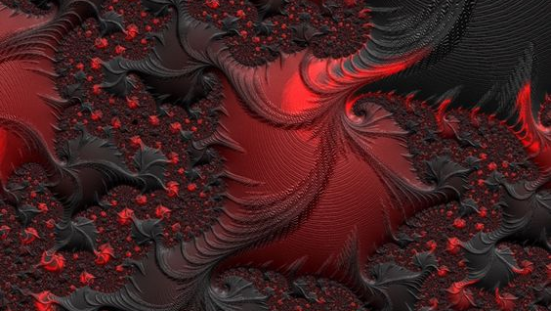
NAHUM…
(The Fall of Nineveh)
Nahum, is a contemporary with Jeremiah, Habakkuk and Zephaniah. His name means “Consolation”
Central Theme of the Message Delivered
Nineveh will fall/destruction
No mercy will be extended; as mercy was taken for granted the first time
Nineveh was a leading city in the Assyrian empire. It was viewed at the time of Nahum’s writing as a world power, but clearly in a state of decline (630-612 bc)
In the days of Jonah, people of Nineveh repented and enjoyed God’s mercy…at least for a short time. They grew to take God’s mercy for granted and found themselves facing God’s judgment/punishment

Slide 2
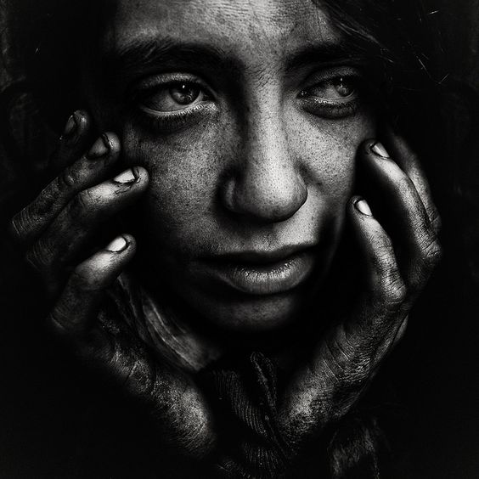
No Mercy…
Nahum’s Three-Part Message On Judgment/Punishment
Chapter One:
Doom; no mercy/no second chance
(see also 2Peter 3:9; Romans 11:22; Romans 12:19)
Chapter Two:
No amount of preparation and defenses set in place will suffice. City will be flooded/plundered
Chapter Three:
Destruction deserved/open, blatant sin
All will be exposed. Neither wealth nor power will be able to save them from what is to come
Fait Accompli (Fata Complete): no other option but to accept. Done deal

Slide 3
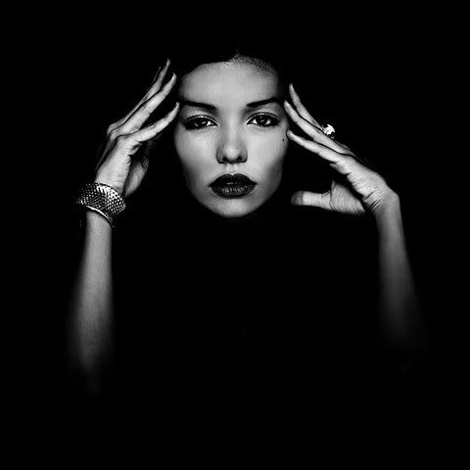
WHAT CAN WE TAKE AWAY (learn) FROM NINEVEH?
“For whatever was written in earlier times was written for our instruction, that through perseverance and the encouragement of the Scriptures we might have hope.” (Romans 15:4)
As A “People”, Can We Honestly Say We Are That Much Different Than The Nations/People Of Old?
“Righteousness exalts a nation, but sin is a disgrace to any people.” (Proverbs 14:34)
Have we been exposed?
Secular progressive attitudes; abortion; gender fluidity; same sex marriage; polyamory; overall malaise regarding moral issues; atheism; changing worldviews
Ephesians 5:11-13
2Peter 3:9

Slide 4
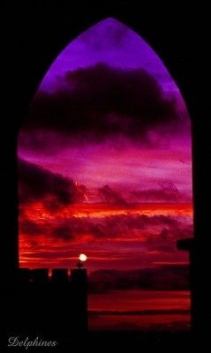
GOD EXTENDED EVERY OPPORTUNITY TO NINEVEH AND HE DOES SO FOR EACH ONE OF US DAY BY DAY.
“Behold then the kindness and severity of God; to those who fell, severity, but toward you, God’s kindness, if you continue in His kindness; otherwise you also will be cut off.”
(Romans 11:22)
Regardless of what others do, we must all bear in mind that each one of us will stand alone before the God of Heaven and be judged based upon what we have done.
Likewise we must all bear in mind that God has proven to be merciful but also exacting in carrying out His Word

