Slide 1
Keeping It All So Simple…
“Where the Bible speaks we speak; where it is silent we are silent.” Thomas Campbell 1803
A Revolutionary statement? So much more than a catch phrase or slogan
Listen To The Sound Of Silence

Slide 2
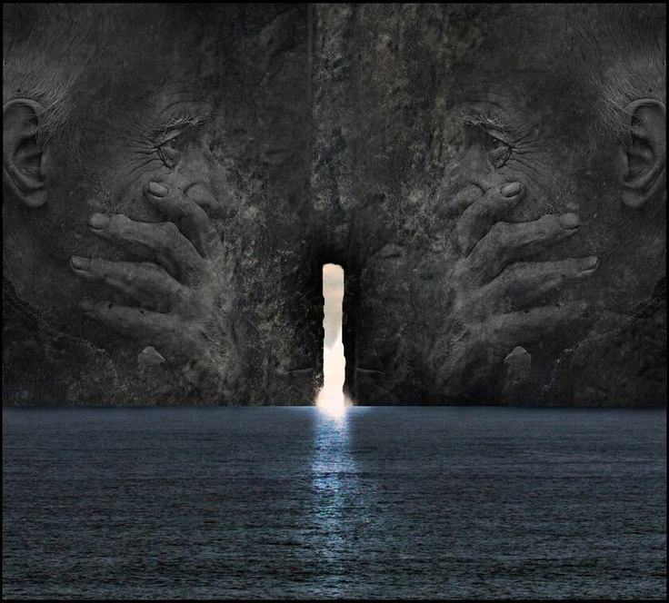
The Sound of Silence
1Peter 4:11
“The Bible, I say, the Bible only, is the religion of the Protestants” W. Chillingworth 1659
“For the church to require more than Christ Himself did, or make the condition of her membership more than our Savior did for discipleship is wholly unwarranted”
E. Stillingfleet 1679
1Corinthians 4:6
“might learn not to exceed what is written…”

Slide 3
If You Don’t Understand The Silence Of God, How Can You Understand His Words?
God is silent on some things, but Why, when we want answers???
Ephesians 3:10
1Corinthians 2:11-16
Does Man Have The Right To Speak For God??
Generic & Specific
Romans 14, 1Corinthians 8 and 10
Liberty
Learn To Listen To The Silence Of God

Slide 4
Is The Bible Simply A Rule Book?
Hebrews 1:1-4
God Has Now Spoken To Us Through His Son
Grace & Truth
Respect The Silence Of God…
Galatians 5:19-23
James 4:11-12 Matt. 7:1-2
We Are Called To Be Disciples Of Christ Not Lawgivers

Slide 5
Ecclesiastes 3:14
Listen To What God Has Said
Respect As Well His Silence

