Slide 1
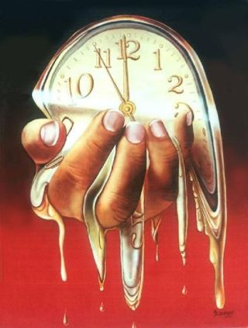
“Believe In God, Believe Also In Me”
John 14:1
“Never did a man speak the way this man speaks.” John 7:46
“And they were amazed at His teaching; for He was teaching them as one having authority, and not as the scribes.” Mark 1:22
“I Am the Alpha and the Omega…” Revelation 1:8
JESUS: Who Was, Who Is & Who Is To Come…
Not Bound By Time…
ETERNAL (see John 1:1-3; Hebrews 1:1-11)
“I AM” a Divine Declarative

Slide 2
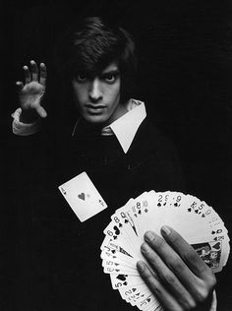
IS IT REALLY A MYSTERY AS TO WHO JESUS IS???
“Behold, a virgin will be with child and bear a son, and she will call His name Immanuel.”
Isaiah 7:14
(see also Matthew 1:23 “God with us”)
“And the Word became flesh and dwelt among us, and we beheld His glory, glory as the only begotten from the Father, full of grace and truth.”
John 1:14
Jesus Did Not Hesitate When Answering Who He Is…
“I AM”: First-Last, True Vine, Truth, Way, Life, Light, Good Shepherd, Door
“Lord, to whom shall we go? Thou hast the word of eternal life.” John 6:68

Slide 3
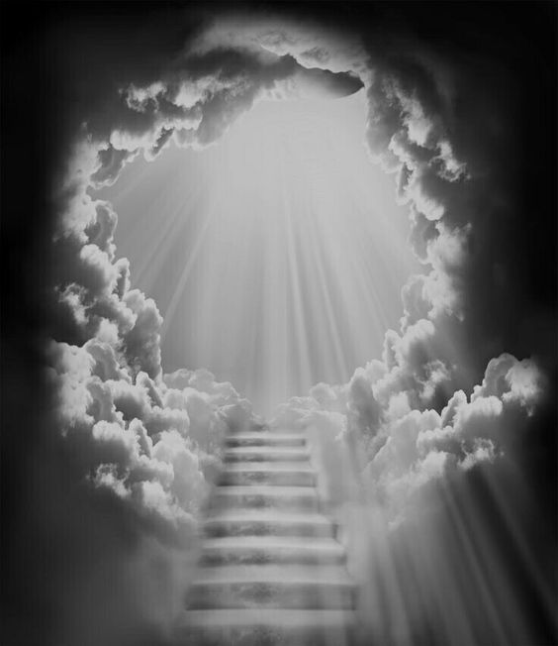
“I AM” denotes singleness
“Jesus said to him, ‘I Am the way, and the truth, and the life; no one comes to the Father, but through Me.’”
John 14:6
Access to the Father found only in Christ
He who has My commandments and keeps them, he it is who loves Me; and he who loves Me shall be loved by My Father, and I will love him, and disclose Myself to him.”
John 14:21
(see also John 14:23-24)
“I Am the door…”
John 10:1, 9

Slide 4

“I Am the light of the world; he who follows Me shall not walk in darkness but shall have the light of life.”
John 8:12
“The unfolding of Thy words gives light; It gives understanding to the simple.” Psalms 119:130
[Jesus referred to as The Word…see John 1:1-3, 14]
“The night is almost gone, and the day is at hand. Let us therefore lay aside the deeds of darkness and put on the armor of light. Let us behave properly as in the day, not in carousing and drunkenness, nor in sexual promiscuity and sensuality, not in strife and jealousy. But put on the Lord Jesus Christ and make no provision for the flesh in regard to its lust.” Romans 13:12-14 [see also 1John 1:5-7]

Slide 5
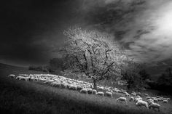
“I Am the good shepherd; the good shepherd lays down His life for the sheep.”
John 10:11
Isaiah 53:7-8, 10
John 15:13-14
“Greater love has no one than this, that one lay down his life for his friends. You are My friends, if you do what I command you.”
“I Am the true vine, and My Father is the vinedresser” John 15:1
John 15:5 Abide in Him
John 15:6 If do not abide in His words, cast aside
John 15:7 Abide in His words…

Slide 6
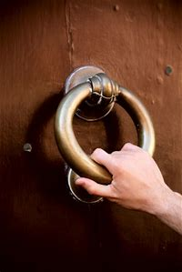
“I Am the Alpha and the Omega, the first and the last, the beginning and the end.”
Revelation 22:13
In Christ there is a unique oneness: Ephesians 4:1-6
He is the fulfillment of the promise and serves as the singular “stairway to heaven”
see Genesis 28:12-15/John 1:49-51
“Behold, I stand at the door and knock; if anyone hears My voice and opens the door, I will come in to him, and will dine with him, and he with Me.”
Revelation 3:20

