Slide 1
“WHAT IS TRUTH?”
John 18:38
Everyone is entitled to their own opinion, but not their own facts
TRUTH [Greek] Αλετηεια
The reality lying at the basis of an appearance: the manifested, veritable essence of a matter
TRUTH [English]
Conformity to fact or actuality; fidelity to an original or standard
2John 1-4
“In truth”
John refers to “truth” five times in the first four verses

Slide 2
“..to the chosen lady and her children, whom I love in the truth; and not only but also all who know the truth” 2John 1
“In truth” stresses a positional relationship
Joined together, held together when IN TRUTH
CHRIST & TRUTH:
Inseparable
(Christ & Word; Word & Truth)
John 1:1-3, 14, 14:6, 17:17
CHURCH & TRUTH:
Inseparable
(Pillar & Support of Truth)
1Timothy 3:15
1PETER 1:14, 22-25
Can one be IN TRUTH and not be IN CHRIST? Can one be IN CHRIST and not IN TRUTH?

Slide 3
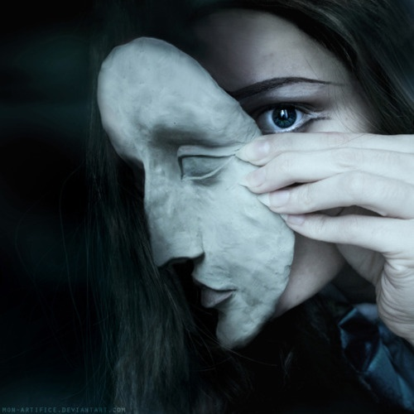
TRUTH: MUST BE MADE KNOWN
2John 1 “know the truth…”
What Good Is Truth If It Is Not Known Or Shared?
“and you shall know the truth, and the truth shall make you free” John 8:32
2Peter 1:12 “In truth”
2Peter 1:17-21 Pay attention
2Peter 3:17-18 Know truth so as not to be misled
Walk By Faith:
Decisions Based On Truth,
Not Emotion

Slide 4
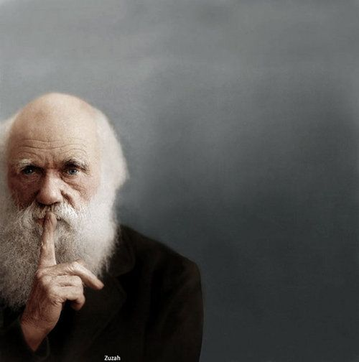
Truth: Abides In The Individual
2John 2
Take ownership of truth
It Is One Thing To “Know” Something,
It Is Another Thing To Be Convicted/Convinced Of It To The Degree That Application Is Made In One’s Life
2Timothy 1:5, 3:14-15
Colossians 3:16-17
A life that is based/governed on truth.
Consistency in life

Slide 5
TRUTH:
Found In Good Company
2John 3 “Truth”
in/with The Father & Christ
John 1:14, 17
Grace & Truth In Christ
Without Truth, how could one ever know of God’s love for mankind?
1Corinthians 2:10-16

Slide 6
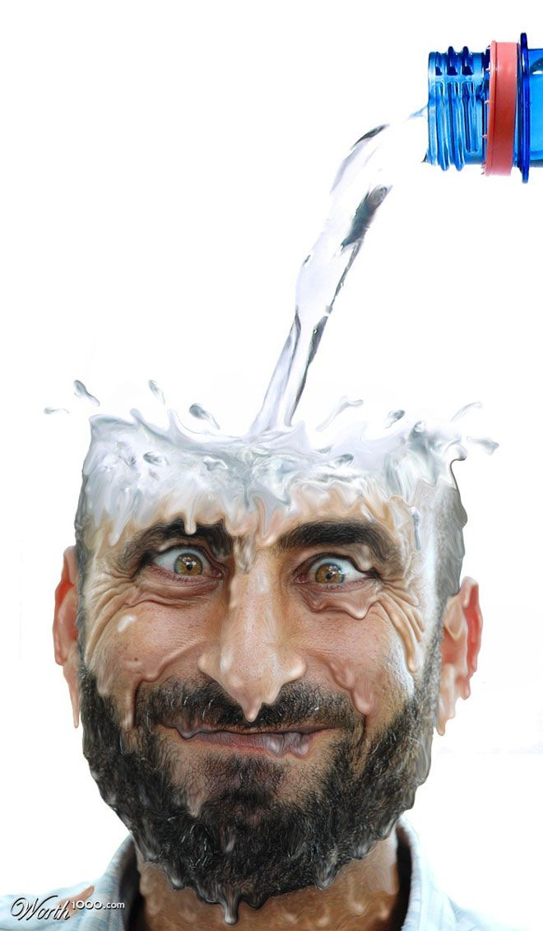
TRUTH: Joyously Refreshing
Walk In Truth
2John 4 “walking in truth”
TRUTH should be the standard for our life
Psalms 119:11
Philippians 1:27
Truth
+
Love
--------
Fidelity

