Slide 1
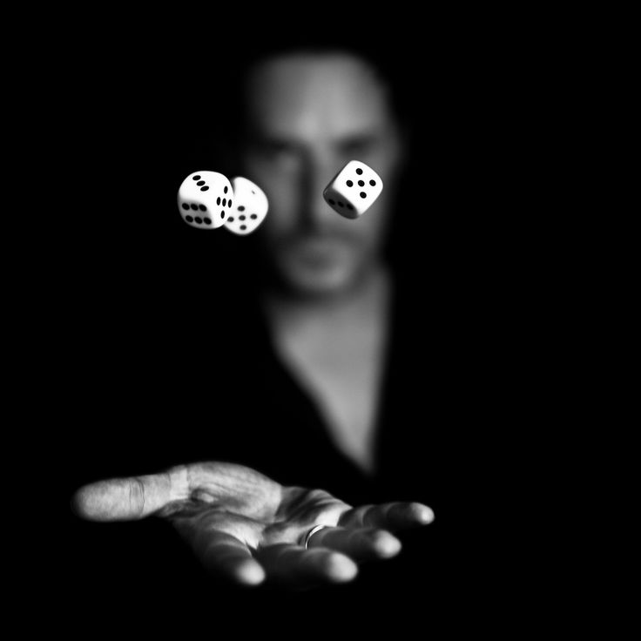
Gamble: “to risk losing (something valuable or important) in order to do or achieve something”
Judges 14:12-18 Samson gambled and lost on what he thought was a “sure thing”
Majority of people have a HUGE wager on the line and for the most part really don’t think all that much about it..
What If It Is True? Are You Really Willing To Gamble Your Soul?

Slide 2
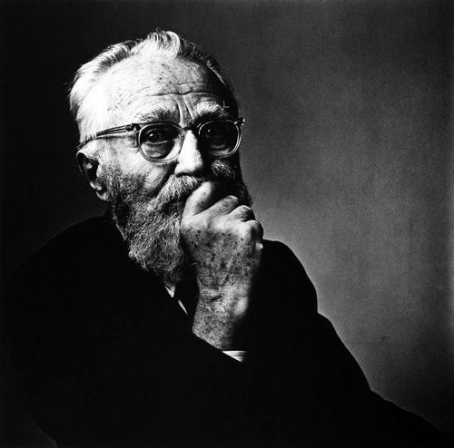
Mark 8:37
What Will A Man Give In
Exchange For His Soul?
What Is Truth?
At Some Point All Of Us Will Have To Come To A Decision…
1Corinthians 1:18-25
Is There Room For Reasonable Doubt To Current Thinking?
What If It True???

Slide 3
The Light Of The World…
What If The Claims Of Jesus Are True?
John 3:8-21
John 4:10, 25-26
John 5:19-24
John 5:37-46
John 6:35-40, 48, 51
John 8:54-58
John 10:7-18
John 10:34-38
John 11:25-26
John 20:30-31
John 8:12-19
John 8:23-26
“Do Not Let Your Hearts Be Troubled; Believe In God, Believe Also In Me” (John 14:1)

Slide 4
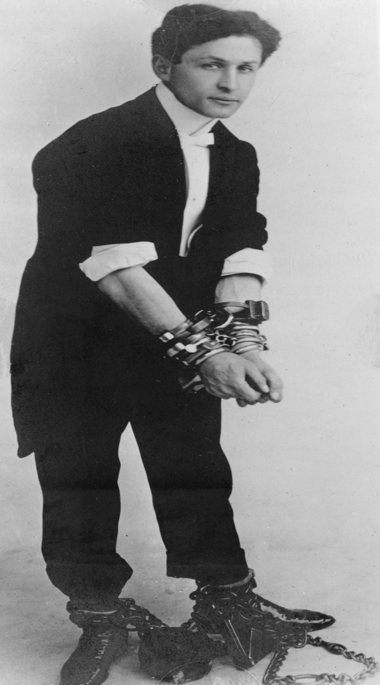
“How will we escape if we neglect so great a salvation? After it was at first spoken through the Lord, it was confirmed to us by those who heard, God also testifying with them, both by signs and wonders and by various miracles and by gifts of the Holy Spirit according to His own will.” (Hebrews 2:3-4)
Hebrews 2:9-18

Slide 5
“In The Beginning Was The Word…”
John 1:1-5
Jesus Is The Embodiment Of Everything The Bible Sets Forth: He Is The Word
The Word Became Flesh…
John 17:17 “Thy Word Is Truth”
1John 1:1; Revelation 19:13
Hebrews 1:1-3
1Peter 1:22-2:2
“He Who Rejects Me And Does Not Receive My Sayings, Has One Who Judges Him; The Word I Spoke Is What Will Judge Him On The Last Day…” John 12:44
There Is No “If”… It Is True

