Slide 1
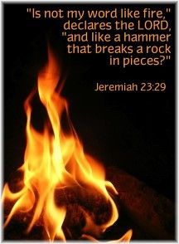
A SCATHING REBUKE ISSUED BY JESUS
(Matthew 23:1ff)
Over the two millennia since Jesus walked on the earth, many have skewed His teaching. Focusing only on that which deals with love, grace, mercy and so forth. However, there was also an edge to the teaching of Jesus…
Jeremiah 23:29-32/Matthew 23:13-33
2Corinthians 10:3-5
Christ wanted to clearly expose the error of the Pharisees and their character
Hypocrite: play-acting; hide behind a mask while speaking dialogue
Woe: an interjection used as a denunciation; heavy affliction or calamity

Slide 2
ABJECT FAILURE TO RESPECT AUTHORITY…
Matthew 23:1-4
“…have seated themselves in the chair of Moses”
who gave authority to the Pharisees?
Matthew 16:6
“And they tie up heavy loads…but they themselves are unwilling to move them with so much as a finger”
do as I say, don’t do as I do
Pharisees sought to bind things that were not binding
Mark 7:6-8
“Be imitators of me, just as I also am of Christ”
(1Corinthians 11:1) [see also Romans 2:21-23]

Slide 3
SELF ELEVATED; ARROGANT
Swell Headed Attitude of Self Importance
“But they do all their deeds to be noticed by men…”
“And they love the place of honor at banquets…”
(Matthew 23:5-7)
Proverbs 16:18
Colossians 3:9-14
In their arrogance, they accepted grandiose titles…
(Matthew 23:8-10)
Psalms 111:9
Romans 12:3; Philippians 2:2-4

Slide 4
“Woe to you, scribes and Pharisees, hypocrites, because you shut off the kingdom of heaven from men…” (Matthew 23:13)
The first “woe” issued…
The Pharisees, scribes were guilty of misguiding the people
doing everything they could to keep people from following Christ
(see John 9:18-34)
At every turn, the Pharisees and scribes along with others in concert with them tried to discredit Jesus (challenged His authority; accused Him of breaking Old Law; misconstrued His words; accused Him of being in league with Satan…)
Matthew 23:14 Second “woe” Jesus charges the scribes and Pharisees with making merchandise of religion. They preyed on the unsuspecting
Matthew 23:15-22 Two more “woes” issued that exposed their “partyism” and standing as blatant false teachers; desire to convert people to their doctrine rather than to God.

Slide 5
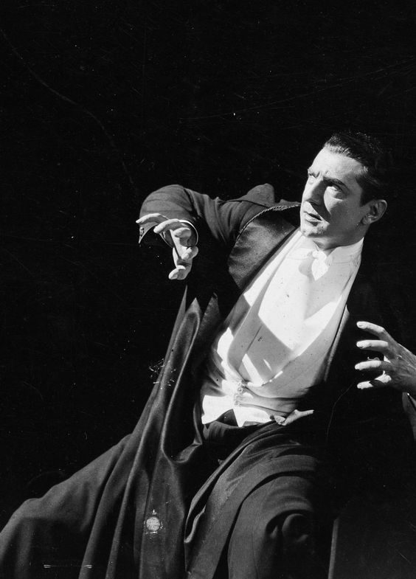
WOE UPON WOE ISSUED FORTH…
Matthew 23:23-24 Pharisees more concerned with “showy” visible observance, but lacked inner truth
1. In their misplaced zeal and knowledge, they had set aside
mercy, justice; but most of all righteousness
2. Jesus showed how inconsistent the Pharisees really were
3. James 2:10
Matthew 23:25-28 Corrupt from the inside out; not pious
1. From the outside the Pharisees appeared pious
2. Closer inspection required
3. Hebrews 4:12-13
“Who may ascend into the hill of the Lord? And who may stand is His holy place?” (Psalms 24:3)

Slide 6
IN SPITE OF ALL THE EVIDENCE SCRIBES AND PHARISEES REFUSED TO SEE THEMSELVES AS THEY TRULY WERE
Matthew 23:27-33 They held to a like attitude of that of their fathers who had killed the prophets; despite saying they would have opposed the shedding of blood.
1. Matthew 27:24-26
2. Acts 4:10
3. Acts 7:51-60
How Difficult Is It To See Self As We Really Are?
Galatians 6:7-8 “Do not be deceived, God is not mocked…”

