Slide 2
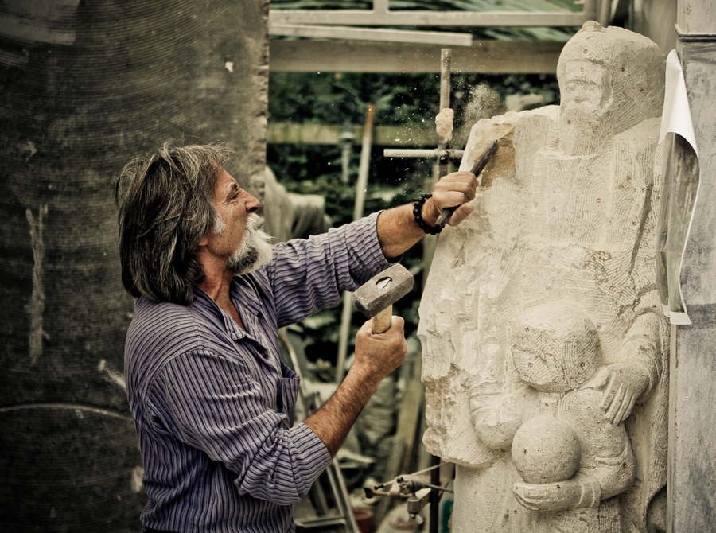
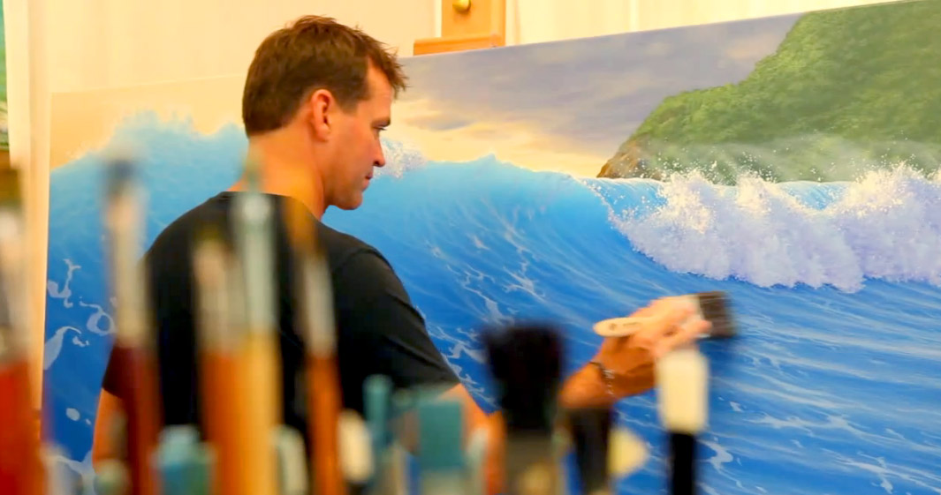

Slide 3
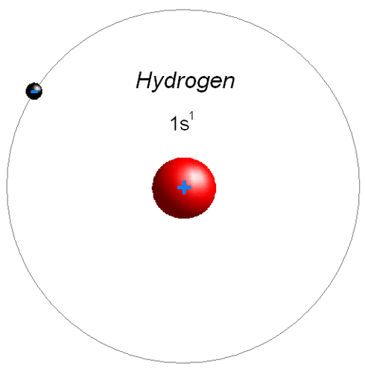

Slide 4
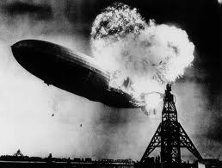

Slide 5
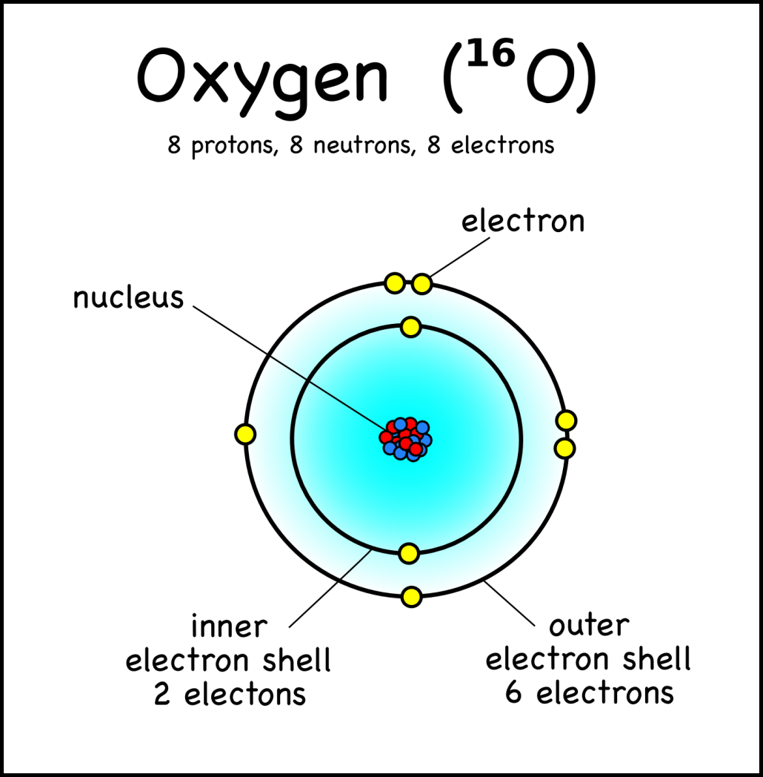

Slide 7
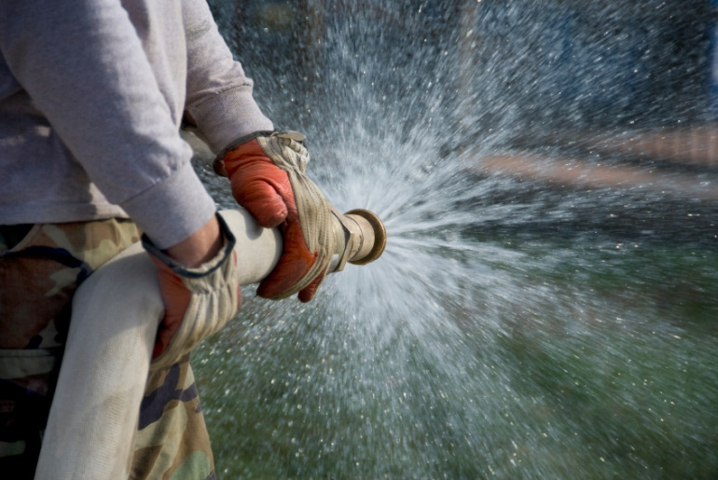
+
=

Slide 8
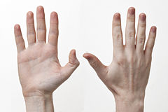
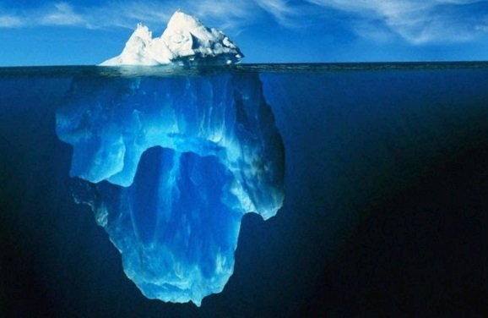
Attention
Action
Attitude

Slide 9
Attention
Defines our character
Proverbs 23:7
For as he thinks in his heart, so is he.

Slide 10
Attention
Sets our path
…and an evil man out of the evil treasure of his heart brings forth evil.
Luke 6:45
A good man out of the good treasure of his heart brings forth good…

Slide 11
Attention
Is required by God
Philippians 4:8
Finally, brethren, whatever things are true, …noble, …just, …pure, …lovely, …of good report, if there is any virtue and if there is anything praiseworthy—meditate on these things.

Slide 12
Action
Situation | + | You | = | Result
Opportunity to do good | + | Act | = | Enhanced as a Brush Stroke
Opportunity to do evil | + | Act | = | Degraded as a Brush Stroke
Opportunity to do good | + | Do not act | = | Degraded as a Brush Stroke
Opportunity to do evil | + | Do not act | = | Enhanced as a Brush Stroke

Slide 13
Action
Romans 8:1
There is therefore now no condemnation to those who are in Christ Jesus, who do not walk according to the flesh, but according to the Spirit.

Slide 14
Action
James 4:17
Therefore, to him who knows to do good and does not do it, to him it is sin.

Slide 15
Attitude
1 Corinthians 15:58
Therefore, my beloved brethren, be steadfast, immovable, always abounding in the work of the Lord, knowing that your labor is not in vain in the Lord.

Slide 16
Attitude
Colossians 3:2
Set your mind on things above, not on things on the earth.

Slide 17
A Loving People
A Righteous People
A Unified People
An Obedient People
A Growing People
A Prayful People
A Sharing People
A Pure People
A Looking People
A Faithful People

