Slide 1

WELCOME TO THE
JACKSON STREET CHURCH OF CHRIST
PLEASE TURN OFF CELLPHONES

Slide 2


Slide 3


Slide 4

SINGING

Slide 5
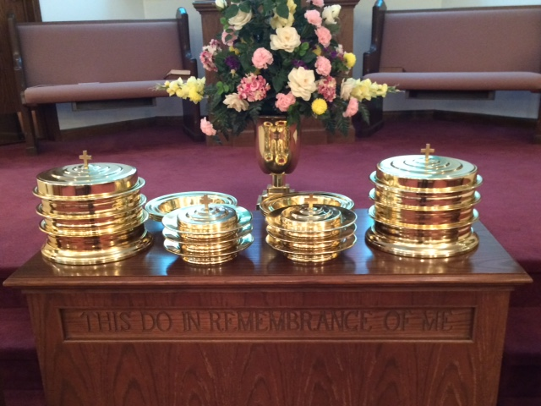
IN REMEMBRANCE OF JESUS

Slide 6
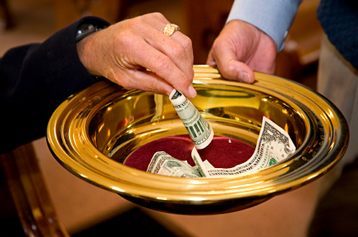
CONTRIBUTION

Slide 7
SINGING

Slide 8
Matthew 9:35–38 Then Jesus went about all the cities and villages, teaching in their synagogues, preaching the gospel of the kingdom, and healing every sickness and every disease among the people. ³⁶ But when He saw the multitudes, He was moved with compassion for them, because they were weary and scattered, like sheep having no shepherd. ³⁷ Then He said to His disciples, “The harvest truly is plentiful, but the laborers are few. ³⁸ Therefore pray the Lord of the harvest to send out laborers into His harvest.”

Slide 10
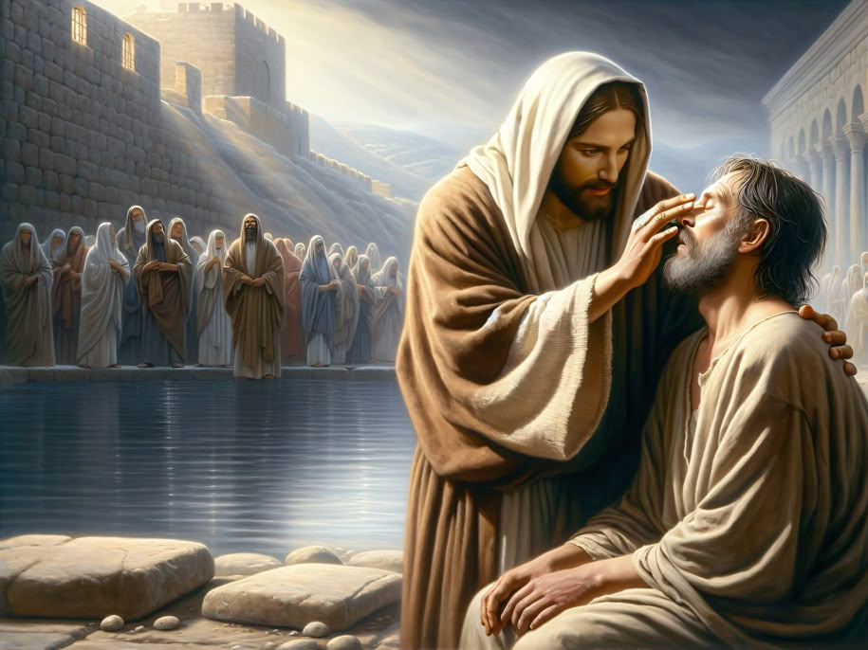
THE COMPASSION OF JESUS

Slide 11
THE COMPASSION OF JESUS
WHENEVER I HAVE ASKED A GROUP, “WHAT CHARACTERESTIC OF JESUS STANDS OUT TO YOU”.?
THE ANSWER IS ALWAYS HIS LOVE OR COMPASSION.
WE DO SEE A LOT OF EXAMPLES OF HIS COMPASSION IN THE SCRIPTURES.
LET’S LOOK AT SOME OF THOSE THIS MORNING

Slide 12
l. COMPASSION ON THE SICK
Mat 14:14 And when Jesus went out, He saw a great multitude; and He was moved with compassion for them, and healed their sick
Mark 1:40-42 Now a leper came to Him, imploring Him, kneeling down to Him and saying to Him, "If You are willing, you can make me clean." {41} Then Jesus, moved with compassion, stretched out His hand and touched him, and said to him, "I am willing; be cleansed." {42} As soon as He had spoken, immediately the leprosy left him, and he was cleansed.

Slide 13
l. COMPASSION ON THE SICK
Mat 20:29-34 Now as they went out of Jericho, a great multitude followed Him. {30} And behold, two blind men sitting by the road, when they heard that Jesus was passing by, cried out, saying, "Have mercy on us, O Lord, Son of David!" {31} Then the multitude warned them that they should be quiet; but they cried out all the more, saying, "Have mercy on us, O Lord, Son of David!" {32} So Jesus stood still and called them, and said, "What do you want Me to do for you?" {33} They said to Him, "Lord, that our eyes may be opened." {34} So Jesus had compassion and touched their eyes. And immediately their eyes received sight, and they followed Him.

Slide 14
ll. COMPASSION ON THE SORROWFUL
Luke 7:11-15 Now it happened, the day after, that He went into a city called Nain; and many of His disciples went with Him, and a large crowd {12} And when He came near the gate of the city, behold, a dead man was being carried out, the only son of his mother; and she was a widow. And a large crowd from the city was with her. {13} When the Lord saw her, He had compassion on her and said to her, "Do not weep." {14} Then He came and touched the open coffin, and those who carried him stood still. And He said, "Young man, I say to you, arise." {15} So he who was dead sat up and began to speak. And He presented him to his mother.

Slide 15
ll. COMPASSION ON THE SORROWFUL
John 11:32-36 Then, when Mary came where Jesus was, and saw Him, she fell down at His feet, saying to Him, "Lord, if You had been here, my brother would not have died." {33} Therefore, when Jesus saw her weeping, and the Jews who came with her weeping, He groaned in the spirit and was troubled. {34} And He said, "Where have you laid him?" They said to Him, "Lord, come and see." {35} Jesus wept. {36} Then the Jews said, "See how He loved him!"

Slide 16
Ill. COMPASSION ON THE SUFFERING
Luke 10:30-37 THE GOOD SAMARITAN
Mat 15:32 Now Jesus called His disciples to Himself and said, "l have compassion on the multitude, because they have now continued with Me three days and have nothing to eat. And I do not want to send them away hungry, lest they faint on the way."

Slide 17
IV. COMPASSION ON THE SHEPHERDLESS
Mark 6:34 And Jesus, when He came out, saw a great multitude and was moved with compassion for them, because they were like sheep not having a shepherd. So He began to teach them many things.
Mat 9:36-38 But men He saw the multitudes, He was moved with compassion for them, because they were weary and scattered, like sheep having no shepherd. {37} Then He said to His disciples, “The harvest truly is plentiful, but the laborers are few. {38} "Therefore pray the Lord of the harvest to send out laborers into His harvest."
Mat 23:37 "O Jerusalem, Jerusalem, the one who kills the prophets and stones those who are sent to her! How often I wanted to gather your children together, as a hen gathers her chicks under her wings, but you were not willing!

Slide 18
V. COMPASSION ON THE SINFUL
John 8:3-11 Then the scribes and Pharisees brought to Him a woman caught in adultery. And when they had set her in the midst, {4} they said to Him, "Teacher, this woman was caught in adultery, in the very act. {5} "Now Moses, in the law, commanded us that such should be stoned. But what do You say?" {6} This they said, testing Him, that they might have something of which to accuse Him. But Jesus stooped down and wrote on the ground with His finger, as though He did not hear. {7} So when they continued asking Him, He raised Himself up and said to them, “He who is without sin among you, let him throw a stone at her first.“ >>>

Slide 19
V. COMPASSION ON THE SINFUL
{8} And again He stooped down and wrote on the ground. {9} Then those who heard it, being convicted by their conscience, went out one by one, beginning with the oldest even to the last. And Jesus was left alone, and the woman standing in the midst. {10} When Jesus had raised Himself up and saw no one but the woman, He said to her, "Woman, where are those accusers of yours? Has no one condemned you?" {11} She said, "No one, Lord." And Jesus said to her, "Neither do I condemn you; go and sin no more."
Luke 15:11-32 THE PRODIGAL SON
Luke 19:10 "For the Son of Man has come to seek and to save that which was lost,"

Slide 20
ARE WE COMPASSIONATE, AS JESUS WAS?
WALK AS JESUS WALKED - 1 John 2:3–6 Now by this we know that we know Him, if we keep His commandments. ⁴ He who says, “I know Him,” and does not keep His commandments, is a liar, and the truth is not in him. ⁵ But whoever keeps His word, truly the love of God is perfected in him. By this we know that we are in Him. ⁶ He who says he abides in Him ought himself also to walk just as He walked.
MEET NEEDS - 1 John 3:17 But whoever has this world's goods, and sees his brother in need, and shuts up his heart from him, how does the love of God abide in him?

Slide 21
ARE WE COMPASSIONATE AS JESUS WAS?
HAVE COMPASSION - 1 Pet 3:8-9 Finally, all of you be of one mind, having compassion for one another; love as brothers, be tenderhearted, be courteous; {9} not returning evil for evil or reviling for reviling, but on the contrary blessing, knowing that you were called to this, that you may inherit a blessing.
COMPASSION ON THE LOST - Jude 20–23 But you, beloved, building yourselves up on your most holy faith, praying in the Holy Spirit, ²¹ keep yourselves in the love of God, looking for the mercy of our Lord Jesus Christ unto eternal life. ²² And on some have compassion, making a distinction; ²³ but others save with fear, pulling them out of the fire, hating even the garment defiled by the flesh.

Slide 22
SINGING

Slide 23
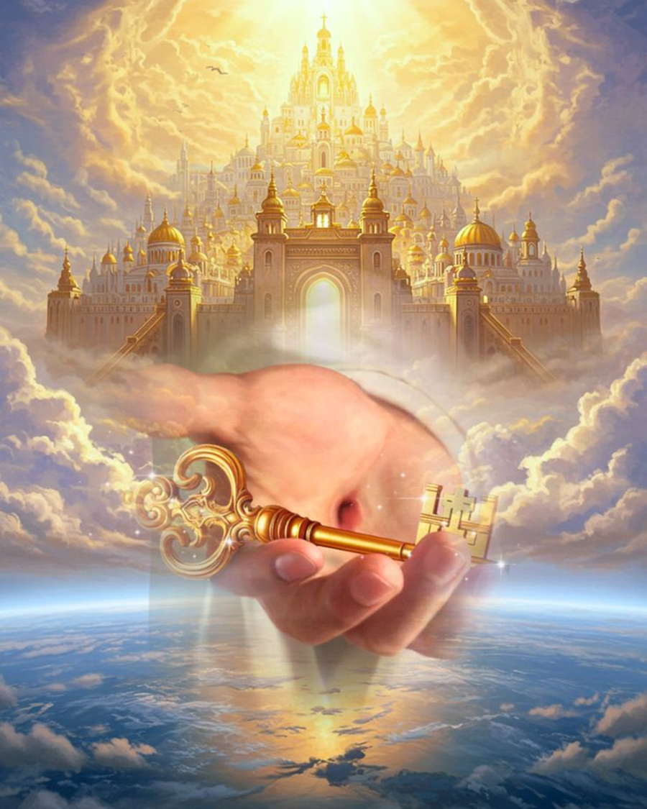
TONIGHT’S SERMON: THE CHURCH - THE KINGDOM OF CHRIST

