Slide 1
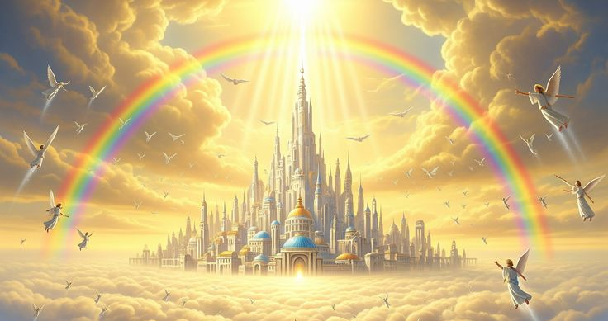
WELCOME TO THE
JACKSON STREET CHURCH OF CHRIST
PLEASE TURN OFF CELLPHONES

Slide 2


Slide 3

LET US PRAY

Slide 4

SINGING

Slide 5
Matthew 16:18–19 And I also say to you that you are Peter, and on this rock I will build My church, and the gates of Hades shall not prevail against it. ¹⁹ And I will give you the keys of the kingdom of heaven, and whatever you bind on earth will be bound in heaven, and whatever you loose on earth will be loosed in heaven.”

Slide 6
LET US PRAY

Slide 7
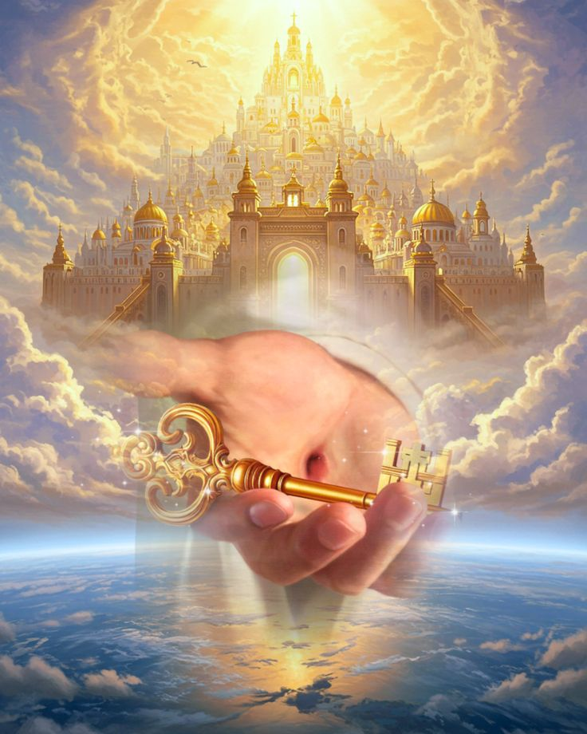
THE CHURCH
THE KINGDOM OF GOD

Slide 8
THE CHURCH AS THE KINGDOM
The word kingdom denotes the government aspect of the church. It speaks of the rule of God over men today.
Common sectarian argument says two separate and distinct institutions.
  To be in the kingdom is to be saved from sin - then you join a church. According to them you can be in one without being in the other,
  There is another age to follow this one - with an earthly kingdom. This is the church age followed by another - premillennial error - materialistic in nature.
The Church and kingdom are the same thing in scripture.

Slide 9
I. THE BEGINNING DATE AND PLACE OF THE KINGDOM.
A. Prophecy
  Isaiah 2:2–3 Now it shall come to pass in the latter days That the mountain of the Lord’s house Shall be established on the top of the mountains, And shall be exalted above the hills; And all nations shall flow to it. ³ Many people shall come and say, “Come, and let us go up to the mountain of the Lord, To the house of the God of Jacob; He will teach us His ways, And we shall walk in His paths.” For out of Zion shall go forth the law, And the word of the Lord from Jerusalem.

Slide 10
I. THE BEGINNING DATE AND PLACE OF THE KINGDOM.
A. Prophecy
  Daniel 2:44 And in the days of these kings (Romans) the God of heaven will set up a kingdom which shall never be destroyed; and the kingdom shall not be left to other people; it shall break in pieces and consume all these kingdoms, and it shall stand forever.
  Mark 9:1 And He said to them, “Assuredly, I say to you that there are some standing here who will not taste death till they see the kingdom of God present with power.”
  Matthew 3:2 and saying, “Repent, for the kingdom of heaven is at hand!”

Slide 11
I. THE BEGINNING DATE AND PLACE OF THE KINGDOM.
B. Fulfillment
Matthew 16:18–19 And I also say to you that you are Peter, and on this rock I will build My church, and the gates of Hades shall not prevail against it. ¹⁹ And I will give you the keys of the kingdom of heaven, and whatever you bind on earth will be bound in heaven, and whatever you loose on earth will be loosed in heaven.”
Acts 8:12 But when they believed Philip as he preached the things concerning the kingdom of God and the name of Jesus Christ, both men and women were baptized.
Acts 28:31 (Paul) preaching the kingdom of God and teaching the things which concern the Lord Jesus Christ with all confidence, no one forbidding him.

Slide 12
I. THE BEGINNING DATE AND PLACE OF THE KINGDOM.
B. Fulfillment
Colossians 1:13 He has delivered us from the power of darkness and conveyed us into the kingdom of the Son of His love,
1 Thessalonians 2:12 that you would walk worthy of God who calls you into His own kingdom and glory.
Revelation 1:9 I, John, both your brother and companion in the tribulation and kingdom and patience of Jesus Christ, was on the island that is called Patmos for the word of God and for the testimony of Jesus Christ.
After Pentecost, spoken of as in existence.

Slide 13
II. THE ESSENTIALS OF A KINGDOM.
KING - JESUS/GOD - John 18:36–37 Jesus answered, “My kingdom is not of this world. If My kingdom were of this world, My servants would fight, so that I should not be delivered to the Jews; but now My kingdom is not from here.” ³⁷ Pilate therefore said to Him, “Are You a king then?” Jesus answered, “You say rightly that I am a king. For this cause I was born, and for this cause I have come into the world, that I should bear witness to the truth. Everyone who is of the truth hears My voice.”

Slide 14
II. THE ESSENTIALS OF A KINGDOM.
LAW - NEW TESTAMENT - James 1:25 But he who looks into the perfect law of liberty and continues in it, and is not a forgetful hearer but a doer of the work, this one will be blessed in what he does.
SUBJECTS - CHRISTIANS - Ephesians 5:23–24 For the husband is head of the wife, as also Christ is head of the church; and He is the Savior of the body. ²⁴ Therefore, just as the church is subject to Christ, so let the wives be to their own husbands in everything.
TERRITORY - HEAVEN - Philippians 3:20 For our citizenship is in heaven, from which we also eagerly wait for the Savior, the Lord Jesus Christ,

Slide 15
III. THE REQUIREMENTS OF CITIZENSHIP.
Enter by a "new birth."
John 3:3–5 Jesus answered and said to him, “Most assuredly, I say to you, unless one is born again, he cannot see the kingdom of God.” ⁴ Nicodemus said to Him, “How can a man be born when he is old? Can he enter a second time into his mother’s womb and be born?” ⁵ Jesus answered, “Most assuredly, I say to you, unless one is born of water and the Spirit, he cannot enter the kingdom of God.
Acts 2:38 Then Peter said to them, “Repent, and let every one of you be baptized in the name of Jesus Christ for the remission of sins; and you shall receive the gift of the Holy Spirit.

Slide 16
III. THE REQUIREMENTS OF CITIZENSHIP.
Must do God's will
Matthew 7:21 “Not everyone who says to Me, ‘Lord, Lord,’ shall enter the kingdom of heaven, but he who does the will of My Father in heaven.
Colossians 1:2 To the saints and faithful brethren in Christ who are in Colosse: Grace to you and peace from God our Father and the Lord Jesus Christ.
Hebrews 5:9 And having been perfected, He became the author of eternal salvation to all who obey Him,

Slide 17
III. THE REQUIREMENTS OF CITIZENSHIP.
C. Greatness in kingdom seen in humble service
Matthew 18:3 and said, “Assuredly, I say to you, unless you are converted and become as little children, you will by no means enter the kingdom of heaven.
Matthew 18:2–3 Then Jesus called a little child to Him, set him in the midst of them, ³ and said, “Assuredly, I say to you, unless you are converted and become as little children, you will by no means enter the kingdom of heaven.

Slide 18
III. THE REQUIREMENTS OF CITIZENSHIP.
D. Must seek it above worldly interest
Matthew 6:33 But seek first the kingdom of God and His righteousness, and all these things shall be added to you.
Matthew 19:24 And again I say to you, it is easier for a camel to go through the eye of a needle than for a rich man to enter the kingdom of God.”
Romans 14:17 for the kingdom of God is not eating and drinking, but righteousness and peace and joy in the Holy Spirit.

Slide 19
III. THE REQUIREMENTS OF CITIZENSHIP.
E. Must sacrifice for it
  Matthew 13:44–46 “Again, the kingdom of heaven is like treasure hidden in a field, which a man found and hid; and for joy over it he goes and sells all that he has and buys that field. ⁴⁵ “Again, the kingdom of heaven is like a merchant seeking beautiful pearls, ⁴⁶ who, when he had found one pearl of great price, went and sold all that he had and bought it.
  Mark 9:47–48 And if your eye causes you to sin, pluck it out. It is better for you to enter the kingdom of God with one eye, rather than having two eyes, to be cast into hell fire—⁴⁸ where ‘Their worm does not die And the fire is not quenched.’

Slide 20
IV. THE REWARDS OF CITIZENSHIP.
Fellowship with Christ
  Matthew 26:29 But I say to you, I will not drink of this fruit of the vine from now on until that day when I drink it new with you in My Father’s kingdom.”
  Matthew 18:20 For where two or three are gathered together in My name, I am there in the midst of them.”
B. The final picture on judgment day
  Matthew 13:36–43 Then Jesus sent the multitude away and went into the house. And His disciples came to Him, saying, “Explain to us the parable of the tares of the field.” ³⁷ He answered and said to them: “He who sows the good seed is the Son of Man. >>>

Slide 21
IV. THE REWARDS OF CITIZENSHIP.
³⁸ The field is the world, the good seeds are the sons of the kingdom, but the tares are the sons of the wicked one. ³⁹ The enemy who sowed them is the devil, the harvest is the end of the age, and the reapers are the angels. ⁴⁰ Therefore as the tares are gathered and burned in the fire, so it will be at the end of this age. ⁴¹ The Son of Man will send out His angels, and they will gather out of His kingdom all things that offend, and those who practice lawlessness, ⁴² and will cast them into the furnace of fire. There will be wailing and gnashing of teeth. ⁴³ Then the righteous will shine forth as the sun in the kingdom of their Father. He who has ears to hear, let him hear!

Slide 22
IV. THE REWARDS OF CITIZENSHIP.
  2. Matthew 25:31–40 “When the Son of Man comes in His glory, and all the holy angels with Him, then He will sit on the throne of His glory. ³² All the nations will be gathered before Him, and He will separate them one from another, as a shepherd divides his sheep from the goats. ³³ And He will set the sheep on His right hand, but the goats on the left. ³⁴ Then the King will say to those on His right hand, ‘Come, you blessed of My Father, inherit the kingdom prepared for you from the foundation of the world: ³⁵ for I was hungry and you gave Me food; I was thirsty and you gave Me drink; I was a stranger and you took Me in; >>>

Slide 23
IV. THE REWARDS OF CITIZENSHIP.
  ³⁶ I was naked and you clothed Me; I was sick and you visited Me; I was in prison and you came to Me.’ ³⁷ “Then the righteous will answer Him, saying, ‘Lord, when did we see You hungry and feed You, or thirsty and give You drink? ³⁸ When did we see You a stranger and take You in, or naked and clothe You? ³⁹ Or when did we see You sick, or in prison, and come to You?’ ⁴⁰ And the King will answer and say to them, ‘Assuredly, I say to you, inasmuch as you did it to one of the least of these My brethren, you did it to Me.’

Slide 24
IV. THE REWARDS OF CITIZENSHIP.
C. The time of deliverance into the presence of the King
  1 Corinthians 15:24 Then comes the end, when He delivers the kingdom to God the Father, when He puts an end to all rule and all authority and power.
  1 Thessalonians 4:16–17 For the Lord Himself will descend from heaven with a shout, with the voice of an archangel, and with the trumpet of God. And the dead in Christ will rise first. ¹⁷ Then we who are alive and remain shall be caught up together with them in the clouds to meet the Lord in the air. And thus we shall always be with the Lord.

Slide 25
ARE YOU IN GOD’S KINGDOM
Hebrews 12:28 Therefore, since we are receiving a kingdom which cannot be shaken, let us have grace, by which we may serve God acceptably with reverence and godly fear.
1 Corinthians 15:50–58 Now this I say, brethren, that flesh and blood cannot inherit the kingdom of God; nor does corruption inherit incorruption. ⁵¹ Behold, I tell you a mystery: We shall not all sleep, but we shall all be changed—⁵² in a moment, in the twinkling of an eye, at the last trumpet. For the trumpet will sound, and the dead will be raised incorruptible, and we shall be changed. ⁵³ For this corruptible must put on incorruption, and this mortal must put on immortality >>>

Slide 26
ARE YOU IN GOD’S KINGDOM
⁵⁴ So when this corruptible has put on incorruption, and this mortal has put on immortality, then shall be brought to pass the saying that is written: “Death is swallowed up in victory.” ⁵⁵ “O Death, where is your sting? O Hades, where is your victory?” ⁵⁶ The sting of death is sin, and the strength of sin is the law. ⁵⁷ But thanks be to God, who gives us the victory through our Lord Jesus Christ. ⁵⁸ Therefore, my beloved brethren, be steadfast, immovable, always abounding in the work of the Lord, knowing that your labor is not in vain in the Lord.

Slide 27
SINGING

Slide 28
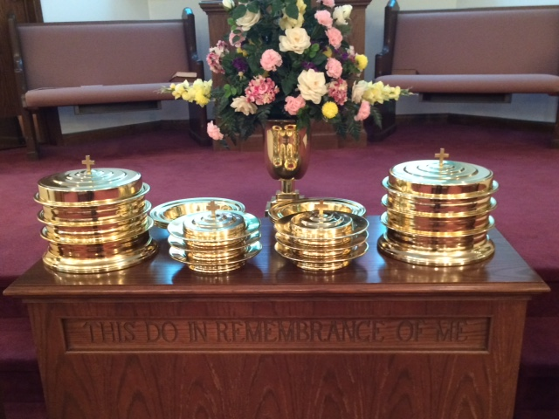
IN REMEMBRANCE OF JESUS

Slide 29
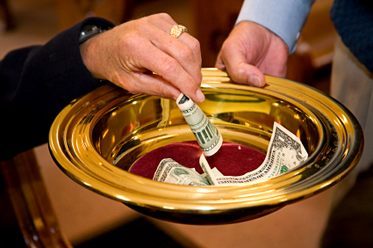
CONTRIBUTION

Slide 30
SINGING

Slide 31
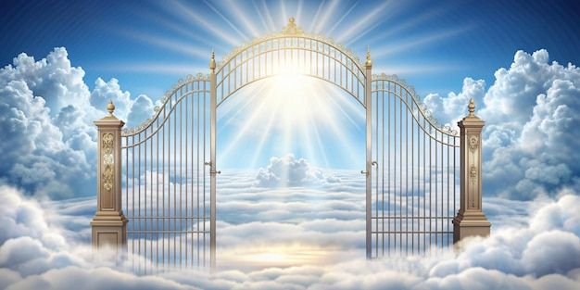
HAVE A HEAVENLY WEEK

