Slide 1

WELCOME TO THE
JACKSON STREET CHURCH OF CHRIST
PLEASE TURN OFF CELLPHONES

Slide 2


Slide 3


Slide 4

SINGING

Slide 5
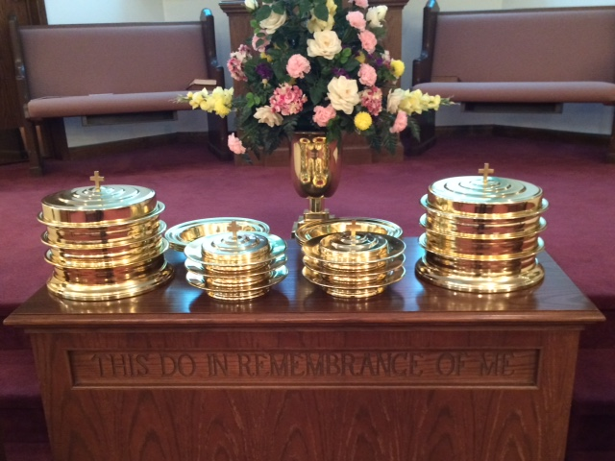
IN REMEMBRANCE OF JESUS

Slide 6
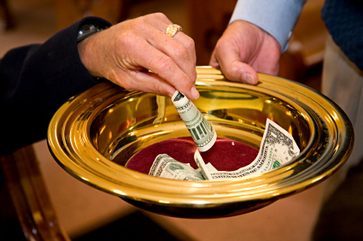
CONTRIBUTION

Slide 7
SINGING

Slide 8
1 Th 5:12-15 And we urge you, brethren, to recognize those who labor among you, and are over you in the Lord and admonish you, {13} and to esteem them very highly in love for their work's sake. Be at peace among yourselves. {14} Now we exhort you, brethren, warn those who are unruly, comfort the fainthearted, uphold the weak, be patient with all {15} See that no one renders evil for evil to anyone, but always pursue what is good both for yourselves and for all.

Slide 10

CHRISTIAN RESPONSIBILITY TOWARD OTHERS

Slide 11
OUR RELATIONSHIP WITH OTHERS
GOD HAS ALWAYS BEEN CONCERNED WITH OUR RELATIONSHIPS.
1 THESS 5:12-15 SHOWS IMPORTANT THINGS IN OUR RELATIONSHIPS WITH THOSE AROUND US IN JUST FOUR VERSES.

Slide 12
RECOGNIZE & ESTEEM, LEADERS, HIGHLY IN LOVE - 12-13a
THOSE WHO LABOR AMONG YOU
THOSE WHO ARE OVER YOU IN THE LORD
THOSE WHO ADMONISH YOU
REASON…FOR THEIR WORK'S SAKE

Slide 13
II. BE AT PEACE WITH ONE ANOTHER - 13b
Mat 5:9 Blessed are the peacemakers, For they shall be called sons of God,
Rom 12:18 If it is possible, as much as depends on you, live peaceably with all men.

Slide 14
III. WARN THE UNRULY – 14a
Brethren, if a man is overtaken in any trespass, you who are spiritual restore such a one in a spirit of gentleness considering yourself lest you also be tempted.
1 Cor 5:12-13 For what have I to do with judging those also who are outside? Do you not judge those who are inside? {13} But those who are outside God judges. Therefore, put away from yourselves the evil person
2 Th 3:14-15 And if anyone does not obey our word in this epistle, note that person and do not keep company with him, that he may be ashamed. {15} Yet do not count him as an enemy, but admonish him as a brother.

Slide 15
IV. COMFORT THE FAINT-HEARTED (EASILY DISCOURGED & ANXIOUS) – 14b
1 Th 2:11 as you know how we exhorted, and comforted, and charged every one of you, as a father does his own children,
1 Th 5:11 Therefore comfort each other and edify one another, just as you also are doing.

Slide 16
V. UPHOLD THE WEAK - 14c
Heb 12:12-13 Therefore strengthen the hands which hang down, and the feeble knees, {13} and make straight paths for your feet, so that what is lame may not be dislocated, but rather be healed.
Gal 6:2 Bear one another's burdens, and so fulfill the law of Christ.
Rom 15:1 We then who are strong ought to bear with the scruples of the weak, and not to please ourselves.

Slide 17
VI. BE PATIENT WILL ALL – 14d
Eph 4:1-2 I, therefore, the prisoner of the Lord, beseech you to walk worthy of the calling with which you were called, {2} with all lowliness and gentleness, with longsuffering, bearing with one another in love,
Col 3:12-13 Therefore, as the elect of God, holy and beloved, put on tender mercies, kindness, humility, meekness, longsuffering; {13} bearing with one another, and forgiving one another, if anyone has a complaint against another; even as Christ forgave you, so you also must do.

Slide 18
VII. DO NOT RENDER EVIL FOR EVIL – 15a
Mat 5:44 "But I say to you, love your enemies, bless those who curse you, do good to those who hate you, and pray for those who spitefully use you and persecute you,
1 Pet 3:9 not returning evil for evil or reviling for reviling, but on the contrary blessing, knowing that you were called to this, that you may inherit a blessing.

Slide 19
VII. DO NOT RENDER EVIL FOR EVIL – 15a
Rom 12:17-21 Repay no one evil for evil. Have regard for good things in the sight of all men. {18} If it is possible, as much as depends on you, live peaceably with all men. {19} Beloved, do not avenge yourselves, but rather give place to wrath; for it is written, "Vengeance is Mine, I will repay, says the Lords {20} Therefore If your enemy is hungry, feed him; If he is thirsty, give him a drink; For in so doing you will heap coals of fire on his head. {21} Do not be overcome by evil, but overcome evil with good.

Slide 20
VIII. PURSUE WHAT IS GOOD FOR YOURSELVES AND ALL – 15b
Gal 6:10 Therefore, as we have opportunity, let us do good to all, especially to those who are of the household of faith.
Phil 2:3-4 Let nothing be done through selfish ambition or conceit, but in lowliness of mind let each esteem others better than himself. {4} Let each of you look out not only for his own interests, but also for the interests of others.

Slide 21
HOW ARE YOU DOING WITH YOUR RELATIONSHIPS WITH OTHERS?
RECOGNIZE & ESTEEM HIGHLY IN LOVE YOUR LEADERS - 12-13a
BE AT PEACE WITH ONE ANOTHER - 13b
WARN THE UNRULY – 14a
COMFORT THE FAINT-HEARTED (EASILY DISCOURGED & ANXIOUS) – 14b
UPHOLD THE WEAK - 14c
BE PATIENT WILL ALL – 14d
DO NOT RENDER EVIL FOR EVIL – 15a
PURSUE WHAT IS GOOD FOR YOURSELVES AND ALL – 15b

Slide 22
HOW ARE YOU DOING WITH YOUR RELATIONSHIPS WITH OTHERS?
IT IS ALL SUMMED UP IN ONE WORD – LOVE - Rom 13:8-10 Owe no one anything except to love one another, for he who loves another has fulfilled the law. {9} For the commandments , "You shall not commit adultery, “You shall not murder,” "You shall not steal,” "You shall not bear false witness," "You shall not covet," and if there is any other commandment, are all summed up in this saying, namely, "You shall love your neighbor as yourself,” {10} Love does no harm to a neighbor; therefore love is the fulfillment of the law.

Slide 23
SINGING

Slide 24
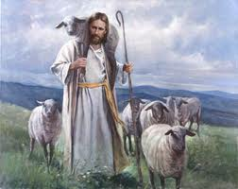
TONIGHT’S SERMON: THE CHURCH - SHEEP AND SHEPHERD

