Slide 1
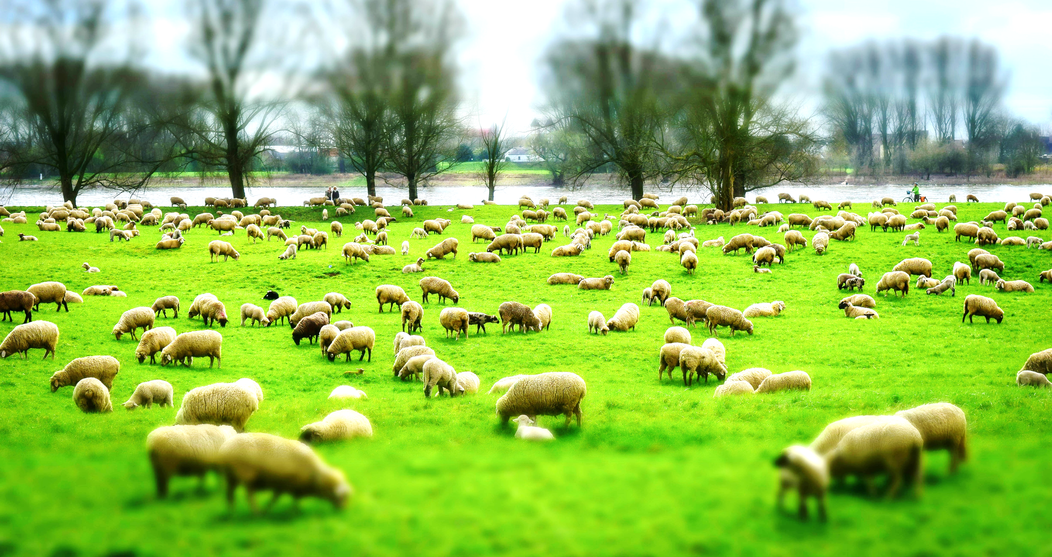
WELCOME TO THE
JACKSON STREET CHURCH OF CHRIST
PLEASE TURN OFF CELLPHONES

Slide 2


Slide 3
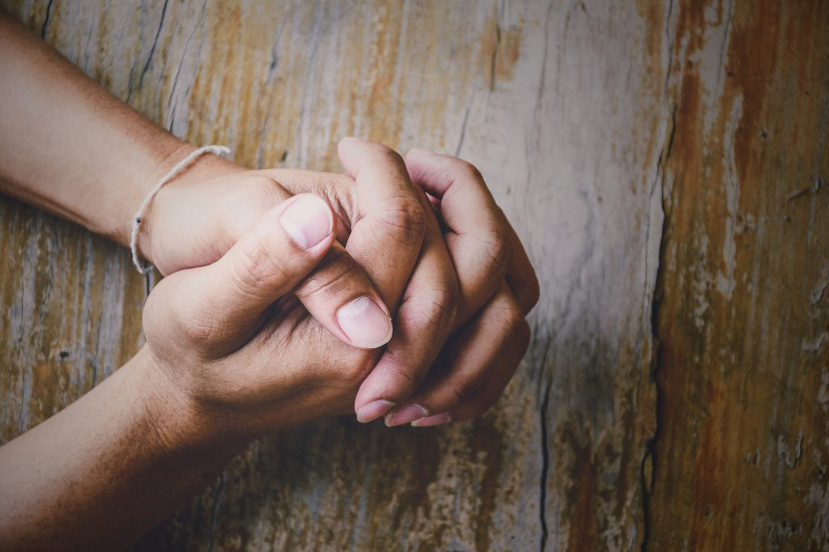
LET US PRAY

Slide 4
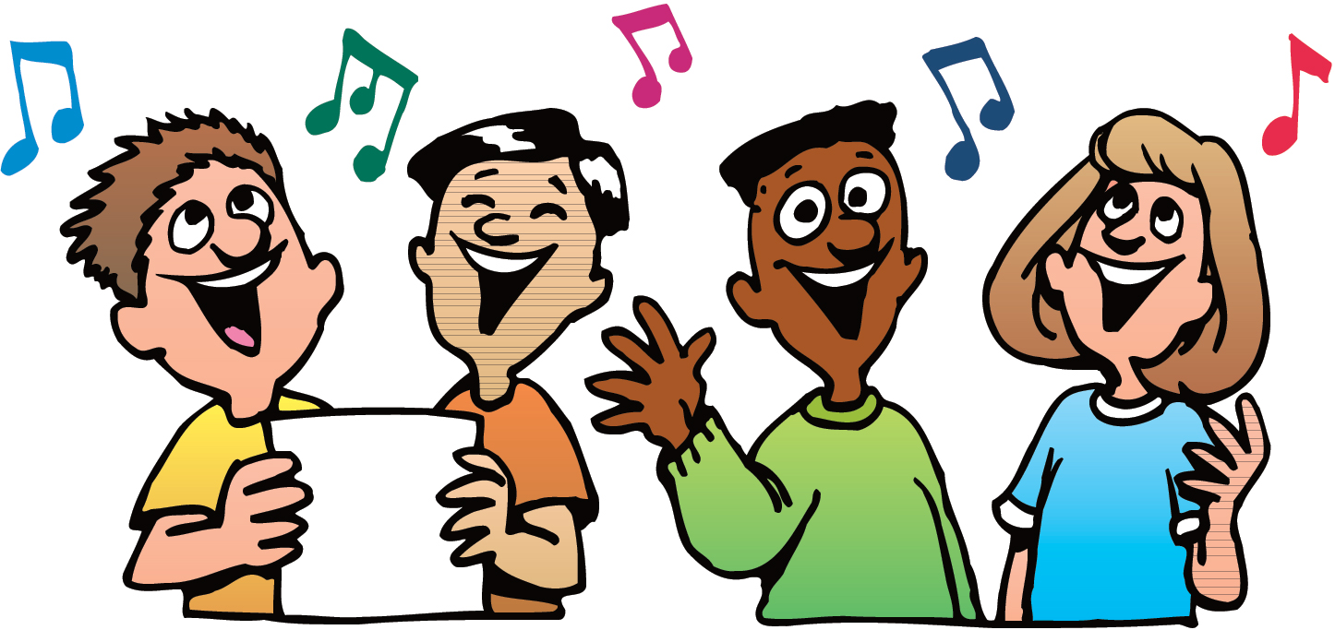
SINGING

Slide 5
John 10:7-18 Then Jesus said to them again, "Most assuredly, I say to you, I am the door of the sheep. {8} "All who ever came before Me are thieves and robbers, but the sheep did not hear them. {9} I am the door. If anyone enters by Me, he will be saved, and will go in and out and find pasture. {10} "The thief does not come except to steal, and to kill and to destroy. I have come that they may have life, and that they may have it more abundantly. {11} “I am the good shepherd. The good shepherd gives His life for the sheep. {12} "But a hireling, he who is not the shepherd, one who does not own the sheep, sees the wolf coming and leaves the sheep and flees; and the wolf catches the sheep and scatters them. {13} "The hireling flees because he is a hireling and does not care about the sheep. 14 I am the good shepherd; and I know My sheep, and am known by My own. 15} "As the Father knows Me, even so I know the Father; and I lay down My life for the sheep.

Slide 6
LET US PRAY

Slide 7
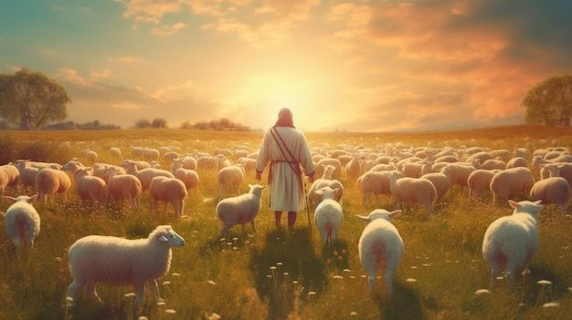
THE CHURCH: THE SHEEP AND THE SHEPHERD

Slide 8
THE CHURCH AS SHEEP
God uses the parallel of His people and sheep throughout the scriptures.
We will see that parallel in many places in the Old Testament as well as the New Testament.
God is our shepherd. Psalm 23
Jesus is the Good Shepherd. John 10
The elders are called shepherds. 1 Peter 5:1–4 The elders who are among you I exhort, I who am a fellow elder and a witness of the sufferings of Christ, and also a partaker of the glory that will be revealed: ² Shepherd the flock of God which is among you, serving as overseers, not by compulsion but willingly, not for dishonest gain but eagerly; ³ nor as being lords over those entrusted to you, but being examples to the flock; ⁴ and when the Chief Shepherd appears, you will receive the crown of glory that does not fade away.

Slide 9
I. WE NEED TO RECOGNIZE OUR NEED FOR A SHEPHERD AND DILIGENTLY FOLLOW HIM.
Isaiah 40:11 He will feed His flock like a shepherd; He will gather the lambs with His arm, And carry them in His bosom, And gently lead those who are with young.
Psalm 23 The LORD is my shepherd; I shall not want. {2} He makes me to lie down in green pastures; He leads me beside the still waters. {3 He restores my soul; He leads me in the paths of righteousness For His name's sake. {4} Yea, though I walk through the valley of the shadow of death, I will fear no evil; For You are with me; Your rod and Your, staff, they comfort me. {5} You prepare a table before me in the presence of my enemies; You anoint my head with oil; My cup runs over, {6} Surely goodness and mercy shall follow me all the days of my life; And I will dwell in the house of the LORD forever.

Slide 10
II. WE NEED TO BE AWARE OF OUR TENDENCY TO STRAY
Isaiah 53:6 All we like sheep have gone astray; We have turned, every one, to his own way; And the LORD has laid on Him the iniquity of us all
Matthew 18:12–14 “What do you think? If a man has a hundred sheep, and one of them goes astray, does he not leave the ninety-nine and go to the mountains to seek the one that is straying? 13 And if he should find it, assuredly, I say to you, he rejoices more over that sheep than over the ninety-nine that did not go astray. 14 Even so it is not the will of your Father who is in heaven that one of these little ones should perish.
1 Peter 2:25 For you were like sheep going astray, but have now returned to the Shepherd and Overseer of your souls.

Slide 11
III. WE NEED TO KNOW WHO OUR ENEMIES ARE
Matthew 7:15 Beware of false prophets, who come to you in sheep's clothing, but inwardly they are ravenous wolves.
John 10:10-13 "The thief does not come except to steal, and to kill, and to destroy. I have come that they may have life, and that they may have it more abundantly. {11} "I am the good shepherd. The good shepherd gives His life for the sheep. {12 "But a hireling, he who is not the shepherd, one who does not own the sheep, sees the wolf coming and leaves the sheep and flees; and the wolf catches the sheep and scatters them. {13} "The hireling flees because he is a hireling and does not care about the sheep.

Slide 12
WE NEED TO REALIZE THE SHEPHERD'S LOVE FOR THE SHEEP
Ezekiel 34:11-12 ' For thus says the Lord GOD: Indeed, I Myself will search for My sheep and seek them out. {12} "As a shepherd seeks out his flock on the day he is among his scattered sheep, so will seek out My sheep and deliver them from all the places where they were scattered on a cloudy and dark day.
Matthew 18:11-14 "For the Son of Man has come to save that which was lost.” {12} “What do you think? If a man has a hundred sheep, and one of them goes astray, does he not leave the ninety-nine and go to the mountains to seek the one that is straying? {13} "And if he should find it, assuredly, I say to you, he rejoices more over that sheep than over the ninety-nine that did not go astray. {14} "Even so it is not the will of your Father who is in heaven that one of these little ones should perish.

Slide 13
WE NEED TO RECOGNIZE THE DIFFERENCE IN SHEEP AND GOATS
Matthew 25:32-33 "All the nations will be gathered before Him, and He will separate them one from another, as a shepherd divides his sheep from the goats. {33} "And He will set the sheep on His right hand, but the goats on the left.
1 Corinthians 15:33 “Do not be deceived: Evil company corrupts good habits.”

Slide 14
WE NEED TO ACCEPT RESPONSIBILITY TO CARE FOR OUR FELLOW SHEEP AND KEEP THEM FROM HARM AND STRAYING
Ezekiel 34:1-10 And the word of the LORD came to me, saying, {2} "Son of man, prophesy against the shepherds of Israel, prophesy and say to them, 'Thus says the Lord GOD to the shepherds: "Woe to the shepherds of Israel who feed themselves! Should not the shepherds feed the flocks? {3} "You eat the fat and clothe yourselves with the wool; you slaughter the fatlings, but you do not feed the flock. {4} "The weak you have not strengthened, nor have you healed those who were sick, nor bound up the broken, nor brought back what was driven away, nor sought what was lost; but with force and cruelty you have ruled them. >>>

Slide 15
WE NEED TO ACCEPT RESPONSIBILITY TO CARE FOR OUR FELLOW SHEEP AND KEEP THEM FROM HARM AND STRAYING
{5} "So they were scattered because there was no shepherd; and they became food for all the beasts of the field when they were scattered. {6} "My sheep wandered through all the mountains, and on every high hill; yes, My flock was scattered over the whole face of the earth, and no one was seeking or searching for them." {7} 'Therefore, you shepherds, hear the word of the LORD: {8} as I live says the Lord GOD, "surely because My flock became a prey, and My flock became food for every beast of the field, because there was no shepherd, nor did My shepherds search for My flock, but the shepherds fed themselves and did not feed My flock", {9} 'therefore, O shepherds, hear the word of I, the LORD! >>>

Slide 16
WE NEED TO ACCEPT RESPONSIBILITY TO CARE FOR OUR FELLOW SHEEP AND KEEP THEM FROM HARM AND STRAYING
{10} 'Thus says the Lord GOD: "Behold, I am against the shepherds, and I will require My flock at their hand; I will cause them to cease feeding the sheep, and the shepherds shall feed themselves no more; for I will deliver My flock from their mouths, that they may no longer be food for them.
James 5:19-20 Brethren, if anyone among you wanders from the truth, and someone turns him back, {20} let him know that he who turns a sinner from the error of his way will save a soul from death and cover a multitude of sins.
Galatians 6:1 Brethren, if a man is overtaken in any trespass, you who are spiritual restore such a one in a spirit of gentleness, considering yourself lest you also be tempted.

Slide 17
JESUS’ SHEEP = CHURCH
John 10: 27-29 'My sheep hear My voice, and I know them, and they follow Me. {28} "And I give them eternal life, and they shall never perish; neither shall anyone snatch them out of My hand. {29} "My Father, who has given them to Me, is greater than all; and no one is able to snatch them out of My Father's hand.
If we are His sheep we will listen to and obey Jesus.
He knows whether we are really following Him. We can’t fake it.
If we follow Him in obedience we will never perish. No one can get us out of His hand.

Slide 18
SINGING

Slide 19
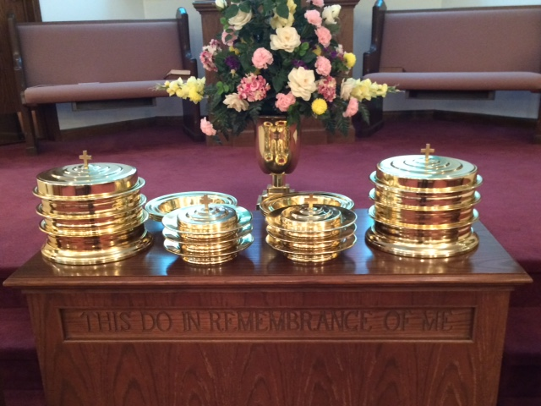
IN REMEMBRANCE OF JESUS

Slide 20
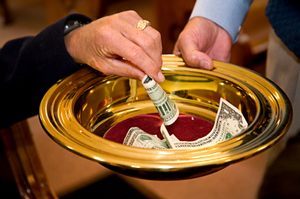
CONTRIBUTION

Slide 21
SINGING

Slide 22
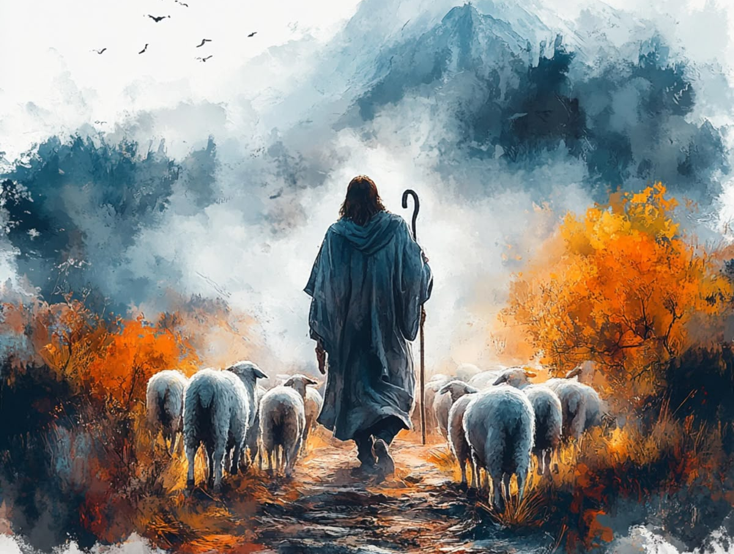
HAVE A CHRIST FOLLOWING WEEK

