Slide 1

WELCOME TO THE
JACKSON STREET CHURCH OF CHRIST
PLEASE TURN OFF CELLPHONES

Slide 2


Slide 3


Slide 4

SINGING

Slide 5
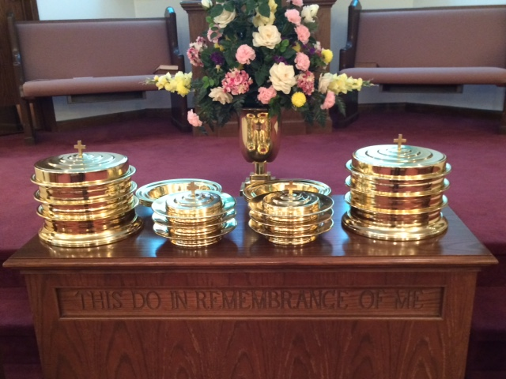
IN REMEMBRANCE OF JESUS

Slide 6
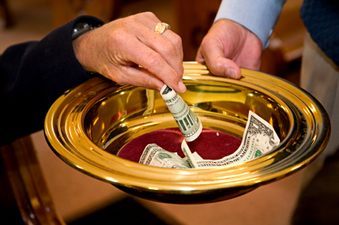
CONTRIBUTION

Slide 7
SINGING

Slide 8
1 Th 5:16-22 Rejoice always, {17} pray without ceasing, {18} in everything give thanks; for this is the will of God in Christ Jesus for you, {19} Do not quench the Spirit. {20} Do not despise prophecies. {21} Test all things; hold fast what is good. {22} Abstain from every form of evil.

Slide 10
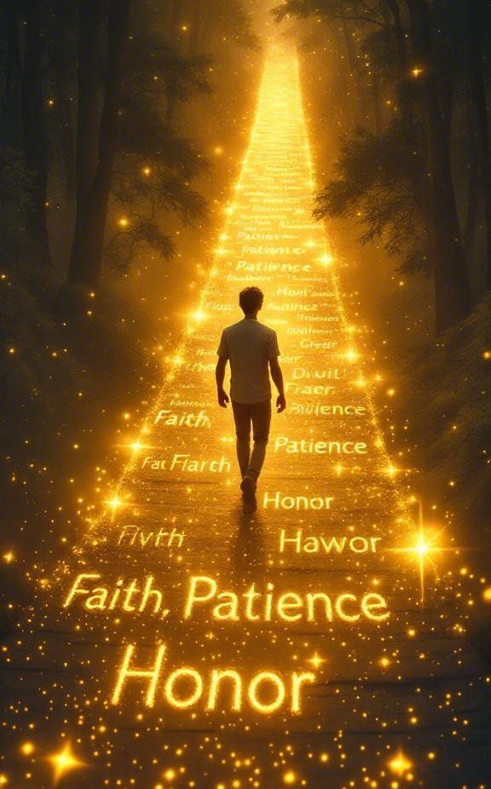
CHRISTIAN RESPONSIBILITY TOWARD GOD

Slide 11
OUR RESPONSIBILITY TOWARD GOD
Last week responsibility toward others recognize & esteem leaders; be at peace with one another; warn the unruly; comfort the fainthearted; uphold the weak; be patient with all; do not return evil for evil; pursue what is good for yourselves and all.
Today we will be looking at our responsibility toward God.

Slide 12
REJOICE ALWAYS - 16
1 Pet 1:8 whom having not seen you love. Though now you do not see Him, yet believing, you rejoice with joy inexpressible and full of glory.
Phil 3:1 Finally, my brethren, rejoice in the Lord. For me to write the same things to you is not tedious, but for you it is safe.
Phil 4:4 Rejoice in the Lord always. Again I will say, rejoice!
AN UNHAPPY, LONG-FACED CHRISTIAN? NO SUCH THING! REJOICE

Slide 13
II. PRAY WITHOUT CEASING - 17
Mat 26:41 "Watch and pray, lest you enter into temptation. The spirit indeed is willing, but the flesh is weak.
Luke 18:1 Then He spoke a parable to them, that men always ought to pray and not lose heart, (The unjust judge)
Hebrews 13:15 Therefore by Him let us continually offer the sacrifice of praise to God, that is, the fruit of our lips, giving thanks to His name.
FOR YOUR NEEDS & OTHERS; SICK; LORD'S WORK; ENEMIES; LEADERS; THERE'S ALWAYS SOMEONE OR SOMETHING TO PRAY FOR.

Slide 14
III. IN EVERYTHING GIVE THANKS - 18
Eph 5:20 giving thanks always for all things to God the Father in the name of our Lord Jesus Christ,
Col 4:2 Continue earnestly in prayer, being vigilant in it with thanksgiving;
Colossians 3:15–17 And let the peace of God rule in your hearts, to which also you were called in one body; and be thankful. ¹⁶ Let the word of Christ dwell in you richly in all wisdom, teaching and admonishing one another in psalms and hymns and spiritual songs, singing with grace in your hearts to the Lord. ¹⁷ And whatever you do in word or deed, do all in the name of the Lord Jesus, giving thanks to God the Father through Him.
NO MATTER HOW BAD THINGS MAY GET THERE IS ALWAYS SOMETHING FOR WHICH TO BE THANKFUL

Slide 15
IV. DO NOT QUENCH THE SPIRIT - 19
Ephesians 4:25–32 Therefore, putting away lying, “Let each one of you speak truth with his neighbor,” for we are members of one another. ²⁶ “Be angry, and do not sin”: do not let the sun go down on your wrath, ²⁷ nor give place to the devil. ²⁸ Let him who stole steal no longer, but rather let him labor, working with his hands what is good, that he may have something to give him who has need. ²⁹ Let no corrupt word proceed out of your mouth, but what is good for necessary edification, that it may impart grace to the hearers. ³⁰ And do not grieve the Holy Spirit of God, by whom you were sealed for the day of redemption. ³¹ Let all bitterness, wrath, anger, clamor, and evil speaking be put away from you, with all malice. ³² And be kind to one another, tenderhearted, forgiving one another, even as God in Christ forgave you.
2 Tim 1:7 For God has not given us a spirit of fear, but of power and of love and of a sound mind.

Slide 16
V. THE SPIRIT WANTS TO CONTROL OUR LIVES FOR OUR OWN GOOD - 20
Psa 119:140 Your word is very pure; Therefore Your servant loves it.
Psa 119:97 Oh, how I love Your law! It is my meditation all the day.
Psa 119:65 Great peace have those who love Your law, And nothing causes them to stumble.
James 1:22 But be doers of the word, and not hearers only, deceiving yourselves.

Slide 17
VI. DO NOT DESPISE PROPHECIES – 20
Matthew 23:29–34 “Woe to you, scribes and Pharisees, hypocrites! Because you build the tombs of the prophets and adorn the monuments of the righteous, ³⁰ and say, ‘If we had lived in the days of our fathers, we would not have been partakers with them in the blood of the prophets.’ ³¹ “Therefore you are witnesses against yourselves that you are sons of those who murdered the prophets. ³² Fill up, then, the measure of your fathers’ guilt. ³³ Serpents, brood of vipers! How can you escape the condemnation of hell? ³⁴ Therefore, indeed, I send you prophets, wise men, and scribes: some of them you will kill and crucify, and some of them you will scourge in your synagogues and persecute from city to city,

Slide 18
VI. DO NOT DESPISE PROPHECIES – 20
Acts 2:36–39 “Therefore let all the house of Israel know assuredly that God has made this Jesus, whom you crucified, both Lord and Christ.” ³⁷ Now when they heard this, they were cut to the heart, and said to Peter and the rest of the apostles, “Men and brethren, what shall we do?” ³⁸ Then Peter said to them, “Repent, and let every one of you be baptized in the name of Jesus Christ for the remission of sins; and you shall receive the gift of the Holy Spirit. ³⁹ For the promise is to you and to your children, and to all who are afar off, as many as the Lord our God will call.”

Slide 19
VI. DO NOT DESPISE PROPHECIES – 20
Acts 7:51–59 “You stiff-necked and uncircumcised in heart and ears! You always resist the Holy Spirit; as your fathers did, so do you. ⁵² Which of the prophets did your fathers not persecute? And they killed those who foretold the coming of the Just One, of whom you now have become the betrayers and murderers, ⁵³ who have received the law by the direction of angels and have not kept it.” ⁵⁴ When they heard these things they were cut to the heart, and they gnashed at him with their teeth. ⁵⁵ But he, being full of the Holy Spirit, gazed into heaven and saw the glory of God, and Jesus standing at the right hand of God, ⁵⁶ and said, “Look! I see the heavens opened and the Son of Man standing at the right hand of God!” ⁵⁷ Then they cried out with a loud voice, stopped their ears, and ran at him with one accord; ⁵⁸ and they cast him out of the city and stoned him. And the witnesses laid down their clothes at the feet of a young man named Saul. ⁵⁹ And they stoned Stephen as he was calling on God and saying, “Lord Jesus, receive my spirit.”

Slide 20
VII. TEST ALL THINGS; HOLD FAST WHAT IS GOOD. ABSTAIN FROM EVERY FORM OF EVIL. – 21-22
Heb 5:14 But solid food belongs to those who are of full age, that is, those who by reason of use have their senses exercised to discern both good and evil
1 Corinthians 2:13–15 These things we also speak, not in words which man’s wisdom teaches but which the Holy Spirit teaches, comparing spiritual things with spiritual. ¹⁴ But the natural man does not receive the things of the Spirit of God, for they are foolishness to him; nor can he know them, because they are spiritually discerned. ¹⁵ But he who is spiritual judges all things, yet he himself is rightly judged by no one.

Slide 21
VII. TEST ALL THINGS; HOLD FAST WHAT IS GOOD. ABSTAIN FROM EVERY FORM OF EVIL. – 21-22
Rom 12:2 And do not be conformed to this world, but be transformed by the renewing of your mind that you may prove what is that good and acceptable and perfect will of God.
Philippians 1:9–11 And this I pray, that your love may abound still more and more in knowledge and all discernment, ¹⁰ that you may approve the things that are excellent, that you may be sincere and without offense till the day of Christ, ¹¹ being filled with the fruits of righteousness which are by Jesus Christ, to the glory and praise of God.

Slide 22
RESPONSIBILITY TOWARD GOD
Mat 22:37-40 Jesus said to him, “You shall love the LORD your God with all your heart, with all your soul , and with all your mind.' {38} "This is the first and great commandment, {39} 'And the second is like it: 'You shall love your neighbor as yourself.' {40} "on these two commandments hang all the Law and the Prophets.
JUST AS WE SAW LAST WEEK WITH OUR RESPONSIBILITY TO OTHERS, LOVE IS THE ANSWER.
IF WE LOVE OUR NEIGHBER, WE WON’T DO ANYTHING TO HURT THEM BUT RATHER, HELP THEM.
IF WE LOVE GOD, WE WILL KEEP HIS ALL OF HIS OTHER COMMANDMENTS.

Slide 23
SINGING

Slide 24
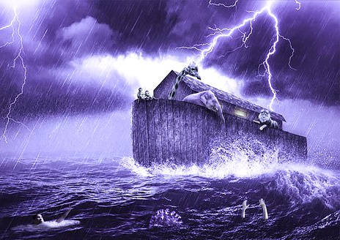
TONIGHT’S SERMON: THE CHURCH - AS A BOAT

