Slide 1
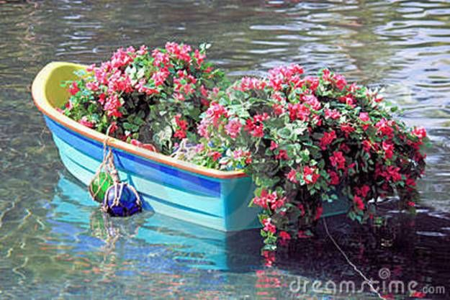
WELCOME TO THE
JACKSON STREET CHURCH OF CHRIST
PLEASE TURN OFF CELLPHONES

Slide 2


Slide 3
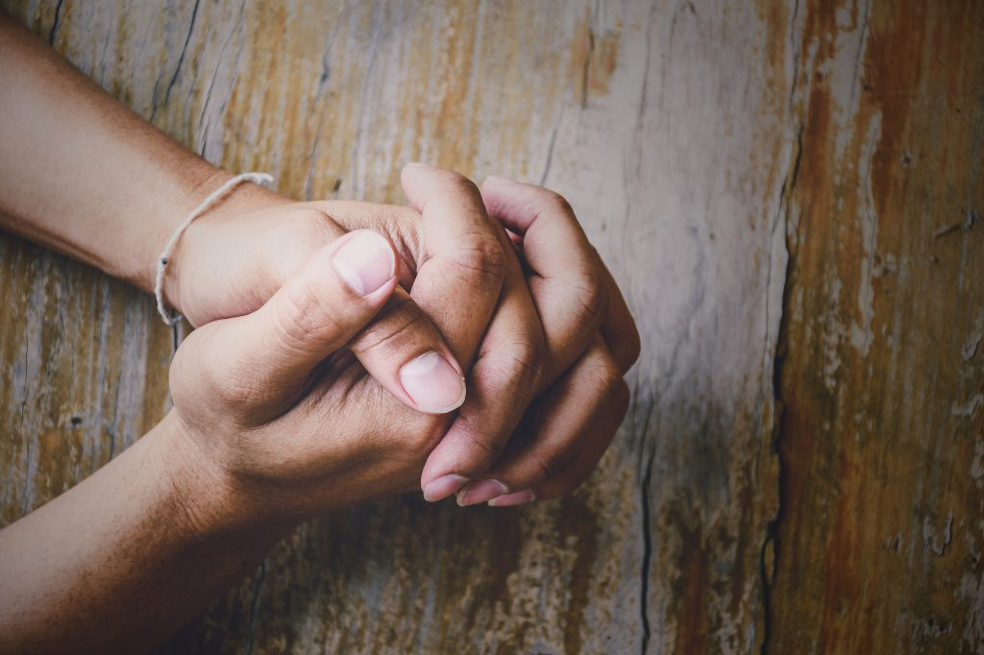
LET US PRAY

Slide 4

SINGING

Slide 5
Mark 4:35–41 On the same day, when evening had come, He said to them, “Let us cross over to the other side.” ³⁶ Now when they had left the multitude, they took Him along in the boat as He was. And other little boats were also with Him. ³⁷ And a great windstorm arose, and the waves beat into the boat, so that it was already filling. ³⁸ But He was in the stern, asleep on a pillow. And they awoke Him and said to Him, “Teacher, do You not care that we are perishing?” ³⁹ Then He arose and rebuked the wind, and said to the sea, “Peace, be still!” And the wind ceased and there was a great calm. ⁴⁰ But He said to them, “Why are you so fearful? How is it that you have no faith?” ⁴¹ And they feared exceedingly, and said to one another, “Who can this be, that even the wind and the sea obey Him!”

Slide 6
LET US PRAY

Slide 7
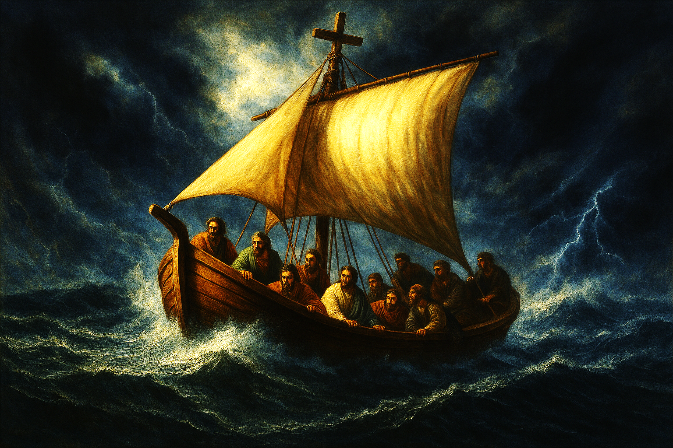
THE CHURCH AS A BOAT

Slide 8
THE CHURCH AS A BOAT
The earliest believers in the first and second centuries marked their meeting places with rough drawings of a boat and sail, a sign that the church gathered in that place. Among the earliest Christian artworks are representations of the church as a boat.
In a letter attributed to Clement, the apostle Peter delivers a sermon on the church and describes it in these terms: For the whole business of the Church is like unto a great ship, bearing through a violent storm, men who are of many places, and who desire to inhabit the city of the good kingdom. Let, therefore, God be your shipmaster; and let the pilot be likened to Christ . . . . Let those sailing expect every tribulation, as traveling over a great and troubled sea, the world.

Slide 9
THE CHURCH AS A BOAT
The central part of Medieval churches where the congregation sat to worship, came to be called the “nave”. The word comes from the Latin “navis,” meaning "ship," showing the popularity and power of the boat symbol a thousand years after Christ.
A boat is a wonderful picture of the church sailing through dangerous times.
The boat is important to Mark's story from 4:1 - 8:21.
We will be looking at the boat in Mark 4:35-41 and compare it to the church.

Slide 10
THE CHURCH AND THE BOAT GET US TO THE OTHER SIDE
Mark 4:35 On the same day, when evening had come, He said to them, “Let us cross over to the other side.”
The boat took them to the other side of the lake.
The church takes us to the other side of this life to eternal life.
Crossing the Bar - By Alfred, Lord Tennyson
Sunset and evening star,
And one clear call for me!
And may there be no moaning of the bar,
When I put out to sea,
But such a tide as moving seems asleep,
Too full for sound and foam,
When that which drew out of the boundless deep Turns again home. >>>

Slide 11
THE CHURCH AND THE BOAT GET US TO THE OTHER SIDE
Twilight and evening bell,
And after that the dark!
And may there be no sadness of farewell, When I embark;
For tho' from out our bourne of Time and Place The flood may bear me far,
I hope to see my Pilot face to face
When I have crost the bar.
Ephesians 5:23 For the husband is head of the wife, as also Christ is head of the church; and He is the Savior of the body.

Slide 12
II. BE SURE YOU ARE IN THE SAME BOAT AND CHURCH AS JESUS
Mark 4:36 Now when they had left the multitude, they took Him along in the boat as He was. And other little boats were also with Him.
The significance of the other little boats with Him is not explained so it is up to interpretation.
Matthew 7:21–23 “Not everyone who says to Me, ‘Lord, Lord,’ shall enter the kingdom of heaven, but he who does the will of My Father in heaven. ²² Many will say to Me in that day, ‘Lord, Lord, have we not prophesied in Your name, cast out demons in Your name, and done many wonders in Your name?’ ²³ And then I will declare to them, ‘I never knew you; depart from Me, you who practice lawlessness!’
Matthew 12:30 He who is not with Me is against Me, and he who does not gather with Me scatters abroad.

Slide 13
III. THOSE IN THE CHURCH FACE STORMS JUST AS BOATS DO
Mark 4:37 And a great windstorm arose, and the waves beat into the boat, so that it was already filling.
If you stay in the boat long enough you will face storms.
Being in the church does not keep us from facing storms.
2 Timothy 3:10–12 But you have carefully followed my doctrine, manner of life, purpose, faith, longsuffering, love, perseverance, ¹¹ persecutions, afflictions, which happened to me at Antioch, at Iconium, at Lystra—what persecutions I endured. And out of them all the Lord delivered me. ¹² Yes, and all who desire to live godly in Christ Jesus will suffer persecution.

Slide 14
IV. JESUS IS WITH US EVEN WHEN WE DON’T REALIZE IT
Mark 4:38 But He was in the stern, asleep on a pillow. And they awoke Him and said to Him, “Teacher, do You not care that we are perishing?”
Jesus may not seem to be there for us at times, but He is there.
Matthew 18:20 For where two or three are gathered together in My name, I am there in the midst of them.”
Acts 18:9–10 Now the Lord spoke to Paul in the night by a vision, “Do not be afraid, but speak, and do not keep silent; ¹⁰ for I am with you, and no one will attack you to hurt you; for I have many people in this city.”

Slide 15
V. WE NEED TO REALIZE HOW POWERFUL OUR LORD IS
Mark 4:39 Then He arose and rebuked the wind, and said to the sea, “Peace, be still!” And the wind ceased and there was a great calm.
Since Jesus is with us we have nothing to fear.
Romans 8:31–32 What then shall we say to these things? If God is for us, who can be against us? ³² He who did not spare His own Son, but delivered Him up for us all, how shall He not with Him also freely give us all things?

Slide 16
VI. SINCE WE SERVE SUCH A POWERFUL LORD, WE SHOULD NOT FEAR
Mark 4:40 But He said to them, “Why are you so fearful? How is it that you have no faith?”
Even in the church, if we are not careful we can become fearful of the world around us.
2 Timothy 1:7 For God has not given us a spirit of fear, but of power and of love and of a sound mind.
Matthew 14:25–33 Now in the fourth watch of the night Jesus went to them, walking on the sea. ²⁶ And when the disciples saw Him walking on the sea, they were troubled, saying, “It is a ghost!” And they cried out for fear. ²⁷ But immediately Jesus spoke to them, saying, “Be of good cheer! It is I; do not be afraid.”>>>

Slide 17
VI. SINCE WE SERVE SUCH A POWERFUL LORD, WE SHOULD NOT FEAR
²⁸ And Peter answered Him and said, “Lord, if it is You, command me to come to You on the water.” ²⁹ So He said, “Come.” And when Peter had come down out of the boat, he walked on the water to go to Jesus. ³⁰ But when he saw that the wind was boisterous, he was afraid; and beginning to sink he cried out, saying, “Lord, save me!” ³¹ And immediately Jesus stretched out His hand and caught him, and said to him, “O you of little faith, why did you doubt?” ³² And when they got into the boat, the wind ceased. ³³ Then those who were in the boat came and worshiped Him, saying, “Truly You are the Son of God.”

Slide 18
VII. WE SHOULD HAVE GREAT FEAR FOR OUR LORD AND SAVIOR
Mark 4:41 And they feared exceedingly, and said to one another, “Who can this be, that even the wind and the sea obey Him!”
This is a different kind of fear, it is awe and respect for his power.
Hebrews 11:7 By faith Noah, being divinely warned of things not yet seen, moved with godly fear, prepared an ark for the saving of his household, by which he condemned the world and became heir of the righteousness which is according to faith.

Slide 19
VII. WE SHOULD GREAT FEAR FOR OUR LORD AND SAVIOR
Romans 8:14–17 For as many as are led by the Spirit of God, these are sons of God. ¹⁵ For you did not receive the spirit of bondage again to fear, but you received the Spirit of adoption by whom we cry out, “Abba, Father.” ¹⁶ The Spirit Himself bears witness with our spirit that we are children of God, ¹⁷ and if children, then heirs—heirs of God and joint heirs with Christ, if indeed we suffer with Him, that we may also be glorified together.

Slide 20
THE CHURCH AS A BOAT
A BOAT SAVED NOAH AND HIS FAMILY FROM THE FLOOD - 1 Peter 3:18–21 For Christ also suffered once for sins, the just for the unjust, that He might bring us to God, being put to death in the flesh but made alive by the Spirit, ¹⁹ by whom also He went and preached to the spirits in prison, ²⁰ who formerly were disobedient, when once the Divine longsuffering waited in the days of Noah, while the ark was being prepared, in which a few, that is, eight souls, were saved through water. ²¹ There is also an antitype which now saves us—baptism (not the removal of the filth of the flesh, but the answer of a good conscience toward God), through the resurrection of Jesus Christ,

Slide 21
THE CHURCH AS A BOAT
BAPTISM SAVES US BECAUSE IT PUTS US INTO THE CHURCH WHERE SALVATION IS FOUND.
THE ONLY WAY THE BIBLE EVER SAYS WE GET INTO CHRIST, HIS BODY, THE CHURCH, IS THROUGH BAPTISM.
Galatians 3:26–27 For you are all sons of God through faith in Christ Jesus. ²⁷ For as many of you as were baptized into Christ have put on Christ.

Slide 22
THE CHURCH AS A BOAT
Romans 6:3–8 Or do you not know that as many of us as were baptized into Christ Jesus were baptized into His death? ⁴ Therefore we were buried with Him through baptism into death, that just as Christ was raised from the dead by the glory of the Father, even so we also should walk in newness of life. ⁵ For if we have been united together in the likeness of His death, certainly we also shall be in the likeness of His resurrection, ⁶ knowing this, that our old man was crucified with Him, that the body of sin might be done away with, that we should no longer be slaves of sin. ⁷ For he who has died has been freed from sin. ⁸ Now if we died with Christ, we believe that we shall also live with Him,

Slide 23
SINGING

Slide 24
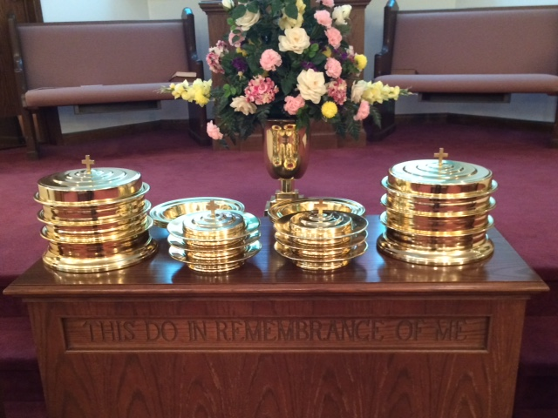
IN REMEMBRANCE OF JESUS

Slide 25
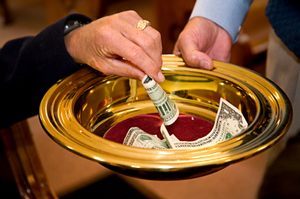
CONTRIBUTION

Slide 26
SINGING

Slide 27
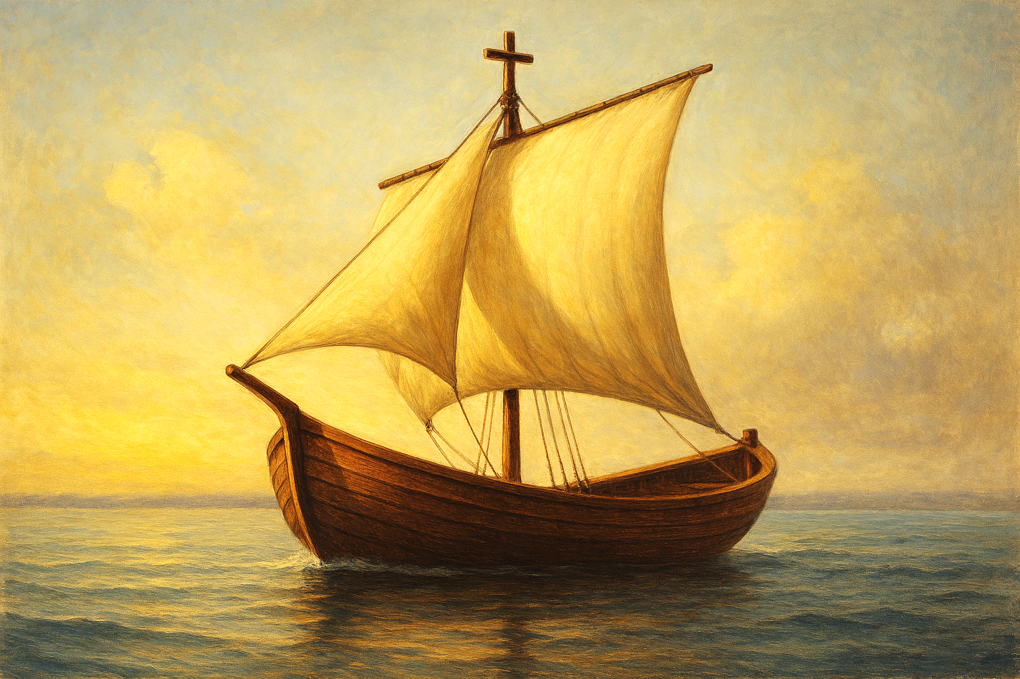
HAVE A LIFE IN THE BOAT WITH JESUS

