Slide 1

WELCOME TO THE
JACKSON STREET CHURCH OF CHRIST
PLEASE TURN OFF CELLPHONES

Slide 2


Slide 3


Slide 4

SINGING

Slide 5
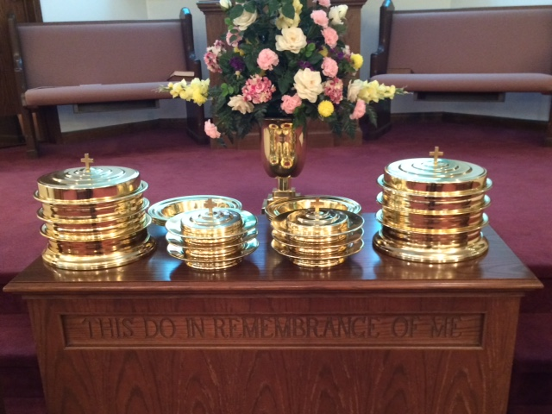
IN REMEMBRANCE OF JESUS

Slide 6
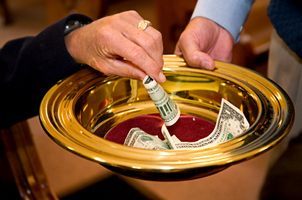
CONTRIBUTION

Slide 7
SINGING

Slide 8
Psa 91:1-7 He who dwells in the secret place of the Most High Shall abide under the shadow of the Almighty. ² I will say of the LORD, "He is my refuge and my fortress; My God, in Him I will trust." ³ Surely He shall deliver you from the snare of the fowler And from the perilous pestilence. ⁴ He shall cover you with His feathers, And under His wings you shall take refuge; His truth shall be your shield and buckler. ⁵ You shall not be afraid of the terror by night, Nor of the arrow that flies by day, ⁶ Nor of the pestilence that walks in darkness, Nor of the destruction that lays waste at noonday. ⁷ A thousand may fall at your side, And ten thousand at your right hand; But it shall not come near you.

Slide 10
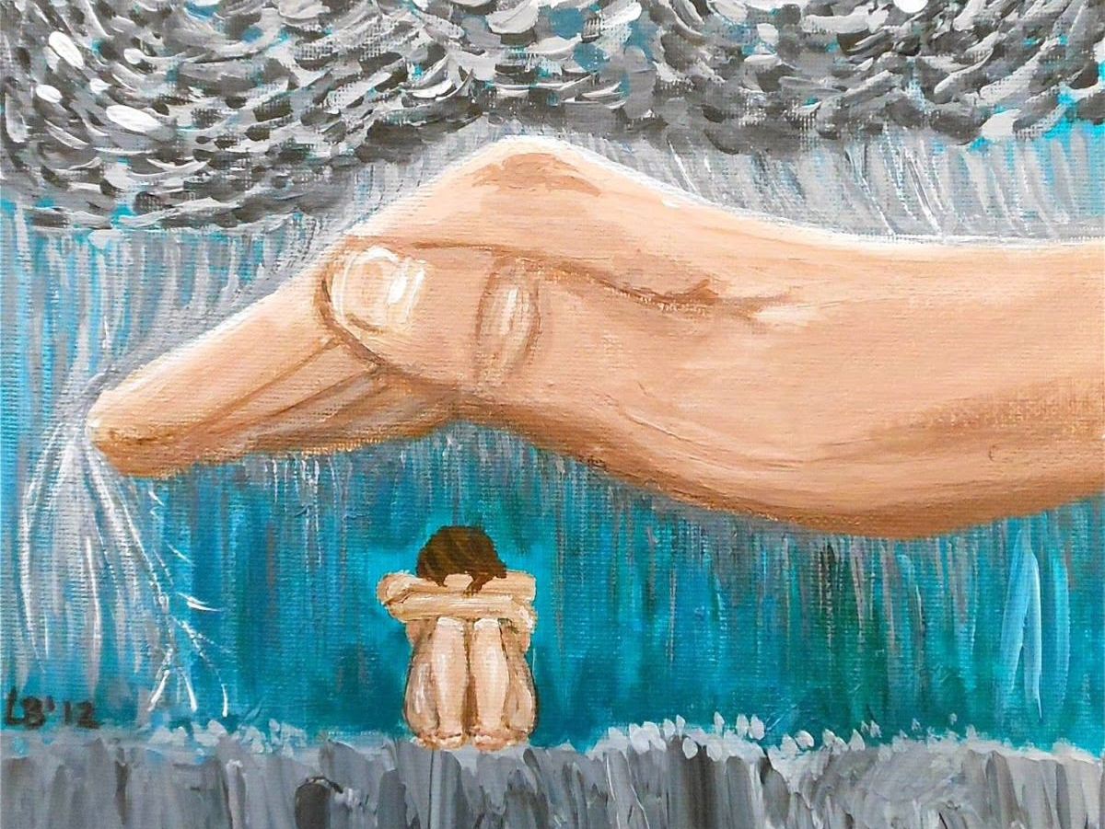
GOD’S PROTECTION

Slide 11
OUR GOD
IN THESE FIRST SEVEN VERSES OF PSALM 91 WE LEARN THREE THINGS ABOUT OUR GOD.
GOD IS OUR REFUGE
GOD IS OUR DELIVERER
GOD IS OUR SHIELD
GOD’S LOVE AND CARE FOR US IS SHOWN IN THESE THREE ACTIONS.

Slide 12
l. GOD IS OUR RUFUGE - VS 2 - A STRONGHOLD, A PLACE OF PROTECTION

Slide 13
l. GOD IS OUR RUFUGE - VS 2
FOR THE POOR - Psa 14:6 You shame the counsel of the poor, But the LORD is his refuge
FOR THE OPPRESSED - Psa 9:9 The LORD also will be a refuge for the oppressed, A refuge in times of trouble.
IN TIME OF TROUBLE - Psa 46:1 God is our refuge and strength, A very present help in trouble.
FROM VIOLENCE - 2 Sam 22:3 The God of my strength, in whom I will trust; My shield and the horn of my salvation, My stronghold and my refuge; My Savior, You save me from violence.

Slide 14
l. GOD IS OUR RUFUGE - VS 2
FOR LABORERS - Ruth 2:12 "The LORD repay your work, and a full reward be given you by the LORD God of Israel, under whose wings you have come for refuge."
FROM CALAMITIES - Psa 57:1 Be merciful to me, O God, be merciful to me! For my soul trusts in You; And in the shadow of Your wings I will make my refuge, Until these calamities have passed by.
FOR GOD'S CHILDREN - Prov 14:26 In the fear of the LORD there is strong confidence, And His children will have a place of refuge
FOR THOSE WHO NEED CONSOLATION - Heb 6:18 that by two immutable things, in which it is impossible for God to lie, we might have strong consolation, who have fled for refuge to lay hold of the hope set before us.

Slide 15
ll. GOD IS OUR DELIVERER – VS 3 - GETS US OUT OF BAD SITUATIONS

Slide 16
ll. GOD IS OUR DELIVERER - VS 3
FROM TEMPTATION - 2 Pet 2:9 then the Lord knows how to deliver the godly out of temptations and to reserve the unjust under punishment for the day of judgment,
FROM BODY OF DEATH - Rom 7:24 O wretched man that I am! Who will deliver me from this body of death?
FROM PHYSICAL DEATH - 2 Cor 1:9-10 Yes, we had the sentence of death in ourselves, that we should not trust in ourselves but in God who raises the dead, ¹⁰ who delivered us from so great a death, and does deliver us; in whom we trust that He will still deliver us,
FROM THE POWER OF DARKNESS - Col 1:13 He has delivered us from the power of darkness and conveyed us into the kingdom of the Son of His love,

Slide 17
ll. GOD IS OUR DELIVERER - VS 3
FROM PERSECUTIONS - 2 Tim 3:11 persecutions, afflictions, which happened to me at Antioch, at Iconium, at Lystra; what persecutions I endured. And out of them all the Lord delivered me.
FROM EVERY EVIL DEED - 2 Tim 4:18 And the Lord will deliver me from every evil work and preserve me for His heavenly kingdom. To Him be glory forever and ever. Amen!
FROM THE EVIL ONE - Luke 11:4 And forgive us our sins, For we also forgive everyone who is indebted to us. And do not lead us into temptation, But deliver us from the evil one."
FROM THE LAW - Rom 7:6 But now we have been delivered from the law, having died to what we were held by, so that we should serve in the newness of the Spirit and not in the oldness of the letter.

Slide 18
ll. GOD IS OUR DELIVERER - VS 3
FROM TROUBLE - Acts 7:9-10 "And the patriarchs, becoming envious, sold Joseph into Egypt. But God was with him ¹⁰ "and delivered him out of all his troubles, and gave him favor and wisdom in the presence of Pharaoh, king of Egypt; and he made him governor over Egypt and all his house.
FROM THIS EVIL AGE - Gal 1:4 who gave Himself for our sins, that He might deliver us from this present evil age, according to the will of our God and Father,
FROM THE COMING WRATH - 1 Th 1:10 and to wait for His son from heaven, whom He raised from the dead, even Jesus who delivers us from the wrath to come.

Slide 19
Ill. GOD IS OUR SHIELD – VS 4 PROTECTION FROM ENEMY ATTACKS

Slide 20
Ill. GOD IS OUR SHIELD – VS 4
FOR THOSE WHO TRUST IN HIM - Prov 30:5 Every word of God is pure; He is a shield to those who put their trust in Him
A SOURCE OF GLORY - Psa 3:3 But You, O LORD, are a shield for me, My glory and the One who lifts up my head.
A SOURCE OF STRENGTH - Psa 28:7 The LORD is my strength and my shield; My heart trusted in Him, and I am helped; Therefore my heart greatly rejoices, And with my song I will praise Him.
A SOURCE OF HELP - Psa 33:20 our soul waits for the LORD; He is our help and our shield.

Slide 21
Ill. GOD IS OUR SHIELD – VS 4
TO SURROUND US - Psa 5:12 For You, O LORD, will bless the righteous; With favor You will surround him as with a shield
BRINGS SALVATION - Psa 18:35 You have also given me the shield of Your salvation; Your right hand has held me up, Your gentleness has made me great.
FOR THE UPRIGHT - Prov 2:7 He stores up sound wisdom for the upright; He is a shield to those who walk uprightly;

Slide 22
DIVINE PROTECTION
Psalm 91:14-16 "Because he has set his love upon Me, therefore I will deliver him; I will set him on high, because he has known My name. ¹⁵ He shall call upon Me, and I will answer him; I will be with him in trouble; I will deliver him and honor him. ¹⁶ With long life I will satisfy him, And show him My salvation."

Slide 23
DIVINE PROTECTION
B. WE HAVE DIVINE PROTECTION BECAUSE
WE LOVE GOD
WE KNOW GOD
C. HE WILL...
DELIVER US
SET US ON HIGH
HEAR US
BE WITH US IN OUR TROUBLE
DELIVER US
HONOR US
GIVE US LONG LIFE
GIVE US SALVATION

Slide 24
SINGING

Slide 25
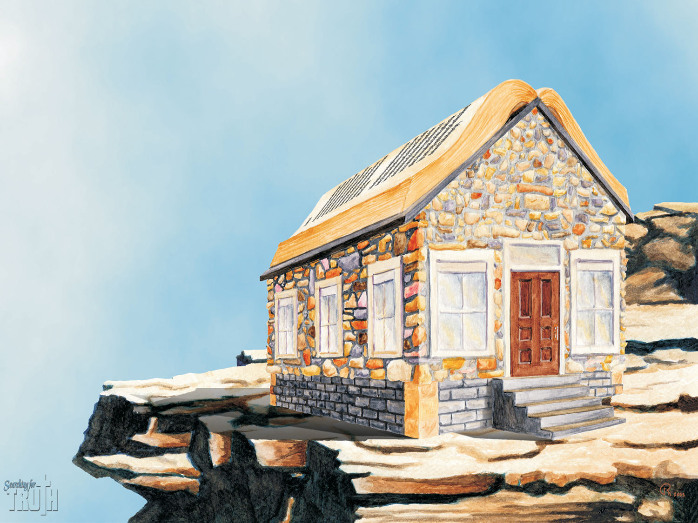
TONIGHT’S SERMON: THE CHURCH - AS A BUILDING

