Slide 1
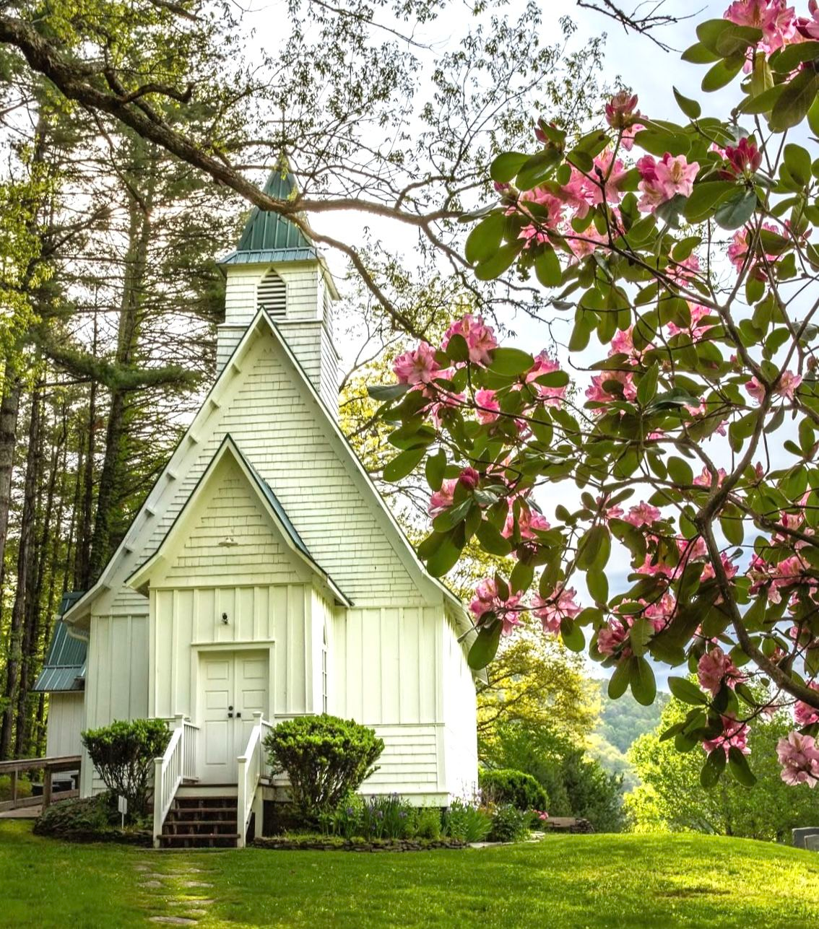
WELCOME TO THE
JACKSON STREET CHURCH OF CHRIST
PLEASE TURN OFF CELLPHONES

Slide 2


Slide 3
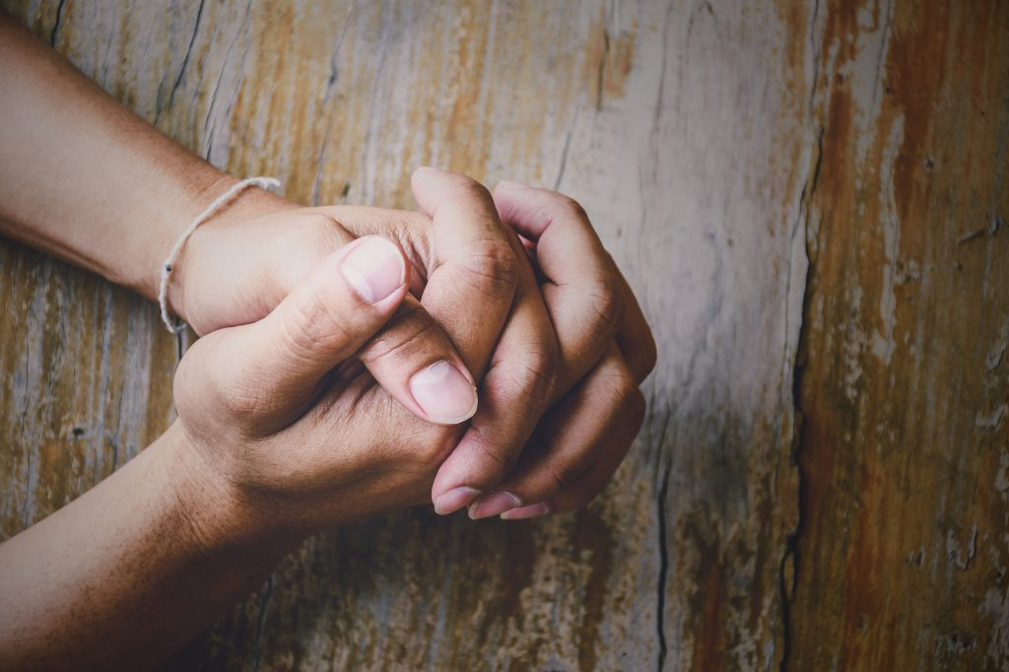
LET US PRAY

Slide 4

SINGING

Slide 5
Matthew 16:13–19 When Jesus came into the region of Caesarea Philippi, He asked His disciples, saying, “Who do men say that I, the Son of Man, am?” ¹⁴ So they said, “Some say John the Baptist, some Elijah, and others Jeremiah or one of the prophets.” ¹⁵ He said to them, “But who do you say that I am?” ¹⁶ Simon Peter answered and said, “You are the Christ, the Son of the living God.” ¹⁷ Jesus answered and said to him, “Blessed are you, Simon Bar-Jonah, for flesh and blood has not revealed this to you, but My Father who is in heaven. ¹⁸ And I also say to you that you are Peter, and on this rock I will build My church, and the gates of Hades shall not prevail against it. ¹⁹ And I will give you the keys of the kingdom of heaven, and whatever you bind on earth will be bound in heaven, and whatever you loose on earth will be loosed in heaven.”

Slide 6
LET US PRAY

Slide 7
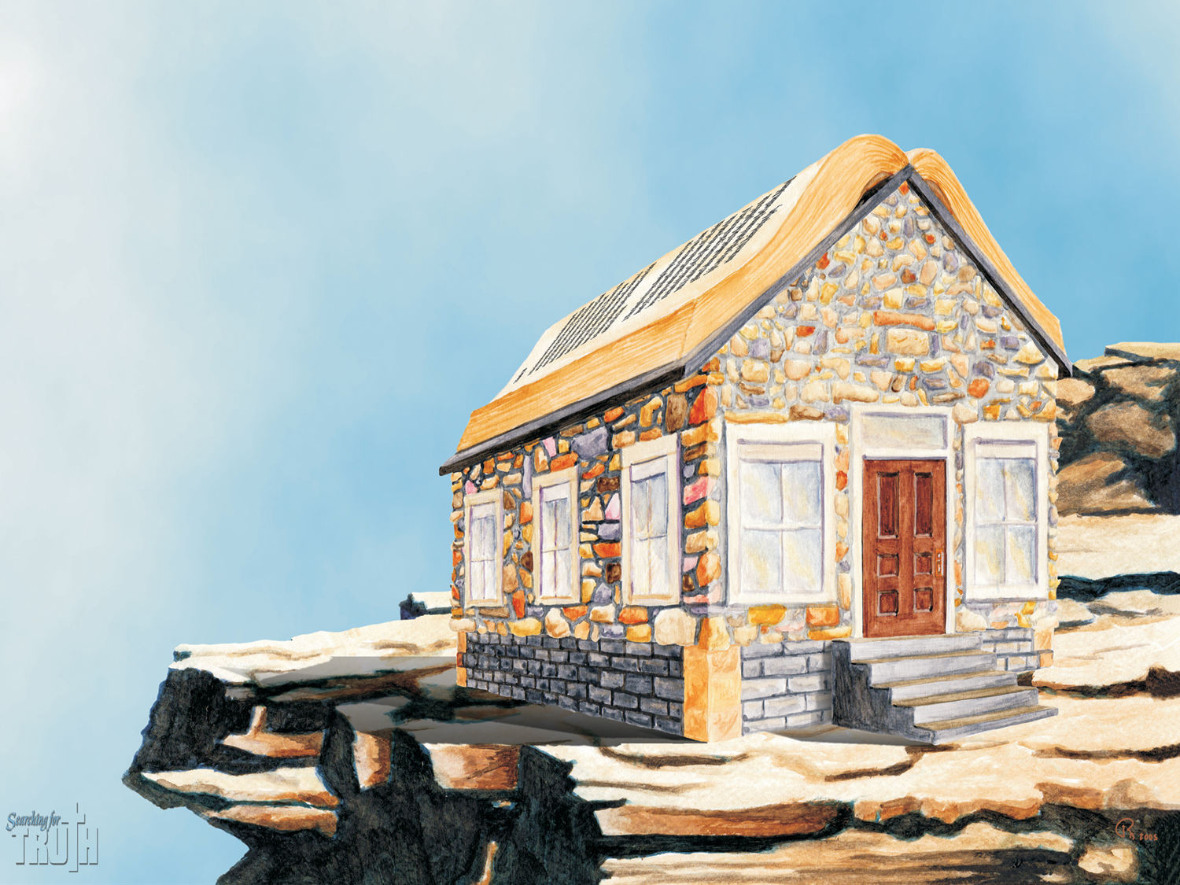
THE CHURCH AS A BUILDING

Slide 8
JESUS BUILT THE CHURCH
Matthew 16:18 And I also say to you that you are Peter, and on this rock I will build My church, and the gates of Hades shall not prevail against it.
Jesus said He would build His church and the terminology of the church as a building is used in scripture often.
The church was built by Christ but the church is not a building, it is the people.
Let’s look at the significance of the church as a building.

Slide 9
JESUS IS THE CORNERSTONE AND FOUNDATION
Matthew 21:42 Jesus said to them, Have you never read in the Scriptures: 'The stone which the builders rejected Has become the chief cornerstone’. This was the Lord's doing, And it is Marvelous in our eyes'?
1 Peter 2:6-8 Therefore it is also contained in the Scripture, Behold, I lay in Zion A chief cornerstone, elect, precious, And he who believes on Him will by no means be put to shame. {7} Therefore, to you who believe, He is precious; but to those who are disobedient, The stone which the builders rejected Has become the chief cornerstone, {8} and "A stone of stumbling And a rock of offence They stumble, being disobedient to the word, to which they also were appointed.”

Slide 10
II. WE ARE GOD'S BUILDING
1 Corinthians 3:9-17 For we are God's fellow workers; you are God's field, you are God’s building. {10} According to the grace of God which was given to me, as a wise master builder I have laid the foundation, and another builds on it. But let each one take heed how he builds on it. {11} For no other foundation can anyone lay than that which is laid, which is Jesus Christ. {12} Now if anyone builds on this foundation with gold, silver, precious stones, wood, hay, straw, {13} each one's work will become clear; for the Day will declare it, because it will be revealed by fire; and the fire will test each one's work, of what sort it, is. {14} If anyone's work which he has built on it endures, he will receive a reward. {15} If anyone's work is burned, he will suffer loss; but he himself will be saved, yet so as through fire. {16} Do you not know that you are the temple of God and that the Spirit of God dwells in you? {17} If anyone defiles the temple of God, God will destroy him. For the temple of God is holy, which temple you are.

Slide 11
II. WE ARE GOD'S BUILDING
Ephesians 2:19-22 Now, therefore, you are no longer strangers and foreigners, but fellow citizens with the saints and members of the household of God {20} having been built, on the foundation of the apostles and prophets, Jesus Christ Himself being the chief corner stone, {21} in whom the whole building, being joined together, grows into a holy temple in the Lord, {22 in whom you also are being built together for a dwelling place of God in the Spirit.
1 Pet 2:4-5 Coming to Him as to a living stone, rejected indeed by men, but chosen by God and precious, {5} you also, as living stones, are being built up a spiritual house, a holy priesthood, to offer up spiritual sacrifices acceptable to God through Jesus Christ.

Slide 12
III. WE MUST DO OUR PART TO KEEP THE BUILDING OR TEMPLE OF GOD FIT FOR HABITATION
WE MUST BE SURE WE HAVE THE PROPER FOUNDATION - 1 Corinthians 3:11 For no other foundation can anyone lay than that which is laid, which is Jesus Christ.
WE MUST BUILD BUT BE CAREFUL HOW WE BUILD - 1 Corinthians 3:10-15 According to the grace of God which was given to me, as a wise master builder I have laid the foundation, and another builds on it, But let each one take heed how he builds on it. >>>

Slide 13
III. WE MUST DO OUR PART TO KEEP THE BUILDING OR TEMPLE OF GOD FIT FOR HABITATION
{11} For no other foundation can anyone lay than that which is laid, which is Jesus Christ. {12} Now if anyone builds on this foundation with gold, silver, precious stones, wood, hay, straw, {13} each one's work will become clear; for the Day will declare it, because it will be revealed by fire; and the fire will test each one's work, of what sort it is. {14} If anyone's work which he has built on it endures, he will receive a reward. {15} If anyone' s work is burned, he will suffer loss; but he himself will be saved, yet so as through fire.

Slide 14
III. WE MUST DO OUR PART TO KEEP THE BUILDING OR TEMPLE OF GOD FIT FOR HABITATION
WE MUST OFFER SPIRITUAL SACRIFICES. WE WERE BUILT FOR THAT PURPOSE - 1 Pet 2:5 you also, as living stones, are being built up a spiritual house, a holy priesthood, to offer up spiritual sacrifices acceptable to God through Jesus Christ.
WE MUST PROCLAIM THE PRAISES OF GOD - 1 Peter 2:9-10 But you are a chosen generation, a royal priesthood, a holy nation, His own special people, that you may proclaim the praises of Him who called you out of darkness into His marvelous light; {10} who once were not a people but are now the people of God, who had not obtained mercy but now have obtained mercy.
WE MUST KEEP THE BUILDING CEMENTED TOGETHER - Colossians 3:14 But above all these things put on love, which is the bond of perfection.

Slide 15
THE CHURCH AS A BUILDING
Jesus is the cornerstone and foundation
And each Christian is a living stone in God's building.
Is the building stronger because you are a part of it
Or is it possibly weakened because of you?

Slide 16
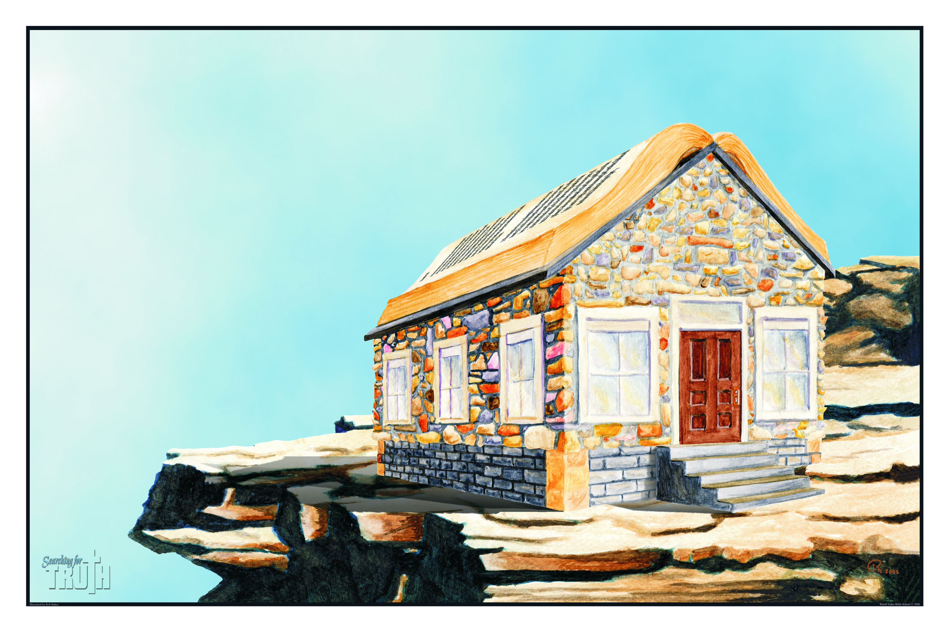
God’s Spiritual House
“The Church”
The Building Blocks Christians
(Living Stones)
1 Peter 2:5
Jesus
(The Door)
John 10:9
Its Protection
(The Scriptures)
1 Timothy 3:15
The Foundation (Apostles & Prophets)
Epehsians 2:20
The Chief Cornerstone - Jesus
Ephesians 2:19-22
Its Building Surface
(The Deity of Christ)
Matthew 16:13-19

Slide 17

How To Get Into The Church
Be Baptized Mar 16:16
Confess Rom 10:9-10
Repent Luke 13:3
Believe John 8:24
Hear John 6:45

Slide 18
SINGING

Slide 19
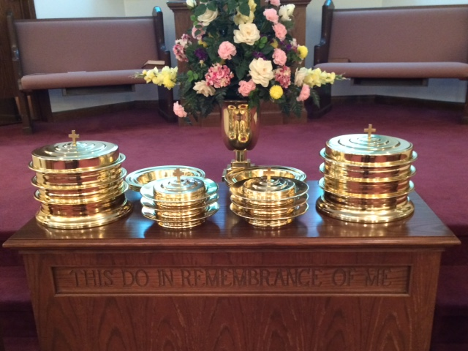
IN REMEMBRANCE OF JESUS

Slide 20
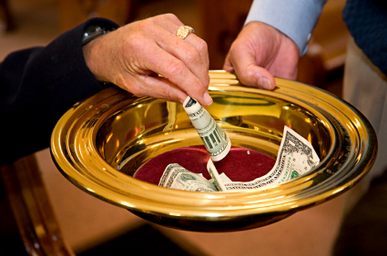
CONTRIBUTION

Slide 21
SINGING

Slide 22
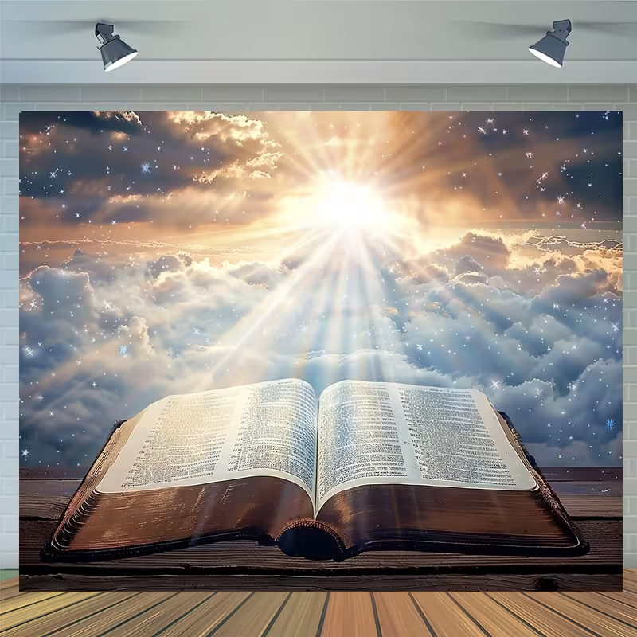
HAVE A HOLY, SPIRITUAL LIFE

