Slide 1
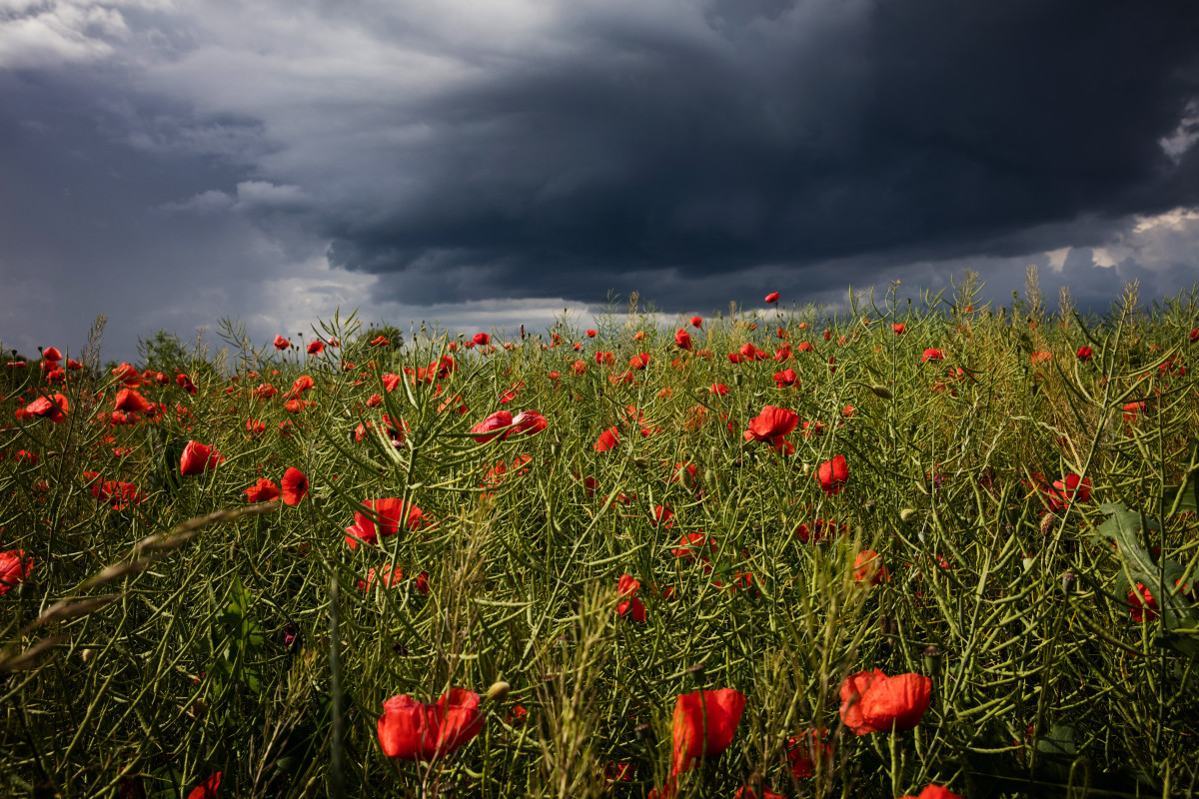
WELCOME TO THE
JACKSON STREET CHURCH OF CHRIST
PLEASE TURN OFF CELLPHONES

Slide 2


Slide 3


Slide 4

SINGING

Slide 5
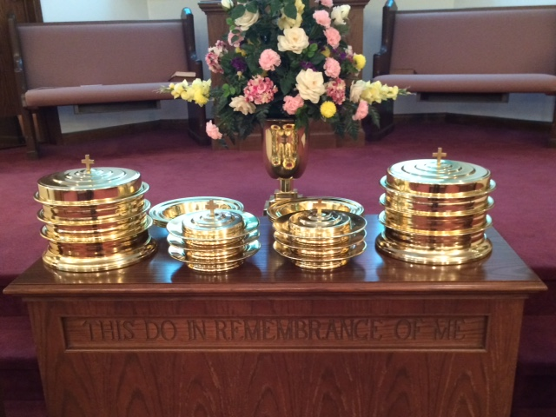
IN REMEMBRANCE OF JESUS

Slide 6
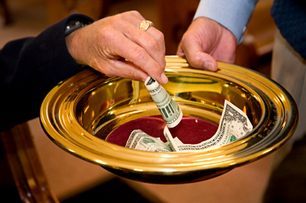
CONTRIBUTION

Slide 7
SINGING

Slide 8
2 Chr 7:13-14 '*When I shut up heaven and there is no rain, or command the locusts to devour the land, or send pestilence among My people, {14} "If My people who are called by My name will humble themselves, and pray and seek My face, and turn from their wicked ways, then I will hear from heaven, and will forgive their sin and heal their land.

Slide 10
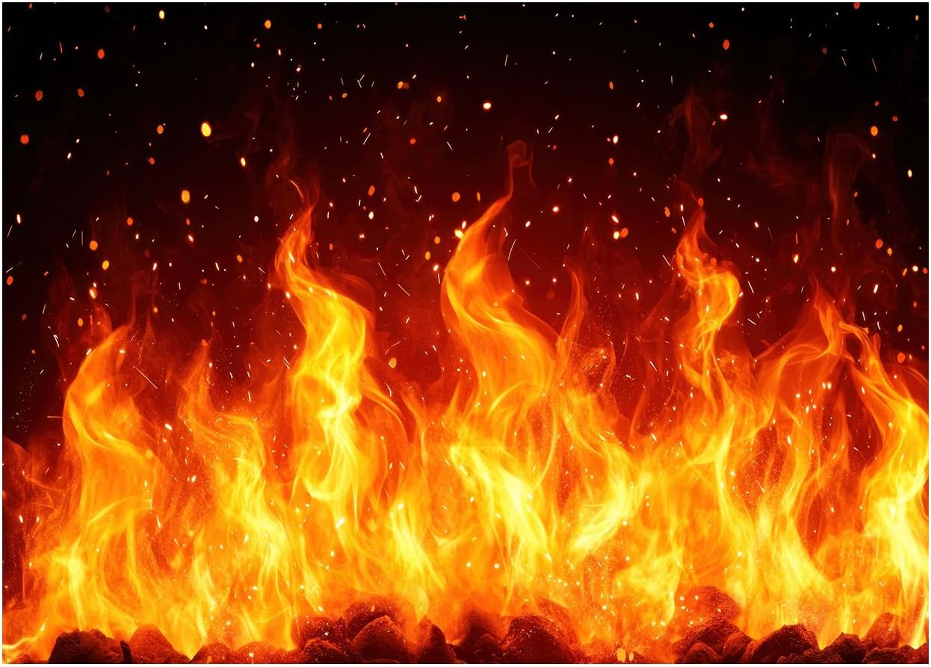
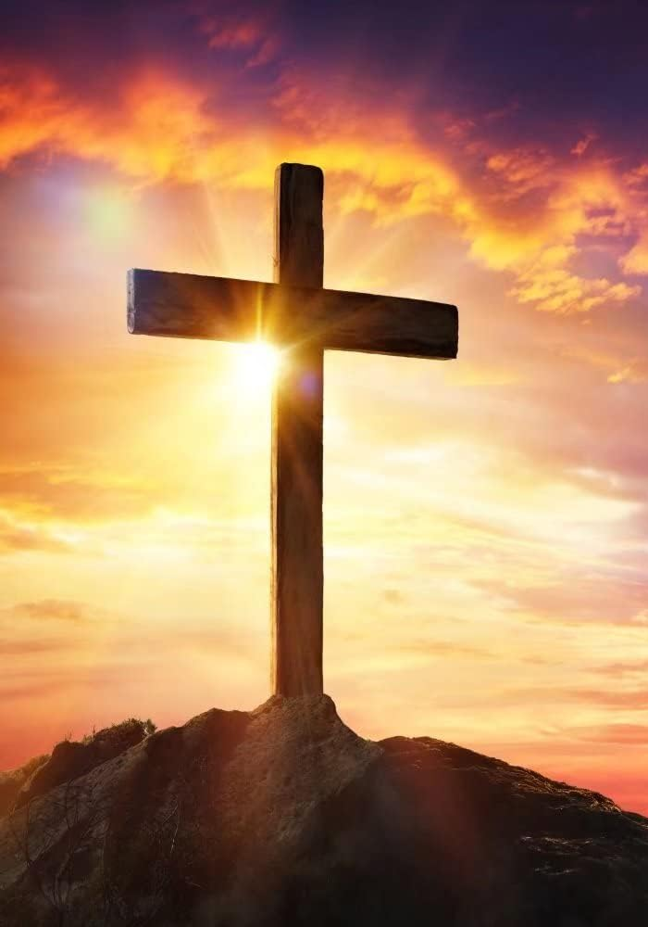
DELIVERANCE FROM GOD'S WRATH

Slide 11
DELIBERANCE FROM GOD’S WRATH
God has always placed two choices before everyone…you can do his will, or not
When you choose not to do his will, he again offers two choices… repent and return to him, or refuse to acknowledge your sin.
This is illustrated in 2 Chr 7:13-14
2 Chr 7:13-14 '*When I shut up heaven and there is no rain, or command the locusts to devour the land, or send pestilence among My people, {14} "If My people who are called by My name will humble themselves, and pray and seek My face, and turn from their wicked ways, then I will hear from heaven, and will forgive their sin and heal their land.

Slide 12
HUMBLE THEMSELVES
Prov 16:18 Pride goes before destruction, And a haughty spirit before a fall.
1 John 2:15-17 Do not love the world or the things in the world. If anyone loves the world, the love of the Father is not in him. {16} For all that is in the world; the lust of the flesh, the lust of the eyes, and the pride of life; is not of the Father but is of the world. {17} And the world is passing away, and the lust of it; but he who does the will of God abides forever.
1 Pet 5:5-6 Likewise you younger people, submit yourselves to your elders. Yes, all of you be submissive to one another, and be clothed with humility, for "God resists the proud, But gives grace to the humble. {6} Therefore humble yourselves under the mighty hand of God, that He may exalt you in due time,

Slide 13
HUMBLE THEMSELVES
Mat 23:1-12 Then Jesus spoke to the multitudes and to His disciples, {2} saying: "The scribes and the Pharisees sit in Moses' seat. {3} "Therefore whatever they tell you to observe, that observe and do, but do not do according to their works; for they say, and do not do. {4} "For they bind heavy burdens, hard to bear, and lay them on men's shoulders; but they themselves will not move them with one of their fingers, {5} "But all their works they do to be seen by men. They make their phylacteries broad and enlarge the borders of their garments. >>>

Slide 14
HUMBLE THEMSELVES
{6} "They love the best places at feasts, the best seats in the synagogues, {7} "greetings in the marketplaces, and to be called by men, 'Rabbi, Rabbi.' {8} "But you, do not be called 'Rabbi'; for One is your Teacher, the Christ, and you are all brethren. {9} "Do not call anyone on earth your father; for One is your Father, He who is in heaven. {10} "And do not be called teachers; for One is your Teacher, the Christ. {11} "But he who is greatest among you shall be your servant. {12} "And whoever exalts himself will be humbled, and he who humbles himself will be exalted.

Slide 15
II. PRAY
2 Chr 6:36-39 "When they sin against You for there is no one who does not sin, and You become angry with them and deliver them to the enemy, and they take them captive to a land far or near; {37} yet when they come to themselves in the land where they were carried captive, and repent, and make supplication to You in the land of their captivity, saying 'We have sinned, we have done wrong, and have committed wickedness'; {38} "and when they return to You with all their heart and with all their soul in the land of their captivity, where they have been carried captive, and pray toward their land which You gave to their fathers, the city which You have chosen, and toward the temple which I have built for Your name: {39} "then hear from heaven Your dwelling place their prayer and their supplications, and maintain their cause, and forgive Your people who have sinned against You.

Slide 16
II. PRAY
Acts 8:18-24 And when Simon saw that through the laying on of the apostles' hands the Holy Spirit was given, he offered them money, {19} saying, "Give me this power also, that anyone on whom I lay hands may receive the Holy Spirit." {20} But Peter said to him, "Your money perish with you, because you thought that the gift of God could be purchased with money! {21} You have neither part nor portion in this matter, for your heart is not right in the sight of God. {22} "Repent therefore of this your wickedness, and pray God if perhaps the thought of your heart may be forgiven you. {23} "For I see that you are poisoned by bitterness and bound by iniquity. {24} Then Simon answered and said, "Pray to the Lord for me, that none of the things which you have spoken may come upon me

Slide 17
II. PRAY
James 5:13-20 Is anyone among you suffering? Let him pray. Is anyone cheerful? Let him sing psalms. {14} Is anyone among you sick? Let him call for the elders of the church, and let them pray over him, anointing him with oil in the name of the Lord. {15} And the prayer of faith will save the sick, and the Lord will raise him up. And if he has committed sins, he will be forgiven. {16} Confess your trespasses to one another, and pray for one another, that you may be healed. The effective, fervent prayer of a righteous man avails much. {17} Elijah was a man with a nature like ours, and he prayed earnestly that it would not rain; and it did not rain on the land for three years and six months. {18 And he prayed again, and the heaven gave rain, and the earth produced its fruit. {19} Brethren, if anyone among you wanders from the truth, and someone turns him back, {20} let him know that he who turns a sinner from the error of his way will save a soul from death and cover a multitude of sins.

Slide 18
SEEK MY FACE
Psa 105:3-4 Glory in His holy name; Let the hearts of those rejoice, who seek the LORD! {4} Seek the LORD and His strength; Seek His face evermore.
Deu 4:29 But from there you will seek the LORD your God, and you will find Him if you seek Him with all your heart and with all your soul
1 Pet 3:12 For the eyes of the LORD are on the righteous, And His ears are open to their prayers; But the face of the LORD is against those who do evil.

Slide 19
IV. TURN FROM YOUR WICKED WAYS
Ezek 18:21-23 But if a wicked man turns from all his sins which he has committed, keeps all My statutes, and does what is lawful and right, he shall surely live; he shall not die. {22} "None of the transgressions which he has committed shall be remembered against him; because of the righteousness which he has done, he shall live. {23} “Do I have any pleasure at all that the wicked should die?" says the Lord GOD, "and not that he should turn from his ways and live?
2 Pet 3:9 The Lord is not slack concerning His promise, as some count slackness, but is longsuffering toward us, not willing that any should perish but that all should come to repentance.
Acts 17:30 "Truly, these times of ignorance God overlooked, but now commands all men everywhere to repent.

Slide 20
HAVE YOU BEEN DELIVERED FROM GOD’S WRATH?
Have you humbled yourself before God
Are you continually praying to God
Are you seeking God’s face
Have you turned from your sinful ways
2 Chr 7:14 I will hear from heaven and will forgive their sin and heal their land

Slide 21
SINGING

Slide 22
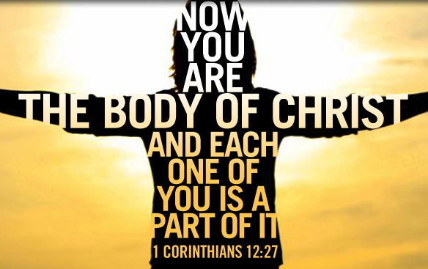
TONIGHT’S SERMON:
THE CHURCH - AS A BODY

