Slide 1

WELCOME TO THE
JACKSON STREET CHURCH OF CHRIST
PLEASE TURN OFF CELLPHONES

Slide 2


Slide 3

LET US PRAY

Slide 4

SINGING

Slide 5
Ephesians 1:22 – 2:3 And He put all things under His feet, and gave Him to be head over all things to the church, ²³ which is His body, the fullness of Him who fills all in all. 2:1 And you He made alive, who were dead in trespasses and sins, ² in which you once walked according to the course of this world, according to the prince of the power of the air, the spirit who now works in the sons of disobedience, ³ among whom also we all once conducted ourselves in the lusts of our flesh, fulfilling the desires of the flesh and of the mind, and were by nature children of wrath, just as the others.

Slide 6
LET US PRAY

Slide 7
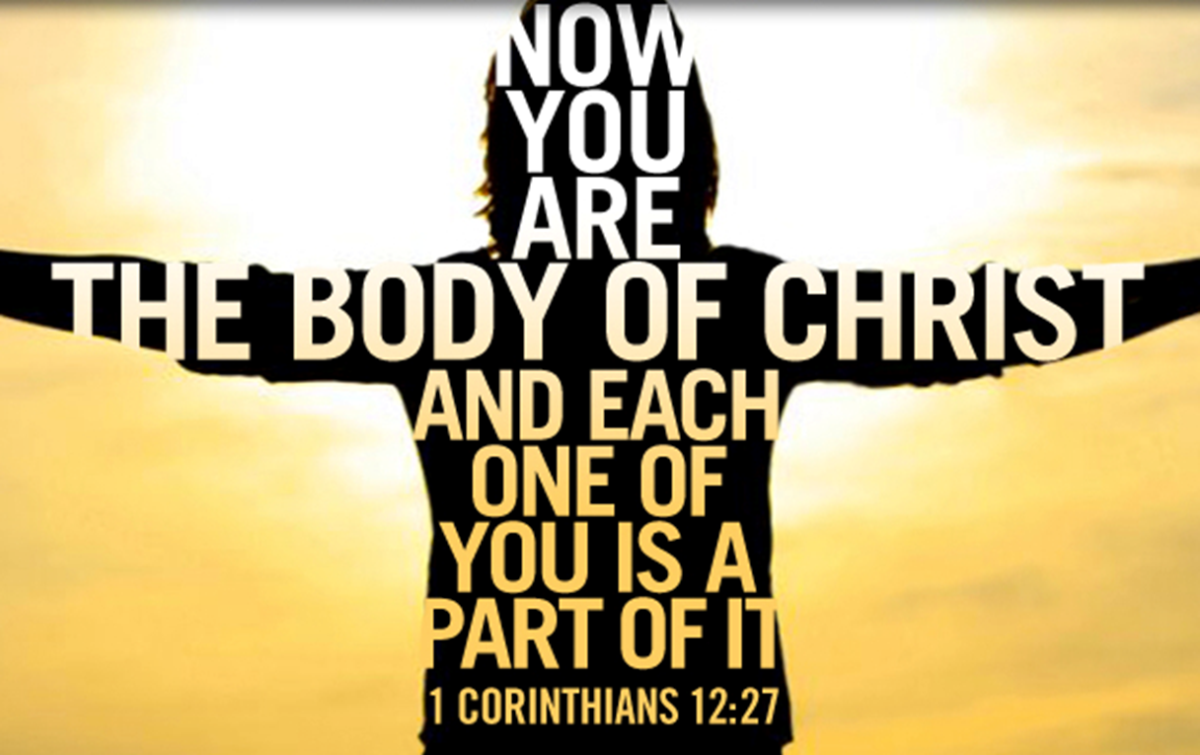
THE CHURCH THE BODY AND ITS MEMBERS

Slide 8
THE CHURCH AS THE BODY
A. Jesus was in a fleshly body. - John 1:14 The Word became flesh and dwelt among us.
1. His work on earth was done in this body: His teaching, His sacrifice for the sins of the world. (Heb. 10:5, 9-10).
2. Christ was raised from the dead and ascended to heaven. 1 Corinthians 15:3–5 For I delivered to you first of all that which I also received: that Christ died for our sins according to the Scriptures, ⁴ and that He was buried, and that He rose again the third day according to the Scriptures, ⁵ and that He was seen by Cephas, then by the twelve.

Slide 9
THE CHURCH AS THE BODY
B. Now the church is His body on earth.
1. The “church” refers to the people through whom the Lord works.
2. The church then functions as the body of Christ.
3. 2 Corinthians 5:14–15 For the love of Christ compels us, because we judge thus: that if One died for all, then all died; ¹⁵ and He died for all, that those who live should live no longer for themselves, but for Him who died for them and rose again.

Slide 10
THERE IS ONE BODY OR CHURCH
Ephesians 4:4 There one body and one Spirit, just as you were called in one hope of your calling;
Colossians 3:15 And let the peace of God rule in your hearts, to which also you were called in one body; and be thankful.
1 Corinthians 10:17 For we, though many, are one bread and one body; for we all partake of that one bread.
God has never been pleased with division in His people. John 17:20–21 “I do not pray for these alone, but also for those who will believe in Me through their word; ²¹ that they all may be one, as You, Father, are in Me, and I in You; that they also may be one in Us, that the world may believe that You sent Me.
The religious world has made it the church of your choice instead of the church that Jesus built.

Slide 11
II. CHRIST IS THE HEAD OF THE BODY, THE CHURCH
Colossians 1:18, 24 And He is the head of the body, the church, who is the beginning, the firstborn from the dead, that in all things He may have the preeminence.
Ephesians 4:15 but, speaking the truth in love, may grow up in al l things into Him who is the head; Christ;
Colossians 2:19 and not holding fast to the Head, from whom all the body, nourished and knit together by joints and ligaments, grows with the increase that is from God.

Slide 12
III. THE CHURCH IS THE BODY OF CHRIST
Ephesians 1:22-23 And He put all things under His feet, and gave Him to be head over all things to the church, {23} which is His body, the fullness of Him who fills all in all.
Colossians 1:24 I now rejoice in my sufferings for you, and fill up in my flesh what is lacking in the afflictions of Christ, for the sake of His body, which is the church.

Slide 13
WE ARE MEMBERS OF CHRIST'S BODY
1 Corinthians 6:15 Do you not know that your bodies members of Christ? Shall I then take the members of Christ and make them members of a harlot? Certainly not!
Ephesians 5:30 For we are members of His body, of His flesh and of His bones.

Slide 14
V. MEMBERS HAVE DIFFERENT FUNCTIONS
1 Corinthians 12:12-27 For as the body is one and has many members, but all the members of that one body, being many, are one body, so also is Christ. {13 For by one Spirit we were all baptized into one body; whether Jews or Greeks, whether slaves or free; and have all been made to drink into one Spirit. {14} For in fact the body is not one member but many. {15} If the foot should say, Because I am not a hand, I am not of the body, is it therefore not of the body? {16} And if the ear should say, "Because I am not an eye, I am not of the body, is it therefore not of the body? {17} If the whole body were an eye, where would be the hearing? If the whole were hearing, where would be the smelling? {18} But now God has set the members, each one of them, in the body just as He pleased, {19} And if they were all one member, where would the body be? >>>

Slide 15
V. MEMBERS HAVE DIFFERENT FUNCTIONS
{20} But now indeed there are many members, yet one body. {21} And the eye cannot say to the hand, I have no need of you, nor again the head to the feet, "I have no need of you. {22} No, much rather, those members of the body which seem to be weaker are necessary. {23} And those members of the body which we think to be less honorable, on these we bestow greater honor; and our unpresentable parts have greater modesty, {24} but our presentable parts have no need. But God composed the body, having given greater honor to that part which lacks it, {25} that there should be no schism in the body, but that the members should have the same care for one another. {26} And if one member suffers, all the members suffer with it; or if one member is honored, all the members rejoice with it. {27 Now you are the body of Christ, and members individually.

Slide 16
V. MEMBERS HAVE DIFFERENT FUNCTIONS
Romans 12:3-8 For I say, through the grace given to me, to everyone who is among you, not to think of himself more highly than he ought to think, but to think soberly, as God has dealt to each one a measure of faith. {4} For as we have many members in one body, but all the members do not have the same function, {5} so we, being many, are one body in Christ, and individually members of one another. {6} Having then gifts differing according to the grace that is given to us, let us use them: if prophecy, let us prophesy in proportion to our faith; {7} or ministry, let us use it in our ministering; he who teaches, in teaching; {8} he who exhorts, in exhortation; he who gives, with liberality; he who leads, with diligence; he who shows mercy, with cheerfulness.

Slide 17
VI. EACH MEMBER HAS A JOB TO DO & NEEDS TO DO IT.
Colossians 2:19 and not holding fast to the Head, from whom all the body, nourished and knit together by joints and ligaments, grows with the increase that is from God.
Ephesians 4:15-16 but, speaking the truth in love, may grow up in all things into Him who is the head; Christ; {16} from whom the whole body, joined and knit together by what every joint supplies, according to the effective working by which every part does its share, causes growth of the body for the edifying of itself in love.

Slide 18
VII. THERE'S ONLY ONE WAY TO GET INTO THE BODY
1 Corinthians 12:13 For by one Spirit we were all baptized into one body; whether Jews or Greeks, whether slaves or free; and have all been made to drink into one Spirit.
Romans 6:3-4 Or do you not know that as many of us as were baptized into Christ Jesus were baptized into His death? {4} Therefore we were buried with Him through baptism into death, that just as Christ was raised from the dead by the glory of the Father, even so we also should walk in newness of life.
Galatians 3:26–27 For you are all sons of God through faith in Christ Jesus. {27} For as many of you as were baptized into Christ have put on Christ.

Slide 19
WHAT ABOUT YOU?
Are you in the body of Christ which is the church?
If not, just repent of sin in your life and confess Jesus as the Son of God and you can be baptized into Christ today.
If you have any doubt of your salvation, let one of us know and we will try to clear up those doubts.

Slide 20
SINGING

Slide 21
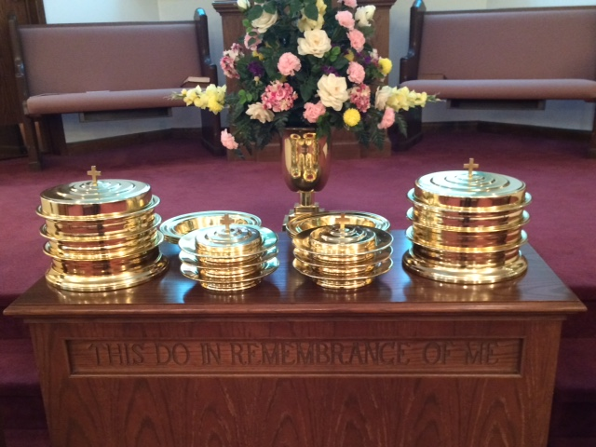
IN REMEMBRANCE OF JESUS

Slide 22
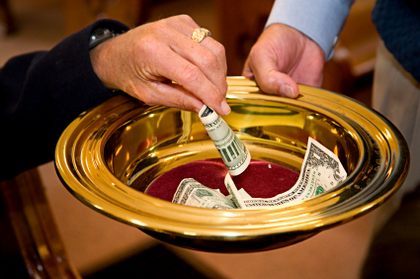
CONTRIBUTION

Slide 23
SINGING

Slide 24
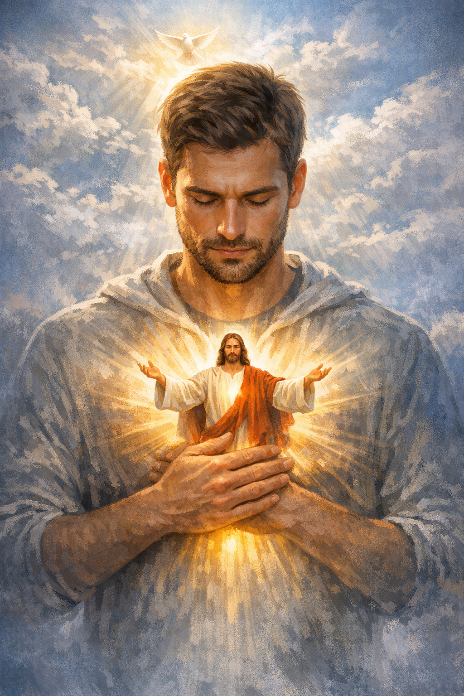
HAVE A LIVING FOR JESUS WEEK

