Slide 1
WELCOME TO THE
JACKSON STREET CHURCH OF CHRIST
PLEASE TURN OFF CELLPHONES

Slide 4
SINGING

Slide 5
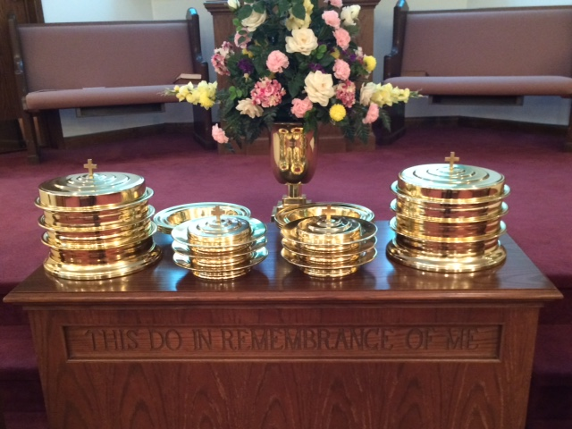
IN REMEMBRANCE OF JESUS

Slide 6
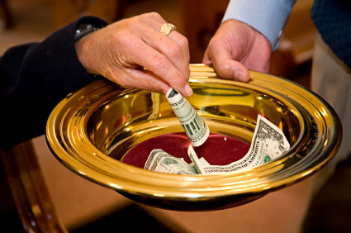
CONTRIBUTION

Slide 7
SINGING

Slide 8
Colossians 3:1–11 If then you were raised with Christ, seek those things which are above, where Christ is, sitting at the right hand of God. ² Set your mind on things above, not on things on the earth. ³ For you died, and your life is hidden with Christ in God. ⁴ When Christ who is our life appears, then you also will appear with Him in glory. ⁵ Therefore put to death your members which are on the earth: fornication, uncleanness, passion, evil desire, and covetousness, which is idolatry. ⁶ Because of these things the wrath of God is coming upon the sons of disobedience, ⁷ in which you yourselves once walked when you lived in them. ⁸ But now you yourselves are to put off all these: anger, wrath, malice, blasphemy, filthy language out of your mouth. ⁹ Do not lie to one another, since you have put off the old man with his deeds, ¹⁰ and have put on the new man who is renewed in knowledge according to the image of Him who created him, ¹¹ where there is neither Greek nor Jew, circumcised nor uncircumcised, barbarian, Scythian, slave nor free, but Christ is all and in all.

Slide 10
TEMPTATION AND THE CHRISTIAN

Slide 11
(1 Cor 10:13) No temptation has overtaken you except such as is common to man; but God is faithful, who will not allow you to be tempted beyond what you are able, but with the temptation will also make the way of escape, that you may be able to bear it.

Slide 12
SATAN IS ALIVE AND WORKING TODAY
(1 Pet 5:6-11) Therefore humble yourselves under the mighty hand of God, that He may exalt you in due time, {7} casting all your care upon Him, for He cares for you. {8} Be sober, be vigilant; because your adversary the devil walks about like a roaring lion, seeking whom he may devour. {9} Resist him, steadfast in the faith, knowing that the same sufferings are experienced by your brotherhood in the world. {10} But may the God of all grace, who called us to His eternal glory by Christ Jesus, after you have suffered a while, perfect, establish, strengthen, and settle you. {11} To Him be the glory and the dominion forever and ever. Amen.
HOW DO WE DEAL WITH HIM?

Slide 13
SATAN PRESENTS THE TEST No temptation has overtaken you except such as is common to man.

Slide 14
SATAN PRESENTS THE TEST
TEMPTATION IS NOT SIN BUT BE DO NOT NEED TO FLIRT WITH IT
BIBLE TEMPTATIONS
(1 John 2:15-17) Do not love the world or the things in the world. If anyone loves the world, the love of the Father is not in him. {16} For all that is in the world; the lust of the flesh, the lust of the eyes, and the pride of life, is not of the Father but is of the world. {17} And the world is passing away, and the lust of it; but he who does the will of God abides forever.

Slide 15
SATAN PRESENTS THE TEST
BIBLE TEMPTATIONS
(Gen 3:6) So when the woman saw that the tree was good for food, that it was pleasant to the eyes, and a tree desirable to make one wise, she took of its fruit and ate. She also gave to her husband with her, and he ate.
(Mat 4:1-11) Then Jesus was led up by the Spirit into the wilderness to be tempted by the devil. {2} And when He had fasted forty days and forty nights, afterward He was hungry. {3} Now when the tempter came to Him, he said, "If You are the Son of God, command that these stones become bread." {4} But He answered and said, "It is written, 'Man shall not live by bread alone, but by every word that proceeds from the mouth of God.“’ >>>

Slide 16
SATAN PRESENTS THE TEST
BIBLE TEMPTATIONS
{5} Then the devil took Him up into the holy city, set Him on the pinnacle of the temple, {6} and said to Him, "If You are the Son of God, throw Yourself down. For it is written: 'He shall give His angels charge over you,' and, 'In their hands they shall bear you up, Lest you dash your foot against a stone."' {7} Jesus said to him, "It is written again, You shall not tempt the LORD your God."' {8} Again, the devil took Him up on an exceedingly high mountain, and showed Him all the kingdoms of the world and their glory. {9} And he said to Him, "All these things I will give You if You will fall down and worship me." {10} Then Jesus said to him, "Away with you, Satan! For it is written, 'You shall worship the LORD your God, and Him only you shall serve."' {11} Then the devil left Him, and behold, angels came and ministered to Him.

Slide 17
SATAN PRESENTS THE TEST
SATAN'S TEMPTATIONS FALL IN 3 AREAS
LUST OF THE FLESH - EVE: GOOD FOR FOOD; JESUS: STONES TO BREAD; US: FLESHLY DESIRES - (1 Cor 7:3-5) Let the husband render to his wife the affection due her, and likewise also the wife to her husband. {4} The wife does not have authority over her own body, but the husband does. And likewise the husband does not have authority over his own body, but the wife does. {5} Do not deprive one another except with consent for a time, that you may give yourselves to fasting and prayer; and come together again so that Satan does not tempt you because of your lack of self-control.

Slide 18
SATAN PRESENTS THE TEST
SATAN'S TEMPTATIONS FALL IN 3 AREAS
LUST OF THE EYES - EVE: PLEASANT TO EYES, JESUS: SHOWED ALL KINGDOMS; US: MATERIALISM - (Acts 5:3) But Peter said, "Ananias, why has Satan filled your heart to lie to the Holy Spirit and keep back part of the price of the land for yourself?
PRIDE OF LIFE - EVE: MAKE WISE, JESUS: CAST SELF DOWN & ANGELS WILL TAKE CARE OF YOU; US: SELFISHNESS, THINKING TO HIGHLY OF SELF - (2 Cor 2:10-11) Now whom you forgive anything, I also forgive. For if indeed I have forgiven anything, I have forgiven that one for your sakes in the presence of Christ, {11} lest Satan should take advantage of us; for we are not ignorant of his devices.

Slide 19
II. YOU PERFORM YOUR BEST God is faithful, who will not allow you to be tempted beyond what you are able.

Slide 20
II. YOU PERFORM YOUR BEST
NOT WHAT DO I HAVE TO DO? BUT WHAT CAN I DO?
(James 4:7) Therefore submit to God. Resist the devil and he will flee from you.
(Heb 4:15) For we do not have a High Priest who cannot sympathize with our weaknesses, but was in all points tempted as we are, yet without sin.
(Rom 6:5-14) For if we have been united together in the likeness of His death, certainly we also shall be in the likeness of His resurrection, {6} knowing this, that our old man was crucified with Him, that the body of sin might be done away with, that we should no longer be slaves of sin. {7} For he who has died has been freed from sin. {8} Now if we died with Christ, we believe that we shall also live with Him, >>>

Slide 21
II. YOU PERFORM YOUR BEST
{9} knowing that Christ, having been raised from the dead, dies no more. Death no longer has dominion over Him. {10} For the death that He died, He died to sin once for all; but the life that He lives, He lives to God. {11} Likewise you also, reckon yourselves to be dead indeed to sin, but alive to God in Christ Jesus our Lord. {12} Therefore do not let sin reign in your mortal body, that you should obey it in its lusts. {13} And do not present your members as instruments of unrighteousness to sin, but present yourselves to God as being alive from the dead, and your members as instruments of righteousness to God. {14} For sin shall not have dominion over you, for you are not under law but under grace.

Slide 22
III. GOD PROVIDES THE REST - with the temptation will also make the way of escape.

Slide 23
III. GOD PROVIDES THE REST
(James 4:8) Draw near to God and He will draw near to you.
(Rom 8:31-39) What then shall we say to these things? If God is for us, who can be against us? {32} He who did not spare His own Son, but delivered Him up for us all, how shall He not with Him also freely give us all things? {33} Who shall bring a charge against God's elect? It is God who justifies. {34} Who is he who condemns? It is Christ who died, and furthermore is also risen, who is even at the right hand of God, who also makes intercession for us. {35} Who shall separate us from the love of Christ? Shall tribulation, or distress, or persecution, or famine, or nakedness, or peril, or sword? {36} As it is written: "For Your sake we are killed all day long; We are accounted as sheep for the slaughter.“ >>>

Slide 24
III. GOD PROVIDES THE REST
{37} Yet in all these things we are more than conquerors through Him who loved us. {38} For I am persuaded that neither death nor life, nor angels nor principalities nor powers, nor things present nor things to come, {39} nor height nor depth, nor any other created thing, shall be able to separate us from the love of God which is in Christ Jesus our Lord.
(2 Cor 3:5) Not that we are sufficient of ourselves to think of anything as being from ourselves, but our sufficiency is from God,
(Rom 6:23) For the wages of sin is death, but the gift of God is eternal life in Christ Jesus our Lord.

Slide 25
HOW IS SATAN TEMPTING YOU
ARE YOU DOING WHAT YOU ARE ABLE IN RESISTING HIS TEMPTATIONS? (Rev 12:9-11) So the great dragon was cast out, that serpent of old, called the Devil and Satan, who deceives the whole world; he was cast to the earth, and his angels were cast out with him. {10} Then I heard a loud voice saying in heaven, "Now salvation, and strength, and the kingdom of our God, and the power of His Christ have come, for the accuser of our brethren, who accused them before our God day and night, has been cast down. {11} "And they overcame him by the blood of the Lamb and by the word of their testimony, and they did not love their lives to the death

Slide 26
HOW IS SATAN TEMPTING YOU
Are you depending on God for deliverance and looking for the way of escape?
The fall of man came because a lie was heard, believed & obeyed restoration comes through hearing, believing & obeying the truth.
We know God and Christians are going to triumph over Satan and evil. It would be foolish and illogical not to continue to believe in Him, trust in Him and serve Him.

Slide 27
SINGING

Slide 28
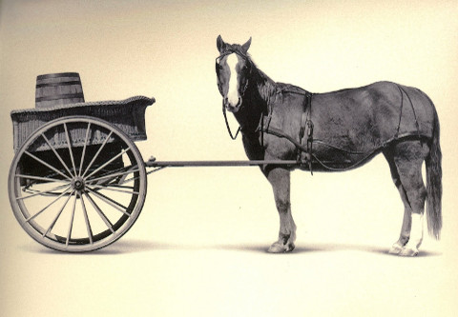
TONIGHT’S SERMON
FIRST THINGS FIRST
TONIGHT’S SERMON
FIRST THINGS FIRST

