Slide 1
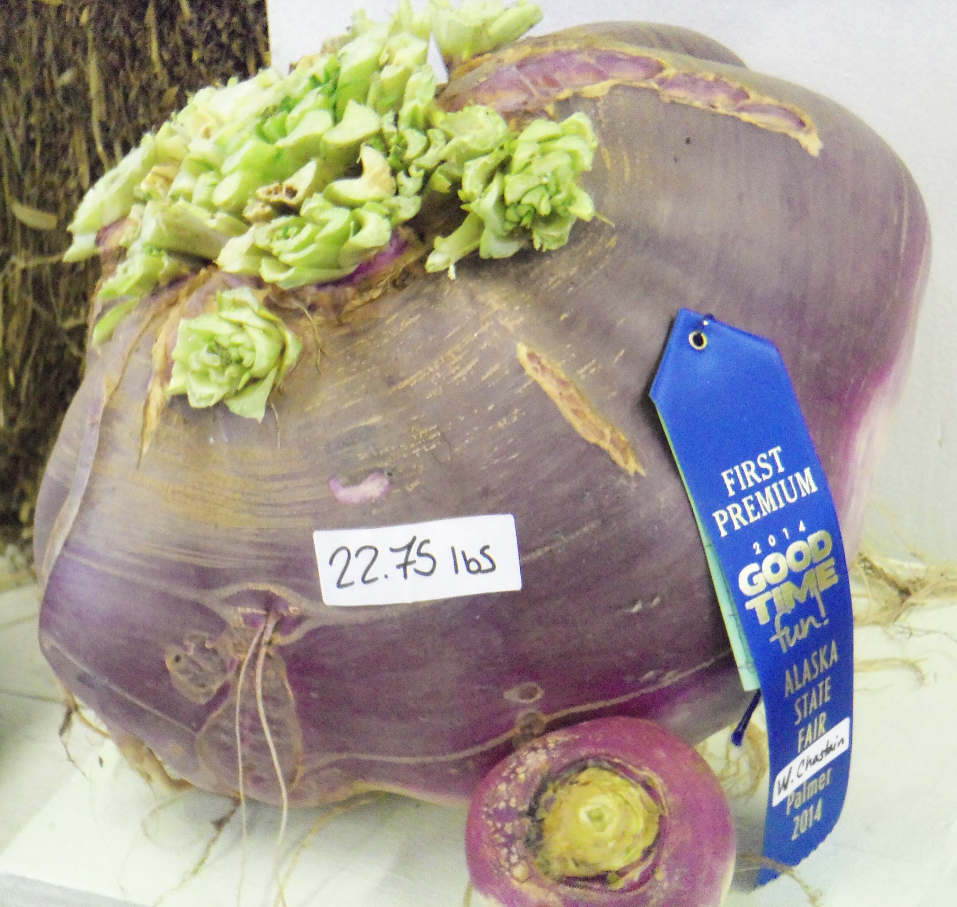
WELCOME TO THE
JACKSON STREET CHURCH OF CHRIST
PLEASE TURN OFF CELL PHONES
This Photo by Unknown Author is licensed under CC BY-NC-ND

Slide 3
LET US PRAY

Slide 4
SINGING

Slide 5
Matthew 6:25–34 “Therefore I say to you, do not worry about your life, what you will eat or what you will drink; nor about your body, what you will put on. Is not life more than food and the body more than clothing? ²⁶ Look at the birds of the air, for they neither sow nor reap nor gather into barns; yet your heavenly Father feeds them. Are you not of more value than they? ²⁷ Which of you by worrying can add one cubit to his stature? ²⁸ “So why do you worry about clothing? Consider the lilies of the field, how they grow: they neither toil nor spin; ²⁹ and yet I say to you that even Solomon in all his glory was not arrayed like one of these. ³⁰ Now if God so clothes the grass of the field, which today is, and tomorrow is thrown into the oven, will He not much more clothe you, O you of little faith? ³¹ “Therefore do not worry, saying, ‘What shall we eat?’ or ‘What shall we drink?’ or ‘What shall we wear?’ ³² For after all these things the Gentiles seek. For your heavenly Father knows that you need all these things. ³³ But seek first the kingdom of God and His righteousness, and all these things shall be added to you. ³⁴ Therefore do not worry about tomorrow, for tomorrow will worry about its own things. Sufficient for the day is its own trouble.

Slide 6
LET US PRAY

Slide 7
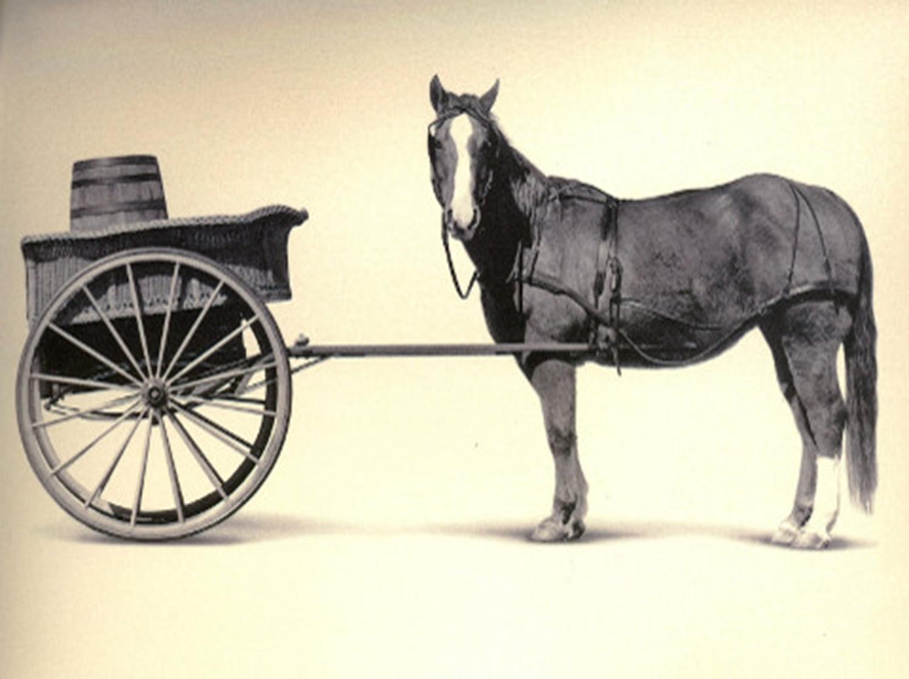
FIRST THINGS FIRST!

Slide 8
PRIORITIES
Christ revealed the need for setting proper priorities in Matthew 6:33 seek first the kingdom of God and His righteousness, and all these things shall be added to you.
We tend, many times to put first things last and last things first.
It was points out that one old recipe for rabbit started out with this injunction: "First catch the rabbit." The writer knew how to put first things first.
That's what we do when we establish priorities -- we put the things that should be in first place in their proper order.
We will be looking at four things from Matthew 6:33 that will help us to see the importance of putting first thing first and how to do that.

Slide 9
1. OBLIGATION - “seek.”
We must understand the Jesus is issuing a command, not an option.
If we desire a heavenly home, we must follow this absolute imperative.
Seeking requires a diligent effort on our part.
Matthew 18:11–12 For the Son of Man has come to save that which was lost. 12 “What do you think? If a man has a hundred sheep, and one of them goes astray, does he not leave the ninety-nine and go to the mountains to seek the one that is straying?
Hebrews 11:6, “but without faith it is impossible to please him: for he that cometh to God must believe that he is, and that he is a rewarder of them that diligently seek him.”

Slide 10
1. OBLIGATION - “seek.”
Seeking requires a diligent effort on our part.
Colossians 3:1–10 If then you were raised with Christ, seek those things which are above, where Christ is, sitting at the right hand of God. ² Set your mind on things above, not on things on the earth. ³ For you died, and your life is hidden with Christ in God. ⁴ When Christ who is our life appears, then you also will appear with Him in glory. ⁵ Therefore put to death your members which are on the earth: fornication, uncleanness, passion, evil desire, and covetousness, which is idolatry. ⁶ Because of these things the wrath of God is coming upon the sons of disobedience, ⁷ in which you yourselves once walked when you lived in them. ⁸ But now you yourselves are to put off all these: anger, wrath, malice, blasphemy, filthy language out of your mouth. ⁹ Do not lie to one another, since you have put off the old man with his deeds, ¹⁰ and have put on the new man who is renewed in knowledge according to the image of Him who created him,

Slide 11
2. OBJECTS - “the kingdom of God and his righteousness.”
The top priorities in a Christian’s life are the “kingdom” or the Church.
Matthew 16:18–19 And I also say to you that you are Peter, and on this rock I will build My church, and the gates of Hades shall not prevail against it. ¹⁹ And I will give you the keys of the kingdom of heaven, and whatever you bind on earth will be bound in heaven, and whatever you loose on earth will be loosed in heaven.”
Matthew 13:44–46 “Again, the kingdom of heaven is like treasure hidden in a field, which a man found and hid; and for joy over it he goes and sells all that he has and buys that field. ⁴⁵ “Again, the kingdom of heaven is like a merchant seeking beautiful pearls, ⁴⁶ who, when he had found one pearl of great price, went and sold all that he had and bought it.

Slide 12
2. OBJECTS - “the kingdom of God and his righteousness.”
and “his righteousness” which is revealed in the Gospel of Jesus Christ (Rom. 1:16-17).
Matthew 5:6 Blessed are those who hunger and thirst for righteousness, For they shall be filled.
Romans 6:18 And having been set free from sin, you became slaves of righteousness.
Romans 10:1–3 Brethren, my heart’s desire and prayer to God for Israel is that they may be saved. ² For I bear them witness that they have a zeal for God, but not according to knowledge. ³ For they being ignorant of God’s righteousness, and seeking to establish their own righteousness, have not submitted to the righteousness of God.

Slide 13
3. ORDER - “first.”
The emphasis is that the Church that belongs to Christ must never take a back seat.
In all we do we must seek to put these things first in our heart, mind, soul and strength!
Mark 12:29–30 Jesus answered him, “The first of all the commandments is: ‘Hear, O Israel, the LORD our God, the LORD is one. ³⁰ And you shall love the LORD your God with all your heart, with all your soul, with all your mind, and with all your strength.’ This is the first commandment.
Luke 14:26–27 “If anyone comes to Me and does not hate his father and mother, wife and children, brothers and sisters, yes, and his own life also, he cannot be My disciple. ²⁷ And whoever does not bear his cross and come after Me cannot be My disciple.
2 Corinthians 8:5 And not only as we had hoped, but they first gave themselves to the Lord, and then to us by the will of God.

Slide 14
4. OUTCOME - “all these things shall be added unto you.”
This statement shows the blessings that will result if your priorities are right.
The result for obediently seeking the kingdom and God’s righteousness will lead to your every need being supplied. What an awesome promise.
Philippians 4:19 And my God shall supply all your need according to His riches in glory by Christ Jesus.
2 Corinthians 9:8–11 And God is able to make all grace abound toward you, that you, always having all sufficiency in all things, may have an abundance for every good work. ⁹ As it is written: “He has dispersed abroad, He has given to the poor; His righteousness endures forever.” ¹⁰ Now may He who supplies seed to the sower, and bread for food, supply and multiply the seed you have sown and increase the fruits of your righteousness, ¹¹ while you are enriched in everything for all liberality, which causes thanksgiving through us to God.

Slide 15
4. OUTCOME - “all these things shall be added unto you.”
This does not mean that all your wants will be taken care of.
It is also a clear reminder that we must be willing to pay the price to get the blessings - Luke 14:28–33 For which of you, intending to build a tower, does not sit down first and count the cost, whether he has enough to finish it—²⁹ lest, after he has laid the foundation, and is not able to finish, all who see it begin to mock him, ³⁰ saying, ‘This man began to build and was not able to finish.’ ³¹ Or what king, going to make war against another king, does not sit down first and consider whether he is able with ten thousand to meet him who comes against him with twenty thousand? ³² Or else, while the other is still a great way off, he sends a delegation and asks conditions of peace. ³³ So likewise, whoever of you does not forsake all that he has cannot be My disciple.

Slide 16
WHAT ABOUT YOU?
Are you putting first things first?
Are you seeking the kingdom of God and His righteousness first?
If so then worry and anxiety should not be in your life.
If have worries about this life God can help.

Slide 17
SINGING

Slide 18
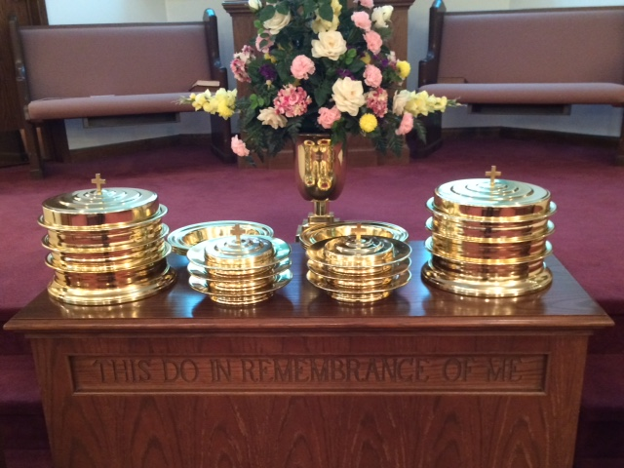
IN REMEMBRANCE OF JESUS

Slide 19
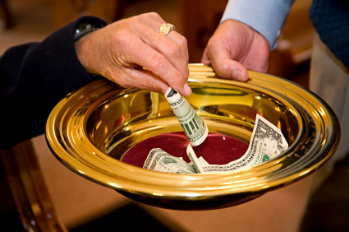
CONTRIBUTION

Slide 20
SINGING

Slide 21
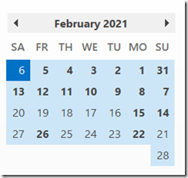
HAVE A PRIORITIZED WEEK

