Slide 1
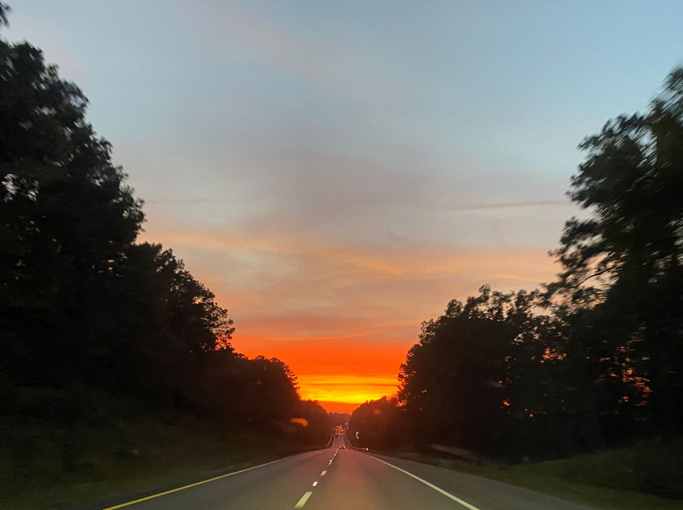
WELCOME TO THE
JACKSON STREET CHURCH OF CHRIST
PLEASE TURN OFF CELLPHONES

Slide 2


Slide 3


Slide 4

SINGING

Slide 5

IN REMEMBRANCE OF JESUS

Slide 6

CONTRIBUTION

Slide 7
SINGING

Slide 8
John 18:12-13, 24 Then the detachment of troops and the captain and the officers of the Jews arrested Jesus and bound Him. ¹³ And they led Him away to Annas first, for he was the father-in-law of Caiaphas who was high priest that year… ²⁴ Then Annas sent Him bound to Caiaphas the high priest.

Slide 10
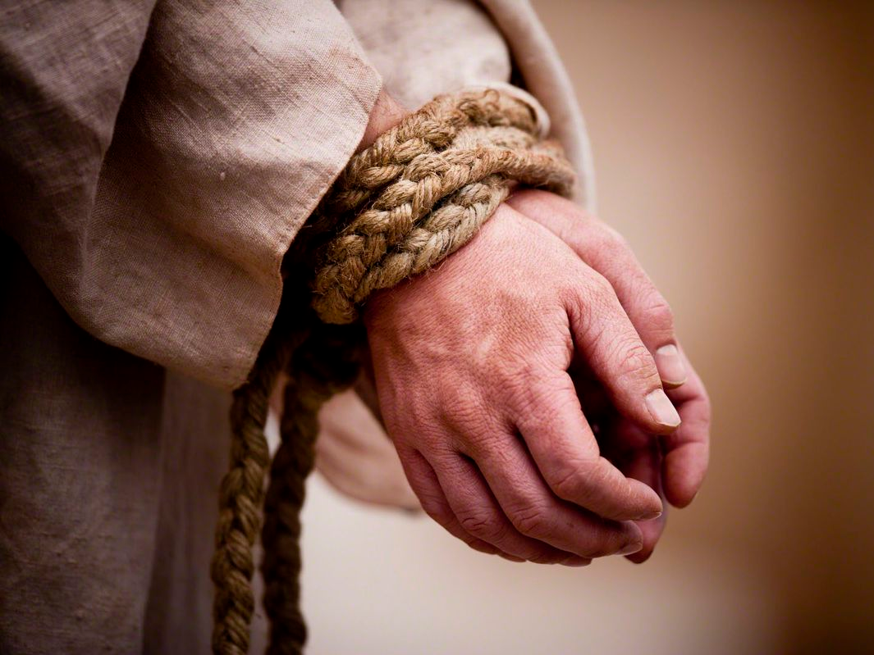
BINDING THE HANDS OF JESUS

Slide 11
BINDING THE HANDS OF JESUS
John 18:12-13, 24 Then the detachment of troops and the captain and the officers of the Jews arrested Jesus and bound Him. ¹³ And they led Him away to Annas first, for he was the father-in-law of Caiaphas who was high priest that year… ²⁴ Then Annas sent Him bound to Caiaphas the high priest.
SONG 329 THEY BOUND THE HANDS OF JESUS....HE COULD HAVE CALLED 10,000 ANGELS - Matthew 26:53 Or do you think that I cannot now pray to My Father, and He will provide Me with more than twelve legions of angels?
The song has it wrong, 12 legions would have actually been 60,000 – 78,000.

Slide 12
l. BY DIVISION IN THE CHURCH
John 17:20-23 I do not pray for these alone, but also for those who will believe in Me through their word; ²¹ "that they all may be one, as You, Father, are in Me, and I in You; that they also may be one in us, that the world may believe that You sent Me. ²² "And the glory which You gave Me I have given them, that they may be one just as We are one: ²³ in them, and You in Me; that they may be made perfect in one, and that the world may know that You have sent Me, and have loved them as You have loved Me.

Slide 13
II. BY IGNORANCE OF HIS WORD
Hosea 4:6 My people are destroyed for lack of knowledge, Because you have rejected knowledge, I also will reject you from being priest for Me; Because you have forgotten the law of your God, I also will forget your children.

Slide 14
III. BY NEGLIGENCE OF OUR DUTY
Mat 7:21 "Not everyone who says to Me, 'Lord, Lord, shall enter the kingdom of heaven, but he who does the will of My Father in heaven.

Slide 15
IV. BY COMPRIMISE OF OUR DEVOTION
Luke 6:46 "But why do you call Me 'Lord, Lord,' and do not do the things which I say?

Slide 16
V. BY SELFISHNESS IN GIVING
2 Sam 24:18-25 And Gad came that day to David and said to him, "Go up, erect an altar to the LORD on the threshing floor of Araunah the Jebusite." ¹⁹ So David, according to the word of Gad, went up as the LORD commanded. ²⁰ Now Araunah looked, and saw the king and his servants coming toward him. So Araunah went out and bowed before the king with his face to the ground. ²¹ Then Araunah said, “Why has my lord the king come to his servant?" And David said, "To buy the threshing floor from you, to build an altar to the LORD, that the plague may be withdrawn from the people.“>>>

Slide 17
V. BY SELFISHNESS IN GIVING
²² Now Araunah said to David, "Let my lord the king take it and offer up whatever seems good to him. Look, here are oxen for burnt sacrifice, and threshing implements and the yokes of the oxen for wood, ²³ "All these, O king, Araunah has given to the king." And Araunah said to the king, "May the LORD your God accept you." ²⁴ Then the king said to Araunah, "No, but I will surely buy it from you for a price; nor will I offer burnt offerings to the LORD my God with that which costs me nothing." So David bought the threshing floor and the oxen for fifty shekels of silver. ²⁵ And David built there an altar to the LORD, and offered burnt offerings and peace offerings. So the LORD heeded the prayers for the land, and the plague was withdrawn from Israel.

Slide 18
VI. BY COMPACENCY IN OUR TEACHING
2 Tim 3:16-17 All Scripture is given by inspiration of God, and is profitable for doctrines for reproof, for correction, for instruction in righteousness, ¹⁷ that the man of God may be complete, thoroughly equipped for every good work,

Slide 19
VII. BY WORLDLINESS OF OUR LIFE
1 John 2:15-17 Do not love the world or the things in the world. If anyone loves the world, the love of the Father is not in him. ¹⁶ For all that is in the world; the lust of the fleshy the lust of the eyes, and the pride of life; is not of the Father but is of the world. ¹⁷ And the world is passing away, and the lust of it; but he who does the will of God abides forever

Slide 20
WHAT ABOUT YOU?
Christ Has No Hands But Ours - Annie Johnson Flint
Christ has no hands but our hands, to do His work today.
He has no feet but our feet, to lead men in His way.
He has no tongue but our tongue, to tell men how He died.
He has no help but our help, to bring them to His side.
We are the only bible, the careless word will read.
We are the sinner’s gospel, we are the scoffer’s creed.
We are the Lord’s last message, written in deed and word.
What if the line is crooked? What if the line is blurred?
What if our hands are busy, with other work than His?
What if our feet are walking, where sin's allurement is?
What if our tongues are speaking, of things His lips would spurn?
How can we hope to help Him, unless from him we learn?
HAVE YOU RESPONDED TO THE WORK OF JESUS TO SAVE YOUR SOUL?
ARE YOU DOING THE WORK OF JESUS, SAVING SOULS?

Slide 21
SINGING

Slide 22
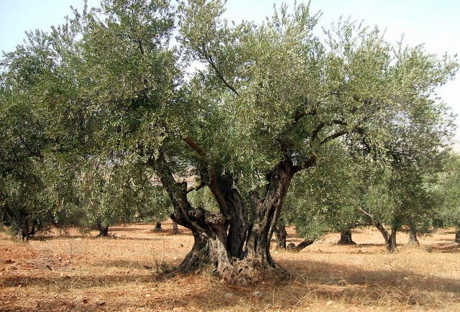
TONIGHT’S SERMON:
THE CHURCH - AS AN OLIVE TREE

