Slide 1
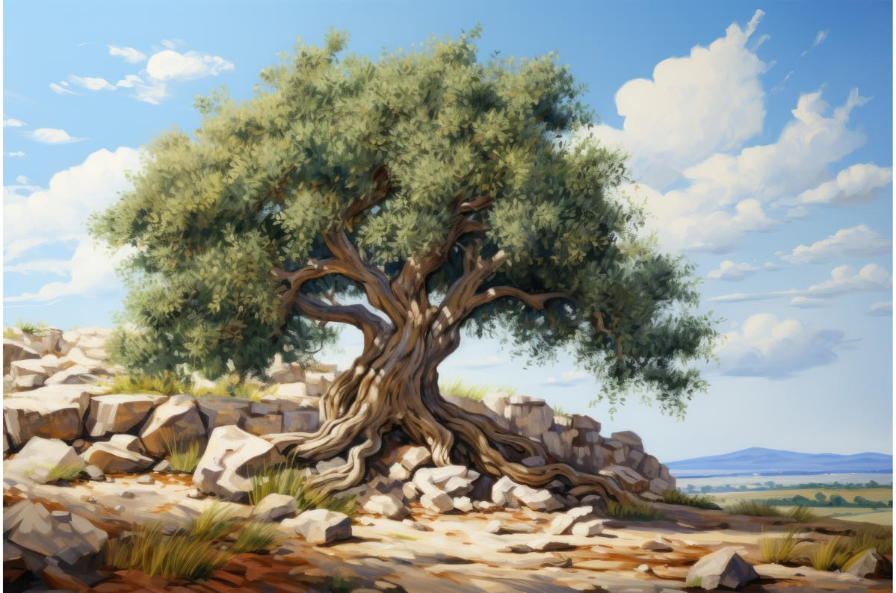
WELCOME TO THE
JACKSON STREET CHURCH OF CHRIST
PLEASE TURN OFF CELLPHONES

Slide 2


Slide 3

LET US PRAY

Slide 4

SINGING

Slide 5
Romans 11:16–24 For if the firstfruit is holy, the lump is also holy; and if the root is holy, so are the branches. ¹⁷ And if some of the branches were broken off, and you, being a wild olive tree, were grafted in among them, and with them became a partaker of the root and fatness of the olive tree, ¹⁸ do not boast against the branches. But if you do boast, remember that you do not support the root, but the root supports you.¹⁹ You will say then, “Branches were broken off that I might be grafted in.” ²⁰ Well said. Because of unbelief they were broken off, and you stand by faith. Do not be haughty, but fear. >>>

Slide 6
²¹ For if God did not spare the natural branches, He may not spare you either. ²² Therefore consider the goodness and severity of God: on those who fell, severity; but toward you, goodness, if you continue in His goodness. Otherwise you also will be cut off. ²³ And they also, if they do not continue in unbelief, will be grafted in, for God is able to graft them in again. ²⁴ For if you were cut out of the olive tree which is wild by nature, and were grafted contrary to nature into a cultivated olive tree, how much more will these, who are natural branches, be grafted into their own olive tree?

Slide 7
LET US PRAY

Slide 8
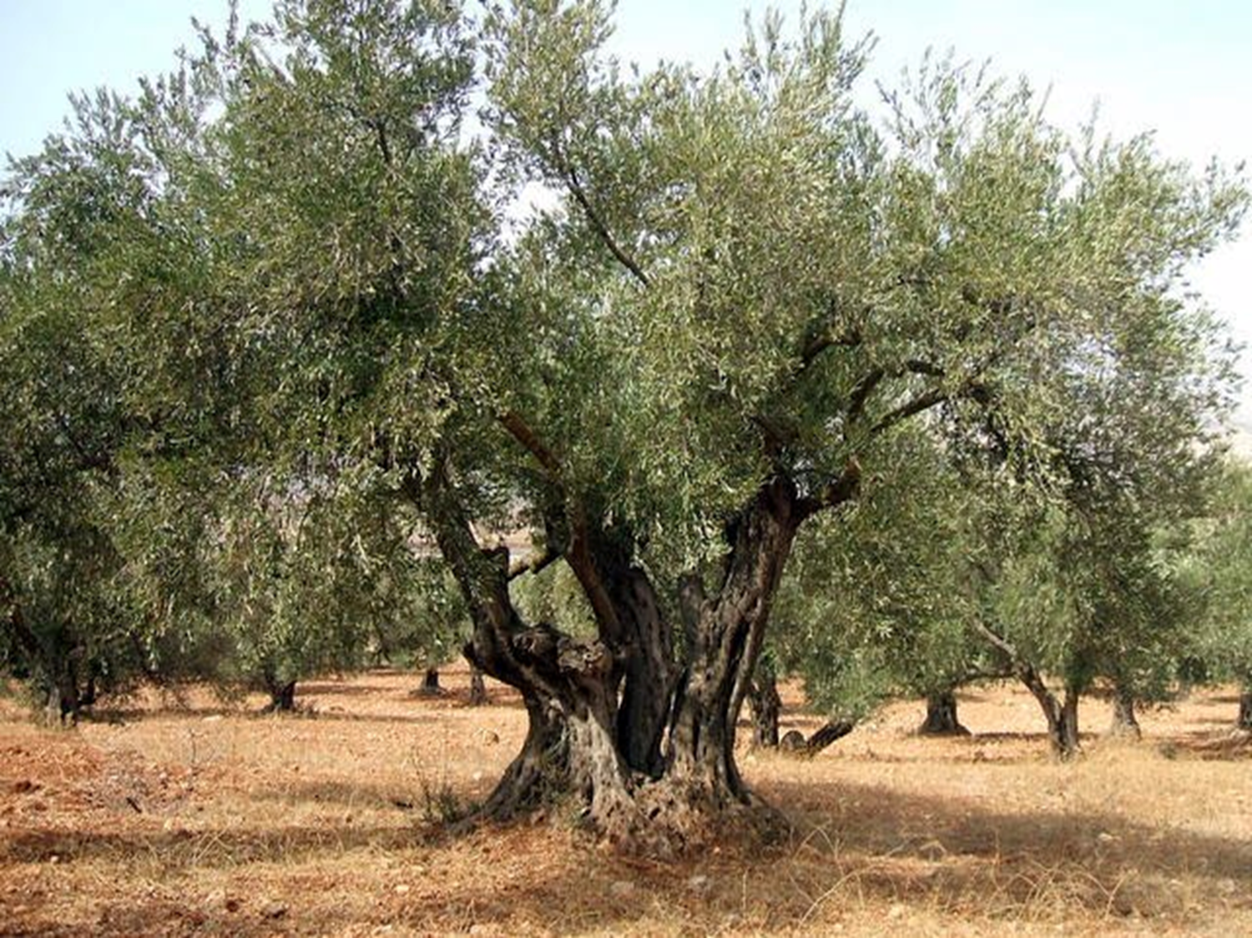
THE CHURCH AS AN OLIVE TREE

Slide 9
THE CHURCH AS AN OLIVE TREE
Paul is dealing with pride from the Gentiles thinking God replaced the Israelites with them.
We will be looking at how this situation applies to the church.

Slide 10
GOD HAS NOT GIVEN UP ON THE ISRAELITES
Romans 11:1–3 I say then, has God cast away His people? Certainly not! For I also am an Israelite, of the seed of Abraham, of the tribe of Benjamin. ² God has not cast away His people whom He foreknew. Or do you not know what the Scripture says of Elijah, how he pleads with God against Israel, saying, ³ “LORD, they have killed Your prophets and torn down Your altars, and I alone am left, and they seek my life”?
2 Peter 3:9 The Lord is not slack concerning His promise, as some count slackness, but is longsuffering toward us, not willing that any should perish but that all should come to repentance

Slide 11
II. GOD HAS A REMNANT OF THE ISRAELITES UNDER HIS GRACE
Romans 11:4–5 But what does the divine response say to him? “I have reserved for Myself seven thousand men who have not bowed the knee to Baal.” ⁵ Even so then, at this present time there is a remnant according to the election of grace.
Romans 9:22–33 What if God, wanting to show His wrath and to make His power known, endured with much longsuffering the vessels of wrath prepared for destruction, ²³ and that He might make known the riches of His glory on the vessels of mercy, which He had prepared beforehand for glory, ²⁴ even us whom He called, not of the Jews only, but also of the Gentiles? ²⁵ As He says also in Hosea: “I will call them My people, who were not My people, And her beloved, who was not beloved.” ²⁶ “And it shall come to pass in the place where it was said to them, ‘You are not My people,’ There they shall be called sons of the living God.” >>>

Slide 12
II. GOD HAS A REMNANT OF THE ISRAELITES UNDER HIS GRACE
²⁷ Isaiah also cries out concerning Israel: “Though the number of the children of Israel be as the sand of the sea, The remnant will be saved. ²⁸ For He will finish the work and cut it short in righteousness, Because the LORD will make a short work upon the earth.” ²⁹ And as Isaiah said before: “Unless the LORD of Sabaoth had left us a seed, We would have become like Sodom, And we would have been made like Gomorrah.” ³⁰ What shall we say then? That Gentiles, who did not pursue righteousness, have attained to righteousness, even the righteousness of faith; ³¹ but Israel, pursuing the law of righteousness, has not attained to the law of righteousness. ³² Why? Because they did not seek it by faith, but as it were, by the works of the law. For they stumbled at that stumbling stone. ³³ As it is written: “Behold, I lay in Zion a stumbling stone and rock of offense, And whoever believes on Him will not be put to shame.”

Slide 13
III. MOST OF THE ISRAELITES REJECTED JESUS
Romans 11:7–10 What then? Israel has not obtained what it seeks; but the elect have obtained it, and the rest were blinded. ⁸ Just as it is written: “God has given them a spirit of stupor, Eyes that they should not see And ears that they should not hear, To this very day.” ⁹ And David says: “Let their table become a snare and a trap, A stumbling block and a recompense to them.¹⁰ Let their eyes be darkened, so that they do not see, And bow down their back always.”
Acts 18:5–6 When Silas and Timothy had come from Macedonia, Paul was compelled by the Spirit, and testified to the Jews that Jesus is the Christ. ⁶ But when they opposed him and blasphemed, he shook his garments and said to them, “Your blood be upon your own heads; I am clean. From now on I will go to the Gentiles.”

Slide 14
IV. PAUL HAD HOPES THAT OPENING UP SALVATION TO THE GENTILES WOULD PROVOKE THE ISRAELITES TO JEALOUSY CAUSING THEM TO RETURN TO GOD
Romans 11:11–15 I say then, have they stumbled that they should fall? Certainly not! But through their fall, to provoke them to jealousy, salvation has come to the Gentiles. ¹² Now if their fall is riches for the world, and their failure riches for the Gentiles, how much more their fullness! ¹³ For I speak to you Gentiles; inasmuch as I am an apostle to the Gentiles, I magnify my ministry, ¹⁴ if by any means I may provoke to jealousy those who are my flesh and save some of them. ¹⁵ For if their being cast away is the reconciling of the world, what will their acceptance be but life from the dead?

Slide 15
IV. PAUL HAD HOPES THAT OPENING UP SALVATION TO THE GENTILES WOULD PROVOKE THE ISRAELITES TO JEALOUSY CAUSING THEM TO RETURN TO GOD
Romans 9:1–5 I tell the truth in Christ, I am not lying, my conscience also bearing me witness in the Holy Spirit, ² that I have great sorrow and continual grief in my heart. ³ For I could wish that I myself were accursed from Christ for my brethren, my countrymen according to the flesh, ⁴ who are Israelites, to whom pertain the adoption, the glory, the covenants, the giving of the law, the service of God, and the promises; ⁵ of whom are the fathers and from whom, according to the flesh, Christ came, who is over all, the eternally blessed God. Amen.

Slide 16
V. THE ROOT OR
THE CHURCH IS HOLY
Romans 11:16 For if the firstfruit is holy, the lump is also holy; and if the root is holy, so are the branches.
1 Peter 1:13–16 Therefore gird up the loins of your mind, be sober, and rest your hope fully upon the grace that is to be brought to you at the revelation of Jesus Christ; ¹⁴ as obedient children, not conforming yourselves to the former lusts, as in your ignorance; ¹⁵ but as He who called you is holy, you also be holy in all your conduct, ¹⁶ because it is written, “Be holy, for I am holy.”

Slide 17
VI. SOME OF THE ISRAELITES WERE CUT OFF AND LOST THEIR SALVATION BECAUSE THEY REJECTED JESUS, THE GENTILES WERE GRAFTED IN
Romans 11:17 And if some of the branches were broken off, and you, being a wild olive tree, were grafted in among them, and with them became a partaker of the root and fatness of the olive tree,
Acts 13:46–48 Then Paul and Barnabas grew bold and said, “It was necessary that the word of God should be spoken to you first; but since you reject it, and judge yourselves unworthy of everlasting life, behold, we turn to the Gentiles. ⁴⁷ For so the Lord has commanded us: ‘I have set you as a light to the Gentiles, That you should be for salvation to the ends of the earth.’ ” ⁴⁸ Now when the Gentiles heard this, they were glad and glorified the word of the Lord. And as many as had been appointed to eternal life believed.

Slide 18
VII. THE GENTILES SHOUL NOT BOAST BECAUSE GOD HAS GRAFTED THEM INTO THE ROOT (CHURCH)
Romans 11:18-20 do not boast against the branches. But if you do boast, remember that you do not support the root, but the root supports you.¹⁹ You will say then, “Branches were broken off that I might be grafted in.” ²⁰ Well said. Because of unbelief they were broken off, and you stand by faith. Do not be haughty, but fear.
Galatians 6:14 But God forbid that I should boast except in the cross of our Lord Jesus Christ, by whom the world has been crucified to me, and I to the world.

Slide 19
VIII. IF THE GENTILES ARE UNFAITHFUL THEY CAN BE CUT OFF JUST LIKE THE ISRAELITES WERE
Romans 11:21 For if God did not spare the natural branches, He may not spare you either. ²² Therefore consider the goodness and severity of God: on those who fell, severity; but toward you, goodness, if you continue in His goodness. Otherwise you also will be cut off.
1 Corinthians 10:6–12 Now these things became our examples, to the intent that we should not lust after evil things as they also lusted. ⁷ And do not become idolaters as were some of them. As it is written, “The people sat down to eat and drink, and rose up to play.” >>>

Slide 20
VIII. IF THE GENTILES ARE UNFAITHFUL THEY CAN BE CUT OFF JUST LIKE THE ISRAELITES WERE
⁸ Nor let us commit sexual immorality, as some of them did, and in one day twenty-three thousand fell; ⁹ nor let us tempt Christ, as some of them also tempted, and were destroyed by serpents; ¹⁰ nor complain, as some of them also complained, and were destroyed by the destroyer. ¹¹ Now all these things happened to them as examples, and they were written for our admonition, upon whom the ends of the ages have come. ¹² Therefore let him who thinks he stands take heed lest he fall.

Slide 21
IX. IF ISRAELITES WHO WERE CUT OFF, REPENT, THEN THEY CAN BE GRAFTED BACK INTO THE ROOT (CHURCH)
Romans 11:23-24 And they also, if they do not continue in unbelief, will be grafted in, for God is able to graft them in again. ²⁴ For if you were cut out of the olive tree which is wild by nature, and were grafted contrary to nature into a cultivated olive tree, how much more will these, who are natural branches, be grafted into their own olive tree?
2 Peter 3:9 The Lord is not slack concerning His promise, as some count slackness, but is longsuffering toward us, not willing that any should perish but that all should come to repentance.

Slide 22
THE CHURCH AS AN OLIVE TREE
The message Paul is giving about the olive tree is important to us in the church as well.
The olive tree (root) is a reference to his people, Israel in the Old Testament and the church in the New Testament.
God cuts off those who are disobedient. - Revelation 3:1–6 “And to the angel of the church in Sardis write, ‘These things says He who has the seven Spirits of God and the seven stars: “I know your works, that you have a name that you are alive, but you are dead. ² Be watchful, and strengthen the things which remain, that are ready to die, for I have not found your works perfect before God. >>>

Slide 23
THE CHURCH AS AN OLIVE TREE
³ Remember therefore how you have received and heard; hold fast and repent. Therefore if you will not watch, I will come upon you as a thief, and you will not know what hour I will come upon you. ⁴ You have a few names even in Sardis who have not defiled their garments; and they shall walk with Me in white, for they are worthy. ⁵ He who overcomes shall be clothed in white garments, and I will not blot out his name from the Book of Life; but I will confess his name before My Father and before His angels. ⁶ “He who has an ear, let him hear what the Spirit says to the churches.”

Slide 24
THE CHURCH AS AN OLIVE TREE
BUT HE LOOKS FORWARD TO, AND WELCOMES BACK, THOSE WHO WILL REPENT - Luke 15:1–7 Then all the tax collectors and the sinners drew near to Him to hear Him. ² And the Pharisees and scribes complained, saying, “This Man receives sinners and eats with them.” ³ So He spoke this parable to them, saying: ⁴ “What man of you, having a hundred sheep, if he loses one of them, does not leave the ninety-nine in the wilderness, and go after the one which is lost until he finds it? ⁵ And when he has found it, he lays it on his shoulders, rejoicing. ⁶ And when he comes home, he calls together his friends and neighbors, saying to them, ‘Rejoice with me, for I have found my sheep which was lost!’ ⁷ I say to you that likewise there will be more joy in heaven over one sinner who repents than over ninety-nine just persons who need no repentance.

Slide 25
SINGING

Slide 26

IN REMEMBRANCE OF JESUS

Slide 27

CONTRIBUTION

Slide 28
SINGING

Slide 29
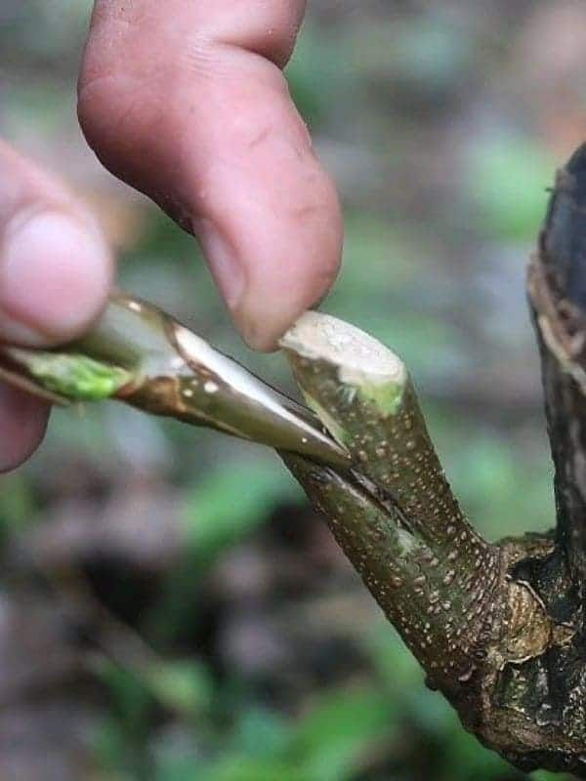
HAVE A CONNECTED WEEK

