Slide 1

WELCOME TO THE
JACKSON STREET CHURCH OF CHRIST
PLEASE TURN OFF CELLPHONES

Slide 2


Slide 3


Slide 4

SINGING

Slide 5
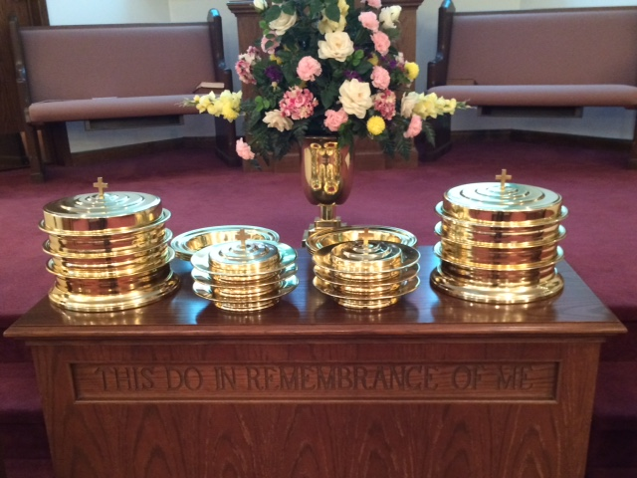
IN REMEMBRANCE OF JESUS

Slide 6
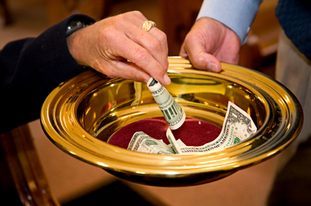
CONTRIBUTION

Slide 7
SINGING

Slide 8
2 Tim. 3:1-5 But know this, that in the last days perilous times will come: [2] For men will be lovers of themselves, lovers of money, boasters, proud, blasphemers, disobedient to parents, unthankful, unholy, [3] unloving, unforgiving, slanderers, without self-control, brutal, despisers of good, [4] traitors, headstrong, haughty, lovers of pleasure rather than lovers of God, [5] having a form of godliness but denying its power. And from such people turn away!

Slide 10

DANGER SIGNS OF

Slide 11
DANGER SIGNS OF APOSTASY
Apostasy (abandoning your faith)
Tim. 4:1-2 Now the Spirit expressly says that in latter times some will depart from the faith, giving heed to deceiving spirits and doctrines of demons, [2] speaking lies in hypocrisy, having their own conscience seared with a hot iron,
Hebrews 3:12 Beware, brethren, lest there be in any of you an evil heart of unbelief in departing from the living God;

Slide 12
I. LOSS OF APPETITE
FOR THE WORD
1 Peter 2:2 as newborn babes, desire the pure milk of the word, that you may grow thereby,

Slide 13
II. NEGLECTING PRAYER
Luke 18:1 Then He spoke a parable to them, that men always ought to pray and not lose heart,

Slide 14
III. ABSENT FROM WORSHIP
Hebrews 10:25 not forsaking the assembling of ourselves together, as is the manner of some, but exhorting one another, and so much the more as you see the Day approaching.

Slide 15
IV. NON-INVOLVEMENT
Ephes. 4:16 from whom the whole body, joined and knit together by what every joint supplies, according to the effective working by which every part does its share, causes growth of the body for the edifying of itself in love.

Slide 16
V. A CRITICAL SPIRIT
Galatians 5:13-15 For you, brethren, have been called to liberty; only do not use liberty as an opportunity for the flesh, but through love serve one another. [14] For all the law is fulfilled in one word, even in this: "You shall love your neighbor as yourself." [15] But if you bite and devour one another, beware lest you be consumed by one another!

Slide 17
VI. LACK OF RESPECT FOR THE TRUTHS OF GOD’S WORD
2 Thes. 2:10-12 and with all unrighteous deception among those who perish, because they did not receive the love of the truth, that they might be saved. [11] And for this reason God will send them strong delusion, that they should believe the lie, [12] that they all may be condemned who did not believe the truth but had pleasure in unrighteousness.

Slide 18
VII. NO CONCERN FOR OTHERS
Philip. 2:3-4 Let nothing be done through selfish ambition or conceit, but in lowliness of mind let each esteem others better than himself. [4] Let each of you look out not only for his own interests, but also for the interests of others.

Slide 19
VIII. MORE TIES TO THE WORLD THAN TO THE CHURCH
1 John 2:15–17 Do not love the world or the things in the world. If anyone loves the world, the love of the Father is not in him. ¹⁶ For all that is in the world—the lust of the flesh, the lust of the eyes, and the pride of life—is not of the Father but is of the world. ¹⁷ And the world is passing away, and the lust of it; but he who does the will of God abides forever.

Slide 20
IX. MORE TREASURE LAID UP ON EARTH THAN IN HEAVEN
Matthew 6:19–21 “Do not lay up for yourselves treasures on earth, where moth and rust destroy and where thieves break in and steal; ²⁰ but lay up for yourselves treasures in heaven, where neither moth nor rust destroys and where thieves do not break in and steal. ²¹ For where your treasure is, there your heart will be also.

Slide 21
X. KNOWINGLY DISOBEYING GOD’S WORD
Hebrews 10:26–29 For if we sin willfully after we have received the knowledge of the truth, there no longer remains a sacrifice for sins, ²⁷ but a certain fearful expectation of judgment, and fiery indignation which will devour the adversaries. ²⁸ Anyone who has rejected Moses’ law dies without mercy on the testimony of two or three witnesses. ²⁹ Of how much worse punishment, do you suppose, will he be thought worthy who has trampled the Son of God underfoot, counted the blood of the covenant by which he was sanctified a common thing, and insulted the Spirit of grace?

Slide 22
Are you exhibiting any of the danger signs of apostasy?
Loss Of Appetite For The Word
Neglecting Prayer
Absent From Worship
Non-Involvement
Critical Spirit
Lack Of Respect For The Truths Of God’s Word
No Concern For Others
More Ties To The World, Than To The Church
More Treasure Laid Up On Earth, Than In Heaven
Knowingly Disobeying God’s Word

Slide 23
SINGING

Slide 24
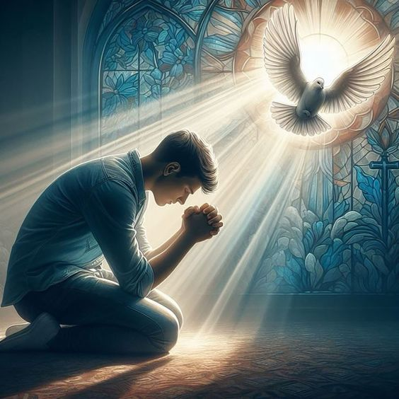
TONIGHT’S SERMON:
THE CHRISTIAN SPIRIT

