Slide 1
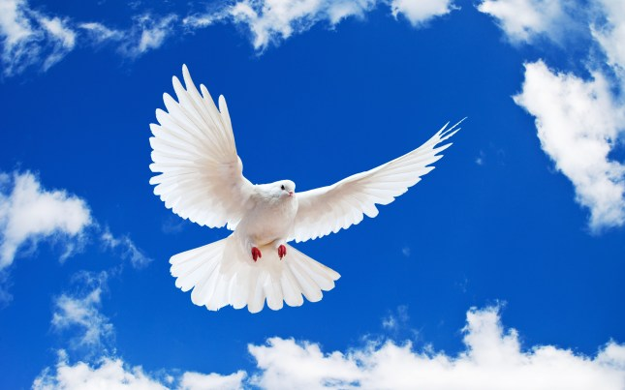
WELCOME TO THE
JACKSON STREET CHURCH OF CHRIST
PLEASE TURN OFF CELLPHONES

Slide 2


Slide 3

LET US PRAY

Slide 4

SINGING

Slide 5
Romans 8:9–11 But you are not in the flesh but in the Spirit, if indeed the Spirit of God dwells in you. Now if anyone does not have the Spirit of Christ, he is not His. ¹⁰ And if Christ is in you, the body is dead because of sin, but the Spirit is life because of righteousness. ¹¹ But if the Spirit of Him who raised Jesus from the dead dwells in you, He who raised Christ from the dead will also give life to your mortal bodies through His Spirit who dwells in you.

Slide 6
LET US PRAY

Slide 7
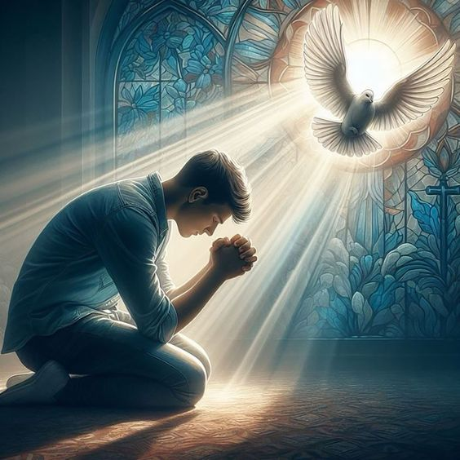
THE CHRISTIAN SPIRIT

Slide 8
THE CHRISTIAN SPIRIT
The Christian spirit is what we exhibit outwardly to others.
It might be referred to as our character. Such as, “She has a quiet and gentle spirit.”
James and John we called the sons of thunder – Mark 3:17
Why did Jesus call them the sons of thunder? We are not told but we get a look into their character in Luke 9:51–54 Now it came to pass, when the time had come for Him to be received up, that He steadfastly set His face to go to Jerusalem, ⁵² and sent messengers before His face. And as they went, they entered a village of the Samaritans, to prepare for Him. >>>

Slide 9
THE CHRISTIAN SPIRIT
⁵³ But they did not receive Him, because His face was set for the journey to Jerusalem. ⁵⁴ And when His disciples James and John saw this, they said, “Lord, do You want us to command fire to come down from heaven and consume them, just as Elijah did?”
It is how others see us.
The Christian spirt is to be shaped by the influence of God, Jesus and the Holy Spirit in our lives as they all live within us.
Our Christian spirit is determined by how much control we allow them to have in our lives and how much we resist Satan’s control.

Slide 10
1. THE SPIRIT OF GOD
NOT OF THE WORLD
1 Cor 2:12-16 Now we have received, not the spirit of the world, but the Spirit who is from God, that we might know the things that have been freely given to us by God. ¹³ These things we also speak, not in words which man's wisdom teaches but which the Holy Spirit teaches, comparing spiritual things with spiritual. ¹⁴ But the natural man does not receive the things of the Spirit of God, for they are foolishness to him; nor can he know them, because they are spiritually discerned. ¹⁵ But he who is spiritual judges all things, yet he himself is rightly judged by no one. ¹⁶ For "who has known the mind of the LORD that he may instruct Him?" But we have the mind of Christ.

Slide 11
2. THE SPIRIT OF GOD, CHRIST
AND THE HOLY SPIRIT
Romans 8:9–11 But you are not in the flesh but in the Spirit, if indeed the Spirit of God dwells in you. Now if anyone does not have the Spirit of Christ, he is not His. ¹⁰ And if Christ is in you, the body is dead because of sin, but the Spirit is life because of righteousness. ¹¹ But if the Spirit of Him who raised Jesus from the dead dwells in you, He who raised Christ from the dead will also give life to your mortal bodies through His Spirit who dwells in you.

Slide 12
3. THE SPIRIT OF LIFE IN CHRIST JESUS NOT OF DEATH
Rom 8:1-9 There is therefore now no condemnation to those who are in Christ Jesus, who do not walk according to the flesh, but according to the Spirit. ² For the law of the Spirit of life in Christ Jesus has made me free from the law of sin and death. ³ For what the law could not do in that it was weak through the flesh, God did by sending His own Son in the likeness of sinful flesh, on account of sin: He condemned sin in the flesh, ⁴ that the righteous requirement of the law might be fulfilled in us who do not walk according to the flesh but according to the Spirit. >>>

Slide 13
3. THE SPIRIT OF LIFE IN CHRIST JESUS NOT OF DEATH
⁵ For those who live according to the flesh set their minds on the things of the flesh, but those who live according to the Spirit, the things of the Spirit. ⁶ For to be carnally minded is death, but to be spiritually minded is life and peace. ⁷ Because the carnal mind is enmity against God; for it is not subject to the law of God, nor indeed can be. ⁸ So then, those who are in the flesh cannot please God. ⁹ But you are not in the flesh but in the Spirit, if indeed the Spirit of God dwells in you. Now if anyone does not have the Spirit of Christ, he is not His.

Slide 14
4. THE SPIRIT OF ADOPTION
NOT OF SLAVERY
Rom 8:14-17 For as many as are led by the Spirit of God, these are sons of God. ¹⁵ For you did not receive the spirit of bondage again to fear, but you received the Spirit of adoption by whom we cry out, "Abba, Father." ¹⁶ The Spirit Himself bears witness with our spirit that we are children of God, ¹⁷ and if children, then heirs; heirs of God and joint heirs with Christ, if indeed we suffer with Him, that we may also be glorified together.

Slide 15
5. THE SPIRIT OF FAITH
NOT UNBELIEF
2 Cor 4:13 And since we have the same spirit of faith, according to what is written, "I believed and therefore I spoke," we also believe and therefore speak,

Slide 16
6. THE SPIRIT OF PURIFICATION OF FLESH & SPIRIT NOT OF PUTRIFICATION
2 Cor 6:14 - 7:1 Do not be unequally yoked together with unbelievers. For what fellowship has righteousness with lawlessness? And what communion has light with darkness? ¹⁵ And what accord has Christ with Belial? Or what part has a believer with an unbeliever? ¹⁶ And what agreement has the temple of God with idols? For you are the temple of the living God. As God has said: "I will dwell in them And walk among them. I will be their God, And they shall be My people." ¹⁷ Therefore "Come out from among them And be separate, says the Lord. Do not touch what is unclean, And I will receive you." ¹⁸ "l will be a Father to you, And you shall be My sons and daughters, Says the LORD Almighty." 7:1 Therefore, having these promises, beloved, let us cleanse ourselves from all filthiness of the flesh and spirit, perfecting holiness in the fear of God.

Slide 17
7. SPIRIT OF GENTLENESS
NOT OF HARSHNESS
Gal 6:1-4 Brethren, if a man is overtaken in any trespass, you who are spiritual restore such a one in a spirit of gentleness, considering yourself lest you also be tempted. ² Bear one another's burdens, and so fulfill the law of Christ. ³ For if anyone thinks himself to be something, when he is nothing, he deceives himself. ⁴ But let each one examine his own work, and then he will have rejoicing in himself alone, and not in another.

Slide 18
8. SPIRIT OF WISDOM AND REVELATION IN THE KNOWLEDGE OF HIM NOT OF IGNORANCE
Eph 1:15-21 Therefore I also, after I heard of your faith in the Lord Jesus and your love for all the saints, ¹⁶ do not cease to give thanks for you, making mention of you in my prayers: ¹⁷ that the God of our Lord Jesus Christ, the Father of glory, may give to you the spirit of wisdom and revelation in the knowledge of Him, ¹⁸ the eyes of your understanding being enlightened; that you may know what is the hope of His calling, what are the riches of the glory of His inheritance in the saints, ¹⁹ and what is the exceeding greatness of His power toward us who believe, according to the working of His mighty power ²⁰ which He worked in Christ when He raised Him from the dead and seated Him at His right hand in the heavenly places, ²¹ far above all principality and power and might and dominion, and every name that is named, not only in this age but also in that which is to come.

Slide 19
9. SPIRIT OF GLORY NOT SHAME
1 Pet 4:12-19 Beloved, do not think it strange concerning the fiery trial which is to try you, as though some strange thing happened to you; ¹³ but rejoice to the extent that you partake of Christ's sufferings, that when His glory is revealed, you may also be glad with exceeding joy. ¹⁴ If you are reproached for the name of Christ, blessed are you, for the Spirit of glory and of God rests upon you. On their part He is blasphemed, but on your part He is glorified. ¹⁵ But let none of you suffer as a murderer, a thief, an evildoer, or as a busybody in other people's matters. ¹⁶ Yet if anyone suffers as a Christian, let him not be ashamed, but let him glorify God in this matter. ¹⁷ For the time has come for judgment to begin at the house of God; and if it begins with us first, what will be the end of those who do not obey the gospel of God? ¹⁸ Now "If the righteous one is scarcely saved, Where will the ungodly and the sinner appear?" ¹⁹ Therefore let those who suffer according to the will of God commit their souls to Him in doing good, as to a faithful Creator.

Slide 20
10. SPIRIT OF POWER, LOVE AND A HEALTHY MIND, NOT OF TIMIDITY
2 Tim 1:7-9 For God has not given us a spirit of fear, but of power and of love and of a sound mind. ⁸ Therefore do not be ashamed of the testimony of our Lord, nor of me His prisoner, but share with me in the sufferings for the gospel according to the power of God, ⁹ who has saved us and called us with a holy calling, not according to our works, but according to His own purpose and grace which was given to us in Christ Jesus before time began,

Slide 21
11. SPIRIT OF A RENEWED MIND NOT OF OLD ACTIONS
Eph 4:17-32 This I say, therefore, and testify in the Lord, that you should no longer walk as the rest of the Gentiles walk, in the futility of their mind, ¹⁸ having their understanding darkened, being alienated from the life of God, because of the ignorance that is in them, because of the blindness of their heart; ¹⁹ who, being past feeling, have given themselves over to lewdness, to work all uncleanness with greediness. ²⁰ But you have not so learned Christ, ²¹ if indeed you have heard Him and have been taught by Him, as the truth is in Jesus: ²² that you put off, concerning your former conduct, the old man which grows corrupt according to the deceitful lusts, ²³ and be renewed in the spirit of your mind, ²⁴ and that you put on the new man which was created according to God, in true righteousness and holiness. ²⁵ Therefore, putting away lying, >>>

Slide 22
11. SPIRIT OF A RENEWED MIND NOT OF OLD ACTIONS
"Let each one of you speak truth with his neighbor," for we are members of one another. ²⁶ "Be angry, and do not sin": do not let the sun go down on your wrath, ²⁷ nor give place to the devil. ²⁸ Let him who stole steal no longer, but rather let him labor, working with his hands what is good, that he may have something to give him who has need. ²⁹ Let no corrupt word proceed out of your mouth, but what is good for necessary edification, that it may impart grace to the hearers. ³⁰ And do not grieve the Holy Spirit of God, by whom you were sealed for the day of redemption. ³¹ Let all bitterness, wrath, anger, clamor, and evil speaking be put away from you, with all malice. ³² And be kind to one another, tenderhearted, forgiving one another, just as God in Christ forgave you.

Slide 23
12. SPIRIT OF TRUTH NOT OF ERROR
1 John 4:1-6 Beloved, do not believe every spirit, but test the spirits, whether they are of God; because many false prophets have gone out into the world. ² By this you know the Spirit of God: Every spirit that confesses that Jesus Christ has come in the flesh is of God, ³ and every spirit that does not confess that Jesus Christ has come in the flesh is not of God. And this is the spirit of the Antichrist, which you have heard was coming, and is now already in the world, ⁴ You are of God, little children, and have overcome them, because He who is in you is greater than he who is in the world. ⁵ They are of the world. Therefore they speak as of the world, and the world hears them. ⁶ We are of God. He who knows God hears us; he who is not of God does not hear us. By this we know the spirit of truth and the spirit of error.

Slide 24
YOUR CHRISTIAN SPIRIT?
What do you exhibit in your spirit or character? - Acts 4:13 Now when they saw the boldness of Peter and John, and perceived that they were uneducated and untrained men, they marveled. And they realized that they had been with Jesus.
Do others see Jesus living in you? - Galatians 2:20 I have been crucified with Christ; it is no longer I who live, but Christ lives in me; and the life which I now live in the flesh I live by faith in the Son of God, who loved me and gave Himself for me.
Are you living for Jesus since he died for you? - 2 Corinthians 5:14–15 For the love of Christ compels us, because we judge thus: that if One died for all, then all died; ¹⁵ and He died for all, that those who live should live no longer for themselves, but for Him who died for them and rose again.

Slide 25
YOUR CHRISTIAN SPIRIT?
We should walk and look like Jesus - 1 John 2:3–6 Now by this we know that we know Him, if we keep His commandments. ⁴ He who says, “I know Him,” and does not keep His commandments, is a liar, and the truth is not in him. ⁵ But whoever keeps His word, truly the love of God is perfected in him. By this we know that we are in Him. ⁶ He who says he abides in Him ought himself also to walk just as He walked.
If you do not have the Spirit of Christ, you don’t belong to Him. - Romans 8:9–11 But you are not in the flesh but in the Spirit, if indeed the Spirit of God dwells in you. Now if anyone does not have the Spirit of Christ, he is not His. ¹⁰ And if Christ is in you, the body is dead because of sin, but the Spirit is life because of righteousness. ¹¹ But if the Spirit of Him who raised Jesus from the dead dwells in you, He who raised Christ from the dead will also give life to your mortal bodies through His Spirit who dwells in you.

Slide 26
SINGING

Slide 27

IN REMEMBRANCE OF JESUS

Slide 28

CONTRIBUTION

Slide 29
SINGING

Slide 30
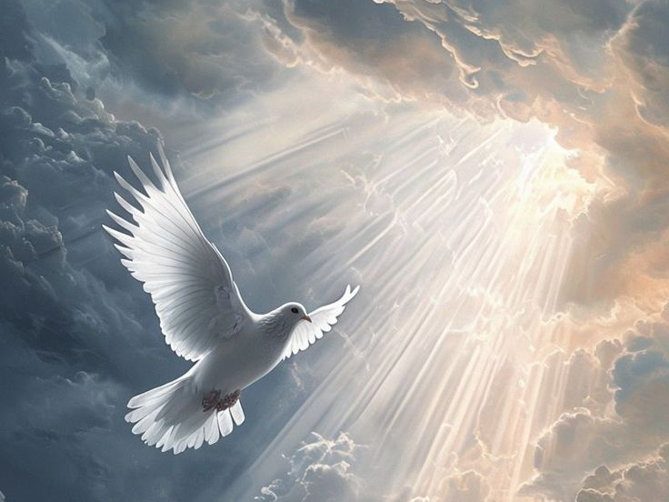
HAVE A SPIRITUAL WEEK

