Slide 1
WELCOME TO THE
JACKSON STREET CHURCH OF CHRIST
PLEASE TURN OFF CELL PHONES
This Photo by Unknown Author is licensed under CC BY-NC-ND

Slide 3
LET US PRAY

Slide 4
SINGING

Slide 5
(James 1:13-18) Let no one say when he is tempted, “I am tempted by God”; for God cannot be tempted by evil, nor does He Himself tempt anyone. {14} But each one is tempted when he is drawn away by his own desires and enticed. {15} Then, when desire has conceived, it gives birth to sin; and sin, when it is full-grown, brings forth death. {16} Do not be deceived, my beloved brethren. {17} Every good gift and every perfect gift is from above, and comes down from the Father of lights, with whom there is no variation or shadow of turning. {18} Of His own will He brought us forth by the word of truth, that we might be a kind of firstfruits of His creatures.

Slide 6
LET US PRAY

Slide 7
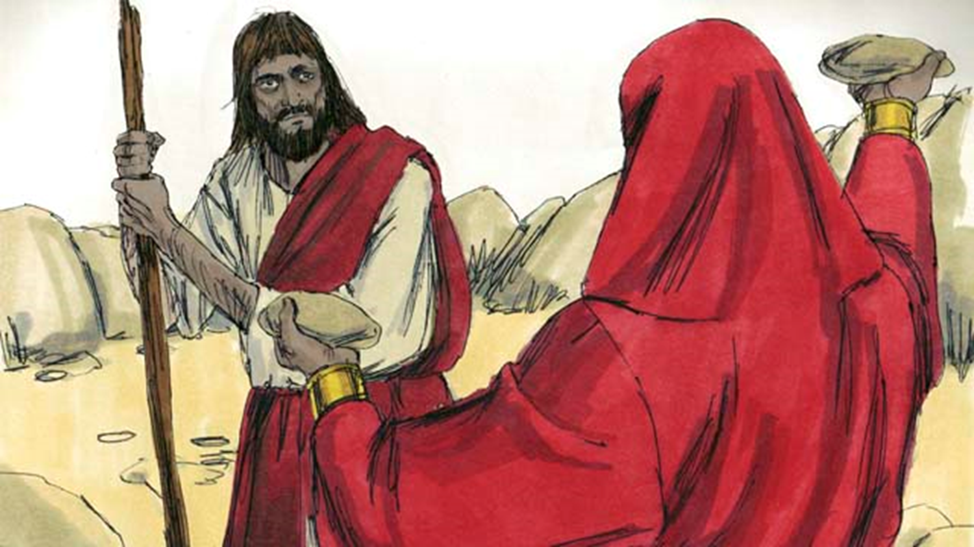
TEMPTATION

Slide 8
TEMPTATION
A. Temptation is no respecter of persons.
1. The young are tempted. (Joseph.).
2. The strong are tempted. (Samson.).
3. Men of nobility are tempted. (Saul, David.).
4. Common people are tempted. (Achan, Josh. 7.).
5. Christ was tempted. (Heb 4:15) For we do not have a High Priest who cannot sympathize with our weaknesses, but was in all points tempted as we are, yet without sin.
B. Temptation never takes a vacation. (1 Pet 5:8) Be sober, be vigilant; because your adversary the devil walks about like a roaring lion, seeking whom he may devour.

Slide 9
I. The Implication of Temptation
A. "Temptation" means "solicitation to sin."
B. Sin implies a standard of right and wrong.
1. "Sin" means to "miss the mark. "
2. Sin is a transgression (trans, across; gress, to step) of the law. (1 John 3:4) Whoever commits sin also commits lawlessness, and sin is lawlessness.
3. Sin is a failure to do good. (James 4:17) Therefore, to him who knows to do good and does not do it, to him it is sin.

Slide 10
I. The Implication of Temptation
C. The current idea of situation ethics denies that there is an objective standard.
1. "Love, not law, is the norm."
a. (John 14:15) “If you love Me, keep My commandments.
b. (1 John 5:3) For this is the love of God, that we keep His commandments. And His commandments are not burdensome.
2. God has specified "works of the flesh," - (Gal 5:19-21) Now the works of the flesh are evident, which are: adultery, fornication, uncleanness, lewdness, {20} idolatry, sorcery, hatred, contentions, jealousies, outbursts of wrath, selfish ambitions, dissensions, heresies, {21} envy, murders, drunkenness, revelries, and the like; of which I tell you beforehand, just as I also told you in time past, that those who practice such things will not inherit the kingdom of God.

Slide 11
II. The Nature of Temptation
A. God is not the author of temptation to do wrong. (James 1:13-14) Let no one say when he is tempted, “I am tempted by God”; for God cannot be tempted by evil, nor does He Himself tempt anyone. {14} But each one is tempted when he is drawn away by his own desires and enticed.
1. Adam tried to blame God. (Gen 3:12) Then the man said, "The woman whom You gave to be with me, she gave me of the tree, and I ate."
2. God tempts no man!
B. God created man the way he did.
1. God gave man the urges and drives which are in man.
2. But, God has also given holy ways for man to satisfy the urges. (1 Cor 7:2) because of sexual immorality, let each man have his own wife, and let each woman have her own husband.
3. God has also given man the ability to develop self-control. (1 Cor 9:27) But I discipline my body and bring it into subjection, lest, when I have preached to others, I myself should become disqualified.

Slide 12
II. The Nature of Temptation
C. How to cope with temptation.
1. Fight temptation with information.
a. Know the enticing nature of temptation.
b. Avoid pornography (literature designed to produce lust); Modern dance (bodily move­ments which incite passion); Immodest dress (which arouses unlawful desire.)
2. Resist temptation with determination.
a. Determination to resist. (James 4:7) Therefore submit to God. Resist the devil and he will flee from you.
b. Daniel is a good example of resisting from a purpose. (Dan 1:10) And the chief of the eunuchs said to Daniel, “I fear my lord the king, who has appointed your food and drink. For why should he see your faces looking worse than the young men who are your age? Then you would endanger my head before the king.”

Slide 13
II. The Nature of Temptation
C. How to cope with temptation.
3. Withstand temptation in dedication.
a. The more one loves righteousness the less enticement in sin. (Psa 119:104) Through Your precepts I get understanding; Therefore I hate every false way.
b. Lot's righteous soul was vexed by the im­morality of Sodom. (2 Pet 2:7-8) and delivered righteous Lot, who was oppressed by the filthy conduct of the wicked {8} (for that righteous man, dwelling among them, tormented his righteous soul from day to day by seeing and hearing their lawless deeds);

Slide 14
III. Righteousness Is Right For Man. (James 1:16, 17)
A. Believe that everything God tells man to do is for his good now and eternally. (1 Pet 3:10-13) For “He who would love life And see good days, Let him refrain his tongue from evil, And his lips from speaking deceit. {11} Let him turn away from evil and do good; Let him seek peace and pursue it. {12} For the eyes of the LORD are on the righteous, And His ears are open to their prayers; But the face of the LORD is against those who do evil.” {13} And who is he who will harm you if you become followers of what is good?

Slide 15
III. Righteousness Is Right For Man. (James 1:16, 17)
B. Believe that everything God tells man to leave alone is not good for man. (Heb 11:24-25) By faith Moses, when he became of age, refused to be called the son of Pharaoh’s daughter, {25} choosing rather to suffer affliction with the people of God than to enjoy the passing pleasures of sin,
C. Resist evil with strong faith. (1 Pet 5:8-9) Be sober, be vigilant; because your adversary the devil walks about like a roaring lion, seeking whom he may devour. {9} Resist him, steadfast in the faith, knowing that the same sufferings are experienced by your brotherhood in the world.

Slide 16
YOU CAN OVERCOME TEMPTATION
A. Man is no stronger than his weakest moment.
B. Temptation is not a disgrace, but an integral part of the battle for manhood.
C. God will help those who try to withstand temptation. (1 Cor 10:13) No temptation has overtaken you except such as is common to man; but God is faithful, who will not allow you to be tempted beyond what you are able, but with the temptation will also make the way of escape, that you may be able to bear it.

Slide 17
SINGING

Slide 18
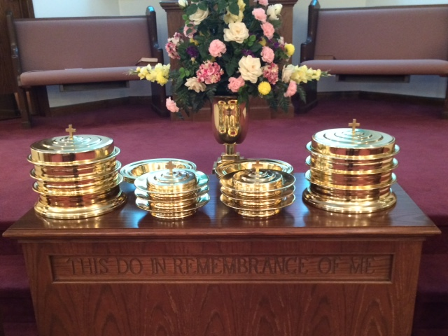
IN REMEMBRANCE OF JESUS

Slide 19
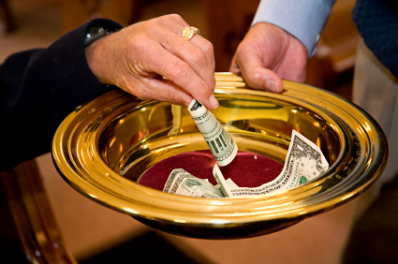
CONTRIBUTION

Slide 20
SINGING

Slide 21
HAVE A PRIORITIZED WEEK
LESS IMPORTANT THINGS
FIRST THINGS

Slide 22
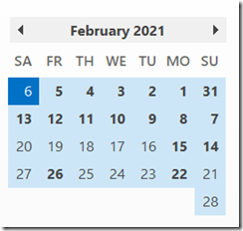
HAVE A PRIORITIZED WEEK
March

