Slide 1
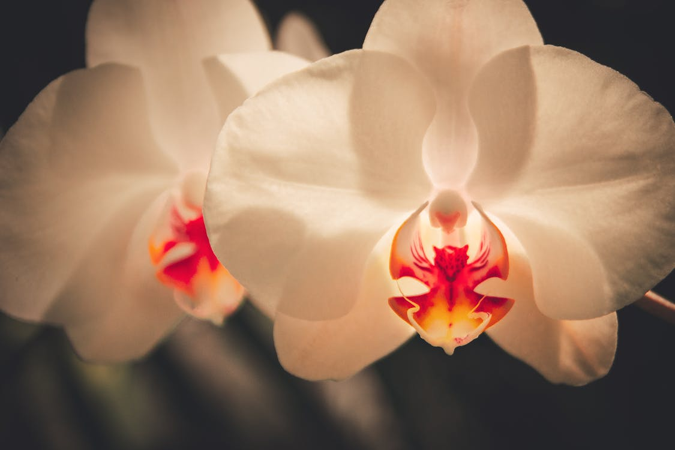
WELCOME TO THE
JACKSON STREET CHURCH OF CHRIST
PLEASE TURN OFF CELLPHONES

Slide 4
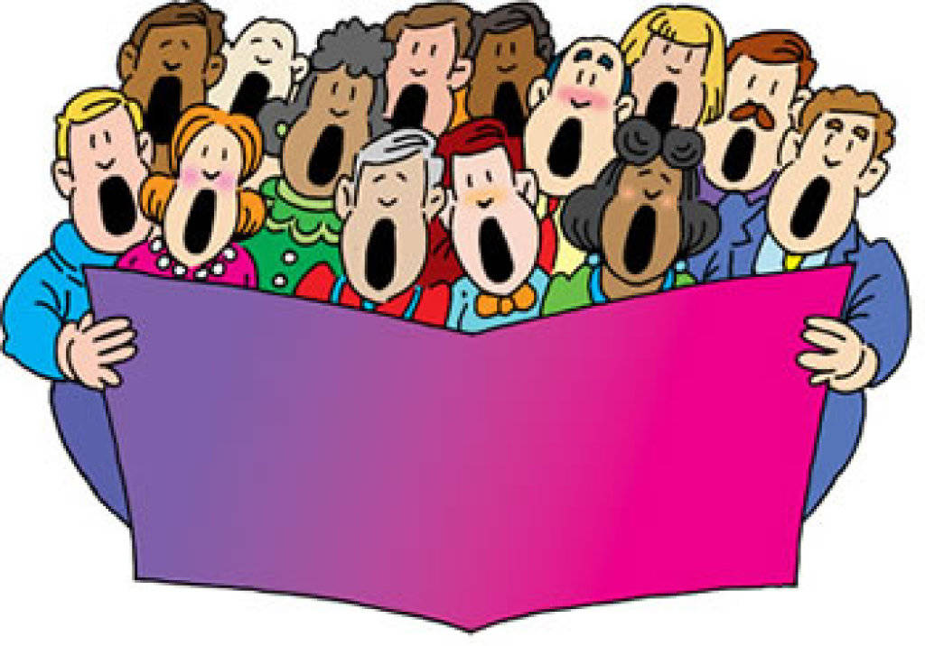
SINGING

Slide 5
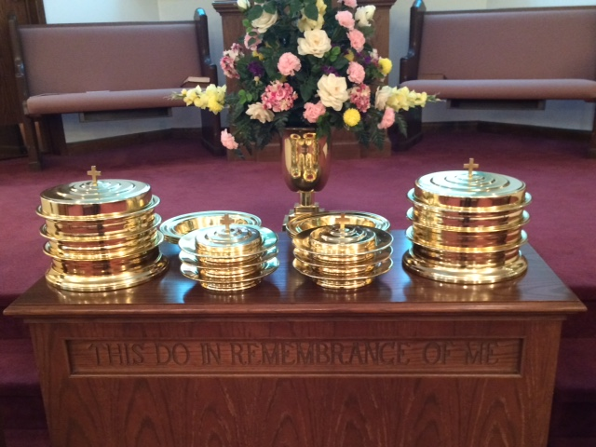
IN REMEMBRANCE OF JESUS

Slide 6
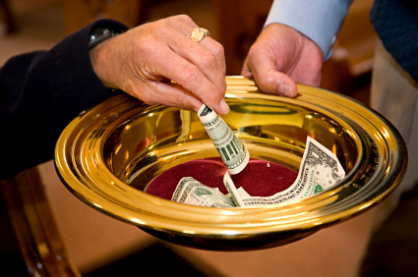
CONTRIBUTION

Slide 7
SINGING

Slide 8
Psalm 32:1–5 Blessed is he whose transgression is forgiven, Whose sin is covered. ² Blessed is the man to whom the LORD does not impute iniquity, And in whose spirit there is no deceit. ³ When I kept silent, my bones grew old Through my groaning all the day long. ⁴ For day and night Your hand was heavy upon me; My vitality was turned into the drought of summer. ⁵ I acknowledged my sin to You, And my iniquity I have not hidden. I said, “I will confess my transgressions to the LORD,” And You forgave the iniquity of my sin.

Slide 10
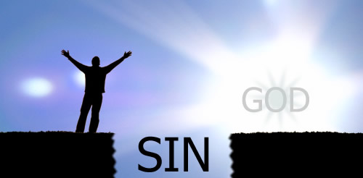
What Sin Does To People

Slide 11
SIN
Sin is an evil power that makes people do evil things. A sinner is a person who allows this evil power to take control of their life.
Every person on earth is either a sinner or a child of God. A sinner is controlled by sin to do bad things. A child of God is controlled by goodness to do good things. A sinner allows the devil to guide their life. A child of God allows God to guide them. This is the basic teaching of the Bible which is difficult for many people to comprehend.
A sinner cannot be good even though he or she may occasionally do good things. A sinner may act good now and then but the evil power inside of them will control them to do evil things.

Slide 12
SIN
We have all been sinners at one time. Every person on earth has sinned.
Some people never change. They stay a sinner all their life to continue evil deeds and attitudes.
Other people who do not want to be sinners turn to God for help. The Bible says,
(1 John 1:8-10) If we say that we have no sin, we deceive ourselves, and the truth is not in us. {9} If we confess our sins, He is faithful and just to forgive us our sins and to cleanse us from all unrighteousness. {10} If we say that we have not sinned, we make Him a liar, and His word is not in us.

Slide 13
I. Sin is deceptive
People who continue in sin often learn too late that sin will destroy them...both in this life and the life to come.
Sinners are deceived by the “lusts” of sin to believe that they are having fun doing evil things when in reality they have destroyed their bodies, their minds, their family and even their lives.
(Romans 7:11) For sin, taking occasion by the commandment, deceived me, and by it killed me.

Slide 14
II. Sin causes shame, fear and guilt in people’s lives
Even when people laugh and mock the sins they commit outwardly...the feelings of guilt, fear and shame haunt them inwardly. The only person who does not experience these feelings any longer are those who been turned over to a “reprobate mind” where they no longer have feelings toward others, themselves or God. The Bible says,
(Ezra 9:6) And I said: "O my God, I am too ashamed and humiliated to lift up my face to You, my God; for our iniquities have risen higher than our heads, and our guilt has grown up to the heavens.
(Psalms 40:12-13) For innumerable evils have surrounded me; My iniquities have overtaken me, so that I am not able to look up; They are more than the hairs of my head; Therefore my heart fails me. {13} Be pleased, O LORD, to deliver me; O LORD, make haste to help me!

Slide 15
III. Sin causes pain and misery
God never intended our life to be unhappy and miserable but sin’s power makes people do things that harm others and themselves. Every bad thing that has ever happened on earth is caused by someone’s sin. Every hurt, every wound and every disease is the result of sin.
(Isaiah 1:2-9) Hear, O heavens, and give ear, O earth! For the LORD has spoken: "I have nourished and brought up children, And they have rebelled against Me; {3} The ox knows its owner And the donkey its master's crib; But Israel does not know, My people do not consider." {4} Alas, sinful nation, A people laden with iniquity, A brood of evildoers, Children who are corrupters! They have forsaken the LORD, They have provoked to anger The Holy One of Israel, They have turned away backward. >>>

Slide 16
III. Sin causes pain and misery
{5} Why should you be stricken again? You will revolt more and more. The whole head is sick, And the whole heart faints. {6} From the sole of the foot even to the head, There is no soundness in it, But wounds and bruises and putrefying sores; They have not been closed or bound up, Or soothed with ointment. {7} Your country is desolate, Your cities are burned with fire; Strangers devour your land in your presence; And it is desolate, as overthrown by strangers. {8} So the daughter of Zion is left as a booth in a vineyard, As a hut in a garden of cucumbers, As a besieged city. {9} Unless the LORD of hosts Had left to us a very small remnant, We would have become like Sodom, We would have been made like Gomorrah.

Slide 17
IV. Sin enslaves the sinner
One of the lies that the devil tells sinners is that they are free to do what they want to...that they are control of their own life...that man does not need God.
What Satan does not reveal is this startling reality...if God does not guide us then the devil will. If God is not in control, the devil is. Every person is either guided by God’s goodness or the devil’s evils.
(John 8:34-36) Jesus answered them, "Most assuredly, I say to you, whoever commits sin is a slave of sin. {35} "And a slave does not abide in the house forever, but a son abides forever. {36} "Therefore if the Son makes you free, you shall be free indeed.
(2 Timothy 2:24-26) And a servant of the Lord must not quarrel but be gentle to all, able to teach, patient, {25} in humility correcting those who are in opposition, if God perhaps will grant them repentance, so that they may know the truth, {26} and that they may come to their senses and escape the snare of the devil, having been taken captive by him to do his will.

Slide 18
IV. Sin enslaves the sinner
(Romans 6:16-23) Do you not know that to whom you present yourselves slaves to obey, you are that one's slaves whom you obey, whether of sin leading to death, or of obedience leading to righteousness? {17} But God be thanked that though you were slaves of sin, yet you obeyed from the heart that form of doctrine to which you were delivered. {18} And having been set free from sin, you became slaves of righteousness. {19} I speak in human terms because of the weakness of your flesh. For just as you presented your members as slaves of uncleanness, and of lawlessness leading to more lawlessness, so now present your members as slaves of righteousness for holiness. {20} For when you were slaves of sin, you were free in regard to righteousness. {21} What fruit did you have then in the things of which you are now ashamed? For the end of those things is death. {22} But now having been set free from sin, and having become slaves of God, you have your fruit to holiness, and the end, everlasting life. {23} For the wages of sin is death, but the gift of God is eternal life in Christ Jesus our Lord.

Slide 19
V. Sin separates us from God and spiritual life
The most serious thing about sin is that it separates us from God.
God is all good. He cannot sin nor can He be a part of sin. God hates sin but not the sinner. But even though God loves sinners, He will not be a friend to people who keep sinning. Sin is like a big wall that separates us from God. God is on one side of the wall while we are on the other side trying to live a happy life without Him. The big wall of sin keeps God from being our friend and partner.
The wall of sin is our problem. It is the wall that we need to get rid of but we can’t tear the wall down by ourselves. The wall of sin is too big and powerful for any person to remove by ourselves. We need God’s help...and fortunately He will if we are sincere to ask.

Slide 20
V. Sin separates us from God and spiritual life
(Isaiah 59:1-2) Behold, the Lord's hand is not shortened, That it cannot save; Nor His ear heavy, That it cannot hear. {2} But your iniquities have separated you from your God; And your sins have hidden His face from you, So that He will not hear.
(Matthew 7:21-23) "Not everyone who says to Me, 'Lord, Lord,' shall enter the kingdom of heaven, but he who does the will of My Father in heaven. {22} "Many will say to Me in that day, 'Lord, Lord, have we not prophesied in Your name, cast out demons in Your name, and done many wonders in Your name?' {23} "And then I will declare to them, 'I never knew you; depart from Me, you who practice lawlessness!'
(Hebrews 12:14) Pursue peace with all people, and holiness, without which no one will see the Lord:

Slide 21
SIN?
The consequences of sin are many. They are seen throughout our world as evil men and women continue to rebel against their Creator. Sin is an evil power that is very deceptive.
Even while going through the motions of lustful pleasures that last for a moment or two the sinner lives within the privacy of his or her mind and emotions where shame, fear and guilt are daily companions. The wounds of sin are many for the sinner. Pain, suffering, family breakdowns, failures in life, loneliness, depression, despair are only of the few examples of sin’s consequences.
Sin is misery and bondage that will eventually destroy the mind, heart, body and soul. Its ultimate consequence is separation from God...who alone is the source of life, love and peace forever. Sin keeps man from enjoying the abundance of life that God so earnestly desires for each and every one of us.
There is nothing good that can be said of sin. It is our enemy, our nemesis, our most tragic problem.

Slide 22
SINGING

Slide 23
TONIGHT’S SERMON

