Slide 1
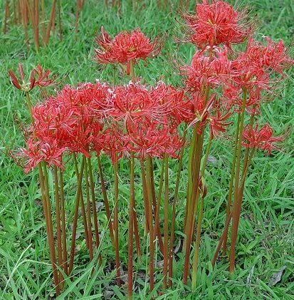
WELCOME TO THE
JACKSON STREET CHURCH OF CHRIST
PLEASE TURN OFF CELLPHONES

Slide 2


Slide 3


Slide 4
SONG
WE SAW THEE NOT #303

Slide 5

IN REMEMBRANCE OF JESUS

Slide 6

CONTRIBUTION

Slide 7
Luke 24:1–7 Now on the first day of the week, very early in the morning, they, and certain other women with them, came to the tomb bringing the spices which they had prepared. ² But they found the stone rolled away from the tomb. ³ Then they went in and did not find the body of the Lord Jesus. ⁴ And it happened, as they were greatly perplexed about this, that behold, two men stood by them in shining garments. ⁵ Then, as they were afraid and bowed their faces to the earth, they said to them, “Why do you seek the living among the dead? ⁶ He is not here, but is risen! Remember how He spoke to you when He was still in Galilee, ⁷ saying, ‘The Son of Man must be delivered into the hands of sinful men, and be crucified, and the third day rise again.’ ”

Slide 9
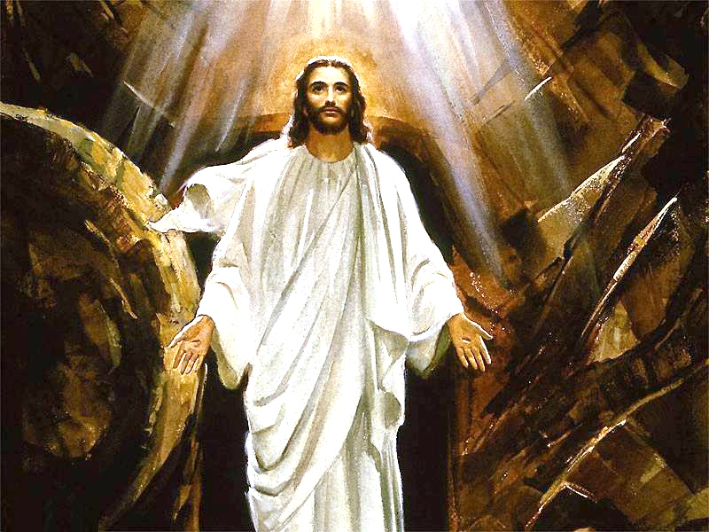
CHRIST AROSE

Slide 10
CHRIST AROSE
Rev 1:18 "l am He who lives, and was dead, and behold, I am alive forevermore. Amen. And I have the keys of Hades and of Death.
John 14:19 "A little while longer and the world will see Me no more, but you will see Me. Because I live, you will live also.
The Resurrection is the most significant happening ever in the religious world.
Because He was resurrected, we know we can be also.

Slide 11
SONG
HE LIVES #305

Slide 12
THAT WE MIGHT LIVE IN HIM
2 Cor 5:17 Therefore, if anyone is in Christ, he is a new creation; old things have passed away; behold, all things have become new.
Rom 8:1-2 There is therefore now no condemnation to those who are in Christ
Jesus, who do not walk according to the flesh, but according to the Spirit. {2} For the law of the Spirit of life in Christ Jesus has made me free from the law of sin and death

Slide 13
THAT WE MIGHT LIVE IN HIM
Gal 3:26-28 For you are all sons of God through faith in Christ Jesus. {27} For as many of you as were baptized into Christ have put on Christ. {28} There is neither Jew nor Greek, there is neither slave nor free, there is neither male nor female; for you are all one in Christ Jesus,
Rom 6:3-4 Or do you not know that as many of us as were baptized into Christ Jesus were baptized into His death? {4} Therefore we were buried with Him through baptism into death, that just as Christ was raised from the dead by the glory of the Father, even so we also should walk in newness of life.

Slide 14
SONG
WHERE PEACE LIKE A RIVER
#543

Slide 15
II. THAT WE MIGHT LIVE LIKE HIM
1 John 2:6 He who says he abides in Him ought himself also to walk just as He walked.
1 Pet 2:21 For to this you were called, because Christ also suffered for us, leaving us an example, that you should follow His steps:
Mat 16:24 Then Jesus said to His disciples, "If anyone desires to come after Me, let him deny himself, and take up his cross, and follow Me.

Slide 16
II. THAT WE MIGHT LIVE LIKE HIM
John 13:12-17 So when He had washed their feet, taken His garments, and sat down again, He said to them, "Do you know what I have done to you? {13} "You call me Teacher and Lord, and you say well, for so I am. {14} "If I then, your Lord and Teacher, have washed your feet, you also ought to wash one another's feet. {15} "For I have given you an example, that you should do as I have done to you. {16} "Most assuredly, I say to you, a servant is not greater than his master; nor is he who is sent greater than he who sent him. {17} "If you know these things, blessed are you if you do them.

Slide 17
SONG
WHERE HE LEADS, I WILL FOLLOW #286

Slide 18
III. THAT WE MIGHT LIVE FOR HIM
2 Cor 5:15 and He died for all, that those who live should live no longer for themselves, but for Him who died for them and rose again.
2 Cor 4:11 For we who live are always delivered to death for Jesus' sake, that the life of Jesus also may be manifested in our mortal flesh.
Eph 2:10 For we are His workmanship, created in Christ Jesus for good works, which God prepared beforehand that we should walk in them.
2 Cor 5:20 Now then, we are ambassadors for Christ, as though God were pleading through us: we implore you on Christ's behalf, be reconciled to God.

Slide 19
SONG
CHRIST FOR THE WORLD WE SING #733

Slide 20
IV. THAT WE MIGHT LIVE WITH HIM
1 Th 4:17 Then we who are alive and remain shall be caught up together with them in the clouds to meet the Lord in the air. And thus we shall always be with the Lord.
John 14:14 "Let not your heart be troubled; you believe in God, believe also in Me. {2} "In My Father's house are many mansions; if it were not so, would have told you. I go to prepare a place for you. {3} "And if I go and prepare a place for you, I will come again and receive you to Myself; that where I am, there you may be also.
John 12:26 "If anyone serves Me, let him follow Me; and where I am, there My servant wilt be also, if anyone serves Me, him My Father will honor.

Slide 21
IV. THAT WE MIGHT LIVE WITH HIM
2 Cor 5:1-10 For we know that if our earthly house, this tent, is destroyed, we have a building from God, a house not made with hands eternal in the heavens, {2} For in this we groan, earnestly desiring to be clothed with our habitation which is from heaven, {3} if indeed, having been clothed, we shall not be found naked. {4} For we Mho are in this tent groan, being burdened, not because we want to be unclothed, but further clothed, that mortality may be swallowed up by life. {5} Now He who has prepared us for this very thing is God, who also has given us the Spirit as a guarantee. >>>

Slide 22
IV. THAT WE MIGHT LIVE WITH HIM
{6} So are always confident, knowing that when we are at home in the body we are absent from the Lord. {7} For we walk by faith, not by sight. {8} We are confident, yes, well pleased rather to be absent from the body and to be present with the Lord. {9} Therefore we make it our aim, whether present or absent, to be well pleasing to Him. {10} For we must all appear before the judgment seat of Christ, that each one may receive the things done in the body, according to what he has done, whether good or bad.

Slide 23
SONG
THIS WORLD IS NOT MY HOME
#795

Slide 24
WHAT ABOUT YOU?
Are You Living In Jesus?
Are You Living Like Jesus?
Are You Living For Jesus?
Are You Confident That One Day You Will Live With Jesus?

Slide 25
INVITATION SONG
I’LL FLY AWAY #807

Slide 26
SONG
I KNOW THAT MY REDEEMER LIVES #489

Slide 27

PRAYER

Slide 28
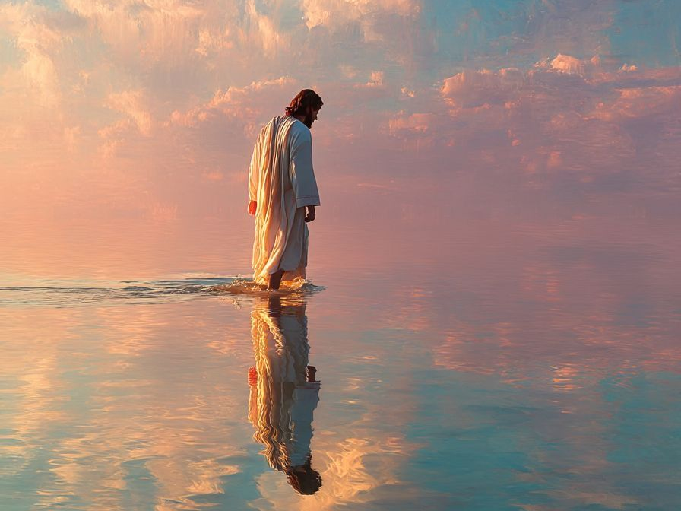
TONIGHT’S SERMON:
THE DEITY OF JESUS

