Slide 1
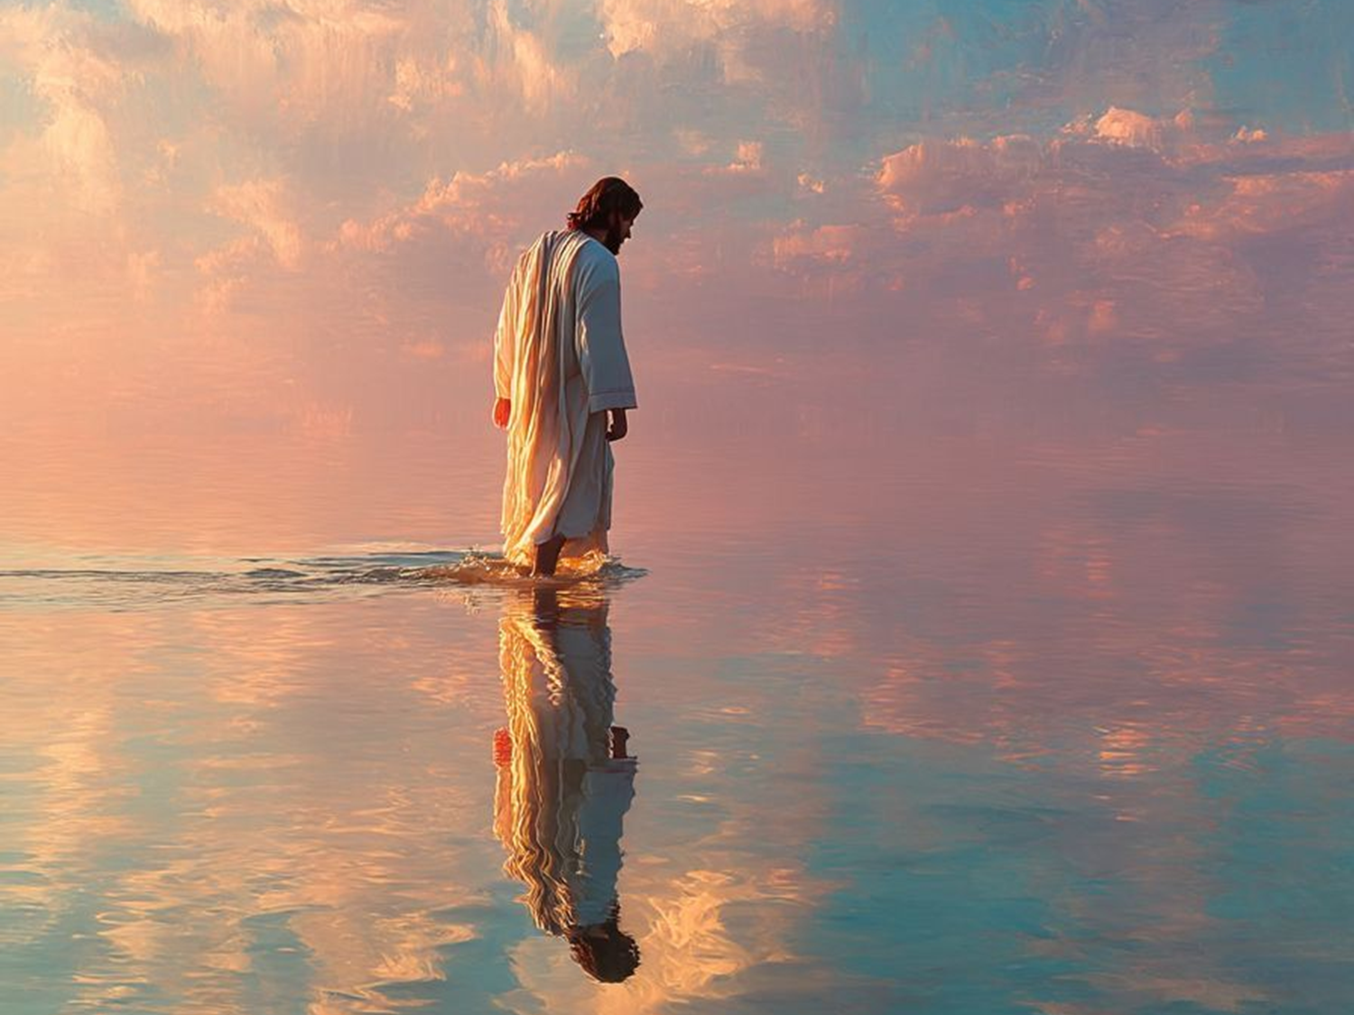
WELCOME TO THE
JACKSON STREET CHURCH OF CHRIST
PLEASE TURN OFF CELLPHONES

Slide 2


Slide 3

LET US PRAY

Slide 4

SINGING

Slide 5
John 1:1-3 In the beginning was the Word, and the Word was with God, and the Word was God. {2} He was in the beginning with God. {3} All things were made through Him, and without Him nothing was made that was made.

Slide 6
LET US PRAY

Slide 7
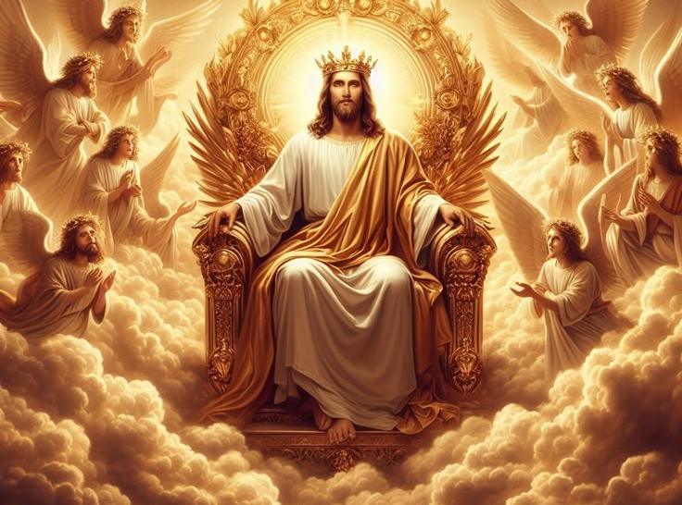
THE DEITY OF JESUS

Slide 8
THE DEITY OF JESUS
Many in the religious world called Christianity, do not accept the fact that Jesus was God on earth.
Jehovah’s Witnesses and Mormons and those who reject the idea of the Trinity or Godhead or the three in one, (Oneness doctrine) do not believe Jesus was God equal to God.
So, we will be looking at what the bible actually teaches on the deity of Jesus.

Slide 9
JESUS IS CALLED GOD AND NEVER DENIES IT
John 1:1-3 In the beginning was the Word, and the Word was with God, and the Word was God. {2} He was in the beginning with God. {3} All things were made through Him, and without Him nothing was made that was made.
John 1:14 And the Word became flesh and dwelt among us, and we beheld His glory, the glory as of the only begotten of the Father, full of grace and truth.
John 20:28 And Thomas answered and said to Him, "My Lord and my God!"

Slide 10
JESUS IS CALLED GOD AND NEVER DENIES IT
Isa 9:6 For unto us a Child is born, Unto us a Son is given; And the government will be upon His shoulder. And His name will be called Wonderful, Counselor, Mighty God, Everlasting Father, Prince of Peace.
2 Pet 1:1 Simon Peter, a bondservant and apostle of Jesus Christ, To those who have obtained like precious faith with us by the righteousness of our God and Savior Jesus Christ:
1 John 5:20 And we know that the Son of God has come and has given us an understanding, that we may know Him who is true; and we are in Him who is true, in His Son Jesus Christ. This is the true God and eternal life.

Slide 11
JESUS IS CALLED GOD AND NEVER DENIES IT
Rom 9:5 of whom are the fathers and from whom, according to the flesh, Christ came, who is over all, the eternally blessed God. Amen.
Col 2:9 For in Him dwells all the fullness of the Godhead bodily;
Mat 1:23 "Behold, the virgin shall be with child, and bear a Son, and they shall call His name Immanuel," which is translated, "God with us.
Heb 1:8-9 But to the Son He says: "Your throne, O God, is forever and ever; A scepter of righteousness is the scepter of Your Kingdom. {9} You have loved righteousness and hated lawlessness; Therefore God, Your God, has anointed You With the oil of gladness more than Your companions."

Slide 12
ll. JESUS MAKES HIMSELF EQUAL TO GOD AND NEVER DENIES THE CHARGE
John 10:33 The Jews answered Him, saying, "For a good work we do not stone You, but for blasphemy, and because You, being a Man, make Yourself God.
John 5:18 Therefore the Jews sought all the more to kill Him, because He not only broke the Sabbath, but also said that God was His Father, making Himself equal with God.
John 8:58-59 Jesus said to them, "Most assuredly, I say to you, before Abraham was, I AM." {59} Then they took up stones to throw at Him, but Jesus hid Himself and went out of the temple, going through the midst of them, and so passed by.

Slide 13
Ill. JESUS IS WORSHIPPED AND NEVER REJECTED IT
Mat 4:10 Then Jesus said to him, "Away with you, Satan! For it is written, 'You shall worship the LORD your God, and Him only you shall serve."'
Acts 10:25-26 As Peter was coming in, Cornelius met him and fell down at his feet and worshiped him. {26} But Peter lifted him up, saying, "Stand up; I myself am also a man."
Mat 14:33 Then those who were in the boat came and worshiped Him, saying, "Truly You are the Son of God."
Heb 1:6 But when He again brings the firstborn into the world, He says: "Let all the angels of God worship Him."

Slide 14
GOD IS THE CREATOR YET JESUS CREATED ALL THINGS
  Col 1:15-17 He is the image of the invisible God, the firstborn over all creation.{16} For by Him all things were created that are in heaven and that are on earth, visible and invisible, whether thrones or dominions or principalities or powers. All things were created through Him and for Him. {17} And He is before all things, and in Him all things consist.
  John 1:3 All things were made through Him, and without Him nothing was made that was made.
  Heb 1:1-2 God, who at various times and in various ways spoke in time past to the fathers by the prophets, {2} has in these last days spoken to us by His Son, whom He has appointed heir of all things, through whom also He made the worlds,

Slide 15
JESUS CLAIMED EQUALITY WITH GOD
John 10:30 "I and My Father are one
John 12:45 "And he who sees Me sees Him who sent Me.
John 14:7 "If you had known Me, you would have known My Father also; and from now on you know Him and have seen Him.
Heb 1:3 who being the brightness of His glory and the express image of His person, and upholding all things by the word of His power, when He had by Himself purged our sins, sat down at the right hand of the Majesty on high,

Slide 16
JESUS CLAIMED EQUALITY WITH GOD
Phil 2:5-9 Let this mind be in you which was also in Christ Jesus, {6} who, being in the form of God, did not consider it robbery to be equal with God, {7} but made Himself of no reputation, taking the form of a bondservant, and coming in the likeness of men. {8} And being found in appearance as a man, He humbled Himself and became obedient to the point of death, even the death of the cross. {9} Therefore God also has highly exalted Him and given Him the name which is above every name,

Slide 17
THE DEITY OF JESUS
Jesus made it very clear that He was equal to God and that unless we accept that fact, we will die in our sins.
He, is in italics meaning it was not in the original but added by translators. Jesus said, “If you do not believe I AM, you will die in your sins.
Exodus 3:14 And God said to Moses, “I AM WHO I AM.” And He said, “Thus you shall say to the children of Israel, ‘I AM has sent me to you.’ ”
John 8:58–59 Jesus said to them, “Most assuredly, I say to you, before Abraham was, I AM.” ⁵⁹ Then they took up stones to throw at Him; but Jesus hid Himself and went out of the temple, going through the midst of them, and so passed by.

Slide 18
THE DEITY OF JESUS
John 8:19–24 Then they said to Him, “Where is Your Father?” Jesus answered, “You know neither Me nor My Father. If you had known Me, you would have known My Father also.” ²⁰ These words Jesus spoke in the treasury, as He taught in the temple; and no one laid hands on Him, for His hour had not yet come. ²¹ Then Jesus said to them again, “I am going away, and you will seek Me, and will die in your sin. Where I go you cannot come.” ²² So the Jews said, “Will He kill Himself, because He says, ‘Where I go you cannot come’?” ²³ And He said to them, “You are from beneath; I am from above. You are of this world; I am not of this world. ²⁴ Therefore I said to you that you will die in your sins; for if you do not believe that I am He, you will die in your sins.”

Slide 19
SINGING

Slide 20

IN REMEMBRANCE OF JESUS

Slide 21

CONTRIBUTION

Slide 22
SINGING

Slide 23
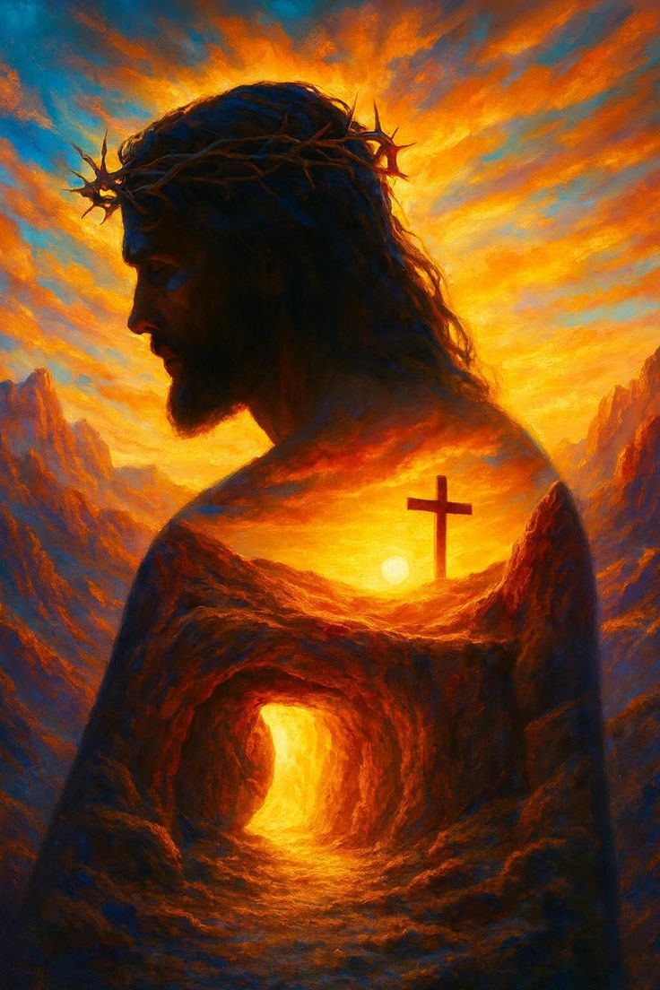
HAVE A BELIEVING WEEK

