Slide 1
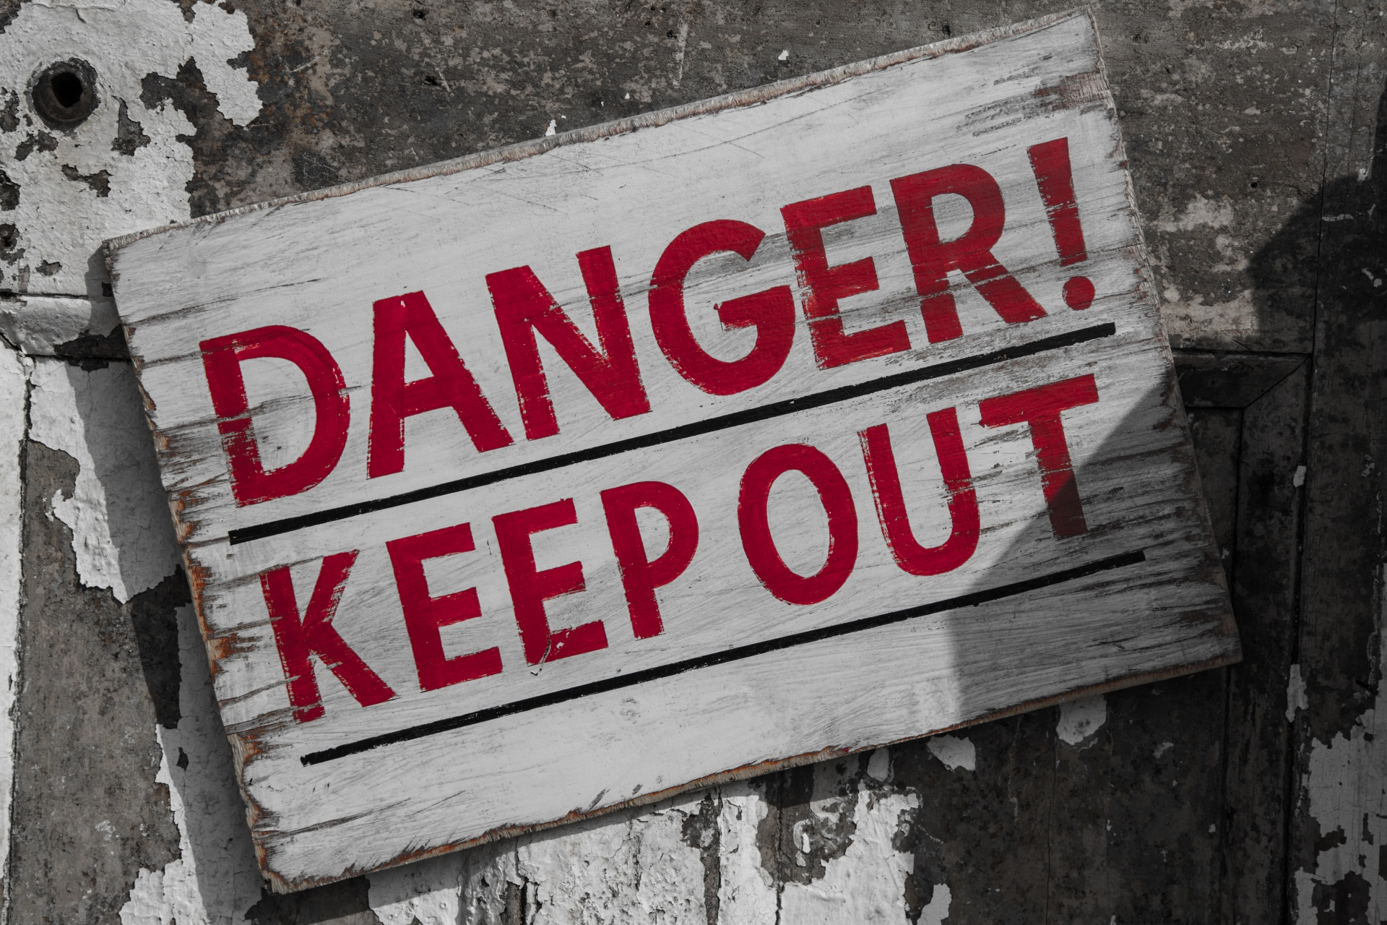
WELCOME TO THE
JACKSON STREET CHURCH OF CHRIST
PLEASE TURN OFF CELLPHONES

Slide 4
SINGING

Slide 5
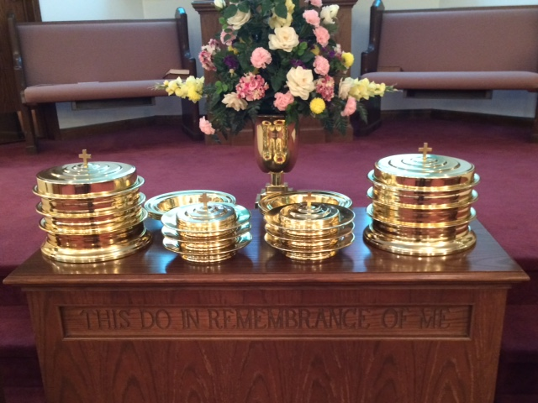
IN REMEMBRANCE OF JESUS

Slide 6
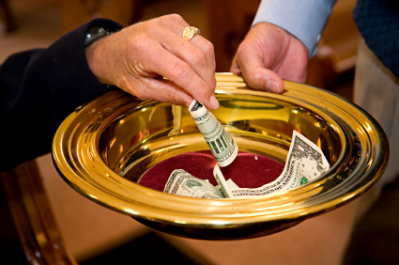
CONTRIBUTION

Slide 7
SINGING

Slide 8
2 Corinthians 11:12–15 But what I do, I will also continue to do, that I may cut off the opportunity from those who desire an opportunity to be regarded just as we are in the things of which they boast. ¹³ For such are false apostles, deceitful workers, transforming themselves into apostles of Christ. ¹⁴ And no wonder! For Satan himself transforms himself into an angel of light. ¹⁵ Therefore it is no great thing if his ministers also transform themselves into ministers of righteousness, whose end will be according to their works.

Slide 10
UNSEEN DANGERS IN THE CHRISTIAN LIFE

Slide 11
UNSEEN DANGERS
Unseen dangers can sneak up on us and we need to be ready for them.
We will be looking at some hidden dangers we may face.

Slide 12
I. THE DANGER OF JUDGING OURSELVES BY THE LIFE AND STANDARDS OF OTHERS.
(Luke 18:10-14) "Two men went up to the temple to pray, one a Pharisee and the other a tax collector. ¹¹ "The Pharisee stood and prayed thus with himself, 'God, I thank You that I am not like other men; extortioners, unjust, adulterers, or even as this tax collector. ¹² 'I fast twice a week; I give tithes of all that I possess.' ¹³ "And the tax collector, standing afar off, would not so much as raise his eyes to heaven, but beat his breast, saying, 'God, be merciful to me a sinner!' ¹⁴ "I tell you, this man went down to his house justified rather than the other; for everyone who exalts himself will be humbled, and he who humbles himself will be exalted."

Slide 13
I. THE DANGER OF JUDGING OURSELVES BY THE LIFE AND STANDARDS OF OTHERS.
2 Corinthians 10:12 For we dare not class ourselves or compare ourselves with those who commend themselves. But they, measuring themselves by themselves, and comparing themselves among themselves, are not wise.
Luke 6:39 And He spoke a parable to them: “Can the blind lead the blind? Will they not both fall into the ditch?

Slide 14
I. THE DANGER OF JUDGING OURSELVES BY THE LIFE AND STANDARDS OF OTHERS.
Matthew 7:21–23 “Not everyone who says to Me, ‘Lord, Lord,’ shall enter the kingdom of heaven, but he who does the will of My Father in heaven. ²² Many will say to Me in that day, ‘Lord, Lord, have we not prophesied in Your name, cast out demons in Your name, and done many wonders in Your name?’ ²³ And then I will declare to them, ‘I never knew you; depart from Me, you who practice lawlessness!’
Because others do wrong it is not ok to do the same.

Slide 15
II. THE DANGER OF COUNTING THE SINS OF OMISSION SMALLER THAN THE SINS OF COMMISSION.
(Mat 23:23-28) "Woe to you, scribes and Pharisees, hypocrites! For you pay tithe of mint and anise and cummin, and have neglected the weightier matters of the law: justice and mercy and faith. These you ought to have done, without leaving the others undone. ²⁴ "Blind guides, who strain out a gnat and swallow a camel! ²⁵ "Woe to you, scribes and Pharisees, hypocrites! For you cleanse the outside of the cup and dish, but inside they are full of extortion and self-indulgence. ²⁶ "Blind Pharisee, first cleanse the inside of the cup and dish, that the outside of them may be clean also. ²⁷ "Woe to you, scribes and Pharisees, hypocrites! For you are like whitewashed tombs which indeed appear beautiful outwardly, but inside are full of dead men's bones and all uncleanness. ²⁸ "Even so you also outwardly appear righteous to men, but inside you are full of hypocrisy and lawlessness.

Slide 16
II. THE DANGER OF COUNTING THE SINS OF OMISSION SMALLER THAN THE SINS OF COMMISSION.
James 2:10–13 For whoever shall keep the whole law, and yet stumble in one point, he is guilty of all. ¹¹ For He who said, “Do not commit adultery,” also said, “Do not murder.” Now if you do not commit adultery, but you do murder, you have become a transgressor of the law. ¹² So speak and so do as those who will be judged by the law of liberty. ¹³ For judgment is without mercy to the one who has shown no mercy. Mercy triumphs over judgment.
James 4:17 Therefore, to him who knows to do good and does not do it, to him it is sin.
“Thou Shalt” is just as much a command as “Thou Shalt Not”.

Slide 17
III. THE DANGER OF LOSING OUR HATRED FOR SIN AND WORLDLINESS.
Psalm 97:10 You who love the LORD, hate evil! He preserves the souls of His saints; He delivers them out of the hand of the wicked.
1 John 2:15–17 Do not love the world or the things in the world. If anyone loves the world, the love of the Father is not in him. ¹⁶ For all that is in the world—the lust of the flesh, the lust of the eyes, and the pride of life—is not of the Father but is of the world. ¹⁷ And the world is passing away, and the lust of it; but he who does the will of God abides forever.

Slide 18
III. THE DANGER OF LOSING OUR HATRED FOR SIN AND WORLDLINESS.
Romans 7:15 For what I am doing, I do not understand. For what I will to do, that I do not practice; but what I hate, that I do.
Hate the sin but love the sinner
Revelation 2:6 But this you have, that you hate the deeds of the Nicolaitans, which I also hate.
Jude 22–23 And on some have compassion, making a distinction; ²³ but others save with fear, pulling them out of the fire, hating even the garment defiled by the flesh.

Slide 19
IV. THE DANGER OF LETTING UP, BACKING OFF, AND TAKING IT EASY IN OUR CHRISTIAN LIFE.
Galatians 5:7–10 You ran well. Who hindered you from obeying the truth? ⁸ This persuasion does not come from Him who calls you. ⁹ A little leaven leavens the whole lump. ¹⁰ I have confidence in you, in the Lord, that you will have no other mind; but he who troubles you shall bear his judgment, whoever he is.Lets our friends and loved ones die and end up in hell.
Galatians 3:1 O foolish Galatians! Who has bewitched you that you should not obey the truth, before whose eyes Jesus Christ was clearly portrayed among you as crucified?

Slide 20
IV. THE DANGER OF LETTING UP, BACKING OFF, AND TAKING IT EASY IN OUR CHRISTIAN LIFE.
Hebrews 6:11–12 And we desire that each one of you show the same diligence to the full assurance of hope until the end, ¹² that you do not become sluggish, but imitate those who through faith and patience inherit the promises.
Romans 12:9–13 Let love be without hypocrisy. Abhor what is evil. Cling to what is good. ¹⁰ Be kindly affectionate to one another with brotherly love, in honor giving preference to one another; ¹¹ not lagging in diligence, fervent in spirit, serving the Lord; ¹² rejoicing in hope, patient in tribulation, continuing steadfastly in prayer; ¹³ distributing to the needs of the saints, given to hospitality.

Slide 21
V. THE DANGER OF FORGETTING WHAT GOD HAS DONE FOR US.
Deuteronomy 4:7–9 “For what great nation is there that has God so near to it, as the LORD our God is to us, for whatever reason we may call upon Him? ⁸ And what great nation is there that has such statutes and righteous judgments as are in all this law which I set before you this day? ⁹ Only take heed to yourself, and diligently keep yourself, lest you forget the things your eyes have seen, and lest they depart from your heart all the days of your life. And teach them to your children and your grandchildren,In taking our salvation for granted.

Slide 22
V. THE DANGER OF FORGETTING WHAT GOD HAS DONE FOR US.
2 Peter 1:5–9 But also for this very reason, giving all diligence, add to your faith virtue, to virtue knowledge, ⁶ to knowledge self-control, to self-control perseverance, to perseverance godliness, ⁷ to godliness brotherly kindness, and to brotherly kindness love. ⁸ For if these things are yours and abound, you will be neither barren nor unfruitful in the knowledge of our Lord Jesus Christ. ⁹ For he who lacks these things is shortsighted, even to blindness, and has forgotten that he was cleansed from his old sins.

Slide 23
V. THE DANGER OF FORGETTING WHAT GOD HAS DONE FOR US.
Ephesians 2:11–13 Therefore remember that you, once Gentiles in the flesh—who are called Uncircumcision by what is called the Circumcision made in the flesh by hands—¹² that at that time you were without Christ, being aliens from the commonwealth of Israel and strangers from the covenants of promise, having no hope and without God in the world. ¹³ But now in Christ Jesus you who once were far off have been brought near by the blood of Christ.

Slide 24
V. THE DANGER OF FORGETTING WHAT GOD HAS DONE FOR US.
1 Peter 4:1–6 Therefore, since Christ suffered for us in the flesh, arm yourselves also with the same mind, for he who has suffered in the flesh has ceased from sin, 2 that he no longer should live the rest of his time in the flesh for the lusts of men, but for the will of God. 3 For we have spent enough of our past lifetime in doing the will of the Gentiles—when we walked in lewdness, lusts, drunkenness, revelries, drinking parties, and abominable idolatries. 4 In regard to these, they think it strange that you do not run with them in the same flood of dissipation, speaking evil of you. 5 They will give an account to Him who is ready to judge the living and the dead. 6 For this reason the gospel was preached also to those who are dead, that they might be judged according to men in the flesh, but live according to God in the spirit.

Slide 25
ARE YOU FACING THESE UNSEEN DANGERS IN YOUR LIFE?
The danger of judging ourselves by the life and standards of others.
The danger of counting the sins of omission smaller than the sins of commission.
The danger of losing our hatred for sin and worldliness.
The danger of letting up, backing off, and taking it easy in our Christian life.
The danger of forgetting what God has done for us.

Slide 26
SINGING

Slide 27
TONIGHT’S SERMON
WAIT UPON THE LORD

