Slide 1
WELCOME TO THE
JACKSON STREET CHURCH OF CHRIST
PLEASE TURN OFF CELL PHONES
This Photo by Unknown Author is licensed under CC BY-NC-ND

Slide 3
LET US PRAY

Slide 4
SINGING

Slide 5
Isaiah 40:28–31 Have you not known? Have you not heard? The everlasting God, the LORD, The Creator of the ends of the earth, Neither faints nor is weary. His understanding is unsearchable. ²⁹ He gives power to the weak, And to those who have no might He increases strength. ³⁰ Even the youths shall faint and be weary, And the young men shall utterly fall, ³¹ But those who wait on the LORD Shall renew their strength; They shall mount up with wings like eagles, They shall run and not be weary, They shall walk and not faint.

Slide 6
LET US PRAY

Slide 7
THOSE WHO WAIT UPON THE LORD

Slide 8
WAITING ON THE LORD
This scripture has given comfort and encouragement to countless numbers of saints over the centuries.
Some believe this scripture is a reference to heaven and what we will be like there.
We will be looking at this scripture and how it applies to us today.

Slide 9
THE POSTURE OF RENEWAL – Those wait upon the Lord.
Psalm 25:21 Let integrity and uprightness preserve me, For I wait for You.
Psalm 27:13–14 I would have lost heart, unless I had believed That I would see the goodness of the LORD In the land of the living. ¹⁴ Wait on the LORD; Be of good courage, And He shall strengthen your heart; Wait, I say, on the LORD!
Psalm 40:1–3 I waited patiently for the LORD; And He inclined to me, And heard my cry. ² He also brought me up out of a horrible pit, Out of the miry clay, And set my feet upon a rock, And established my steps. ³ He has put a new song in my mouth— Praise to our God; Many will see it and fear, trust in the LORD.

Slide 10
THE POSTURE OF RENEWAL – Those wait upon the Lord.
Lamentations 3:25–26 The LORD is good to those who wait for Him, To the soul who seeks Him. ²⁶ It is good that one should hope and wait quietly For the salvation of the LORD.
1 Thessalonians 1:6–10 And you became followers of us and of the Lord, having received the word in much affliction, with joy of the Holy Spirit, ⁷ so that you became examples to all in Macedonia and Achaia who believe. ⁸ For from you the word of the Lord has sounded forth, not only in Macedonia and Achaia, but also in every place. Your faith toward God has gone out, so that we do not need to say anything. ⁹ For they themselves declare concerning us what manner of entry we had to you, and how you turned to God from idols to serve the living and true God, ¹⁰ and to wait for His Son from heaven, whom He raised from the dead, even Jesus who delivers us from the wrath to come.

Slide 11
II. THE PROMISE OF RENEWAL – Shall renew their strength.
Job 17:9 Yet the righteous will hold to his way, And he who has clean hands will be stronger and stronger.
Job 33:24–26 Then He is gracious to him, and says, ‘Deliver him from going down to the Pit; I have found a ransom’; ²⁵ His flesh shall be young like a child’s, He shall return to the days of his youth. ²⁶ He shall pray to God, and He will delight in him, He shall see His face with joy, For He restores to man His righteousness.
Colossians 3:8–10 But now you yourselves are to put off all these: anger, wrath, malice, blasphemy, filthy language out of your mouth. ⁹ Do not lie to one another, since you have put off the old man with his deeds, ¹⁰ and have put on the new man who is renewed in knowledge according to the image of Him who created him,

Slide 12
III. THE POWER OF RENEWAL – They shall mount up with wings like eagles.
Psalm 103:1–5 Bless the LORD, O my soul; And all that is within me, bless His holy name! ² Bless the LORD, O my soul, And forget not all His benefits: ³ Who forgives all your iniquities, Who heals all your diseases, ⁴ Who redeems your life from destruction, Who crowns you with lovingkindness and tender mercies, ⁵ Who satisfies your mouth with good things, So that your youth is renewed like the eagle’s.
Psalm 138:1–3 I will praise You with my whole heart; Before the gods I will sing praises to You. ² I will worship toward Your holy temple, And praise Your name For Your lovingkindness and Your truth; For You have magnified Your word above all Your name. ³ In the day when I cried out, You answered me, And made me bold with strength in my soul.

Slide 13
III. THE POWER OF RENEWAL – They shall mount up with wings like eagles.
2 Corinthians 12:7–10 And lest I should be exalted above measure by the abundance of the revelations, a thorn in the flesh was given to me, a messenger of Satan to buffet me, lest I be exalted above measure. ⁸ Concerning this thing I pleaded with the Lord three times that it might depart from me. ⁹ And He said to me, “My grace is sufficient for you, for My strength is made perfect in weakness.” Therefore most gladly I will rather boast in my infirmities, that the power of Christ may rest upon me. ¹⁰ Therefore I take pleasure in infirmities, in reproaches, in needs, in persecutions, in distresses, for Christ’s sake. For when I am weak, then I am strong.

Slide 14
IV. THE PERSEVERANCE OF RENEWAL - They shall run and not be weary, They shall walk and not faint.
Job 17:9 Yet the righteous will hold to his way, And he who has clean hands will be stronger and stronger.
2 Corinthians 4:16–18 Therefore we do not lose heart. Even though our outward man is perishing, yet the inward man is being renewed day by day. ¹⁷ For our light affliction, which is but for a moment, is working for us a far more exceeding and eternal weight of glory, ¹⁸ while we do not look at the things which are seen, but at the things which are not seen. For the things which are seen are temporary, but the things which are not seen are eternal.
Galatians 6:8–9 For he who sows to his flesh will of the flesh reap corruption, but he who sows to the Spirit will of the Spirit reap everlasting life. ⁹ And let us not grow weary while doing good, for in due season we shall reap if we do not lose heart.

Slide 15
Isaiah 40:31 Those who wait on the LORD Shall renew their strength; They shall mount up with wings like eagles, They shall run and not be weary, They shall walk and not faint.
DO YOU HAVE THE POSTURE OF RENEWAL – Are you waiting upon the Lord?
DO YOU HAVE THE PROMISE OF RENEWAL – Is your strength being renewed?
DO YOU HAVE THE POWER OF RENEWAL – Are you mounting up with wings like eagles.
DO YOU HAVE THE PERSEVERANCE OF RENEWAL – Are you running and not becoming weary, and walking and not fainting.

Slide 16
SINGING

Slide 17
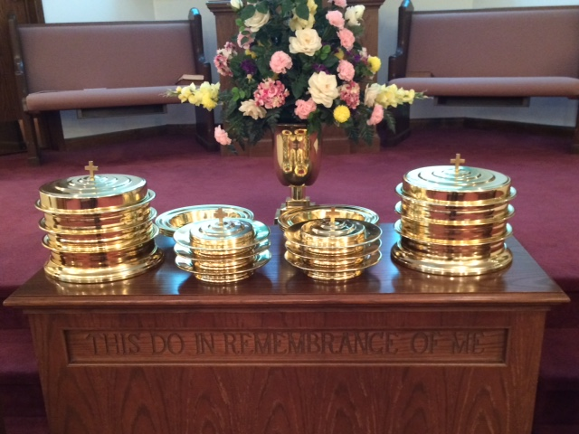
IN REMEMBRANCE OF JESUS

Slide 18
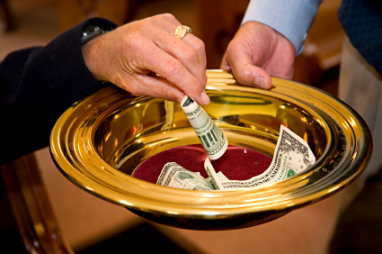
CONTRIBUTION

Slide 19
SINGING

Slide 20
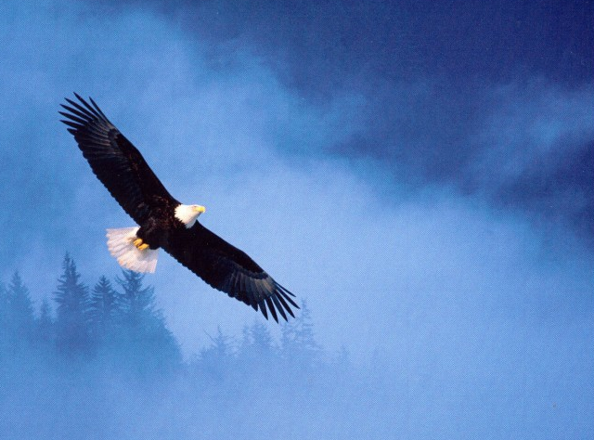
Have a waiting on the Lord week
Isaiah 40:31 But those who wait on the LORD Shall renew their strength; They shall mount up with wings like eagles, They shall run and not be weary, They shall walk and not faint.

