Slide 1
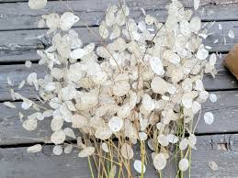
WELCOME TO THE
JACKSON STREET CHURCH OF CHRIST
PLEASE TURN OFF CELLPHONES

Slide 2


Slide 3


Slide 4

SINGING

Slide 5
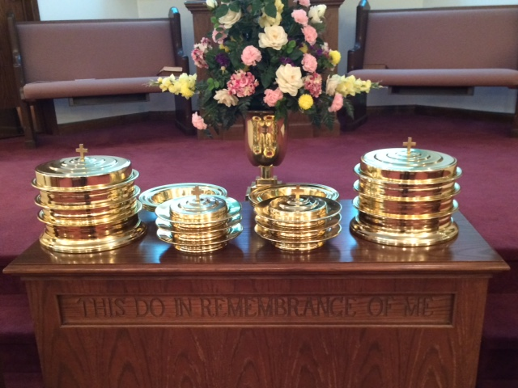
IN REMEMBRANCE OF JESUS

Slide 6
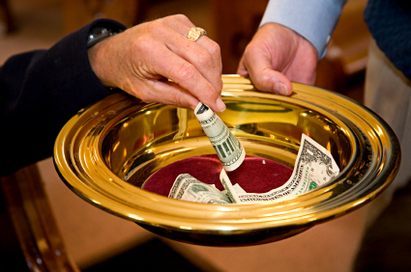
CONTRIBUTION

Slide 7


Slide 8
1 Timothy 6:17-19 Command those who are rich in this present age not to be haughty, nor to trust in uncertain riches but in the living God, who gives us richly all things to enjoy. {18} Let them do good, that they be in good works, ready to give, willing to share, {19} storing up for themselves a good foundation for the time to come, that they may lay hold on eternal life,

Slide 10
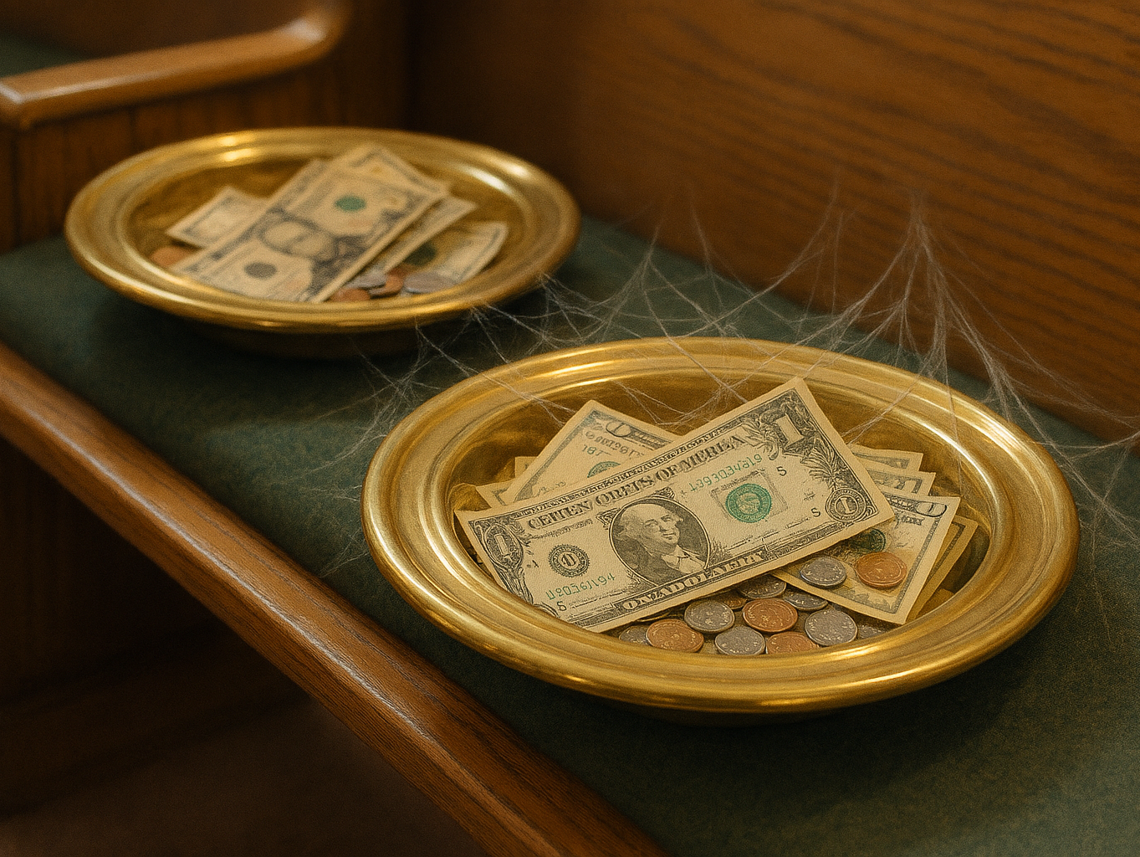
BIBLICAL PRINCIPLES OF GIVING

Slide 11
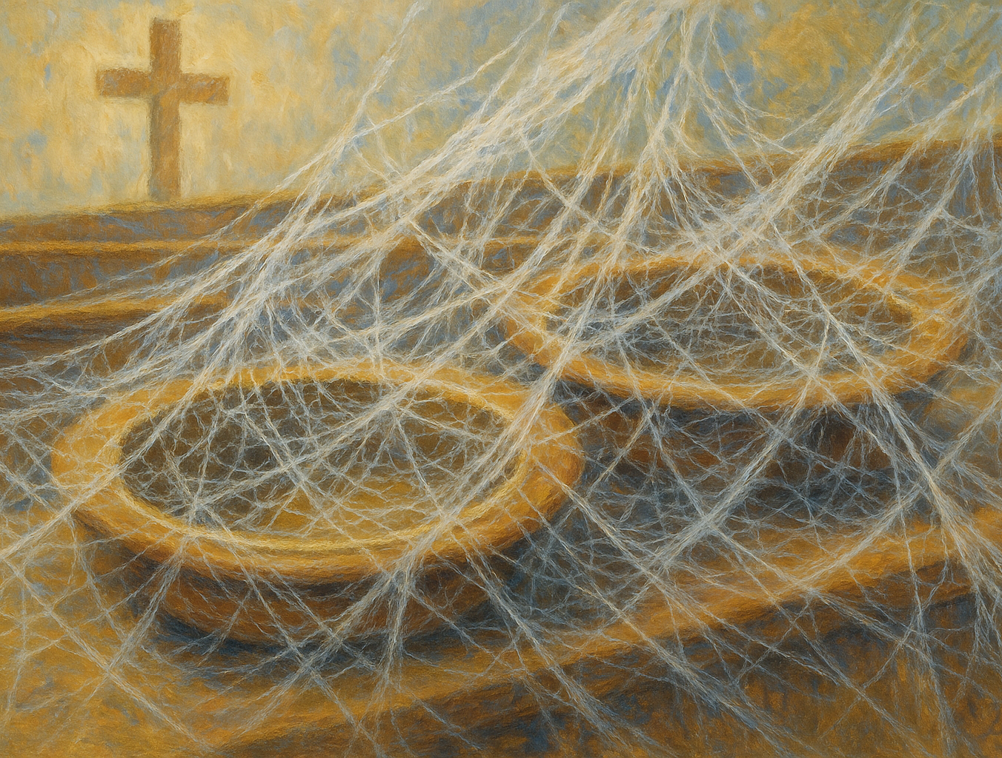
ARTIST CONCEPTION
OF DYING CHURCH

Slide 12
I. GIVE YOURSELF FIRST TO THE LORD
2 Corinthians 8:1-5 Moreover, brethren, we make known to you the grace of God bestowed on the churches of Macedonia: {2} that in a great trial of affliction the abundance of their joy and their deep poverty abounded in the riches of their liberal {3} For I bear witness that according to their ability, yes, and beyond their ability, they were freely willing {4} imploring us with much urgency that we would receive the gift and the fellowship of the ministering to the saints. {5} And not only as we had hoped, but they first gave themselves to the Lord, and then to us by the will of God.

Slide 13
II. GIVING TO OTHERS IS GIVING TO THE LORD
Matthew 25:31-40 'When the Son of Man comes in His glory, and aII the holy angels with Him, then He will sit on the throne of His glory, {32} "All the nations will be gathered before Him, and He will separate them one from another, as a shepherd divides his sheep from the goats. {33} And He Will set the sheep on His right hand, but the goats on the left, {34} "Then the King will say to those on His right hand, 'Come , you blessed of My Father, inherit the kingdom prepared for you from the foundation of the world:

Slide 14
II. GIVING TO OTHERS IS GIVING TO THE LORD
{35 'for I was hungry and you gave Me food; I was thirsty and you gave Me drink; I was a stranger and you took Me in; {36} 'I was naked and you clothed Me; I was sick and you visited Me; I was in prison and you came to Me. {37} "Then the righteous will answer Him, saying Lord, when did we see You hungry and feed You, or thirsty and give You drink? {38} 'When did we see You a stranger and take You in, or naked and clothe You? {39} 'Or when did we see You sick, or in prison, and come to You?' {40} And the King will answer and say to them, 'Assuredly, I say to you, inasmuch as you did it to one of the least of these My brethren, you did it to Me.

Slide 15
III. DON'T GIVE TO BE SEEN OF MEN
Matthew 6:1-4 'Take heed that you do not do your charitable deeds before men, to be seen by them. Otherwise you have no reward from your Father in heaven, {2} therefore when you do a charitable deed, do not sound a trumpet before you as the hypocrites do in the synagogues and in the streets, that they may have glory from men. Assuredly, I say to you, they have their reward. {3} But when you do a charitable deed, do not let your left hand know what your right hand is doing, {4} that your charitable deed may be in secret; and your Father who sees in secret will Himself reward you openly,

Slide 16
IV. OUR GIVING IS PROOF
OF OUR LOVE
2 Corinthians 8:8, 24 I speak not, by commandment, but I am testing the sincerity of your love by the diligence of others, … ²⁴ Therefore, show to them, and before the churches the proof of your love and of our boasting on your behalf.

Slide 17
V. GIVE CHEERFULLY NOT GRUDGINGLY OR UNDER COMPULSION
2 Corinthians 9:7 So let each one give as he purposes in his heart, not grudgingly or of necessity; for God loves a cheerful giver.

Slide 18
VI. GIVE AS PROSPERED
I Corinthians 16:2 On the first day of the week let each one of you lay something aside, storing up as he may prosper, that there be no collections when I come.

Slide 19
VII. GIVE AND IT WILL BE GIVEN UNTO YOU
Luke 6:38 Give and it will be given to you: good measure, pressed down, shaken together, and running over will be put into your bosom, For with the same measure that you use, it will be measured back to you.
2 Corinthians 9:6-10 But this I say, He who sows sparingly will also reap sparingly, and he who sows bountifully will also reap bountifully, {7} So let each one give as he purposes in his heart, not grudgingly or of necessity; for God loves a cheerful giver, >>>

Slide 20
VII. GIVE AND IT WILL BE GIVEN UNTO YOU
{8} And God is able to make all grace abound toward you, that you, always having all sufficiency in all things, may have an abundance for every good work. {9} As it is written: He has dispersed abroad, He has given to the poor; His righteousness endures forever. {10} Now may He who supplies seed to the sower, and bread for food, supply and multiply the seed you have sown and increase the fruits of your righteousness.

Slide 21
VIII. DO NOT NEGLECT GOD'S NEEDS
Haggai 1:1-11 In the second year of King Darius, in the sixth month, on the first day of the month, the word of the LORD came by Haggai the prophet to Zerubbabel the son of Shealtiel, governor of Judah, and to Joshua the son of Jehozadak, the high priest, saying, {2} "Thus speaks the LORD of hosts, saying: 'This people says, "The time has not come, the time that the Lord's house should be built, {3} Then the word of the LORD came by Haggai the prophet, saying, {4} Is it time for you yourselves to dwell in your paneled houses, and this temple to lie in ruins?" {5} Now therefore, thus says the LORD of hosts: "Consider your ways! {6} You have sown much, and bring in little; You eat, but do not have enough; You drink, but you are not filled with drink; You clothe yourselves, but no one is warm; >>>

Slide 22
VIII. DO NOT NEGLECT GOD'S NEEDS
And he who earns wages, Earns wages to put into a bag with holes. {7} Thus says the LORD of hosts: Consider your ways! {8} Go up to the mountains and bring wood and build the temple, that I may take pleasure in it and be glorified, says the LORD, {9} You looked for much, but indeed it came to little; and when you brought it home, I blew it away. Why?" says the LORD of hosts, because of MY house that is in ruins, while every one of you runs to his own houses {10} "Therefore the heavens above you withhold the dew, and the earth withholds its fruit. {11} "For I called for a drought on the land and the mountains, on the grain and the new wine and the oil, on whatever the ground brings forth, on men and livestock, and on all the labor of your hands,

Slide 23
IX. DO NOT GIVE TO GOD THAT WHICH COSTS YOU NOTHING
2 Samuel 24: 24 Then the king said to Araunah, "No, but I will surely buy it from you for a price; nor will I offer burnt offerings to the LORD my God with that which costs me nothing. So, David bought the threshing floor and the oxen for fifty shekels of silver.
LUKE 21; 3-4 Widow's Mite
II COR. 8:1-4 MACEDONIANS GAVE BEYOND THEIR ABILITY
Philippians 4:18-19 Indeed I have all and abound, I am full, having received from Epaphroditus the things sent from you, a sweet-smelling aroma, an acceptable sacrifice, well pleasing to God, {19} And my God shall supply all your need according to His riches in glory by Christ Jesus.

Slide 24
X. GIVE SO YOU ARE LAYING UP TREASURE IN HEAVEN NOT ON EARTH
Matthew 6:19-21 Do not lay up for yourselves treasures on earth, where moth and rust destroy and where thieves break in and steal; {20} "but lay up for yourselves treasures in heaven, where neither moth nor rust destroys and where thieves do not break in and steal {21} "For where your treasure is, there your heart will be also.
1 Timothy 6:17-19 Command those who are rich in this present age not to be haughty, nor to trust in uncertain riches but in the living God, who gives us richly all things to enjoy. {18} Let them do good, that they be in good works, ready to give, willing to share, {19} storing up for themselves a good foundation for the time to come, that they may lay hold on eternal life,
Hebrews 10:34 for you had compassion on me in my chains, and joyfully accepted the plundering of your goods, knowing that you have a better and an enduring possession for yourselves in heaven.

Slide 25
X. GIVE SO YOU ARE LAYING UP TREASURE IN HEAVEN NOT ON EARTH
Matthew 19:16-22 Now behold, one came and said to Him, "Good Teacher, what good thing shall do that I may have eternal life? {17} So He said to him, "Why do you call Me good? No one is good but One, that is, God, But if you want to enter into life, keep the commandments. " {18} He said to Him, "Which ones?" Jesus said, 'You shall not murder, 'You shall not commit adultery, ''You shall not steal,'' You shall not bear false witness, {19} 'Honor your father and your mother and, 'You shall love your neighbor as yourself.' {20} The young man said to Him, All these things I have kept from my youth, What do I still lack?" {21} Jesus said to him, if you want to be perfect, go, sell what you have and give to the poor, and you will have treasure in heaven; and come, follow Me, {22} But when the young man heard that saying, he went away sorrowful, for he had great possessions,
Philippians 4:17 Not that I seek the gift, but I seek the fruit that abounds to your account,

Slide 26
YOUR GIVING?
Jesus gave His life for you, what are your giving Him?
2 Corinthians 5:15 and He died for all, that those who live should live no longer for themselves, but for Him who died for them and rose again.

Slide 28

PRAYER

Slide 29
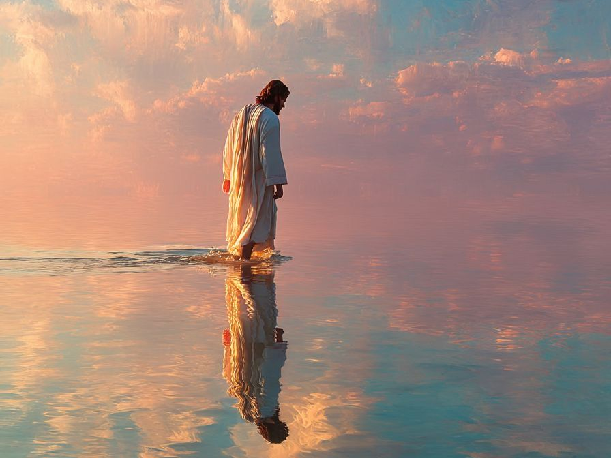
TONIGHT’S SERMON:
THE DEITY OF JESUS

