Slide 1
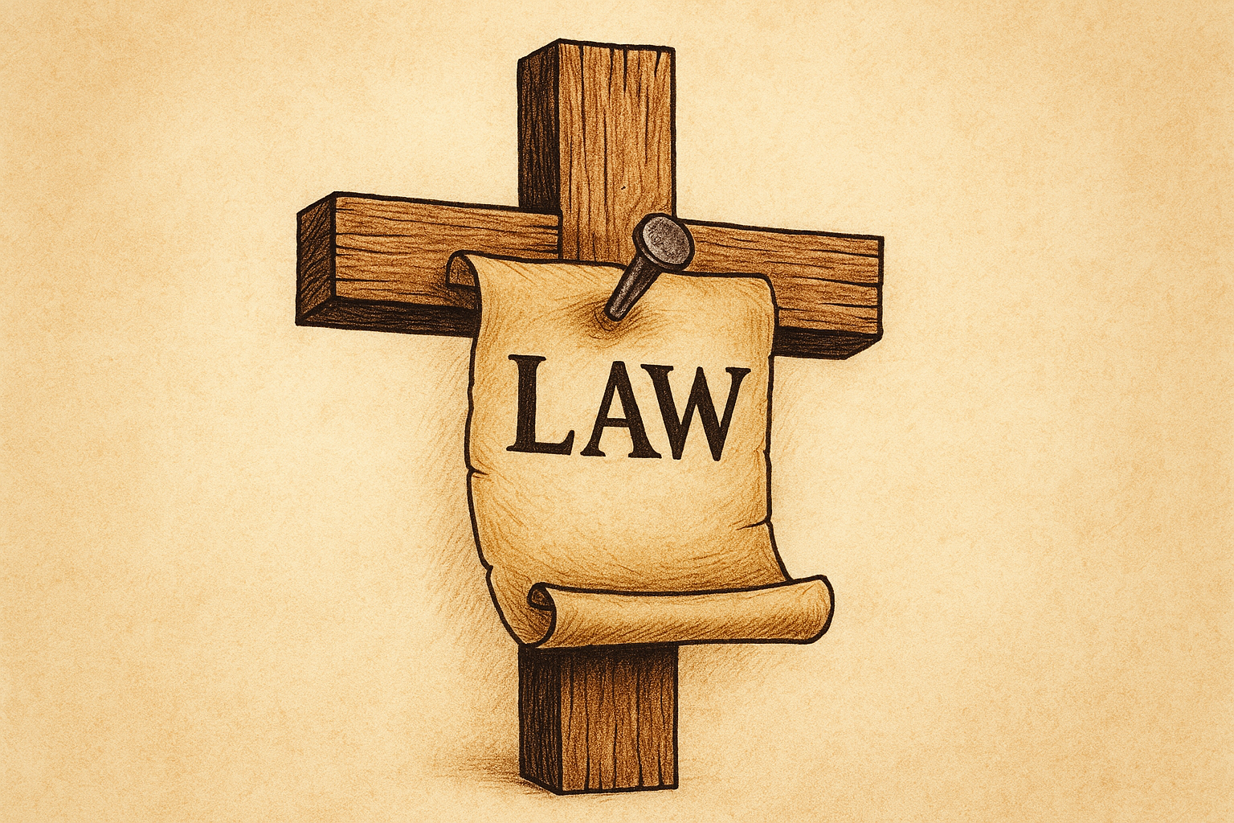
WELCOME TO THE
JACKSON STREET CHURCH OF CHRIST
PLEASE TURN OFF CELLPHONES

Slide 2


Slide 3

LET US PRAY

Slide 4

SINGING

Slide 5
Galatians 2:15–16 We who are Jews by nature, and not sinners of the Gentiles, ¹⁶ knowing that a man is not justified by the works of the law but by faith in Jesus Christ, even we have believed in Christ Jesus, that we might be justified by faith in Christ and not by the works of the law; for by the works of the law no flesh shall be justified.

Slide 6
LET US PRAY

Slide 7
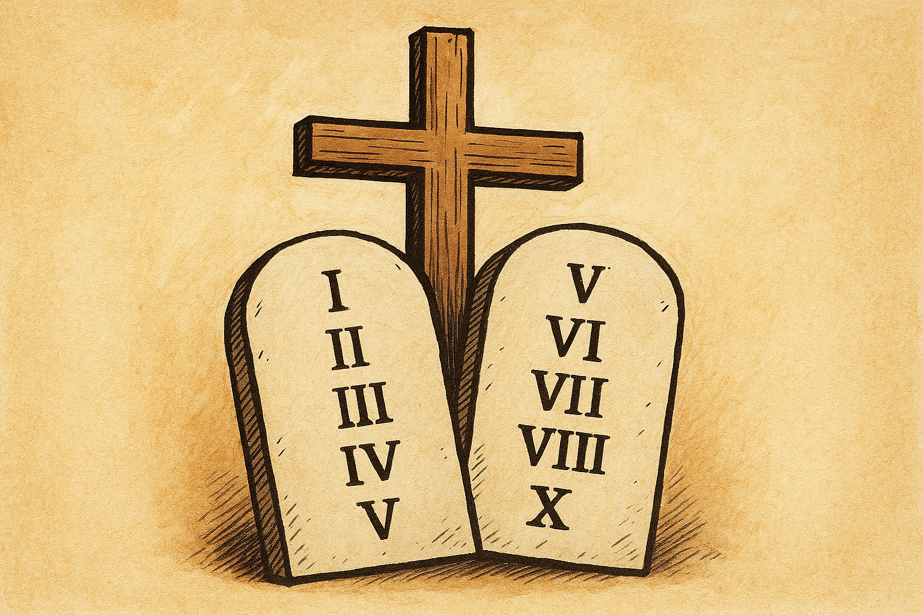
THE CHRISTIANS RELATION TO LAW

Slide 8
CHRISTIANS AND LAW?
There is much confusion today about the Christian’s relationship with grace and law.
As Christians we are not saved by the law of Moses but by the grace of God. However we are to fulfill our responsibility to the law of liberty and will be judged by how well we do so.
We cannot be saved without God’s grace therefore we can say, “We are saved by grace alone.”
No one will be in heaven without God’s grace.

Slide 9
l. WE ARE NOT SAVED BY THE LAW OF MOSES - WHEN PAUL TALKS ABOUT NOT BEING JUSTIFIED BY THE LAW OR LAW, HE IS REFERRING TO THE LAW OF MOSES.

Slide 10
l. WE ARE NOT SAVED
BY THE LAW OF MOSES
Rom 3:27-28 Where is boasting then? It is excluded. By what law? Of works? No, but by the law of faith. {28} Therefore we conclude that a man is justified by faith apart from the deeds of the law.
Gal 2:16 "knowing that a man is not justified by the works of the law but by faith in Jesus Christ, even we have believed in Christ Jesus, that we might be justified by faith in
Christ and not by the works of the law, for by the works of the law no flesh sha// be justified.

Slide 11
l. WE ARE NOT SAVED
BY THE LAW OF MOSES
Gal 5:4 You have become estranged from Christ, you who attempt io be justified by law; you have fallen from grace.
Gal 2:21 "I do not set aside the grace of God, for if righteousness comes through the law, then Christ died in vain."
Acts 13:39 "and by Him everyone who believes is justified from all things from which you could not be justified by the law of Moses.

Slide 12
II. WE ARE SAVED BY GRACE AND WITHOUT GRACE WE CANNOT BE SAVED
Rom 3:24 being justified freely by His grace through the redemption that is in Christ Jesus,
Eph 1:6-7 to the praise of the glory of His grace, by which He has made us accepted in the Beloved. {7} In Him we have redemption through His blood. the forgiveness of sins, according to the riches of His grace.
2 Tim 1:9 who has saved us and called us with a holy calling, not according to our works, but according to His own purpose and grace which was given to us in Christ Jesus before time began,

Slide 13
II. WE ARE SAVED BY GRACE AND WITHOUT GRACE WE CANNOT BE SAVED
Eph 2:5-8 even when we were dead in trespasses, made us alive together with Christ by grace you have been saved, {6} and raised us up together, and made us sit together in the heavenly places in Christ Jesus, {7} that in the ages to come He might show the exceeding riches of His grace in His kindness toward us in Christ Jesus. {8} For by grace you have been saved through faith, and that not of yourselves; it is the gift of God,
Titus 3:5 not by works of righteousness which we have done, but according to His mercy He saved us, through the washing of regeneration and renewing of the Holy Spirit,

Slide 14
III. GRACE PRODUCES WORKS IN CHRISTIANS
Galatians 2:20–21 I have been crucified with Christ; it is no longer I who live, but Christ lives in me; and the life which I now live in the flesh I live by faith in the Son of God, who loved me and gave Himself for me. ²¹ I do not set aside the grace of God; for if righteousness comes through the law, then Christ died in vain.”
Gal 5:18 But if you are led by the Spirit, you are not under the law.
Rom 6:14-15 For sin shall not have dominion over you, for you are not under law but under grace. {15} What then? Shall we sin because we are not under law but under grace? Certainly not!

Slide 15
III. GRACE PRODUCES WORKS IN CHRISTIANS
1 Cor 3:10 According to the grace of God which was given to me, as a wise master builder I have laid the foundation, and another builds on it. But let each one take heed how he builds on it.
1 Cor 15:10 But by the grace of God I am what I am, and His grace toward me was not in vain: but I labored more abundantly than they all. Yet not I. but the grace of God which was with me.
2 Cor 1:12 For our boasting is this: the testimony of our conscience that we conducted ourselves in the world in simplicity and godly sincerity, not with fleshly Wisdom but by the grace of God, and more abundantly toward you.
2 Cor 6:1 We then, as workers together with Him also plead with you not to receive the grace of God in vain.

Slide 16
IV. WE ARE UNDER LAW AS CHRISTIANS CHRISTIAN WORKS ARE NECESSARY FOR SALVATION
THE CHRISTIAN LAW OF LIBERTY
  PAUL SAID HE WAS UNDER THE LAW OF GOD & CHRIST - 1 Cor 9:20-21 and to the Jews I became as a Jew, that I might win Jews; to those who are under the law, as under the law, that I might win those who are under the law; {21} to those who are without law, as without law not being without law toward God? but under law toward Christ, that I might win those who are without law,
  James 1:25 But he who looks into the perfect law of liberty and continues in it, and is not a forgetful hearer but a doer of the work, this one will be blessed in what he does.

Slide 17
IV. WE ARE UNDER LAW AS CHRISTIANS CHRISTIAN WORKS ARE NECESSARY FOR SALVATION
THE CHRISTIAN LAW OF LIBERTY
  James 2:8-12 If you really fulfill the royal law according to the Scripture, "You shall love your neighbor as yourself," you do well, {9} but if you show partiality, you commit sin, and are convicted by the law as transgressors. {10} For whoever shall keep the whole law, and yet stumble in one point, he is guilty of all. {11} For He who said, "Do not commit adultery," also said, "Do not murder." Now if you do not commit adultery, but you do murder, you have become a transgressor of the law {12} So speak and so do as those who will be judged by the law of liberty.

Slide 18
IV. WE ARE UNDER LAW AS CHRISTIANS CHRISTIAN WORKS ARE NECESSARY FOR SALVATION
GRACE DOES NOT ALLOW UNRESTRAINED SIN FOR CHRISTIANS
  Rom 6:14-15 For sin shall not have dominion over you, for you are not under law but under grace. {15} What then? Shall we sin because we are not under law but under grace? Certainly not!
  Jude 1 For certain men have crept in unnoticed, who long ago were marked out for this condemnation, ungodly men, who turn the grace of our God into lewdness and deny the only Lord God and our Lord Jesus Christ.
  2 Cor 6:1 We then, as workers together with Him also plead with you not to receive the grace of God in vain

Slide 19
IV. WE ARE UNDER LAW AS CHRISTIANS CHRISTIAN WORKS ARE NECESSARY FOR SALVATION
GRACE DOES NOT ALLOW UNRESTRAINED SIN FOR CHRISTIANS
  Heb 10:26-29 For if we sin willfully after we have received the knowledge of the truth, there no longer remains a sacrifice for sins, {27} but a certain fearful expectation of judgment, and fiery indignation which will devour the adversaries. {28} Anyone who has rejected Moses' law dies without mercy on the testimony of two or three witnesses. {29} Of how much worse punishment, do you suppose, will he be thought worthy who has trampled the Son of God underfoot, counted the blood of the covenant by which he was sanctified a common thing, and insulted the Spirit of grace?

Slide 20
IV. WE ARE UNDER LAW AS CHRISTIANS CHRISTIAN WORKS ARE NECESSARY FOR SALVATION
OBEDIENCE AND WORKS ARE REQUIRED OF CHRISTIANS
Mat 7:21 Not everyone who says to Me, Lord, Lord, 'shall enter the kingdom of heaven, but he who does the will of My Father in heaven
1 Tm 6:17-19 Command those who are rich in this present age not to be haughty, nor to trust in uncertain riches but in the living God, who gives us richly all things to enjoy. {18} Let them that they be rich in good works, ready to give, willing to share, {19} storing up for themselves a good foundation for the time to come, that they may lay hold on eternal life.

Slide 21
IV. WE ARE UNDER LAW AS CHRISTIANS CHRISTIAN WORKS ARE NECESSARY FOR SALVATION
OBEDIENCE AND WORKS ARE REQUIRED OF CHRISTIANS
Rom 2:7-12 eternal life to those who by patient continuance in doing good seek for glory. honor. and immortality, {8} but to those who are self-seeking and do not obey the truth, but obey unrighteousness; indignation and wrath, {9} tribulation and anguish, on every soul of man who does evil, of the Jew first and also of the Greek; {10} but glory, honor, and peace to everyone who works what is good, to the Jew first and also to the Greek. {11} For there is no partiality with God. {12} For as many as have sinned without law will also perish without law, and as many as have sinned in the law will be judged by the law

Slide 22
IV. WE ARE UNDER LAW AS CHRISTIANS CHRISTIAN WORKS ARE NECESSARY FOR SALVATION
OBEDIENCE AND WORKS ARE REQUIRED OF CHRISTIANS
Titus 2:14 who gave Himself for us, that He might redeem us from every lawless deed and purify for Himself His own special people, zealous for good works.
James 2:14, 17-18, 20-22 What does it profit, my brethren, if someone says he has faith but does not have works? Can faith save him? Thus also faith by itself if it does not have works is dead. >>>

Slide 23
IV. WE ARE UNDER LAW AS CHRISTIANS CHRISTIAN WORKS ARE NECESSARY FOR SALVATION
OBEDIENCE AND WORKS ARE REQUIRED OF CHRISTIANS
{18} But someone will say, “You have faith, and I have works." Show me your faith without your works, and I will show you my faith by my works......But do you want to know, O foolish man, that faith without works is dead? {21} Was not Abraham our father justified by works when he offered Isaac his son on the altar? {22} Do you see that faith was working together with his works, and by works faith was made perfect?

Slide 24
IV. WE ARE UNDER LAW AS CHRISTIANS CHRISTIAN WORKS ARE NECESSARY FOR SALVATION
CHRISTIANS WILL BE JUDGED BY THEIR DEEDS OR WORKS
  Mat 16:27 "For the Son of Man will come in the glory of His Father with His angels, and then He will reward each according to his works.
  John 5:28-29 “DO not Maryel at this; for the hour is coming in which all who are in the graves will hear His voice {29} and come forth: those who have done good, to the resurrection of life, and those who have done evil, to the resurrection of condemnation,
  2 Cor 5:10 For we must all appear before the judgment seat of Christ, that each one may receive the things done in the body according to what he has done, whether good or bad.

Slide 25
IV. WE ARE UNDER LAW AS CHRISTIANS CHRISTIAN WORKS ARE NECESSARY FOR SALVATION
CHRISTIANS WILL BE JUDGED BY THEIR DEEDS OR WORKS
  Rev 20:12-13 And I saw the dead. small and great, standing before God, and books were opened. And another book was opened, which is the Book of Life. And the dead were judged according to their works, by the things which were written in the books. {13} The sea gave up the dead who were in it, and Death and Hades delivered up the dead who were in them. And they were judged, each one according to his works.
  Rev 22:12 "And behold, I am coming quickly, and My reward is with Me, to give to everyone according to his work.

Slide 26
WHAT ABOUT YOU?
Do you understand that it is only by the grace of God through Jesus’ blood that you will be saved?
Do you also understand that since we are saved by his grace and Jesus’ sacrifice on the cross, that you have a responsibility to live your life on earth for Him?
2 Corinthians 5:14–15 For the love of Christ compels us, because we judge thus: that if One died for all, then all died; ¹⁵ and He died for all, that those who live should live no longer for themselves, but for Him who died for them and rose again.
1 Corinthians 15:10 But by the grace of God I am what I am, and His grace toward me was not in vain; but I labored more abundantly than they all, yet not I, but the grace of God which was with me.

Slide 27
SINGING

Slide 28

IN REMEMBRANCE OF JESUS

Slide 29

CONTRIBUTION

Slide 30
SINGING

Slide 31
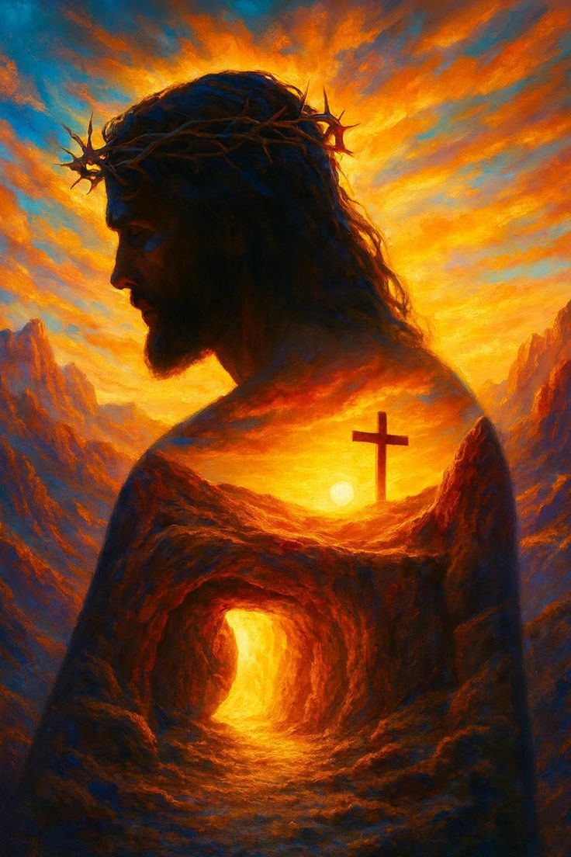
HAVE A WORKING WEEK

