Slide 1
WELCOME TO THE
JACKSON STREET CHURCH OF CHRIST
PLEASE TURN OFF CELLPHONES

Slide 4
SINGING

Slide 5
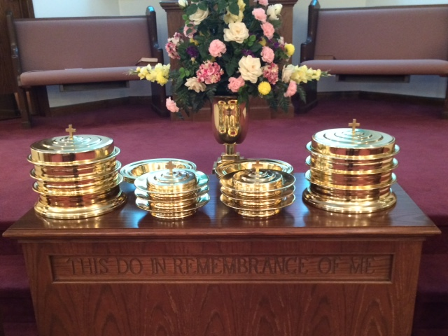
IN REMEMBRANCE OF JESUS

Slide 6
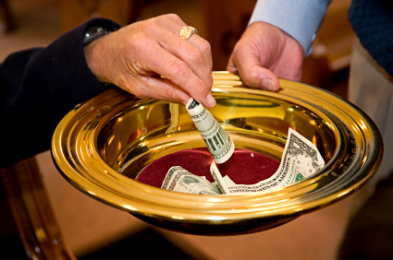
CONTRIBUTION

Slide 7
SINGING

Slide 8
Hebrews 5:12–14 For though by this time you ought to be teachers, you need someone to teach you again the first principles of the oracles of God; and you have come to need milk and not solid food. ¹³ For everyone who partakes only of milk is unskilled in the word of righteousness, for he is a babe. ¹⁴ But solid food belongs to those who are of full age, that is, those who by reason of use have their senses exercised to discern both good and evil.

Slide 10
HOW TO TELL RIGHT FROM WRONG

Slide 11
GOOD AND EVIL
Genesis 2:16–17 And the LORD God commanded the man, saying, “Of every tree of the garden you may freely eat; ¹⁷ but of the tree of the knowledge of good and evil you shall not eat, for in the day that you eat of it you shall surely die.”
1 Kings 3:9 Therefore give to Your servant (Solomon) an understanding heart to judge Your people, that I may discern between good and evil. For who is able to judge this great people of Yours?”
John 5:28–29 Do not marvel at this; for the hour is coming in which all who are in the graves will hear His voice ²⁹ and come forth—those who have done good, to the resurrection of life, and those who have done evil, to the resurrection of condemnation.
A five-step test to be able to discern between good and evil (Heb. 5:14).

Slide 12
REPUTATION--If my action were known in the community, how would the reputation of the Lord's church be affected?

Slide 13
REPUTATION
2 Corinthians 6:3 We give no offense in anything, that our ministry may not be blamed.
1 Timothy 6:1 Let as many bondservants as are under the yoke count their own masters worthy of all honor, so that the name of God and His doctrine may not be blasphemed.
1 Timothy 5:14 Therefore I desire that the younger widows marry, bear children, manage the house, give no opportunity to the adversary to speak reproachfully.
2 Peter 2:2 And many will follow their destructive ways, because of whom the way of truth will be blasphemed.

Slide 14
II. INFLUENCE--If those on the verge of a decision hear about my word or my action, which way will my influence take them?

Slide 15
II. INFLUENCE
Romans 14:7 For none of us lives to himself, and no one dies to himself.
1 Corinthians 8:13 Therefore, if food makes my brother stumble, I will never again eat meat, lest I make my brother stumble.
Romans 14:21 It is good neither to eat meat nor drink wine nor do anything by which your brother stumbles or is offended or is made weak.

Slide 16
III. GLORY--If you include this activity or possession as part of your life, where will it put the spotlight--on spiritual things or material things? Will it bring glory to God?

Slide 17
III. GLORY
1 Corinthians 10:31 Therefore, whether you eat or drink, or whatever you do, do all to the glory of God.
1 Peter 4:11 If anyone speaks, let him speak as the oracles of God. If anyone ministers, let him do it as with the ability which God supplies, that in all things God may be glorified through Jesus Christ, to whom belong the glory and the dominion forever and ever. Amen.
Matthew 5:16 Let your light so shine before men, that they may see your good works and glorify your Father in heaven.
Colossians 3:23 And whatever you do, do it heartily, as to the Lord and not to men,

Slide 18
IV. HEART/HEADING--Why do you really, really want to participate in this activity? What will be the long-term result of your participation?

Slide 19
IV. HEART/HEADING
2 Timothy 2:22 Flee also youthful lusts; but pursue righteousness, faith, love, peace with those who call on the Lord out of a pure heart.
1 Timothy 1:5 Now the purpose of the commandment is love from a pure heart, from a good conscience, and from sincere faith,
Romans 6:21 What fruit did you have then in the things of which you are now ashamed? For the end of those things is death.

Slide 20
V. TRUTH--Last, and certainly not least, is the activity listed in God's Word as a sin? If it is, then it is always a sin.

Slide 21
V. TRUTH
2 Timothy 3:16–17 All Scripture is given by inspiration of God, and is profitable for doctrine, for reproof, for correction, for instruction in righteousness, ¹⁷ that the man of God may be complete, thoroughly equipped for every good work.
John 17:17 Sanctify them by Your truth. Your word is truth.
John 3:18–21 “He who believes in Him is not condemned; but he who does not believe is condemned already, because he has not believed in the name of the only begotten Son of God. ¹⁹ And this is the condemnation, that the light has come into the world, and men loved darkness rather than light, because their deeds were evil. ²⁰ For everyone practicing evil hates the light and does not come to the light, lest his deeds should be exposed. ²¹ But he who does the truth comes to the light, that his deeds may be clearly seen, that they have been done in God.”

Slide 22
YOU AND RIGHT AND WRONG
The five step test.
Reputation
Influence
Glory
Heart/Heading
Truth
If an action or activity can pass all these tests, it is R-I-G-H-T

Slide 23
SINGING

Slide 24
TONIGHT’S SERMON
WHEN LONLINESS COMES

