Slide 1
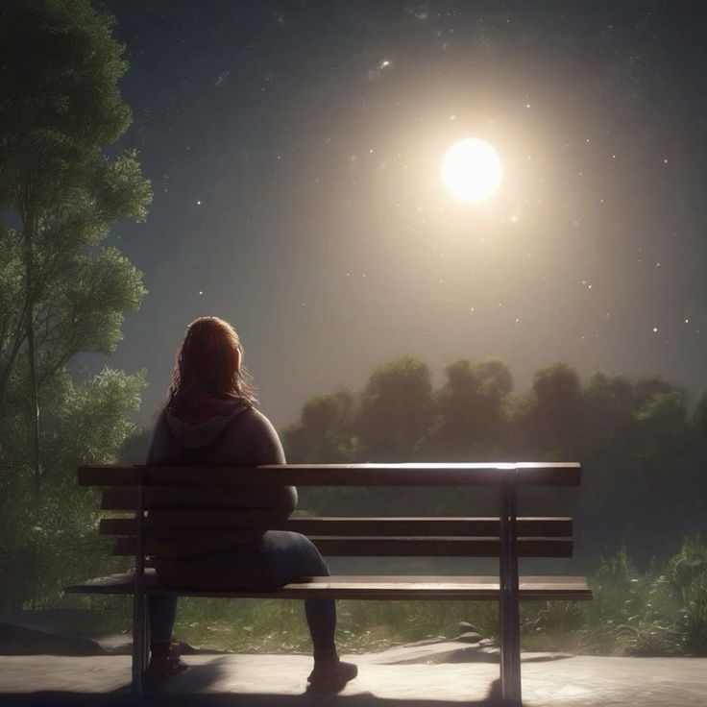
WELCOME TO THE
JACKSON STREET CHURCH OF CHRIST
PLEASE TURN OFF CELL PHONES

Slide 3
LET US PRAY

Slide 4
SINGING

Slide 5
2 Timothy 4:9–18 Be diligent to come to me quickly; ¹⁰ for Demas has forsaken me, having loved this present world, and has departed for Thessalonica—Crescens for Galatia, Titus for Dalmatia. ¹¹ Only Luke is with me. Get Mark and bring him with you, for he is useful to me for ministry. ¹² And Tychicus I have sent to Ephesus. ¹³ Bring the cloak that I left with Carpus at Troas when you come—and the books, especially the parchments. ¹⁴ Alexander the coppersmith did me much harm. May the Lord repay him according to his works. ¹⁵ You also must beware of him, for he has greatly resisted our words. ¹⁶ At my first defense no one stood with me, but all forsook me. May it not be charged against them. ¹⁷ But the Lord stood with me and strengthened me, so that the message might be preached fully through me, and that all the Gentiles might hear. Also I was delivered out of the mouth of the lion. ¹⁸ And the Lord will deliver me from every evil work and preserve me for His heavenly kingdom. To Him be glory forever and ever. Amen!

Slide 6
LET US PRAY

Slide 7
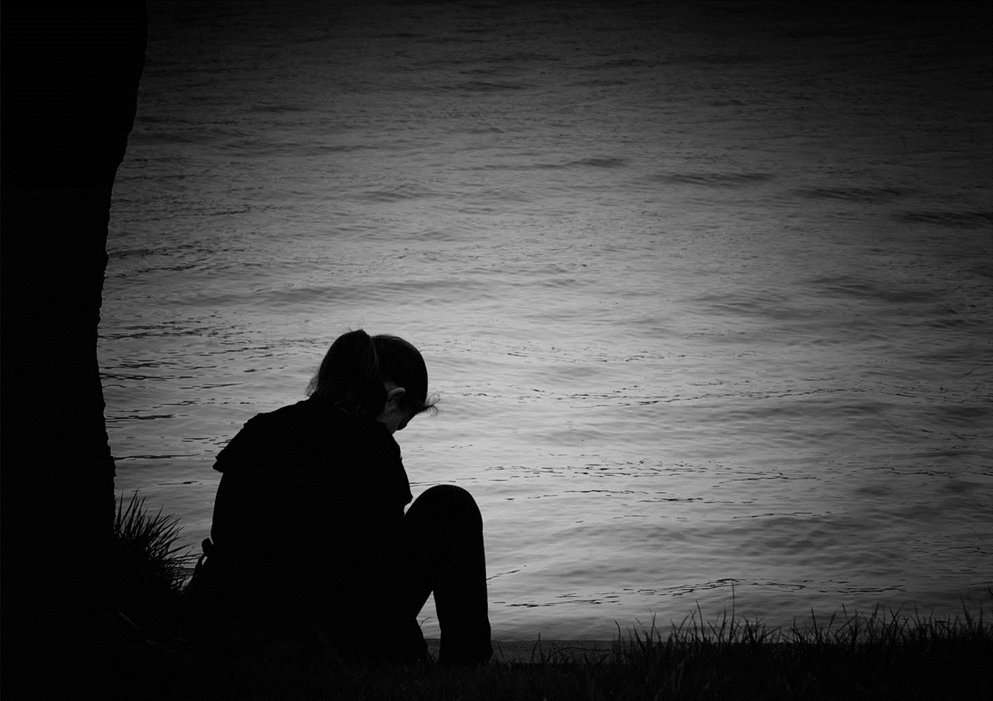
WHEN LONELINESS COMES...

Slide 8
LONELINESS
“Have you ever been lonely, have you ever been blue.” Patsy Cline
We have all probably been, or will be, lonely at some time in our lives.
The apostle Paul was no exception to that rule.
We get some insight into how to deal with loneliness from Paul in 2 Timothy Chap. 4.

Slide 9
FOCUS ON YOUR ATTITUDE.
Forgive friends who fail you in a trying moment.
2 Timothy 4:16 At my first defense no one stood with me, but all forsook me. May it not be charged against them.
Luke 23:33–34 And when they had come to the place called Calvary, there they crucified Him, and the criminals, one on the right hand and the other on the left. ³⁴ Then Jesus said, “Father, forgive them, for they do not know what they do.” And they divided His garments and cast lots.
Acts 7:59–60 And they stoned Stephen as he was calling on God and saying, “Lord Jesus, receive my spirit.” ⁶⁰ Then he knelt down and cried out with a loud voice, “Lord, do not charge them with this sin.” And when he had said this, he fell asleep.

Slide 10
FOCUS ON YOUR ATTITUDE.
Let the Lord take vengeance on those who persist in hurting you.
2 Timothy 4:14 Alexander the coppersmith did me much harm. May the Lord repay him according to his works.
Romans 12:19 Beloved, do not avenge yourselves, but rather give place to wrath; for it is written, “Vengeance is Mine, I will repay,” says the Lord.

Slide 11
II. ON YOUR ACTIVITIES.
Read the Bible to glean the wisdom of God.
2 Timothy 4:13 Bring the cloak that I left with Carpus at Troas when you come—and the books, especially the parchments.
2 Timothy 3:15–17 and that from childhood you have known the Holy Scriptures, which are able to make you wise for salvation through faith which is in Christ Jesus. ¹⁶ All Scripture is given by inspiration of God, and is profitable for doctrine, for reproof, for correction, for instruction in righteousness, ¹⁷ that the man of God may be complete, thoroughly equipped for every good work.
Psalm 119:105 Your word is a lamp to my feet And a light to my path.

Slide 12
II. ON YOUR ACTIVITIES.
Be busy in doing the Lord's spiritual work (with others).
2 Timothy 4:17 But the Lord stood with me and strengthened me, so that the message might be preached fully through me, and that all the Gentiles might hear. Also I was delivered out of the mouth of the lion.
2 Timothy 4:9 Be diligent to come to me quickly;
2 Timothy 4:11 Only Luke is with me. Get Mark and bring him with you, for he is useful to me for ministry.
1 Timothy 5:3–5 Honor widows who are really widows. ⁴ But if any widow has children or grandchildren, let them first learn to show piety at home and to repay their parents; for this is good and acceptable before God. ⁵ Now she who is really a widow, and left alone, trusts in God and continues in supplications and prayers night and day.

Slide 13
III. FOCUS ON YOUR ASSURANCES.
Of your ultimate home in eternity.
2 Timothy 4:8 Finally, there is laid up for me the crown of righteousness, which the Lord, the righteous Judge, will give to me on that Day, and not to me only but also to all who have loved His appearing.
James 1:12 Blessed is the man who endures temptation; for when he has been approved, he will receive the crown of life which the Lord has promised to those who love Him.

Slide 14
III. FOCUS ON YOUR ASSURANCES.
B. Of strength from the Lord in this life.
2 Timothy 4:17–18 But the Lord stood with me and strengthened me, so that the message might be preached fully through me, and that all the Gentiles might hear. Also I was delivered out of the mouth of the lion. 18 And the Lord will deliver me from every evil work and preserve me for His heavenly kingdom. To Him be glory forever and ever. Amen!
Hebrews 4:15 For we do not have a High Priest who cannot sympathize with our weaknesses, but was in all points tempted as we are, yet without sin.
Hebrews 2:18 For in that He Himself has suffered, being tempted, He is able to aid those who are tempted.

Slide 15
OUR LONELINESS?
Jesus was never alone because the Father was with Him.
John 8:29 And He who sent Me is with Me. The Father has not left Me alone, for I always do those things that please Him.”
John 16:32 Indeed the hour is coming, yes, has now come, that you will be scattered, each to his own, and will leave Me alone. And yet I am not alone, because the Father is with Me.
As Christians we will never be alone either.
Isaiah 41:10 Fear not, for I am with you; Be not dismayed, for I am your God. I will strengthen you, Yes, I will help you, I will uphold you with My righteous right hand.’
Matthew 28:18–20 And Jesus came and spoke to them, saying, “All authority has been given to Me in heaven and on earth. ¹⁹ Go therefore and make disciples of all the nations, baptizing them in the name of the Father and of the Son and of the Holy Spirit, ²⁰ teaching them to observe all things that I have commanded you; and lo, I am with you always, even to the end of the age.” Amen.

Slide 16
SINGING

Slide 17
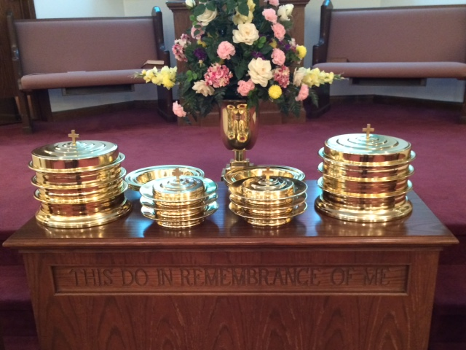
IN REMEMBRANCE OF JESUS

Slide 18
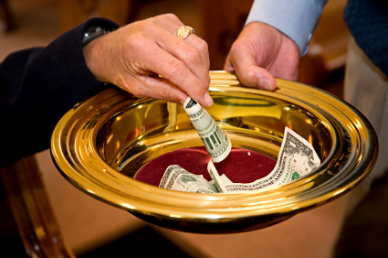
CONTRIBUTION

Slide 19
SINGING

Slide 20
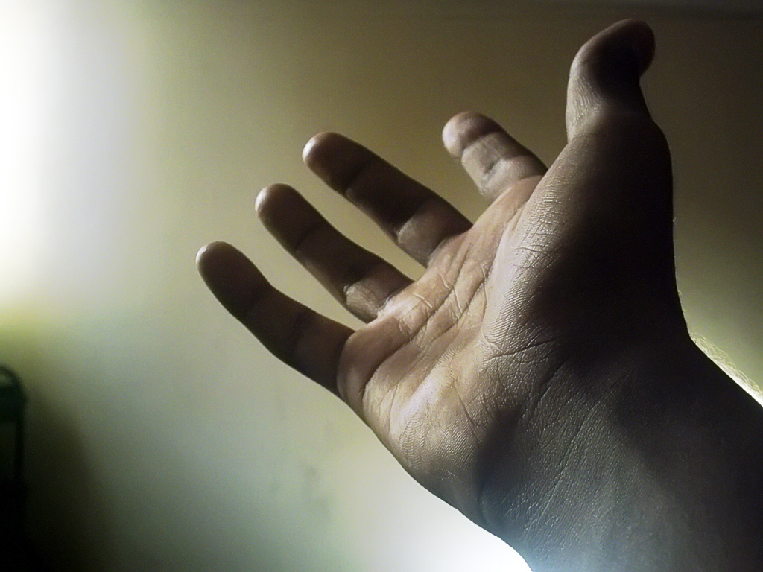
HAVE AN UNLONELY WEEK

