Slide 1

WELCOME TO THE
JACKSON STREET CHURCH OF CHRIST
PLEASE TURN OFF CELLPHONES

Slide 2


Slide 3


Slide 4

SINGING

Slide 5

IN REMEMBRANCE OF JESUS

Slide 6

CONTRIBUTION

Slide 7


Slide 8
Colossians 1:9–14 For this reason we also, since the day we heard it, do not cease to pray for you, and to ask that you may be filled with the knowledge of His will in all wisdom and spiritual understanding; ¹⁰ that you may walk worthy of the Lord, fully pleasing Him, being fruitful in every good work and increasing in the knowledge of God; ¹¹ strengthened with all might, according to His glorious power, for all patience and longsuffering with joy; ¹² giving thanks to the Father who has qualified us to be partakers of the inheritance of the saints in the light. ¹³ He has delivered us from the power of darkness and conveyed us into the kingdom of the Son of His love, ¹⁴ in whom we have redemption through His blood, the forgiveness of sins.

Slide 10
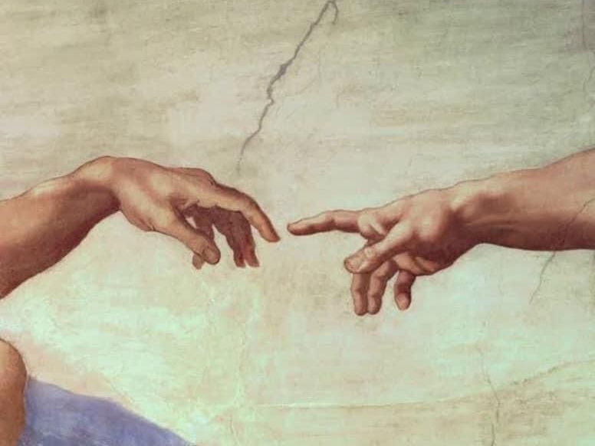
KNOWING GOD

Slide 11
KNOWING GOD
Colossians 1:10 “so that you may walk in a manner worthy of the Lord, to please Him in all respects, bearing fruit in every good work and increasing in the knowledge of God.”
How much do you know about God?
Do you really know God?
Does God know you? Matthew 7:21–23 “Not everyone who says to Me, ‘Lord, Lord,’ shall enter the kingdom of heaven, but he who does the will of My Father in heaven. ²² Many will say to Me in that day, ‘Lord, Lord, have we not prophesied in Your name, cast out demons in Your name, and done many wonders in Your name?’ ²³ And then I will declare to them, ‘I never knew you; depart from Me, you who practice lawlessness!’

Slide 12
I. IT HAS ALWAYS BEEN GOD’S DESIRE TO BE KNOWN
THE ISRAELITES - Exodus 6:6-7 “Say, therefore, to the sons of Israel, ‘I am the LORD, and I will bring you out from under the burdens of the Egyptians, and I will deliver you from their bondage. I will also redeem you with an outstretched arm and with great judgments. Then I will take you for My people, and I will be your God; and you shall know that I am the LORD your God, who brought you out from under the burdens of the Egyptians.” As you may recall, Moses didn’t even know God’s name and had to ask. Israel did not know God yet either.
THE NATIONS - Psalm 46:10 Be still, and know that I am God; I will be exalted among the nations, I will be exalted in the earth!

Slide 13
I. IT HAS ALWAYS BEEN GOD’S DESIRE TO BE KNOWN
Hebrews 8:10-12 Hebrews 8:7–12 For if that first covenant had been faultless, then no place would have been sought for a second. ⁸ Because finding fault with them, He says: “Behold, the days are coming, says the LORD, when I will make a new covenant with the house of Israel and with the house of Judah—⁹ not according to the covenant that I made with their fathers in the day when I took them by the hand to lead them out of the land of Egypt; because they did not continue in My covenant, and I disregarded them, says the LORD. >>>

Slide 14
I. IT HAS ALWAYS BEEN GOD’S DESIRE TO BE KNOWN
¹⁰ For this is the covenant that I will make with the house of Israel after those days, says the LORD: I will put My laws in their mind and write them on their hearts; and I will be their God, and they shall be My people. ¹¹ None of them shall teach his neighbor, and none his brother, saying, ‘Know the LORD,’ for all shall know Me, from the least of them to the greatest of them. ¹² For I will be merciful to their unrighteousness, and their sins and their lawless deeds I will remember no more.”

Slide 15
I. IT HAS ALWAYS BEEN GOD’S DESIRE TO BE KNOWN
2 Timothy 1:12 “For this reason I also suffer these things, but I am not ashamed; for I know whom I have believed I am convinced that He is able to guard what I have entrusted to Him until that day.”
Ephesians 3:19 “to know the love of Christ” 4:13 “until we all attain to the unity of the faith, and of the knowledge of the Son of God, to a mature man, to the measure of the stature which belongs to the fullness of Christ.”
2 Corinthians 10:5 “We are destroying speculations and every lofty thing raised up against the knowledge of God, and we are taking every thought captive to the obedience of Christ.”

Slide 16
I. IT HAS ALWAYS BEEN GOD’S DESIRE TO BE KNOWN
Philippians 3:8-10 “More than that, I count all things to be loss in view of the surpassing value of knowing Christ Jesus my Lord, for whom I have suffered the loss of all things, and count them but rubbish in order that I may gain Christ, and may be found in Him, not having a righteousness of my own derived from the Law, but that which is through faith in Christ, the righteousness which comes from God on the basis of faith, that I may know Him, and the power of His resurrection and the fellowship of His sufferings, being conformed to His death;”

Slide 17
II. THERE ARE THOSE WHO
DO NOT KNOW GOD
YOUNG SAMUEL - 1 Samuel 3:7 “Now Samuel did not yet know the LORD, nor had the word of the LORD yet been revealed to him.”
PHARAOH - Exodus 5:2 Exodus 5:1–2 Afterward Moses and Aaron went in and told Pharaoh, “Thus says the LORD God of Israel: ‘Let My people go, that they may hold a feast to Me in the wilderness.’ ” ² And Pharaoh said, “Who is the LORD, that I should obey His voice to let Israel go? I do not know the LORD, nor will I let Israel go.”

Slide 18
II. THERE ARE THOSE WHO
DO NOT KNOW GOD
THE UNGODLY WHO REJECTED GOD - Romans 1:28 “And just as they did not see fit to acknowledge God any longer, God gave them over to a depraved mind, to do those things are which not proper”
THOSE WE FAIL TO TEACH - 1 Corinthians 15:34 “Become sober-minded as you ought, and stop sinning; for some have no knowledge of God. I speak this to your shame.”
THOSE WHO HAVE NOT OBEYED THE GOSPEL - 2 Thessalonians 1:7-8 “…when the Lord Jesus shall be revealed from heaven with His mighty angels in flaming fire, dealing out retribution to those who do not know God and to those who do not obey the gospel of our Lord Jesus.”

Slide 19
II. THERE ARE THOSE WHO
DO NOT KNOW GOD
THE SEXUALLY IMMORAL GENTILES - 1 Thessalonians 4:3-5 “For this is the will of God, your sanctification; that is, that you abstain from sexual immorality; that each of you know how to possess his own vessel in sanctification and honor, not in lustful passion like the Gentiles who do not know God.”
DISOBEDIENT CHRISTIANS - Titus 1:16 “They profess to know God, but by their deeds they deny Him, being detestable and disobedient, and worthless for any good deed.”

Slide 20
III. KNOWING GOD MAKES A DIFFERENCE IN OUR LIVES
HELPS US TO PLEASE HIM AND BEAR FRUIT IN EVERY GOOD WORK - Colossians 1:9-10 “For this reason also, since the day we heard of it, we have not ceased to pray for you and to ask that you may be filled with the knowledge of His will in all spiritual wisdom and understanding, so that you may walk in a manner worthy of the Lord, to please Him in all respects, bearing fruit in every good work and increasing in the knowledge of God.”
BRINGS GRACE AND PEACE - 2 Peter 1:2-3 “Grace and peace be multiplied to you in the knowledge of God and of Jesus our Lord; seeing that His divine power has granted to us everything pertaining to life and godliness, through the true knowledge of Him who called us by His own glory and excellence.”

Slide 21
III. KNOWING GOD MAKES A DIFFERENCE IN OUR LIVES
HELPS US ESCAPE DEFILEMENTS OF THE WORLD - 2 Peter 2:20 “For if after they have escaped the defilements of the world by the knowledge of the Lord and Savior Jesus Christ, they are again entangled in them and are overcome, the last state has become worse for them than the first.”
HELPS US GUARD AGAINST ERROR - 2 Peter 3:17-18 “You therefore, beloved, knowing this before hand, be on your guard lest, being carried away by the error of unprincipled men, you fall from your own stedfastness, but grow in the grace and knowledge of our Lord and Savior Jesus Christ. To Him be the glory, both now and to the day of eternity. Amen.”

Slide 22
III. KNOWING GOD MAKES A DIFFERENCE IN OUR LIVES
HELPS US TO PLEASE HIM AND BEAR FRUIT IN EVERY GOOD WORK - Colossians 1:9-10 “For this BETTER THAN RICHES - Jeremiah 9:23-24 “Thus says the LORD, ‘Let not a wise man boast of his wisdom, and let not the mighty man boast of his might, let not a rich man boast of his riches; but let him who boasts boast of this, that he understands and knows Me, that I am the LORD who exercises loving kindness, justice, and righteousness on earth; for I delight in these things,’ declares the LORD.”
PRODUCES LOVE - 1 John 4:8 “The one who does not love does not know God, for God is love.

Slide 23
III. KNOWING GOD MAKES A DIFFERENCE IN OUR LIVES
RESULTS IN OBEDIENCE - 1 John 2:3-6 “And by this we know that we have come to know Him, if we keep His commandments. The one who says, ‘I have come to know Him,’ and does not keep His commandments, is a liar, and the truth is not in him; but whoever keeps His word, in him the love of God has truly been perfected. By this we know that we are in Him; the one who says he abides in Him ought himself to walk in the same manner as He walked.”
BROUGHT LISTENING TO GOD’S WORD THROUGH THE APOSTLES - 1 John 4:6 “We are from God; he who knows God listens to us (inspired apostles); he who is not from God does not listen to us. By this we know the spirit of truth and the spirit of error.”

Slide 24
DO YOU REALLY KNOW GOD?
Colossians 1:10 “so that you may walk in a manner worthy of the Lord, to please Him in all respects, bearing fruit in every good work and increasing in the knowledge of God.”
Are you increasing in the knowledge of God?
Are you walking worthy of your calling?

Slide 26

PRAYER

Slide 27
TONIGHT’S SERMON:

