Slide 1
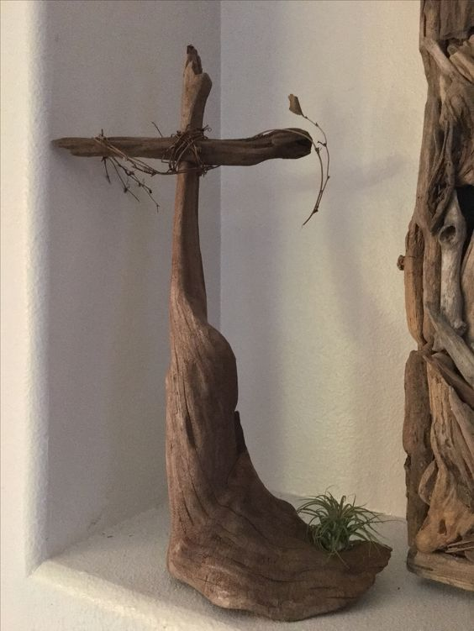
WELCOME TO THE
JACKSON STREET CHURCH OF CHRIST
PLEASE TURN OFF CELLPHONES

Slide 4
SINGING

Slide 5
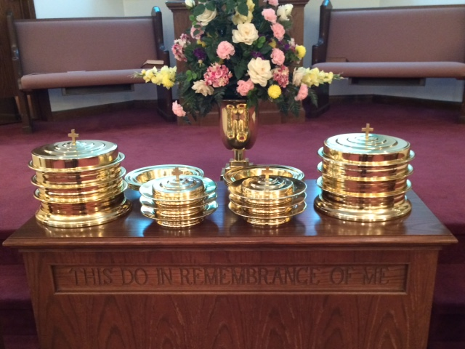
IN REMEMBRANCE OF JESUS

Slide 6
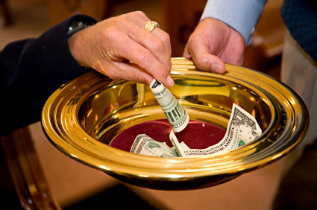
CONTRIBUTION

Slide 7
SINGING

Slide 8
1 Timothy 2:1–6 Therefore I exhort first of all that supplications, prayers, intercessions, and giving of thanks be made for all men, ² for kings and all who are in authority, that we may lead a quiet and peaceable life in all godliness and reverence. ³ For this is good and acceptable in the sight of God our Savior, ⁴ who desires all men to be saved and to come to the knowledge of the truth. ⁵ For there is one God and one Mediator between God and men, the Man Christ Jesus, ⁶ who gave Himself a ransom for all, to be testified in due time,

Slide 10
WHAT CHRIST GAVE UP

Slide 11
WHAT CHRIST GAVE UP
Song #364 I gave My life for thee, What hast thou given for Me?
What would you be willing to give up for someone who died for you?
When we remember all that Christ gave up for us, it should cause us to want to give up all for Him.

Slide 12
CHRIST GAVE UP HEAVEN, THAT WE MIGHT HAVE HEAVEN AS OUR HOME.
2 Corinthians 8:9 For you know the grace of our Lord Jesus Christ, that though He was rich, yet for your sakes He became poor, that you through His poverty might become rich.
1 Timothy 1:15 This is a faithful saying and worthy of all acceptance, that Christ Jesus came into the world to save sinners, of whom I am chief.
John 14:2–3 In My Father’s house are many mansions; if it were not so, I would have told you. I go to prepare a place for you. ³ And if I go and prepare a place for you, I will come again and receive you to Myself; that where I am, there you may be also.
Galatians 1:3–4 Grace to you and peace from God the Father and our Lord Jesus Christ, ⁴ who gave Himself for our sins, that He might deliver us from this present evil age, according to the will of our God and Father,

Slide 13
II. CHRIST GAVE UP ACCEPTANCE BY MEN, THAT WE MIGHT BE ACCEPTED BY GOD.
Isaiah 53:3 He is despised and rejected by men, A Man of sorrows and acquainted with grief. And we hid, as it were, our faces from Him; He was despised, and we did not esteem Him.
John 1:11 He came to His own, and His own did not receive Him.
Luke 20:13–15 “Then the owner of the vineyard said, ‘What shall I do? I will send my beloved son. Probably they will respect him when they see him.’ ¹⁴ But when the vinedressers saw him, they reasoned among themselves, saying, ‘This is the heir. Come, let us kill him, that the inheritance may be ours.’ ¹⁵ So they cast him out of the vineyard and killed him. Therefore what will the owner of the vineyard do to them?

Slide 14
II. CHRIST GAVE UP ACCEPTANCE BY MEN, THAT WE MIGHT BE ACCEPTED BY GOD.
Matthew 26:67 Then they spat in His face and beat Him; and others struck Him with the palms of their hands,
Matthew 27:27–31 Then the soldiers of the governor took Jesus into the Praetorium and gathered the whole garrison around Him. ²⁸ And they stripped Him and put a scarlet robe on Him. ²⁹ When they had twisted a crown of thorns, they put it on His head, and a reed in His right hand. And they bowed the knee before Him and mocked Him, saying, “Hail, King of the Jews!” ³⁰ Then they spat on Him, and took the reed and struck Him on the head. ³¹ And when they had mocked Him, they took the robe off Him, put His own clothes on Him, and led Him away to be crucified.
Galatians 3:13 3 Christ has redeemed us from the curse of the law, having become a curse for us (for it is written, “Cursed is everyone who hangs on a tree”),

Slide 15
III. CHRIST GAVE UP HIS LIFE, THAT WE MIGHT BE MADE ALIVE.
Matthew 20:28 just as the Son of Man did not come to be served, but to serve, and to give His life a ransom for many.”
Hebrews 2:9 But we see Jesus, who was made a little lower than the angels, for the suffering of death crowned with glory and honor, that He, by the grace of God, might taste death for everyone.
John 10:11 “I am the good shepherd. The good shepherd gives His life for the sheep.
1 Corinthians 15:45 And so it is written, “The first man Adam became a living being.” The last Adam became a life-giving spirit.
Colossians 2:13 And you, being dead in your trespasses and the uncircumcision of your flesh, He has made alive together with Him, having forgiven you all trespasses,
1 John 4:9–10 In this the love of God was manifested toward us, that God has sent His only begotten Son into the world, that we might live through Him. ¹⁰ In this is love, not that we loved God, but that He loved us and sent His Son to be the propitiation for our sins.

Slide 16
IV. HE GAVE UP HIS LIFE FOR US SO ME MIGHT GIVE OUR LIFE FOR HIM
2 Corinthians 5:15 and He died for all, that those who live should live no longer for themselves, but for Him who died for them and rose again.
Galatians 2:20 I have been crucified with Christ; it is no longer I who live, but Christ lives in me; and the life which I now live in the flesh I live by faith in the Son of God, who loved me and gave Himself for me.
1 Peter 2:24 who Himself bore our sins in His own body on the tree, that we, having died to sins, might live for righteousness—by whose stripes you were healed.
1 Peter 1:17–19 And if you call on the Father, who without partiality judges according to each one’s work, conduct yourselves throughout the time of your stay here in fear; ¹⁸ knowing that you were not redeemed with corruptible things, like silver or gold, from your aimless conduct received by tradition from your fathers, ¹⁹ but with the precious blood of Christ, as of a lamb without blemish and without spot.

Slide 17
V. HE GAVE UP ALL FOR US SO THAT WE MIGHT GIVE UP ALL FOR HIM
Matthew 13:44–46 “Again, the kingdom of heaven is like treasure hidden in a field, which a man found and hid; and for joy over it he goes and sells all that he has and buys that field. ⁴⁵ “Again, the kingdom of heaven is like a merchant seeking beautiful pearls, ⁴⁶ who, when he had found one pearl of great price, went and sold all that he had and bought it.
Matthew 16:24–26 Then Jesus said to His disciples, “If anyone desires to come after Me, let him deny himself, and take up his cross, and follow Me. ²⁵ For whoever desires to save his life will lose it, but whoever loses his life for My sake will find it. ²⁶ For what profit is it to a man if he gains the whole world, and loses his own soul? Or what will a man give in exchange for his soul?

Slide 18
V. HE GAVE UP ALL FOR US SO THAT WE MIGHT GIVE UP ALL FOR HIM
Mark 10:29–31 So Jesus answered and said, “Assuredly, I say to you, there is no one who has left house or brothers or sisters or father or mother or wife or children or lands, for My sake and the gospel’s, ³⁰ who shall not receive a hundredfold now in this time—houses and brothers and sisters and mothers and children and lands, with persecutions—and in the age to come, eternal life. ³¹ But many who are first will be last, and the last first.”
Philippians 3:7–9 But what things were gain to me, these I have counted loss for Christ. ⁸ Yet indeed I also count all things loss for the excellence of the knowledge of Christ Jesus my Lord, for whom I have suffered the loss of all things, and count them as rubbish, that I may gain Christ ⁹ and be found in Him, not having my own righteousness, which is from the law, but that which is through faith in Christ, the righteousness which is from God by faith;

Slide 19
WE SHOULD ASK OURSELVES: WHAT HAVE WE GIVEN UP FOR CHRIST?
He asks us to give up only things of no eternal value to us. - 1 John 2:15–17 Do not love the world or the things in the world. If anyone loves the world, the love of the Father is not in him. ¹⁶ For all that is in the world—the lust of the flesh, the lust of the eyes, and the pride of life—is not of the Father but is of the world. ¹⁷ And the world is passing away, and the lust of it; but he who does the will of God abides forever.

Slide 20
WE SHOULD ASK OURSELVES: WHAT HAVE WE GIVEN UP FOR CHRIST?
He asks us to give up things which would bring shame to us. - Romans 6:20–23 For when you were slaves of sin, you were free in regard to righteousness. ²¹ What fruit did you have then in the things of which you are now ashamed? For the end of those things is death. ²² But now having been set free from sin, and having become slaves of God, you have your fruit to holiness, and the end, everlasting life. ²³ For the wages of sin is death, but the gift of God is eternal life in Christ Jesus our Lord.

Slide 21
WE SHOULD ASK OURSELVES: WHAT HAVE WE GIVEN UP FOR CHRIST?
Your worth to the Lord is measured by what you are willing to give up for Him. - Ephesians 5:25–27 Husbands, love your wives, just as Christ also loved the church and gave Himself for her, ²⁶ that He might sanctify and cleanse her with the washing of water by the word, ²⁷ that He might present her to Himself a glorious church, not having spot or wrinkle or any such thing, but that she should be holy and without blemish.

Slide 22
SINGING

Slide 23
TONIGHT’S SERMON
GOD
&
SATAN

