Slide 1
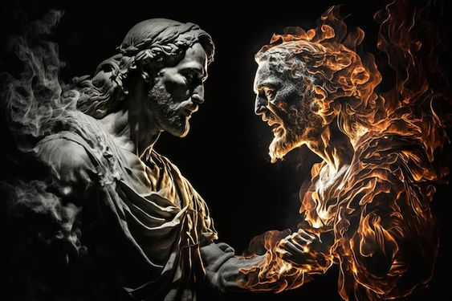
WELCOME TO THE
JACKSON STREET CHURCH OF CHRIST
PLEASE TURN OFF CELL PHONES
This Photo by Unknown Author is licensed under CC BY-NC-ND

Slide 3
LET US PRAY

Slide 4
SINGING

Slide 5
Job 2:1–2 Again there was a day when the sons of God came to present themselves before the LORD, and Satan came also among them to present himself before the LORD. ² And the LORD said to Satan, “From where do you come?” Satan answered the LORD and said, “From going to and fro on the earth, and from walking back and forth on it.”

Slide 6
LET US PRAY

Slide 7
GOD
&
SATAN

Slide 8
GOD AND SATAN
It is important for us to understand God and Satan. Their differences and similarities.
The contrasts between God and Satan are as different as darkness and light.
Acts 26:17–18 I will deliver you from the Jewish people, as well as from the Gentiles, to whom I now send you, ¹⁸ to open their eyes, in order to turn them from darkness to light, and from the power of Satan to God, that they may receive forgiveness of sins and an inheritance among those who are sanctified by faith in Me.’

Slide 9
DIFFERENCES
God is eternal; Satan is created
Psalm 93:2 Your throne is established from of old; You are from everlasting.
Colossians 1:16 For by Him all things were created that are in heaven and that are on earth, visible and invisible, whether thrones or dominions or principalities or powers. All things were created through Him and for Him.
Ezekiel 28:13–16 You were in Eden, the garden of God; Every precious stone was your covering: The sardius, topaz, and diamond, Beryl, onyx, and jasper, Sapphire, turquoise, and emerald with gold. The workmanship of your timbrels and pipes Was prepared for you on the day you were created. >>>

Slide 10
DIFFERENCES
God is eternal; Satan is created
¹⁴ “You were the anointed cherub who covers; I established you; You were on the holy mountain of God; You walked back and forth in the midst of fiery stones. ¹⁵ You were perfect in your ways from the day you were created, Till iniquity was found in you. ¹⁶ “By the abundance of your trading You became filled with violence within, And you sinned; Therefore I cast you as a profane thing Out of the mountain of God; And I destroyed you, O covering cherub, From the midst of the fiery stones.

Slide 11
DIFFERENCES
God is omnipresent (all places); Satan is localized
Psalm 139:7 Where can I go from Your Spirit? Or where can I flee from Your presence?
Jeremiah 23:24 Can anyone hide himself in secret places, So I shall not see him?” says the Lord; “Do I not fill heaven and earth?” says the Lord.
Job 1:7 And the Lord said to Satan, “From where do you come?” So Satan answered the Lord and said, “From going to and fro on the earth, and from walking back and forth on it.”

Slide 12
DIFFERENCES
God is omnipotent (all powerful); Satan is under God's control
Job 1:12 And the Lord said to Satan, “Behold, all that he has is in your power; only do not lay a hand on his person.” So Satan went out from the presence of the Lord.
Job 2:6 And the Lord said to Satan, “Behold, he is in your hand, but spare his life.”
1 Corinthians 10:13 No temptation has overtaken you except such as is common to man; but God is faithful, who will not allow you to be tempted beyond what you are able, but with the temptation will also make the way of escape, that you may be able to bear it.

Slide 13
DIFFERENCES
God is omniscient (all knowing); Satan is not
2 Chronicles 16:9 For the eyes of the Lord run to and fro throughout the whole earth, to show Himself strong on behalf of those whose heart is loyal to Him. In this you have done foolishly; therefore from now on you shall have wars.”
1 Corinthians 2:6–8 However, we speak wisdom among those who are mature, yet not the wisdom of this age, nor of the rulers of this age, who are coming to nothing. ⁷ But we speak the wisdom of God in a mystery, the hidden wisdom which God ordained before the ages for our glory, ⁸ which none of the rulers of this age knew; for had they known, they would not have crucified the Lord of glory.

Slide 14
DIFFERENCES
God is good; Satan is evil
Exodus 34:6 And the Lord passed before him and proclaimed, “The Lord, the Lord God, merciful and gracious, longsuffering, and abounding in goodness and truth,
Psalm 52:1 Why do you boast in evil, O mighty man? The goodness of God endures continually.
1 John 2:13 I write to you, fathers, Because you have known Him who is from the beginning. I write to you, young men, Because you have overcome the wicked one. I write to you, little children, Because you have known the Father. God wants what is best for us; Satan wants what is worst for us

Slide 15
DIFFERENCES
God offers long term rewards; Satan offers short time rewards
Romans 8:18–23 For I consider that the sufferings of this present time are not worthy to be compared with the glory which shall be revealed in us. ¹⁹ For the earnest expectation of the creation eagerly waits for the revealing of the sons of God. ²⁰ For the creation was subjected to futility, not willingly, but because of Him who subjected it in hope; ²¹ because the creation itself also will be delivered from the bondage of corruption into the glorious liberty of the children of God. >>>

Slide 16
DIFFERENCES
God offers long term rewards; Satan offers short time rewards
²² For we know that the whole creation groans and labors with birth pangs together until now. ²³ Not only that, but we also who have the firstfruits of the Spirit, even we ourselves groan within ourselves, eagerly waiting for the adoption, the redemption of our body.
Hebrews 11:24–25 By faith Moses, when he became of age, refused to be called the son of Pharaoh’s daughter, ²⁵ choosing rather to suffer affliction with the people of God than to enjoy the passing pleasures of sin,

Slide 17
SIMILARITIES
Both are interested in the souls of men
1 Timothy 2:4 who desires all men to be saved and to come to the knowledge of the truth.
2 Peter 3:9 The Lord is not slack concerning His promise, as some count slackness, but is longsuffering toward us, not willing that any should perish but that all should come to repentance.
Ezekiel 33:11 Say to them: ‘As I live,’ says the Lord God, ‘I have no pleasure in the death of the wicked, but that the wicked turn from his way and live. Turn, turn from your evil ways! For why should you die, O house of Israel?’
1 Peter 5:8 Be sober, be vigilant; because your adversary the devil walks about like a roaring lion, seeking whom he may devour.
Luke 22:31–32 And the Lord said, “Simon, Simon! Indeed, Satan has asked for you, that he may sift you as wheat. ³² But I have prayed for you, that your faith should not fail; and when you have returned to Me, strengthen your brethren.”

Slide 18
SIMILARITIES
Both have their ministers
2 Corinthians 4:7 But we have this treasure in earthen vessels, that the excellence of the power may be of God and not of us.
Romans 10:14 How then shall they call on Him in whom they have not believed? And how shall they believe in Him of whom they have not heard? And how shall they hear without a preacher?
1 Corinthians 1:21 For since, in the wisdom of God, the world through wisdom did not know God, it pleased God through the foolishness of the message preached to save those who believe.
2 Corinthians 11:14–15 And no wonder! For Satan himself transforms himself into an angel of light. ¹⁵ Therefore it is no great thing if his ministers also transform themselves into ministers of righteousness, whose end will be according to their works.
Matthew 7:15 “Beware of false prophets, who come to you in sheep’s clothing, but inwardly they are ravenous wolves.

Slide 19
SIMILARITIES
Both have children
John 1:12 But as many as received Him, to them He gave the right to become children of God, to those who believe in His name:
1 John 3:1 Behold what manner of love the Father has bestowed on us, that we should be called children of God! Therefore the world does not know us, because it did not know Him.
John 8:43–44 Why do you not understand My speech? Because you are not able to listen to My word. ⁴⁴ You are of your father the devil, and the desires of your father you want to do. He was a murderer from the beginning, and does not stand in the truth, because there is no truth in him. When he speaks a lie, he speaks from his own resources, for he is a liar and the father of it.
1 John 3:10 In this the children of God and the children of the devil are manifest: Whoever does not practice righteousness is not of God, nor is he who does not love his brother.

Slide 20
SIMILARITIES
Both work in accordance with the will of man
Revelation 3:20 Behold, I stand at the door and knock. If anyone hears My voice and opens the door, I will come in to him and dine with him, and he with Me.
Matthew 16:24 Then Jesus said to His disciples, “If anyone desires to come after Me, let him deny himself, and take up his cross, and follow Me.
John 4:14 but whoever drinks of the water that I shall give him will never thirst. But the water that I shall give him will become in him a fountain of water springing up into everlasting life.”
Revelation 22:17 And the Spirit and the bride say, “Come!” And let him who hears say, “Come!” And let him who thirsts come. Whoever desires, let him take the water of life freely.
Joshua 24:15 And if it seems evil to you to serve the Lord, choose for yourselves this day whom you will serve, whether the gods which your fathers served that were on the other side of the River, or the gods of the Amorites, in whose land you dwell. But as for me and my house, we will serve the Lord.”

Slide 21
GOD AND SATAN
Do you understand the drastic differences between God and Satan?
Are you going toward the light and not the darkness?
Do you always choose the good over the evil?
If you give in to evil, God will always welcome you back if you confess and repent.
1 John 1:9 If we confess our sins, He is faithful and just to forgive us our sins and to cleanse us from all unrighteousness.

Slide 22
SINGING

Slide 23
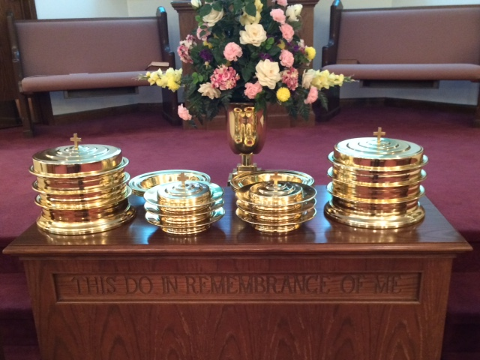
IN REMEMBRANCE OF JESUS

Slide 24
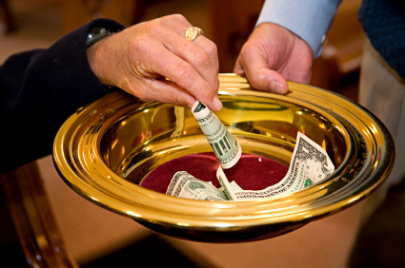
CONTRIBUTION

Slide 25
SINGING

Slide 26
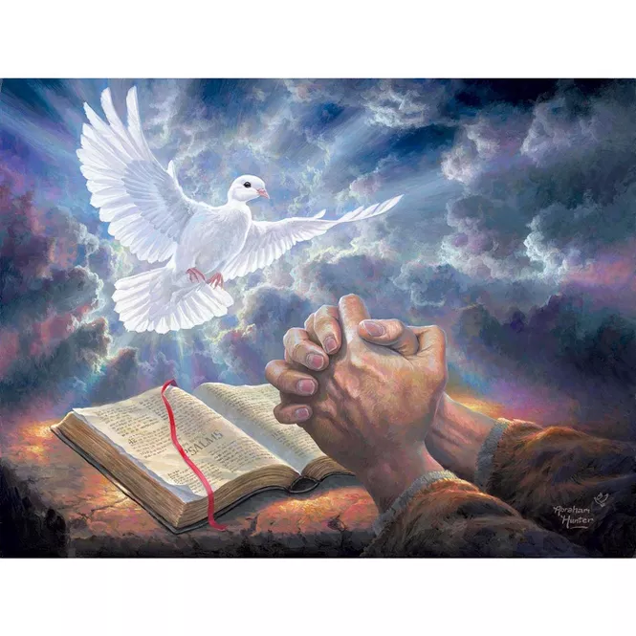
HAVE A GODLY WEEK

