Slide 1

WELCOME TO THE
JACKSON STREET CHURCH OF CHRIST
FAITH
PLEASE TURN OFF CELLPHONES

Slide 2


Slide 3


Slide 4

SINGING

Slide 5
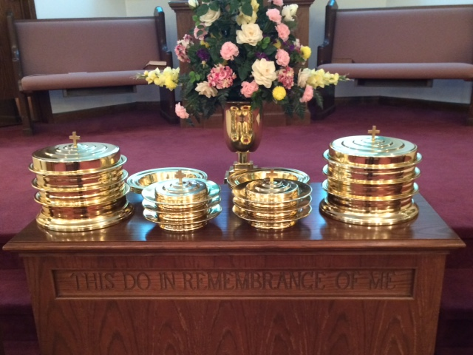
IN REMEMBRANCE OF JESUS

Slide 6
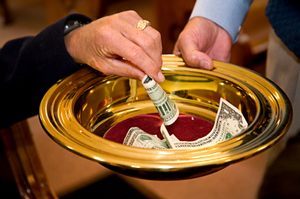
CONTRIBUTION

Slide 7


Slide 8
James 2:14–16 What does it profit, my brethren, if someone says he has faith but does not have works? Can faith save him? {15} If a brother or sister is naked and destitute of daily food, {16} and one of you says to them, “Depart in peace, be warmed and filled,” but you do not give them the things which are needed for the body, what does it profit?

Slide 10


Slide 11
FAITH ALONE?
Many in the realm of “Christianity” teach that you are saved when you believe in Jesus.
If pressed on this, most will admit that repentance and confession are necessary also.
But they usually will not say that baptism has anything to do with our salvation.
  Acts 2:38–39 Then Peter said to them, “Repent, and let every one of you be baptized in the name of Jesus Christ for the remission of sins; and you shall receive the gift of the Holy Spirit. {39} For the promise is to you and to your children, and to all who are afar off, as many as the Lord our God will call.”

Slide 12
FAITH ALONE?
But they usually will not say that baptism has anything to do with our salvation.
  Colossians 2:11–13 In Him you were also circumcised with the circumcision made without hands, by putting off the body of the sins of the flesh, by the circumcision of Christ, {12} buried with Him in baptism, in which you also were raised with Him through faith in the working of God, who raised Him from the dead. {13} And you, being dead in your trespasses and the uncircumcision of your flesh, He has made alive together with Him, having forgiven you all trespasses,

Slide 13
FAITH ALONE?
But they usually will not say that baptism has anything to do with our salvation.
  Mark 16:16 He who believes and is baptized will be saved; but he who does not believe will be condemned.
  Romans 6:4 Therefore we were buried with Him through baptism into death, that just as Christ was raised from the dead by the glory of the Father, even so we also should walk in newness of life.
  1 Peter 3:21 There is also an antitype which now saves us—baptism (not the removal of the filth of the flesh, but the answer of a good conscience toward God), through the resurrection of Jesus Christ,

Slide 14
OBEDIENCE AND WORKS ARE REQUIRED OF CHRISTIANS
James 2:14–24 What does it profit, my brethren, if someone says he has faith but does not have works? Can faith save him? {15} If a brother or sister is naked and destitute of daily food, {16} and one of you says to them, “Depart in peace, be warmed and filled,” but you do not give them the things which are needed for the body, what does it profit? {17} Thus also faith by itself, if it does not have works, is dead. {18} But someone will say, “You have faith, and I have works.” Show me your faith without your works, and I will show you my faith by my works. >>>

Slide 15
OBEDIENCE AND WORKS ARE REQUIRED OF CHRISTIANS
{19} You believe that there is one God. You do well. Even the demons believe—and tremble! {20} But do you want to know, O foolish man, that faith without works is dead? {21} Was not Abraham our father justified by works when he offered Isaac his son on the altar? {22} Do you see that faith was working together with his works, and by works faith was made perfect? {23} And the Scripture was fulfilled which says, “Abraham believed God, and it was accounted to him for righteousness.” And he was called the friend of God. {24} You see then that a man is justified by works, and not by faith only.

Slide 16
OBEDIENCE AND WORKS ARE REQUIRED OF CHRISTIANS
Mat 7:21 Not everyone who says to Me, Lord, Lord, 'shall enter the kingdom of heaven, but he who does the will of My Father in heaven
Acts 10:35 "But in every nation whoever fears Him and works righteousness is accepted by Him.
Rom 2:7-12 eternal life to those who by patient continuance in doing good seek for glory. honor. and immortality, {8} but to those who are self-seeking and do not obey the truth, but obey unrighteousness; indignation and wrath, {9} tribulation and anguish, on every soul of man who does evil, of the Jew first and also of the Greek; {10} but glory, honor, and peace to everyone who works what is good, to the Jew first and also to the Greek. {11} For there is no partiality with God. {12} For as many as have sinned without law will also perish without law, and as many as have sinned in the law will be judged by the law

Slide 17
OBEDIENCE AND WORKS ARE REQUIRED OF CHRISTIANS
1 Cor 3:11-14 For no other foundation can anyone lay than that which is laid, which is Jesus Christ. {12} Now if anyone builds on this foundation with gold, silver, precious stones, wood, hay, straw, {13} each one's work will become clear: for the Dav will declare it, because it will be revealed by fire; and the fire will test each one's work. of what sort it is. {14} If anyone's work which he has built on it endures, he will receive a reward.
1 Cor15:58 Therefore, my beloved brethren, be steadfast, immovable, always abounding in the work of the Lord, knowing that your labor is not in vain in the Lord.
Gal 5:6 For in Christ Jesus neither circumcision nor uncircumcision avails anything, but faith working through love.

Slide 18
OBEDIENCE AND WORKS ARE REQUIRED OF CHRISTIANS
Eph 2:8-10 For by grace you have been saved through faith, and that not of yourselves; it is the gift of God, {9} not of works, lest anyone should boast. {10} For we are His workmanship, created in Christ Jesus for good works, which God prepared beforehand that we should walk in them.
Phil 2:12-13 Therefore, my beloved, as you have always obeyed, not as in my presence only, but now much more in my absence, work out your own salvation with fear and trembling {13} for it is God who works in you both to will and to do for His good pleasure.

Slide 19
OBEDIENCE AND WORKS ARE REQUIRED OF CHRISTIANS
Col 1:9-15 For this reason we also, since the day we heard it, do not cease to pray for you, and to ask that you may be filled with the knowledge of His will in all wisdom and spiritual understanding; {10} that you may walk worth of the Lord fully pleasing Him being fruitful in every good work and increasing in the knowledge of God, {11} strengthened with all might, according to His glorious power, for all patience and longsuffering with joy; {12} giving thanks to the Father who has qualified us to be partakers of the inheritance of the saints in the light. {13} He has delivered us from the power of darkness and conveyed us into the kingdom of the Son of His love, {14} in whom we have redemption through His blood, the forgiveness of sins. {15} He is the image of the invisible God, the firstbom over all creation.

Slide 20
OBEDIENCE AND WORKS ARE REQUIRED OF CHRISTIANS
1 Tm 6:17-19 Command those who are rich in this present age not to be haughty, nor to trust in uncertain riches but in the living God, who gives us richly all things to enjoy. {18} Let them that they be rich in good works, ready to give, willing to share, {19} storing up for themselves a good foundation for the time to come, that they may lay hold on eternal life.
Titus 1:16 They profess to know God, but in works they deny Him, being abominable, disobedient, and disqualified for every good work.
Titus 2:14 who gave Himself for us, that He might redeem us from every lawless deed and purify for Himself His own special people, zealous for good works.

Slide 21
II. CHRISTIANS WILL BE JUDGED BY THEIR DEEDS OR WORKS
John 5:28-29 “DO not Maryel at this; for the hour is coming in which all who are in the graves will hear His voice {29} and come forth: those who have done good, to the resurrection of life, and those who have done evil, to the resurrection of condemnation,
Rom 2:5-11 But in accordance with your hardness and your impenitent heart you are treasuring up for yourself wrath in the day of wrath and revelation of the righteous judgment of God, {6} who "will render to each one according to his deed": {7} eternal life to those who by patient continuance in doing good seek for glory, honor, and immortality; {8} but to those who are self-seeking and do not obey the truth, but obey unrighteousness; indignation and wrath, {9} tribulation and anguish, on every soul of man who does evil, of the Jew first and also of the Greek; {10} but glory, honor, and peace to everyone who works what is good, to the Jew first and also to the Greek. {11} For there is no partiality with God.

Slide 22
II. CHRISTIANS WILL BE JUDGED BY THEIR DEEDS OR WORKS
Mat 16:27 "For the Son of Man will come in the glory of His Father with His angels, and then He will reward each according to his works.
2 Cor 5:10 For we must all appear before the judgment seat of Christ, that each one may receive the things done in the body according to what he has done, whether good or bad.
Pet 1:17 And if you call on the Father, who without partiality according to each one's work, conduct yourselves throughout the time of your stay here in fear;
REV 2-3 SEVEN CHURCHES OF ASIA I KNOW YOUR WORKS, REPENT OR CANDLESTICK REMOVED.

Slide 23
II. CHRISTIANS WILL BE JUDGED BY THEIR DEEDS OR WORKS
Rev 14:13 Then I heard a voice from heaven saying to me, "Write: 'Blessed are the dead who die in the Lord from now on. “Yes,” says the Spirit, "that they may rest from their labors, and their works follow them."
Rev 20:12-13 And I saw the dead. small and great, standing before God, and books were opened. And another book was opened, which is the Book of Life. And the dead were judged according to their works, by the things which were written in the books. {13} The sea gave up the dead who were in it, and Death and Hades delivered up the dead who were in them. And they were judged, each one according to his works.
Rev 22:12 "And behold, I am coming quickly, and My reward is with Me, to give to everyone according to his work.

Slide 24
WHAT ABOUT YOU?
ARE YOU IN CHRIST? THE ONLY WAY THE BIBLE SAYS YOU CAN GET INTO CHRIST IS THROUGH BAPTISM.
  Galatians 3:26–27 For you are all sons of God through faith in Christ Jesus. {27} For as many of you as were baptized into Christ have put on Christ.
  Romans 6:3 Or do you not know that as many of us as were baptized into Christ Jesus were baptized into His death?
HOW ARE YOU DOING WITH YOUR WORKING FOR JESUS? - Ephesians 2:10 For we are His workmanship, created in Christ Jesus for good works, which God prepared beforehand that we should walk in them.

Slide 26

PRAYER

Slide 27


TONIGHT’S SERMON:
CONCERN FOR THE LOST

