Slide 1
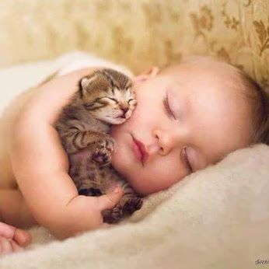
WELCOME TO THE
JACKSON STREET CHURCH OF CHRIST
PLEASE TURN OFF CELLPHONES

Slide 2


Slide 3

LET US PRAY

Slide 4

SINGING

Slide 5
Matthew 9:35–38 Then Jesus went about all the cities and villages, teaching in their synagogues, preaching the gospel of the kingdom, and healing every sickness and every disease among the people. ³⁶ But when He saw the multitudes, He was moved with compassion for them, because they were weary and scattered, like sheep having no shepherd. ³⁷ Then He said to His disciples, “The harvest truly is plentiful, but the laborers are few. ³⁸ Therefore pray the Lord of the harvest to send out laborers into His harvest.”

Slide 6
LET US PRAY

Slide 7
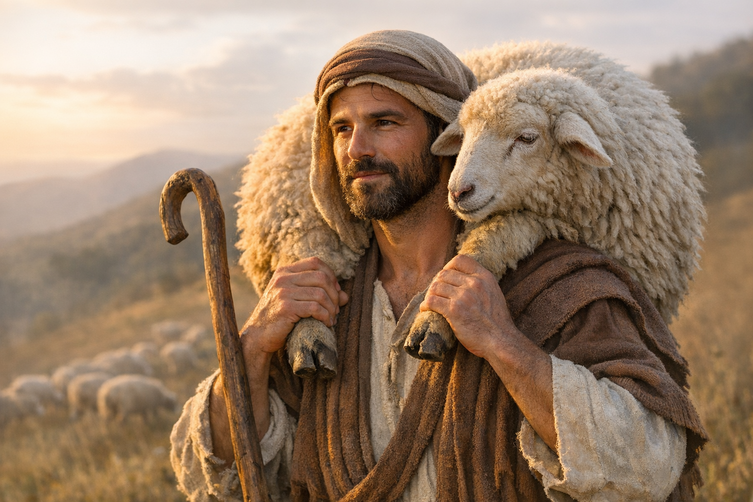
CONCERN FOR THE LOST

Slide 8



THE LOST POTTED PLANTS

Slide 9
GOD IS CONCERNED ABOUT THE LOST
John 3:16 For God so loved the world that He gave His only begotten Son, that whoever believes in Him should not perish but have everlasting life.
2 Peter 3:9 The Lord is not slack concerning His promise, as some count slackness, but is longsuffering toward us, not willing that any should perish but that all should come to repentance.

Slide 10
JESUS WAS CONCERNED ABOUT THE LOST
Luke 19:10 for the Son of Man has come to seek and to save that which was lost.
Mat 23:37 O Jerusalem, Jerusalem, the one who kills the prophets and stones those who are sent to her! How often I wanted to gather your children together, as a hen gathers her chicks under her wings, but you were not willing.
Mat 28:18-20 And Jesus came and spoke to them, saying, “All authority has been given to Me in heaven and on earth. {19} "Go therefore and make disciples of all the nations, baptizing them in the name of the Father and of the Son and of the Holy Spirit, {20} "teaching them to observe all things that I have commanded you; and lo, I am with you always, even to the end of the age. Amen.

Slide 11
III. PAUL WAS CONCERNED ABOUT THE LOST
Rom 9:2-3 that I have great sorrow and continual grief in my heart. {3} For I could wish that I myself were accursed from Christ for my brethren, my countrymen according to the flesh.
2 Tim 2:2 And the things that you have heard from me among many witnesses, commit these to faithful men who will be able to teach others also.

Slide 12
IV. WE NEED TO BE CONCERNED ABOUT THE LOST
A COMPASSIONATE CONCERN
HELL IS A HORRIBLE PLACE Luke 16:19-31 "There was a certain rich man who was clothed in purple and fine linen and fared sumptuously every day. {20} "But there was a certain beggar named Lazarus, full of sores, who was laid at his gate, {21} "desiring to be fed with the crumbs which fell from the rich man's table n Moreover the dogs came and licked his sores. {22} "So it was that the beggar died I and was carried by the angels to Abraham's bosom. The rich man also died and was buried, {23} And being in torments in Hades, he lifted up his eyes and saw Abraham afar off, and Lazarus in his bosom. >>>

Slide 13
IV. WE NEED TO BE CONCERNED ABOUT THE LOST
A. A COMPASSIONATE CONCERN
HELL IS A HORRIBLE PLACE
{24} "Then he cried and said, 'Father Abraham, have mercy on me, and send Lazarus that he may dip the tip of his finger in water and cool my tongue; for I am tormented in this flame. {25} "But Abraham said, 'Son, remember that in your lifetime you received your good things, and likewise Lazarus evil things; but now he is comforted and you are tormented. {26} 'And besides all this, between us and you there is a great gulf fixed, so that those who want to pass from here to you cannot, nor can those from there pass to us. {27} "Then he said, 'I beg you therefore, father, that you would send him to my father's house, >>>

Slide 14
IV. WE NEED TO BE CONCERNED ABOUT THE LOST
A COMPASSIONATE CONCERN
1. HELL IS A HORRIBLE PLACE
{28} 'for I have five brothers, that he may testify to them, lest they also come to this place of torment. {29} "Abraham said to him, 'They have Moses and the prophets; let them hear them. {30} "And he said, 'No, father Abraham; but if one goes to them from the dead, they will repent. {31} "But he said to him. 'If they do not hear Moses and the prophets, neither will they be persuaded though one rise from the dead.”
JESUS & PAUL SHOWED THEIR COMPASSION WITH TEARS AND ACTION. HOW DO WE SHOW OUR COMPASSION?
Mat 12:34 "Brood of vipers! How can you, being evil, speak good things? For out of the abundance of the heart the mouth speaks.
SONG #466 SEND THE LIGHT

Slide 15
IV. WE NEED TO BE CONCERNED ABOUT THE LOST
B. A CONSCIENTIOUS CONCERN DO YOU FEEL GUILTY ABOUT NOT REACHING OUT TO THE LOST?
Ezek 3:17-21 "Son of man, I have made you a watchman for the house of Israel ; therefore hear a word from My mouth, and give them warning from Me: {18} "When I say to the wicked, 'You shall surely die, and you give him no warning, nor speak to warn the wicked from his wicked way, to save his life, that same wicked man shall die in his iniquity; but his blood I will require at your hands. {19} "Yet, if you warn the wicked, and he does not turn from his wickedness, nor from his wicked way, he shall die in his iniquity; but you have delivered your soul >>>

Slide 16
IV. WE NEED TO BE CONCERNED ABOUT THE LOST
{20} "Again, when a righteous man turns from his righteousness and commits iniquity, and I lay a stumbling block before him, he shall die; because you did not give him warning, he shall die in his sin, and his righteousness which he has done shall not be remembered; but his blood I will require at your hand. {21} "Nevertheless if you warn the righteous man that the righteous should not sin, and he does not sin, he shall surely live because he took warning; also you will have delivered your SOUL.”
2. SONG #663 YOU NEVER MENTIONED HIM TO ME

Slide 17
IV. WE NEED TO BE CONCERNED ABOUT THE LOST
C. A COMPULSIVE CONCERN - SONG #461 SEEKING THE LOST
DO YOU FEEL THAT SOMETHING BEYOND YOUR CONTROL IS COMPELLING YOU TO REACH OUT TO OTHERS?
1 Cor 9:16 For if I preach the gospel I have nothing to boast of, for necessity is laid upon me; yes, woe is me if I do not preach the gospel!
SONG #479 SOWING THE SEED OF THE KINGDOM

Slide 18
IV. WE NEED TO BE CONCERNED ABOUT THE LOST
D. A COSTLY CONCERN
JESUS DIED, PAUL WAS WILLING TO DIE AND THEY BOTH DEDICATED THEIR LIVES TO REACHING OUT TO THE LOST, WHAT ARE YOU GIVING UP?
2 Cor 5:15 and He died for all, that those who live should live no longer for themselves, but for Him who died for them and rose
SONG #159 I GAVE MY LIFE FOR THEE

Slide 19
IV. WE NEED TO BE CONCERNED ABOUT THE LOST
E. A CONTINUAL CONCERN
ARE YOU CONTINUALLY THINKING ABOUT THE LOST OR DO YOU JUST THINK ABOUT IT OCCASIONALLY WHEN IT'S BROUGHT UP AT CHURCH?
John 9:4 I must work the works of Him who sent Me while it is day; the night is coming when no one can work.
JESUS DYING BREATH WAS ONE OF CONCERN FOR THE LOST - Luke 23:34 Then Jesus said, ⁵' Father forgive them, for they do not know what they do. And they divided His garments and cast lots.
- SONG #479 SOWING THE SEED OF THE KINGDOM

Slide 20
ARE YOU CONCERNED ABOUT THE LOST?
2 Corinthians 5:20–21 Now then, we are ambassadors for Christ, as though God were pleading through us: we implore you on Christ’s behalf, be reconciled to God. ²¹ For He made Him who knew no sin to be sin for us, that we might become the righteousness of God in Him.
LEAD ME TO SOME SOUL #762
Lead me to some soul today;
O teach me, Lord, just what to say;
Friends of mine are lost in sin,
and cannot find their way.
Few there are who seem to care,
and few there are who pray;
Melt my heart and fill my life;
give me one soul today.

Slide 21
SINGING

Slide 22
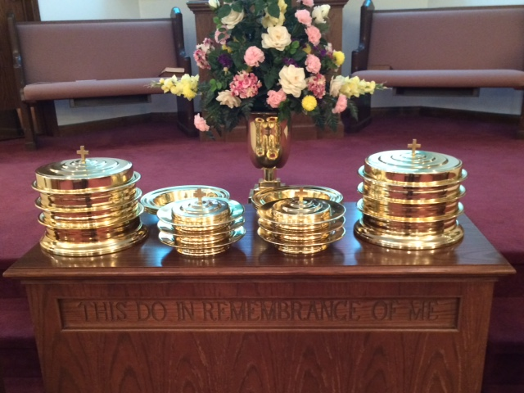
IN REMEMBRANCE OF JESUS

Slide 23
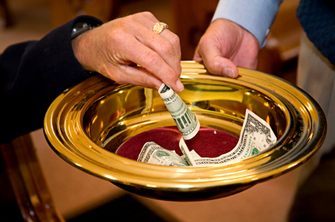
CONTRIBUTION

Slide 24
SINGING

Slide 25

HAVE A
CONCERNED WEEK

