Slide 1

WELCOME TO THE
JACKSON STREET CHURCH OF CHRIST
PLEASE TURN OFF CELLPHONES

Slide 2


Slide 3

LET US PRAY

Slide 4

SINGING

Slide 5
Acts 2:36–39 “Therefore let all the house of Israel know assuredly that God has made this Jesus, whom you crucified, both Lord and Christ.” ³⁷ Now when they heard this, they were cut to the heart, and said to Peter and the rest of the apostles, “Men and brethren, what shall we do?” ³⁸ Then Peter said to them, “Repent, and let every one of you be baptized in the name of Jesus Christ for the remission of sins; and you shall receive the gift of the Holy Spirit. ³⁹ For the promise is to you and to your children, and to all who are afar off, as many as the Lord our God will call.”

Slide 6
LET US PRAY

Slide 7

WHAT THE HOLY SPIRIT DOES FOR US TODAY 1

Slide 8
WHAT THE HOLY SPIRIT DOES?
A. Because of false teaching about the Holy Spirit, we have been reluctant to teach about the Spirit.
B. Many, today in the religious world, believe the Spirit gives people the ability to work miracles.
C. Miracles were given in the first century to prove that those speaking were from God.
1. John 20:30–31 And truly Jesus did many other signs in the presence of His disciples, which are not written in this book; ³¹ but these are written that you may believe that Jesus is the Christ, the Son of God, and that believing you may have life in His name.
2. Mark 16:19–20 So then, after the Lord had spoken to them, He was received up into heaven, and sat down at the right hand of God. ²⁰ And they went out and preached everywhere, the Lord working with them and confirming the word through the accompanying signs. Amen.

Slide 9
WHAT THE HOLY SPIRIT DOES?
D. Paul said, miracles would cease when that which was perfect would come.
1. 1 Corinthians 13:8–10 Love never fails. But whether there are prophecies, they will fail; whether there are tongues, they will cease; whether there is knowledge, it will vanish away. 9 For we know in part and we prophesy in part. ¹⁰ But when that which is perfect has come, then that which is in part will be done away.
2. Miraculous knowledge was partial. The completed New Testament brought complete, perfect knowledge. - 1 Corinthians 13:12 For now we see in a mirror, dimly, but then face to face. Now I know in part, but then I shall know just as I also am known.

Slide 10
GOSPEL CAME BY THE SPIRIT
1 Thessalonians 1:5-6 For our gospel did not come to you in word only, but also in power, and in the Holy Spirit and in much assurance, as you know what kind of men we were among you for your sake. ⁶ And you became followers of us and of the Lord, having received the word in much affliction, with joy of the Holy Spirit,

Slide 11
THE GIFT OF THE HOLY SPIRIT
Acts 2:38 Then Peter said to them, “Repent, and let every one of you be baptized in the name of Jesus Christ for the remission of sins; and you shall receive the gift of the Holy Spirit.

Slide 12
RENEWED BY THE SPIRIT
Titus 3:5-6 not by works of righteousness which we have done, but according to His mercy He saved us, through the washing of regeneration and renewing of the Holy Spirit, ⁶ whom He poured out on us abundantly through Jesus Christ our Savior,

Slide 13
HOLY SPIRIT GIVEN TO THOSE WHO OBEY HIM
Acts 5:32 And we are His witnesses to these things, and so also is the Holy Spirit whom God has given to those who obey Him.”

Slide 14
PROOF THAT WE BELONG TO CHRIST
Romans 8:9 But you are not in the flesh but in the Spirit, if indeed the Spirit of God dwells in you. Now if anyone does not have the Spirit of Christ, he is not His.

Slide 15
SPIRIT BEARS WITH OUR SPIRIT THAT WE ARE GOD’S CHILDREN
Romans 8:16–17 The Spirit Himself bears witness with our spirit that we are children of God, ¹⁷ and if children, then heirs—heirs of God and joint heirs with Christ, if indeed we suffer with Him, that we may also be glorified together.

Slide 16
BAPTIZED INTO BODY OF CHRIST BY THE SPIRIT
1 Corinthians 12:13 For by one Spirit we were all baptized into one body--whether Jews or Greeks, whether slaves or free--and have all been made to drink into one Spirit.

Slide 17
THE SPIRIT IS OUR SEAL AND GUARANTEE
2 Corinthians 1:22 who also has sealed us and given us the Spirit in our hearts as a guarantee.

Slide 18
SEALED AND GUARANTEE BY SPIRIT
Ephesians 1:13–14 In Him you also trusted, after you heard the word of truth, the gospel of your salvation; in whom also, having believed, you were sealed with the Holy Spirit of promise, ¹⁴ who is the guarantee of our inheritance until the redemption of the purchased possession, to the praise of His glory.

Slide 19
WE KNOW WE ABIDE IN HIM AND HE IS US BY THE SPIRIT HE GAVE US
A. 1 John 3:24 Now he who keeps His commandments abides in Him, and He in him. And by this we know that He abides in us, by the Spirit whom He has given us.
1 John 4:13 By this we know that we abide in Him, and He in us, because He has given us of His Spirit.

Slide 20
A GUARANTEE OF OUR HOME IN HEAVEN
2 Corinthians 5:4–8 For we who are in this tent groan, being burdened, not because we want to be unclothed, but further clothed, that mortality may be swallowed up by life. ⁵ Now He who has prepared us for this very thing is God, who also has given us the Spirit as a guarantee. ⁶ So we are always confident, knowing that while we are at home in the body we are absent from the Lord. ⁷ For we walk by faith, not by sight. ⁸ We are confident, yes, well pleased rather to be absent from the body and to be present with the Lord.

Slide 21
BY THE SPIRIT WE CRY OUT ABBA, FATHER
Galatians 4:6 And because you are sons, God has sent forth the Spirit of His Son into your hearts, crying out, "Abba, Father!"

Slide 22
HOLY SPIRIT GIVES COMFORT
Acts 9:31 Then the churches throughout all Judea, Galilee, and Samaria had peace and were edified. And walking in the fear of the Lord and in the comfort of the Holy Spirit, they were multiplied.

Slide 23
LOVE OF GOD POURED OUT IN OUR HEARTS BY HOLY SPIRIT
Romans 5:5 Now hope does not disappoint, because the love of God has been poured out in our hearts by the Holy Spirit who was given to us.

Slide 24
HOLY SPIRIT DELIVERED FROM LAW OF MOSES
Romans 7:6 But now we have been delivered from the law, having died to what we were held by, so that we should serve in the newness of the Spirit and not in the oldness of the letter.

Slide 25
WE WALK ACCORDING TO THE SPIRIT
Romans 8:1 There is therefore now no condemnation to those who are in Christ Jesus, who do not walk according to the flesh, but according to the Spirit.
Romans 8:4 that the righteous requirement of the law might be fulfilled in us who do not walk according to the flesh but according to the Spirit.

Slide 26
MADE FREE FROM LAW OF SIN AND DEATH
Romans 8:2 For the law of the Spirit of life in Christ Jesus has made me free from the law of sin and death.

Slide 27
LIVE BY THE SPIRIT AND FOCUS ON SPIRITUAL THINGS
Romans 8:5 For those who live according to the flesh set their minds on the things of the flesh, but those who live according to the Spirit, the things of the Spirit.

Slide 28
SPIRITUAL MINDEDNESS BRINGS LIFE AND PEACE
Romans 8:6 For to be carnally minded is death, but to be spiritually minded is life and peace.

Slide 29
LIFE BECAUSE OF RIGHTEOUSNESS
Romans 8:10 And if Christ is in you, the body is dead because of sin, but the Spirit is life because of righteousness.

Slide 30
LIFE THROUGH THE INDWELLING SPIRIT
Romans 8:11 But if the Spirit of Him who raised Jesus from the dead dwells in you, He who raised Christ from the dead will also give life to your mortal bodies through His Spirit who dwells in you.

Slide 31
BY THE SPIRIT PUT TO DEATH THE DEEDS OF THE BODY
Romans 8:13 For if you live according to the flesh you will die; but if by the Spirit you put to death the deeds of the body, you will live.

Slide 32
LED BY THE SPIRIT = SONS OF GOD
Romans 8:14 For as many as are led by the Spirit of God, these are sons of God.

Slide 33
BY THE SPIRIT WE CAN CALL GOD OUR FATHER
Romans 8:15 For you did not receive the spirit of bondage again to fear, but you received the Spirit of adoption by whom we cry out, “Abba, Father.”

Slide 34
SPIRIT INTERCEEDS FOR US
Romans 8:27 Now He who searches the hearts knows what the mind of the Spirit is, because He makes intercession for the saints according to the will of God.

Slide 35
PRODUCES PACE AND JOY
Romans 14:17 for the kingdom of God is not eating and drinking, but righteousness and peace and joy in the Holy Spirit.

Slide 36
ABOUND IN HOPE BY THE SPIRIT
Romans 15:13 Now may the God of hope fill you with all joy and peace in believing, that you may abound in hope by the power of the Holy Spirit.

Slide 37
THE HOLY SPIRIT AND YOU?
Have you been baptized into Christ, for the remission of your sins, to receive the gift of the Holy Spirit?
If so, are you allowing the Spirit to direct you into obedience to the Word of God?
Do you need to do something to get your life right with God?

Slide 38
SINGING

Slide 39
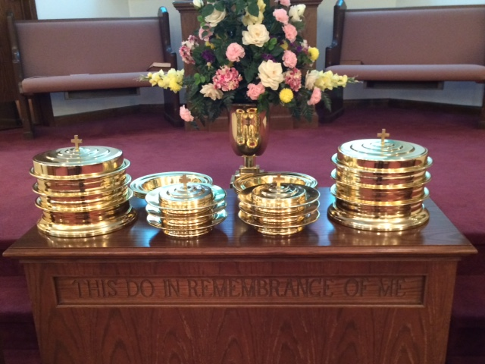
IN REMEMBRANCE OF JESUS

Slide 40
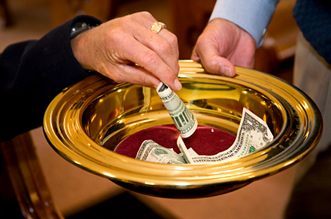
CONTRIBUTION

Slide 41
SINGING

Slide 42

HAVE A
SPIRIT-LED WEEK

