Slide 1

WELCOME TO THE
JACKSON STREET CHURCH OF CHRIST
PLEASE TURN OFF CELLPHONES

Slide 2


Slide 3


Slide 4

SINGING

Slide 5
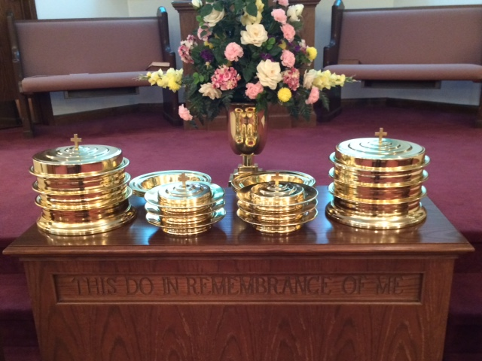
IN REMEMBRANCE OF JESUS

Slide 6
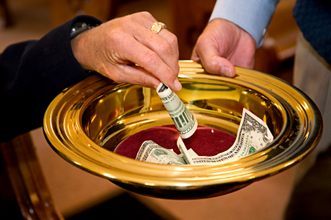
CONTRIBUTION

Slide 7


Slide 8
Heb 12:1-4 Therefore we also, since we are surrounded by so great a cloud of witnesses, let us lay aside every weight, and the sin which so easily ensnares us, and let us run with endurance the race that is set before us, {2} looking unto Jesus, the author and finisher of our faith, who for the joy that was set before Him endured the cross, despising the shame, and has sat down at the right hand of the throne of God, {3} For consider Him who endured such hostility from sinners against Himself, lest you become weary and discouraged in your souls, {4} You have not yet resisted to bloodshed, striving against sin.

Slide 10
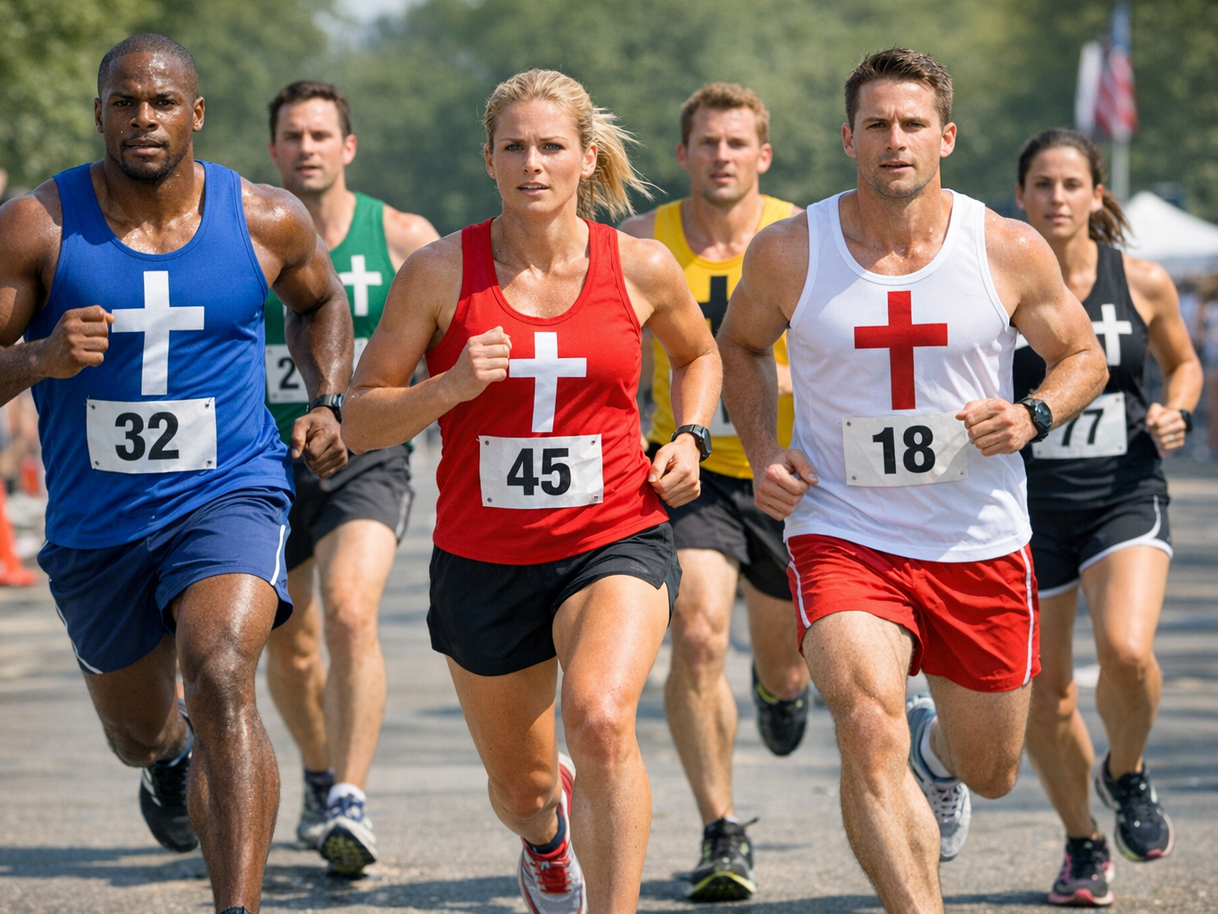
THE CHRISTIAN RACE

Slide 11
THE CHRISTIAN RACE
The Hebrew writer compares Christianity to an athletic race.
He points out the comparisons to those running the race.
He also points us to Jesus as the example to follow in spite of the obstacles He faced.

Slide 12
I. THE RACE COURSE
ALL WHO RUN MUST ENTER IT. THE CHURCH. NO USE RUNNING ON THE OUTSIDES - Eph 5:23 For the husband is head of the wife, as also Christ is head of the church; and He is the Savior of the body.
THE COURSE IS NARROW - Mat 7:13-14 "Enter by the narrow gate; for wide is the gate and broad is the way that leads to destruction, and there are many who go in by it, {14} "Because narrow is the gate and difficult is the way which leads to life, and there are few who find it.

Slide 13
I. THE RACE COURSE
IT BEGINS AT CONVERSION AND ENDS AT DEATH - Colossians 1:21–23 And you, who once were alienated and enemies in your mind by wicked works, yet now He has reconciled {22} in the body of His flesh through death, to present you holy, and blameless, and above reproach in His sight—{23} if indeed you continue in the faith, grounded and steadfast, and are not moved away from the hope of the gospel which you heard, which was preached to every creature under heaven, of which I, Paul, became a minister.

Slide 14
II. THINGS NECESSARY FOR SUCCESS
A GOOD START IS IMPORTANT BUT DOES NOT GUARANTEE SUCCESS - Gal 5: 7 You were running well. Who cut in on you and kept you from obeying the truth?
DILIGENCE - 1 Corinthians 9:25–26 And everyone who competes for the prize is temperate in all things. Now they do it to obtain a perishable crown, but we for an imperishable crown. {26} Therefore I run thus: not with uncertainty. Thus, I fight, not as one who beats the air.

Slide 15
II. THINGS NECESSARY FOR SUCCESS
SELF-CONTROL - 1 Corinthians 9:25–26 And everyone who competes for the prize is temperate in all things. Now they do it to obtain a perishable crown, but we for an imperishable crown. {26} Therefore I run thus: not with uncertainty. Thus I fight: not as one who beats the air.
PROPER TRAINING - 1 Cor 9:27 But I discipline my body and bring it into subjection, lest, when I have preached to others I myself should become disqualified.

Slide 16
II. THINGS NECESSARY FOR SUCCESS
PERSEVERENCE - 1 Cor 15:58 Therefore, my beloved brethren, be steadfast, immovable, always abounding in the work of the Lord, knowing that your labor is not in vain in the Lord.
CONCENTRATED EFFORT - Phil 3:13-14 Brethren, I do not count myself to have apprehended; but one thing I do, forgetting those things which are behind and reaching forward to those things which are ahead, {14} I press toward the goal for the prize of the upward call of God in Christ Jesus.

Slide 17
II. THINGS NECESSARY FOR SUCCESS
KEEP SIGHTS ON GOAL - Col 3:1-4 If then you were raised with Christ, seek those things which are above, where Christ is, sitting at the right hand of God. {2} Set your mind on things above, not on things on the earth. {3} For you died, and your life is hidden with Christ in God. {4} When Christ who is our life appears, then you also win appear with Him in glory.

Slide 18
III. HINDRANCES
SIN - Heb 12:1 Therefore we also, since we are surrounded by so great a cloud of witnesses, let us lay aside every weight, and the sin which so easily ensnares us, and let us run with endurance the race that is set before us,
THE WORLD - 1 John 2:15–17 Do not love the world or the things in the world. If anyone loves the world, the love of the Father is not in him. {16} For all that is in the world—the lust of the flesh, the lust of the eyes, and the pride of life—is not of the Father but is of the world. {17} And the world is passing away, and the lust of it; but he who does the will of God abides forever.

Slide 19
III. HINDRANCES
THE FLESH - Gal 5:17 For the flesh lusts against the Spirit, and the Spirit against the flesh; and these are contrary to one another, so that you do not do the things that you wish.
SATAN - 1 Th 2:18 Therefore we wanted to come to you; even I, Paul, time and again; but Satan hindered us.
PEOPLE - Galatians 5:7 You ran well. Who hindered you from obeying the truth?

Slide 20
IV. THE REWARD
CROWN OF LIFE James 1:12 Blessed is the man who endures temptation; for when he has been approved, he will receive the crown of life which the Lord has promised to those who love Him.
CROWN OF RIGHTEOUSNESS 2 Tim 4:7-8 I have fought the good fight, I have finished the race, I have kept the faith: {8} Finally, there is laid up for me the crown of righteousness, which the Lord, the righteous Judge, will give to me on that Day, and not to me only but also to all who have loved His appearing.
ABUNDANT LIFE - John 10:1b I have come that they may have life, and that they may have it more abundantly.

Slide 21
IV. THE REWARD
ETERNAL LIFE - Romans 2:6–11 who “will render to each one according to his deeds”: {7} eternal life to those who by patient continuance in doing good seek for glory, honor, and immortality; {8} but to those who are self-seeking and do not obey the truth, but obey unrighteousness—indignation and wrath, {9} tribulation and anguish, on every soul of man who does evil, of the Jew first and also of the Greek; {10} but glory, honor, and peace to everyone who works what is good, to the Jew first and also to the Greek. {11} For there is no partiality with God.

Slide 22
THE CHRISTIAN RACE?
Have you entered the Christian race?
Are you running with endurance?
Are you freeing yourself from things that hinder your success?
Are you convinced that you will finish the race and receive the crown of life eternal, in heaven with God.

Slide 24

PRAYER

Slide 25
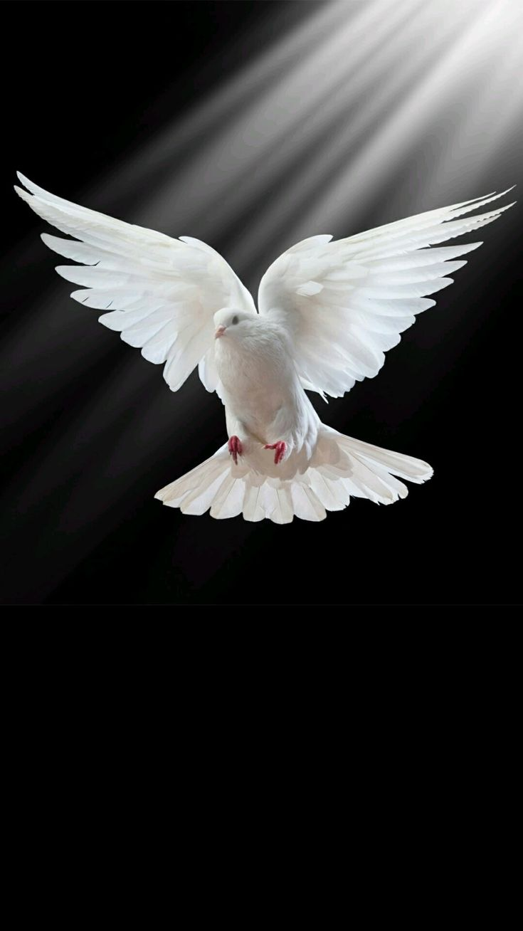
TONIGHT’S SERMON: WHAT THE HOLY SPIRIT DOES TODAY

